Slide 1
Building Project
讓我們一起來建神的殿
5/14/2017
BOLGPC 爾灣大公園靈糧堂
Rev. Joseph Chang 張玉明牧師

Slide 2
5/6/2017 E-Mail from Landlord
Pastor Chang,
Time flies, it has been almost 2 months since we last met. We’ve decided to market the 2 Wrigley building for sale in the coming weeks.
The church’s lease is coming up in July, 2017. From a business perspective, I think there are a few potential scenarios for the ground floor spaces in the event the building is sold to a new owner. The new owner may decide to:
Negotiate a renewal of the lease with church at a rate closer to the current market rent, or
Negotiate a month to month lease with the church while they will look for a new tenant and allowing the time for the church to relocate, or
Terminate the lease with church and use the spaces as an owner user.

Slide 3
5/6/2017 E-Mail from Landlord
I don’t have any projection on the marketing timeframe needed, but our preference is to have the transaction consummated at beginning of 2018. I will do my best to be sensitive in the arrangement to give the church as much flexibility as possible. Please feel free to let me know anytime you want to talk about this matter.
Thank you.
Sincerely,
Jerry Yeh, ext.102

Slide 4
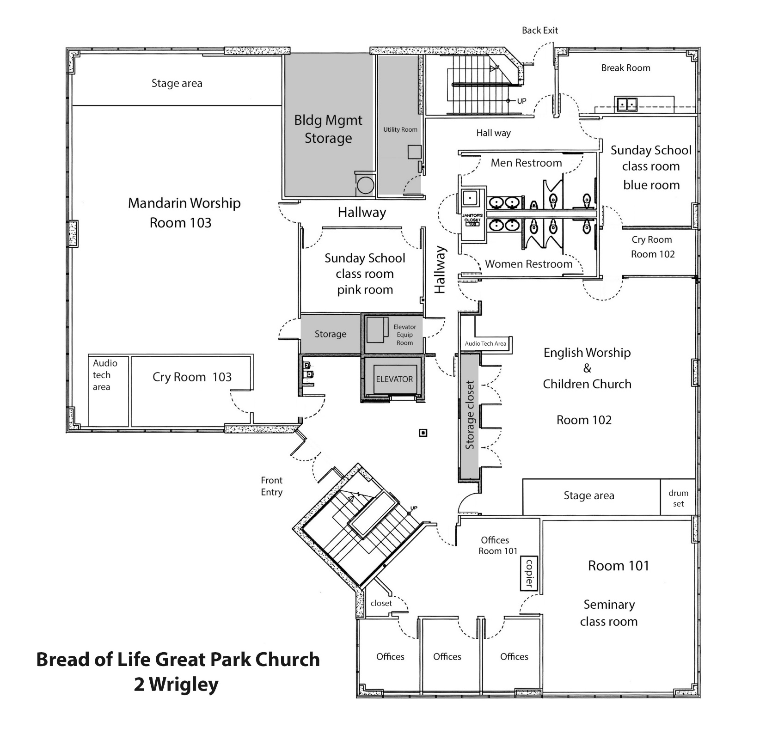
2012 – Suite 101

Slide 5
2013—Suite 102

Slide 6
2014—Suite 103

Slide 8
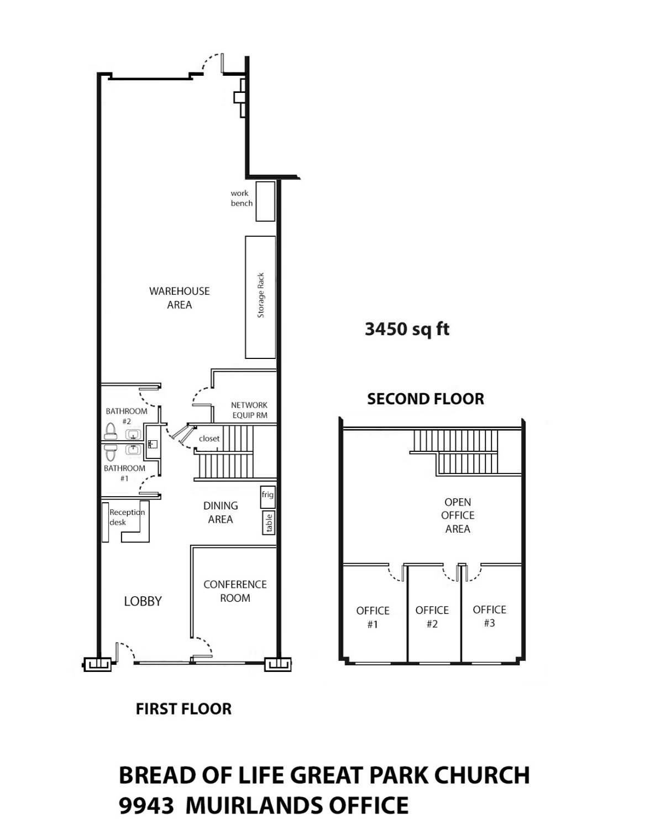
2016—9943 Muirlands

Slide 9
Parking Space
2 Wrigley, 14,000 sf | 4.5 x 14 = 63 (we have 66-6=60) | 60+16+43 = 119

Slide 10
Parking Space
2 Wrigley, 14,000 sf | 4.5 x 14 = 63 (we have 66-6=60) | 60+16+43 = 119
20,000 sf | 4.5 x 20 = 90

Slide 11
Parking Space
2 Wrigley, 14,000 sf | 4.5 x 14 = 63 (we have 66-6=60) | 60+16+43 = 119
20,000 sf | 4.5 x 20 = 90
60,000 sf | 4.5 x 60 = 270

Slide 12
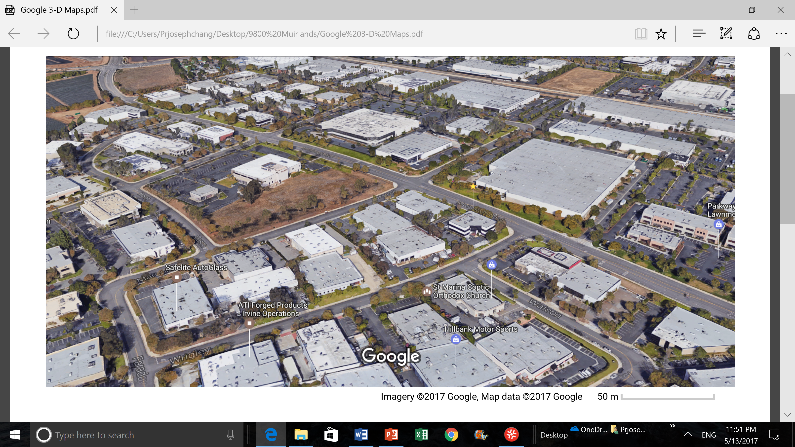

Slide 13
啟示錄 Revelation 3:7-8
⁷你要寫信給非拉鐵非教會的使者，說：那聖潔、真實、拿著大衛的鑰匙、開了就沒有人能關、關了就沒有人能開的，說：⁸我知道你的行為，你略有一點力量，也曾遵守我的道，沒有棄絕我的名。看哪，我在你面前給你一個敞開的門，是無人能關的。
⁷"To the angel of the church in Philadelphia write: These are the words of him who is holy and true, who holds the key of David. What he opens no one can shut, and what he shuts no one can open. ⁸I know your deeds. See, I have placed before you an open door that no one can shut. I know that you have little strength, yet you have kept my word and have not denied my name.

Slide 14
哈該書 Haggai 1:1-10
¹大利烏王第二年六月初一日，耶和華的話藉先知哈該向猶大省長撒拉鐵的兒子所羅巴伯和約撒答的兒子大祭司約書亞說：²萬軍之耶和華如此說：這百姓說，建造耶和華殿的時候尚未來到。
¹In the second year of King Darius, on the first day of the sixth month, the word of the LORD came through the prophet Haggai to Zerubbabel son of Shealtiel, governor of Judah, and to Joshua son of Jehozadak, the high priest: ²This is what the LORD Almighty says: "These people say, 'The time has not yet come for the Lord's house to be built.'"

Slide 15
哈該書 Haggai 1:1-10
³那時耶和華的話臨到先知哈該說：⁴這殿仍然荒涼，你們自己還住天花板的房屋麼？⁵現在萬軍之耶和華如此說：你們要省察自己的行為。⁶你們撒的種多，收的卻少；你們吃，卻不得飽；喝，卻不得足；穿衣服，卻不得暖；得工錢的，將工錢裝在破漏的囊中。
³Then the word of the LORD came through the prophet Haggai: ⁴"Is it a time for you yourselves to be living in your paneled houses, while this house remains a ruin?" ⁵Now this is what the LORD Almighty says: "Give careful thought to your ways. ⁶You have planted much, but have harvested little. You eat, but never have enough. You drink, but never have your fill. You put on clothes, but are not warm. You earn wages, only to put them in a purse with holes in it."

Slide 16
哈該書 Haggai 1:1-10
⁷萬軍之耶和華如此說：你們要省察自己的行為。⁸你們要上山取木料，建造這殿，我就因此喜樂，且得榮耀。這是耶和華說的。
⁷This is what the LORD Almighty says: "Give careful thought to your ways. ⁸Go up into the mountains and bring down timber and build the house, so that I may take pleasure in it and be honored," says the LORD.

Slide 17
哈該書 Haggai 1:1-10
⁹你們盼望多得，所得的卻少；你們收到家中，我就吹去。這是為甚麼呢？因為我的殿荒涼，你們各人卻顧（顧原文作奔）自己的房屋。這是萬軍之耶和華說的。¹⁰所以為你們的緣故，天就不降甘露，地也不出土產。
⁹"You expected much, but see, it turned out to be little. What you brought home, I blew away. Why?" declares the LORD Almighty. "Because of my house, which remains a ruin, while each of you is busy with his own house. ¹⁰Therefore, because of you the heavens have withheld their dew and the earth its crops.

Slide 18
哈該書 Haggai 2:18-19
¹⁸你們要追想此日以前，就是從這九月二十四日起，追想到立耶和華殿根基的日子。¹⁹倉裡有穀種麼？葡萄樹、無花果樹、石榴樹、橄欖樹都沒有結果子。從今日起，我必賜福與你們。
¹⁸'From this day on, from this twenty-fourth day of the ninth month, give careful thought to the day when the foundation of the Lord's temple was laid. Give careful thought: ¹⁹Is there yet any seed left in the barn? Until now, the vine and the fig tree, the pomegranate and the olive tree have not borne fruit. "'From this day on I will bless you.'"

Slide 19
大衛為神建殿 David Builds God’s House
²那時，王對先知拿單說：看哪，我住在香柏木的宮中， 神的約櫃反在幔子裡。【撒下 7:2】
²he said to Nathan the prophet, "Here I am, living in a palace of cedar, while the ark of God remains in a tent." 【2Sam 7:2】
¹¹ . . . 並且我─耶和華應許你，必為你建立家室。【撒下 7:11】
¹¹ . . .The LORD declares to you that the LORD himself will establish a house for you: 【2Sam 7:11】

