Slide 1
Jesus Our Passover Lamb 耶穌,我們逾越節的羔羊
4/9/2017
BOLGPC 爾灣大公園靈糧堂
Rev. Joseph Chang 張玉明牧師

Slide 2
路加福音Luke 22:7-20
⁷除酵節，須宰踰越羊羔的那一天到了。⁸耶穌打發彼得、約翰，說：你們去為我們預備踰越節的筵席，好叫我們吃。⁹他們問他說：要我們在那裡預備？¹⁰耶穌說：你們進了城，必有人拿著一瓶水迎面而來，你們就跟著他，到他所進的房子裡去，
⁷Then came the day of Unleavened Bread, on which the Passover lamb had to be sacrificed. ⁸So Jesus sent Peter and John, saying, ""Go and prepare the Passover for us, that we may eat it."" ⁹They said to him, "Where will you have us prepare it?" ¹⁰He said to them, ""Behold, when you have entered the city, a man carrying a jar of water will meet you. Follow him into the house that he enters "

Slide 3
路加福音Luke 22:7-20
¹¹對那家的主人說：夫子說：客房在那裡？我與門徒好在那裡吃踰越節的筵席。¹²他必指給你們擺設整齊的一間大樓，你們就在那裡預備。¹³他們去了，所遇見的正如耶穌所說的；他們就預備了踰越節的筵席。¹⁴時候到了，耶穌坐席，使徒也和他同坐。 ¹¹"and tell the master of the house, 'The Teacher says to you, Where is the guest room, where I may eat the Passover with my disciples?'" ¹²"And he will show you a large upper room furnished; prepare it there."" ¹³And they went and found it just as he had told them, and they prepared the Passover. ¹⁴And when the hour came, he reclined at table, and the apostles with him.

Slide 4
路加福音Luke 22:7-20
¹⁵耶穌對他們說：我很願意在受害以先和你們吃這踰越節的筵席。¹⁶我告訴你們，我不再吃這筵席，直到成就在神的國裡。¹⁷耶穌接過杯來，祝謝了，說：你們拿這個，大家分著喝。¹⁸我告訴你們，從今以後，我不再喝這葡萄汁，直等神的國來到。 ¹⁵And he said to them, ""I have earnestly desired to eat this Passover with you before I suffer." ¹⁶"For I tell you I will not eat ituntil it is fulfilled in the kingdom of God."" ¹⁷And he took a cup, and when he had given thanks he said, ""Take this, and divide it among yourselves." ¹⁸"For I tell you that from now on I will not drink of the fruit of the vine until the kingdom of God comes.""

Slide 5
路加福音Luke 22:7-20
¹⁹又拿起餅來，祝謝了，就擘開，遞給他們，說：這是我的身體，為你們捨的，你們也應當如此行，為的是記念我。²⁰飯後也照樣拿起杯來，說：這杯是用我血所立的新約，是為你們流出來的。
¹⁹And he took bread, and when he had given thanks, he broke it and gave it to them, saying, ""This is my body, which is given for you. Do this in remembrance of me."" ²⁰And likewise the cup after they had eaten, saying, ""This cup that is poured out for you is the new covenant in my blood."

Slide 6
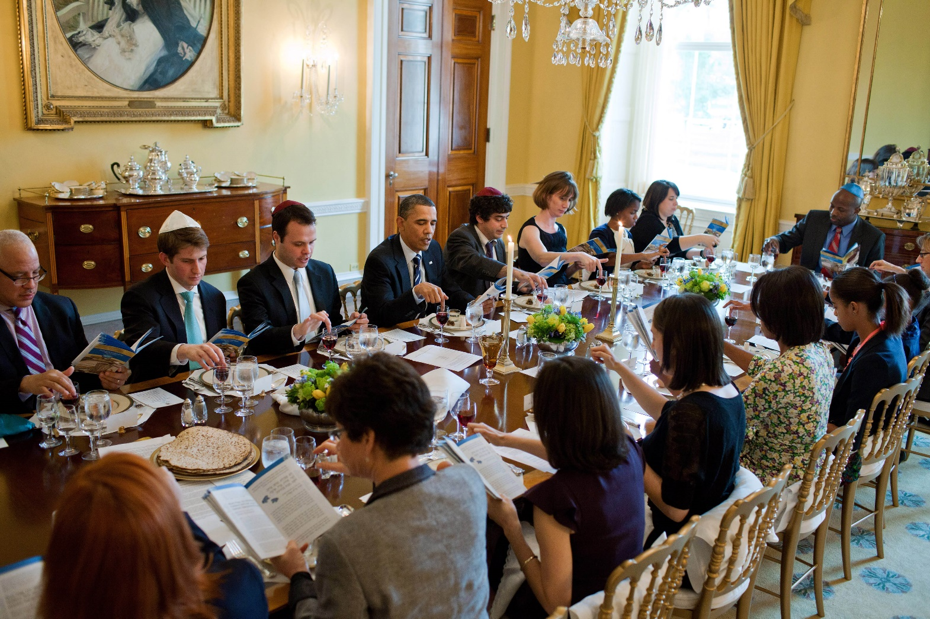
I. 耶穌吃預言自己的逾越節晚餐 Jesus Participate in His Passover Seder

Slide 7
I. 耶穌吃預言自己的逾越節晚餐 Jesus Participate in His Passover Seder

Slide 8
II. 主耶穌給逾越節的晚餐新的定義. Jesus gives a new definition to the Passover Seder.
A. 主的餅 The Lord’s Bread
Aficomen

Slide 9
加拉太書 Galatians 3:29
²⁹你們既屬乎基督，就是亞伯拉罕的後裔，是照著應許承受產業的了。 ²⁹And if you are Christ's, then you are Abraham's offspring, heirs according to promise.

Slide 10
馬太福音 Matthew 8:14-17
¹⁴耶穌到了彼得家裡，見彼得的岳母害熱病躺著。¹⁵耶穌把他的手一摸，熱就退了；他就起來服事耶穌。¹⁶到了晚上，有人帶著許多被鬼附的來到耶穌跟前，他只用一句話就把鬼都趕出去，並且治好了一切有病的人。¹⁷這是要應驗先知以賽亞的話，說：他代替我們的軟弱，擔當我們的疾病。
¹⁴And when Jesus entered Peter's house, he saw his mother-in-law lying sick with a fever. ¹⁵He touched her hand, and the fever left her, and she rose and began to serve him. ¹⁶That evening they brought to him many who were oppressed by demons, and he cast out the spirits with a word and healed all who were sick. ¹⁷This was to fulfill what was spoken by the prophet Isaiah: "He took our illnesses and bore our diseases."

Slide 11
以賽亞書 Isaiah 53:5
⁵哪知他為我們的過犯受害，為我們的罪孽壓傷。因他受的刑罰，我們得平安；因他受的鞭傷，我們得醫治。
⁵But he was wounded for our transgressions; he was crushed for our iniquities; upon him was the chastisement that brought us peace, and with his stripes we are healed.

Slide 12
II. 主耶穌給逾越節的晚餐新的定義. Jesus gives a new definition to the Passover Seder.
B. 主的杯 The Lord’s Cup.
⁸摩西將血灑在百姓身上，說：你看！這是立約的血，是耶和華按這一切話與你們立約的憑據。【出 24:8】 ⁸And Moses took the blood and threw it on the people and said, "Behold the blood of the covenant that the Lord has made with you in accordance with all these words." 【Exod 24:8】

Slide 13
II. 主耶穌給逾越節的晚餐新的定義. Jesus gives a new definition to the Passover Seder.
¹⁸我告訴你們，從今以後，我不再喝這葡萄汁，直等神的國來到。【路 22:18】 ¹⁸"For I tell you that from now on I will not drink of the fruit of the vine until the kingdom of God comes."" 【Luke 22:18】

Slide 14
III. 我們要努力過無酵節. We need to have the unleaven bread.

Slide 15
利未記 Leviticus 23:4-11
⁴耶和華的節期，就是你們到了日期要宣告為聖會的，乃是這些。⁵正月十四日，黃昏的時候，是耶和華的踰越節。⁶這月十五日是向耶和華守的無酵節；你們要吃無酵餅七日。
⁴"These are the appointed feasts of the Lord, the holy convocations, which you shall proclaim at the time appointed for them. ⁵In the first month, on the fourteenth day of the month at twilight, is the Lord's Passover. ⁶And on the fifteenth day of the same month is the Feast of Unleavened bread to the Lord; for seven days you shall eat unleavened bread.

Slide 16
利未記 Leviticus 23:4-11
⁷第一日當有聖會，甚麼勞碌的工都不可做；⁸要將火祭獻給耶和華七日。第七日是聖會，甚麼勞碌的工都不可做。⁷On the first day you shall have a holy convocation; you shall not do any ordinary work. ⁸But you shall present a food offering to the Lord for seven days. On the seventh day is a holy convocation; you shall not do any ordinary work."

Slide 17
利未記 Leviticus 23:4-11
⁹耶和華對摩西說：¹⁰你曉諭以色列人說：你們到了我賜給你們的地，收割莊稼的時候，要將初熟的莊稼一捆帶給祭司。¹¹他要把這一捆在耶和華面前搖一搖，使你們得蒙悅納。祭司要在安息日的次日把這捆搖一搖。
⁹And the Lord spoke to Moses, saying, ¹⁰"Speak to the people of Israel and say to them, When you come into the land that I give you and reap its harvest, you shall bring the sheaf of the firstfruits of your harvest to the priest, ¹¹and he shall wave the sheaf before the Lord, so that you may be accepted. On the day after the Sabbath the priest shall wave it.

Slide 18
哥林多前書 1 Corinthians 5:6-8
⁶你們這自誇是不好的。豈不知一點麵酵能使全團發起來麼？⁷你們既是無酵的麵，應當把舊酵除淨，好使你們成為新團；因為我們踰越節的羔羊基督已經被殺獻祭了。⁸所以，我們守這節不可用舊酵，也不可用惡毒（或作：陰毒）、邪惡的酵，只用誠實真正的無酵餅。 ⁶Your boasting is not good. Do you not know that a little leaven leavens the whole lump? ⁷Cleanse out the old leaven that you may be a new lump, as you really are unleavened. For Christ, our Passover lamb, has been sacrificed. ⁸Let us therefore celebrate the festival, not with the old leaven, the leaven of malice and evil, but with the unleavened bread of sincerity and truth.

