Slide 1
Suffering 患難
Rev. Joseph Chang 張玉明牧師
5/21/2017
BOLGPC 爾灣大公園靈糧堂

Slide 2
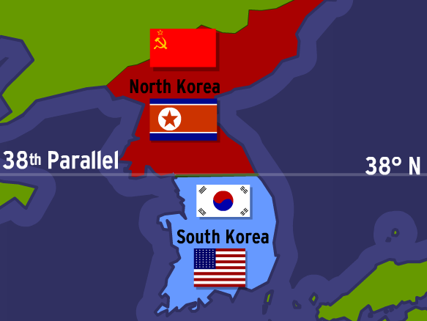
Korean War 韓戰 (1950-1953)

Slide 3
Korean War 韓戰 (1950-1953)

Slide 4
Korean War 韓戰 (1950-1953)

Slide 5
Korean War 韓戰 (1950-1953)
將肉體的需要, 昇華到心靈的層次,
使人的生命因心靈的滿足, 取代對肉體生命需要的渴求.
Elevate the physical need to spiritual level.
Let the satisfaction of spiritual need replaces the physical hunger and thirst.

Slide 6
Korean War 韓戰 (1950-1953)
祈禱就是力量; 分享就是神蹟!
Praying is power, Sharing is miracle!

Slide 7
Romans (羅馬書) 5:1-5
¹我們既因信稱義，就藉著我們的主耶穌基督得與神相和。²我們又藉著他，因信得進入現在所站的這恩典中，並且歡歡喜喜盼望神的榮耀。 ¹Therefore, since we have been justified through faith, we have peace with God through our Lord Jesus Christ, ²through whom we have gained access by faith into this grace in which we now stand. And we rejoice in the hope of the glory of God.

Slide 8
Romans (羅馬書) 5:1-5
³不但如此，就是在患難中也是歡歡喜喜的；因為知道患難生忍耐，⁴忍耐生老練，老練生盼望；⁵盼望不至於羞恥，因為所賜給我們的聖靈將神的愛澆灌在我們心裡。 ³Not only so, but we also rejoice in our sufferings, because we know that suffering produces perseverance; ⁴perseverance, character; and character, hope. ⁵And hope does not disappoint us, because God has poured out his love into our hearts by the Holy Spirit, whom he has given us.

Slide 9
I. Suffering Produces Perseverance. 患難生忍耐 (5:3b).
忍

Slide 10
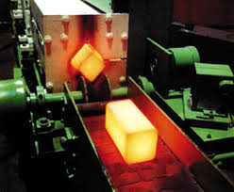

Slide 11
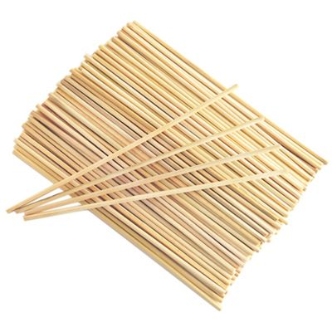

Slide 12
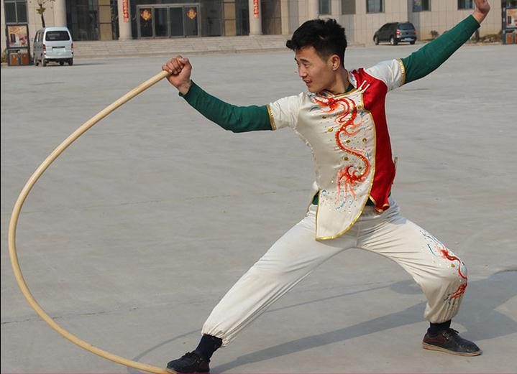
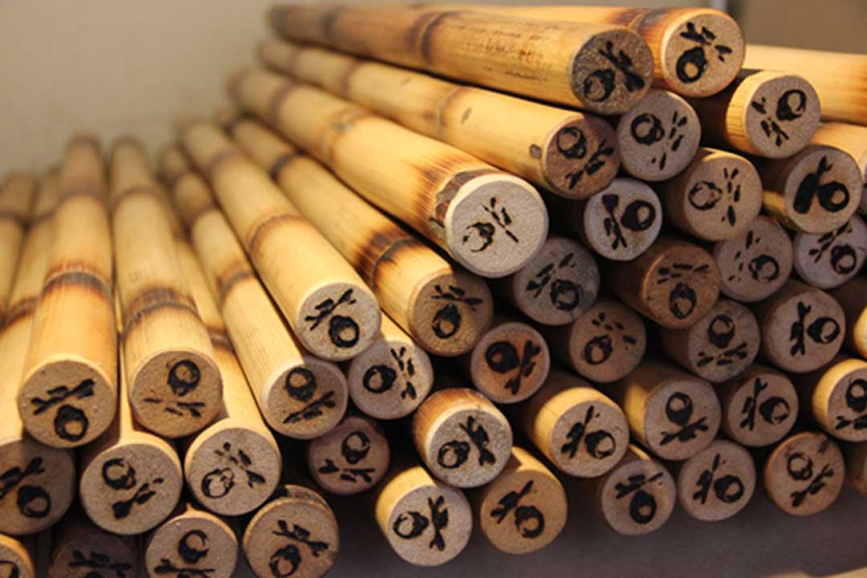
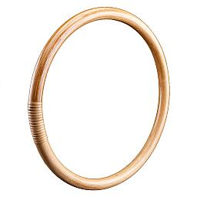
Rattan 藤條

Slide 13
Psalm (詩篇 58:3-6)
³惡人一出母胎就與 神疏遠，一離母腹便走錯路，說謊話。⁴他們的毒氣好像蛇的毒氣；他們好像塞耳的聾虺，^{. . . 6} 神啊，求你敲碎他們口中的牙；耶和華啊，求你敲掉少壯獅子的大牙！
³Even from birth the wicked go astray; from the womb they are wayward and speak lies. ⁴Their venom is like the venom of a snake, like that of a cobra that has stopped its ears, ^{. . . 6}Break the teeth in their mouths, O God; tear out, O LORD, the fangs of the lions!

Slide 14
II. Perseverance produces character. 忍耐生老練 (5:4a).
Dystonia

Slide 15
III. Character produces hope not disappointing. 老練產生那不讓我們失望的盼望 (5:4b-5a).
⁷¹我受苦是與我有益，為要使我學習你的律例。【詩 119:71】 ⁷¹It was good for me to be afflicted so that I might learn your decrees. 【Ps 119:71】

Slide 16
We must accept finite disappointment, but never lose infinite hope.
我們必須接受暫時的失望, 但是不能丟掉永遠的盼望.
--Martin Luther King Jr.

Slide 17
IV. God pours out his love on us while we are suffering. 在整個患難的過程裡面, 神的愛充滿祂所愛的兒女 (羅5:5b).

Slide 18
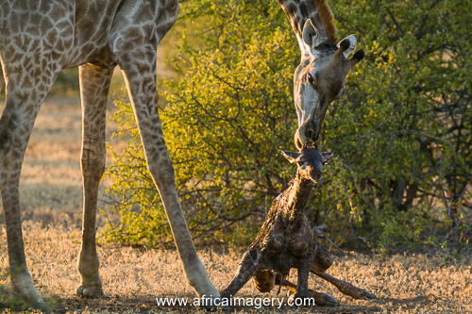
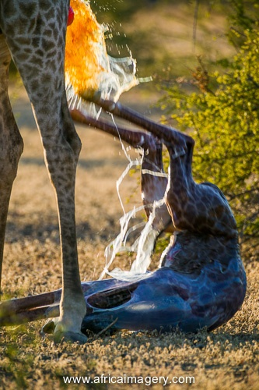
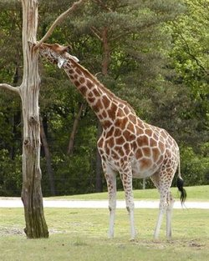
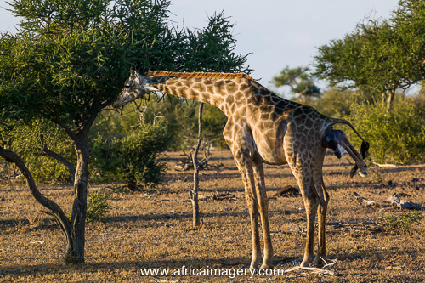
Angola giraffe 安哥拉長頸鹿

Slide 19
Conclusion 結論

Slide 20
Conclusion 結論
Faith信心

Slide 21
Conclusion 結論
Faith信心 → Hope 盼望

Slide 22
Conclusion 結論
Faith信心 → Hope 盼望 →Love 愛

Slide 23
Conclusion 結論
Faith信心 → Hope 盼望 →Love 愛
Sufferings 患難

Slide 24
Conclusion 結論
Faith信心 → Hope 盼望 →Love 愛
Sufferings 患難→Perseverance 忍耐

Slide 25
Conclusion 結論
Faith信心 → Hope 盼望 →Love 愛
Sufferings 患難→Perseverance 忍耐 →Character老練

Slide 26
Conclusion 結論
Faith信心 → Hope 盼望 →Love 愛
Sufferings 患難→Perseverance 忍耐 →Character老練 →Hope 盼望

Slide 27
Conclusion 結論
Faith信心 → Hope 盼望 →Love 愛
Sufferings 患難→Perseverance 忍耐 →Character老練 →Hope 盼望
God’s love accompanies us in our suffering 在我們受患難的時候, 神的愛圍繞在我們的週圍.

