Slide 1
1st Miracle of Jesus Christ
主耶穌所行的第一個神蹟
9/10/2017
BOLGPC 爾灣大公園靈糧堂
Rev. Joseph Chang 張玉明牧師

Slide 2
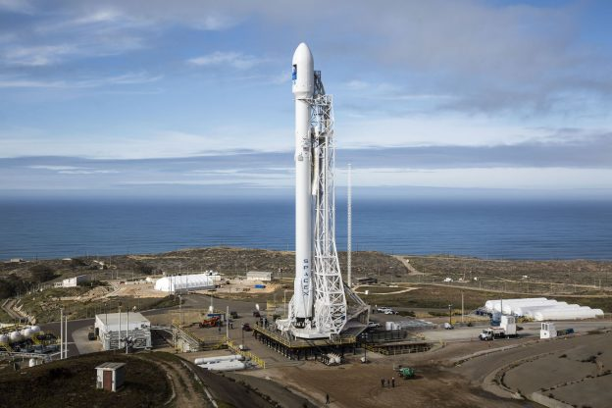
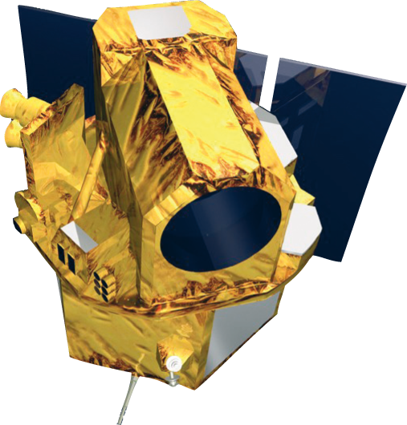
福爾摩沙衛星五號（福衛五號）預計將在 8 月 25 日凌晨 2 時 50 分，由委託的 SpaceX 獵鷹九號（Falcon 9）火箭發射升空。

Slide 3
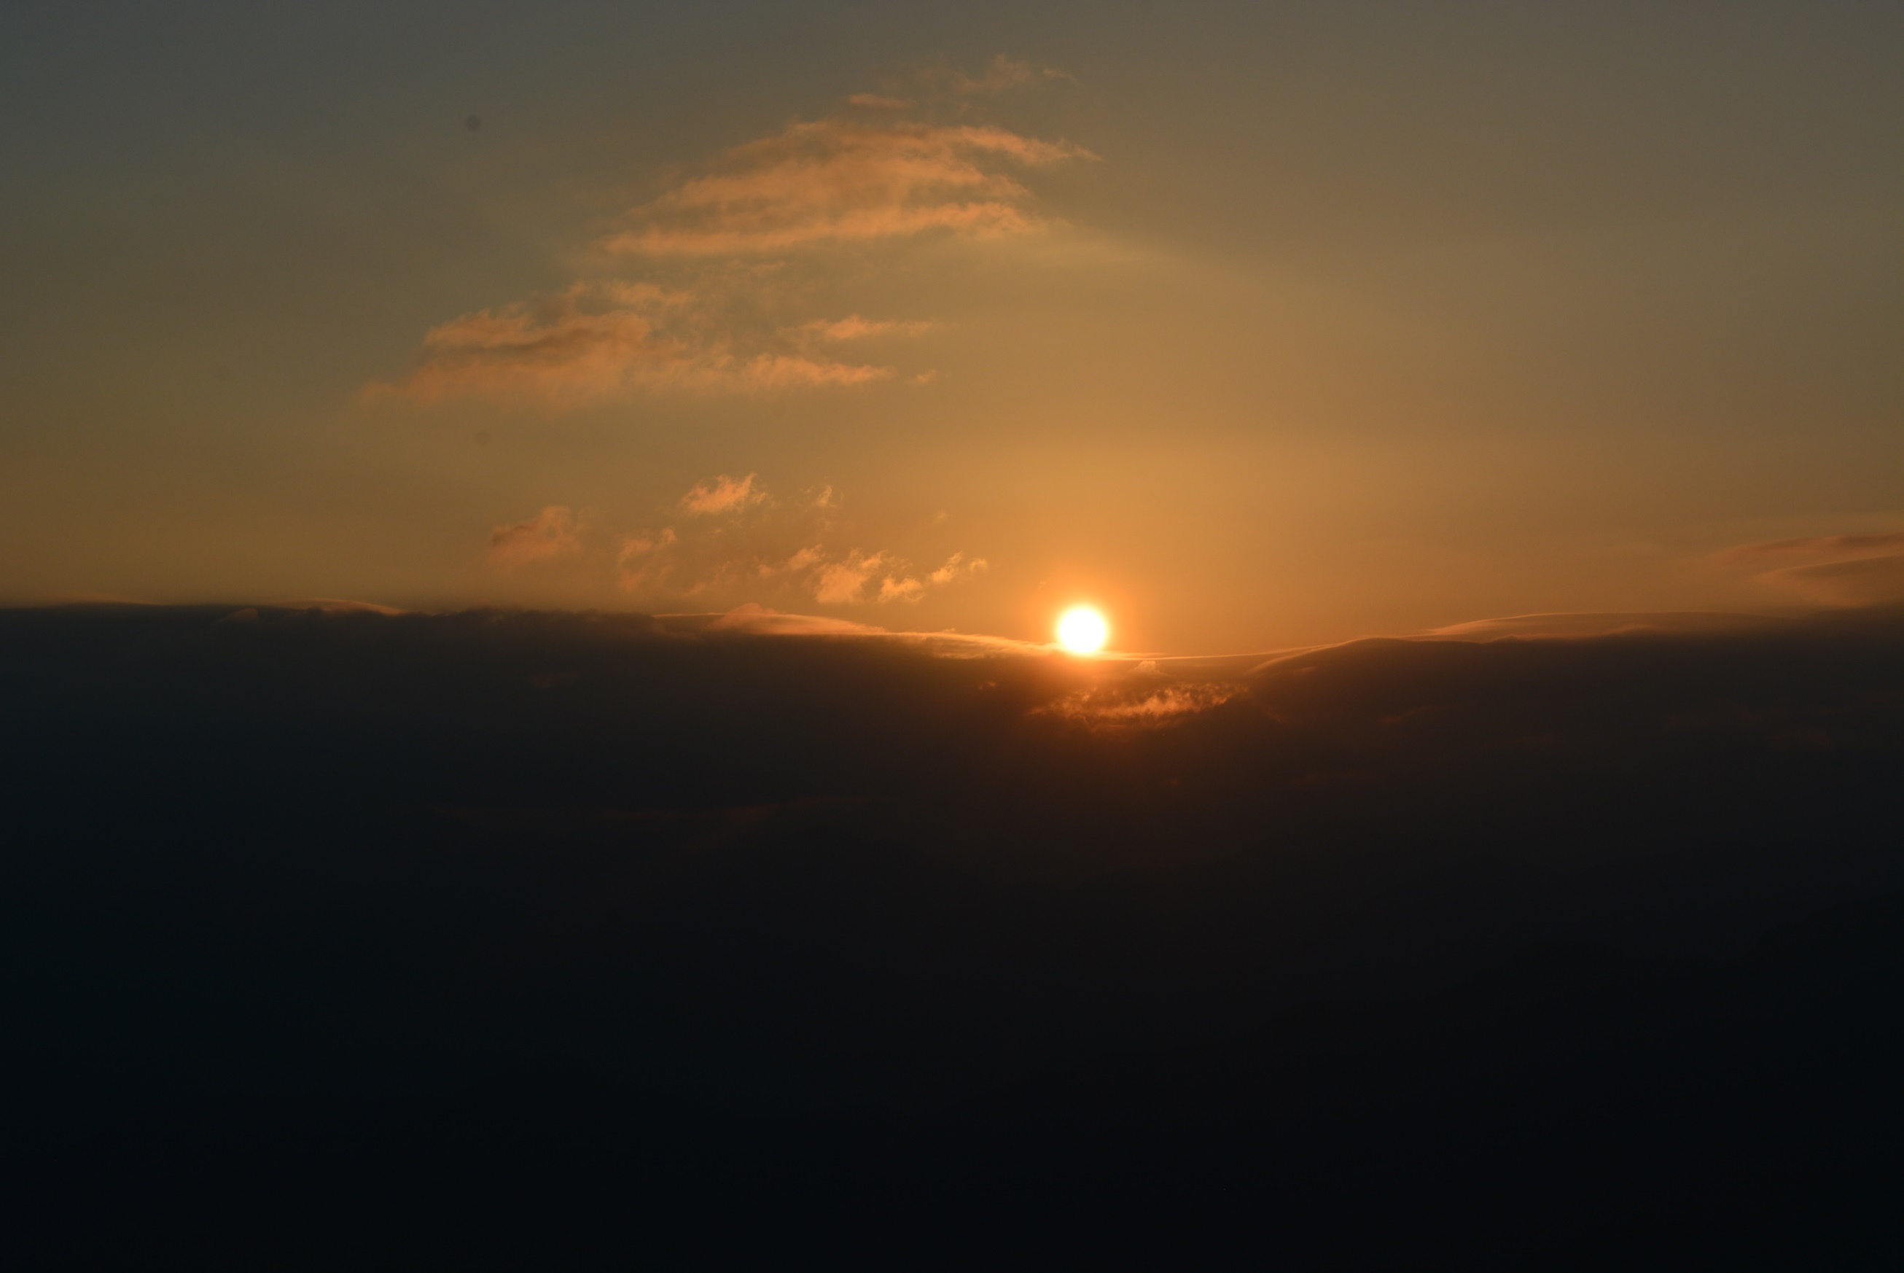

Slide 4


Slide 5
¹⁷他在萬有之先；萬有也靠他而立。【西 1:17】
¹⁷He is before all things, and in him all things hold together. 【Col 1:17】

Slide 6
1st Miracle of Jesus Christ
主耶穌所行的第一個神蹟

Slide 7
¹第三日，在加利利的迦拿有娶親的筵席，耶穌的母親在那裡。²耶穌和他的門徒也被請去赴席。³酒用盡了，耶穌的母親對他說：「他們沒有酒了。」⁴耶穌說：「母親（原文作婦人），我與你有甚麼相干？我的時候還沒有到。」⁵他母親對用人說：「他告訴你們甚麼，你們就做甚麼。」【約 2:1~5】
¹On the third day a wedding took place at Cana in Galilee. Jesus' mother was there, ²and Jesus and his disciples had also been invited to the wedding. ³When the wine was gone, Jesus' mother said to him, "They have no more wine." ⁴"Dear woman, why do you involve me?" Jesus replied. "My time has not yet come." ⁵His mother said to the servants, "Do whatever he tells you." 【John 2:1~5】

Slide 8
⁶照猶太人潔淨的規矩，有六口石缸擺在那裡，每口可以盛兩三桶水。⁷耶穌對用人說：「把缸倒滿了水。他們就倒滿了，直到缸口。」⁸耶穌又說：「現在可以舀出來，送給管筵席的。他們就送了去。」⁹管筵席的嘗了那水變的酒，並不知道是那裡來的，只有舀水的用人知道。管筵席的便叫新郎來，【約 2:1~9】
⁶Nearby stood six stone water jars, the kind used by the Jews for ceremonial washing, each holding from twenty to thirty gallons. ⁷Jesus said to the servants, "Fill the jars with water"; so they filled them to the brim. ⁸Then he told them, "Now draw some out and take it to the master of the banquet." They did so, ⁹and the master of the banquet tasted the water that had been turned into wine. He did not realize where it had come from, though the servants who had drawn the water knew. Then he called the bridegroom aside 【John 2:1~9】

Slide 9
¹⁰對他說：「人都是先擺上好酒，等客喝足了，才擺上次的，你倒把好酒留到如今！」¹¹這是耶穌所行的頭一件神蹟，是在加利利的迦拿行的，顯出他的榮耀來；他的門徒就信他了。【約 2:10~11】
¹⁰and said, "Everyone brings out the choice wine first and then the cheaper wine after the guests have had too much to drink; but you have saved the best till now." ¹¹This, the first of his miraculous signs, Jesus performed at Cana in Galilee. He thus revealed his glory, and his disciples put their faith in him. 【John 2:10~11】

Slide 10
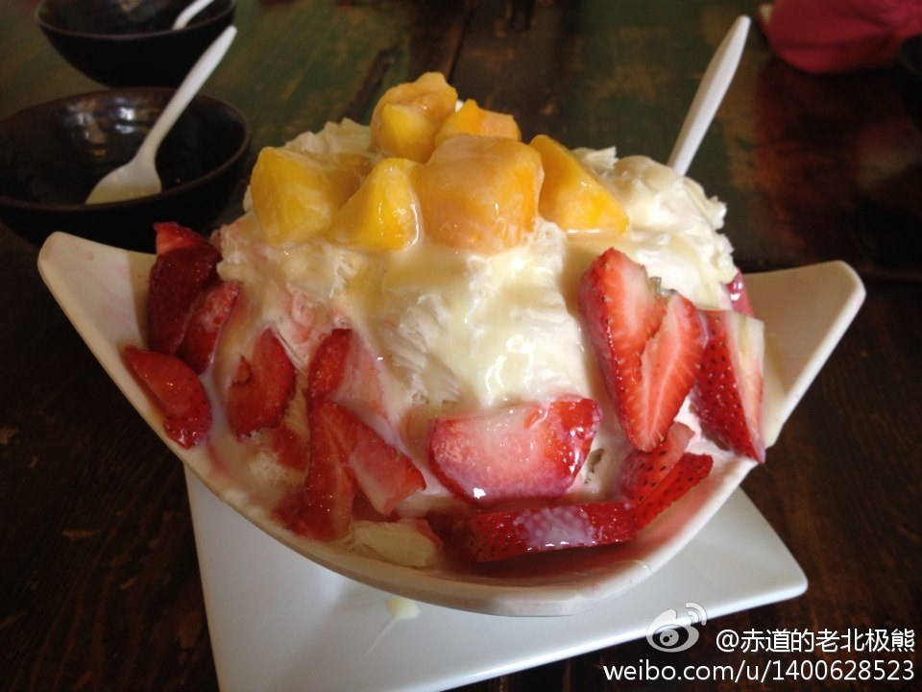
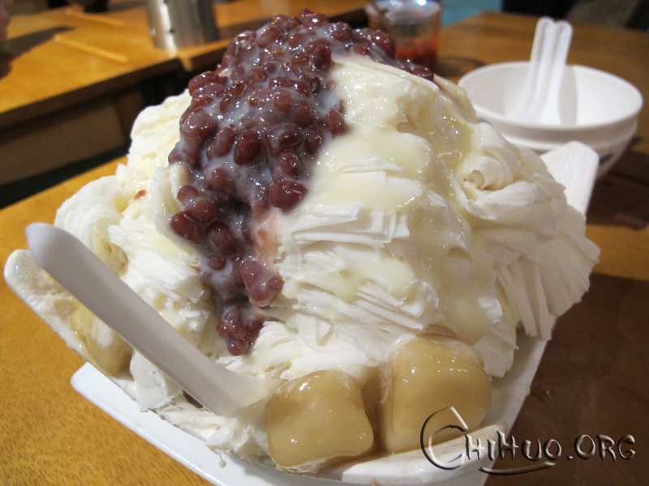
I. The Characteristics of this Miracle
這個神蹟的特性
A. Quantity 量很豐富

Slide 11
To his followers/對來跟隨耶穌的人
²⁹凡為我的名撇下房屋，或是弟兄、姐妹、父親、母親、（有古卷添妻子）兒女、田地的，必要得著百倍，並且承受永生。【太 19:29】
²⁹And everyone who has left houses or brothers or sisters or father or mother or children or fields for my sake will receive a hundred times as much and will inherit eternal life. 【Matt 19:29】

Slide 12
To the believer who tithes/
對於那些實行十一奉獻的人
¹⁰萬軍之耶和華說：你們要將當納的十分之一全然送入倉庫，使我家有糧，以此試試我，是否為你們敞開天上的窗戶，傾福與你們，甚至無處可容。【瑪 3:10】
¹⁰Bring the whole tithe into the storehouse, that there may be food in my house. Test me in this," says the LORD Almighty, "and see if I will not throw open the floodgates of heaven and pour out so much blessing that you will not have room enough for it. 【Mal 3:10】

Slide 13
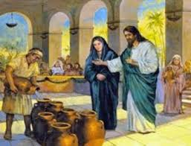
6 Stone Jars 6口石缸
30 x 6 = 180 gallons

Slide 14
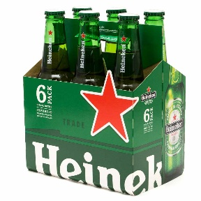
6 pack of beer = 12 oz x 6 = 72 fl oz = 72/128 = 0.5625 gallon.
180/0.5625= 320 packs,
or
1920 bottles of 12oz beer.

Slide 15
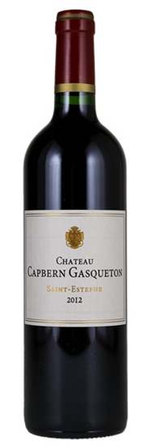
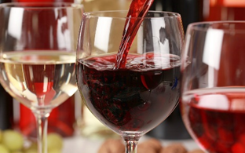
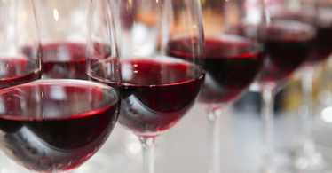
750 ml=25 oz=25/128=0.195 gallon.
180/0.195=923 bottles of red wine.

Slide 16
I. The Characteristics of this Miracle
這個神蹟的特性
2. Quality 品質很美好

Slide 17
I. The Characteristics of this Miracle
這個神蹟的特性
3. Transformation質的改變
Water → Wine
水 → 酒

Slide 18
II. Do we have a repetition of this miracle today? 今天我們有同樣的神蹟嗎?
A. God does not like to repeat the miracles in the same way. 神不喜歡重複神蹟.
Healing the Blind 醫治瞎眼得看見

Slide 19
²⁷耶穌從那裡往前走，有兩個瞎子跟著他，喊叫說：大衛的子孫，可憐我們罷！²⁸耶穌進了房子，瞎子就來到他跟前。耶穌說：你們信我能作這事麼？他們說：主阿，我們信。²⁹耶穌就摸他們的眼睛，說：照著你們的信給你們成全了罷。³⁰他們的眼睛就開了。耶穌切切的囑咐他們說：你們要小心，不可叫人知道。【太 9:27~30】
²⁷As Jesus went on from there, two blind men followed him, calling out, "Have mercy on us, Son of David!" ²⁸When he had gone indoors, the blind men came to him, and he asked them, "Do you believe that I am able to do this?" "Yes, Lord," they replied. ²⁹Then he touched their eyes and said, "According to your faith will it be done to you"; ³⁰and their sight was restored. Jesus warned them sternly, "See that no one knows about this." 【Matt 9:27~30】

Slide 20
²⁹他們出耶利哥的時候，有極多的人跟隨他。³⁰有兩個瞎子坐在路旁，聽說是耶穌經過，就喊著說：主阿，大衛的子孫，可憐我們罷！³¹眾人責備他們，不許他們作聲；他們卻越發喊著說：主阿，大衛的子孫，可憐我們罷！³²耶穌就站住，叫他們來，說：要我為你們做甚麼？³³他們說：主阿，要我們的眼睛能看見！³⁴耶穌就動了慈心，把他們的眼睛一摸，他們立刻看見，就跟從了耶穌。【太 20:29~34】
²⁹As Jesus and his disciples were leaving Jericho, a large crowd followed him. ³⁰Two blind men were sitting by the roadside, and when they heard that Jesus was going by, they shouted, "Lord, Son of David, have mercy on us!" ³¹The crowd rebuked them and told them to be quiet, but they shouted all the louder, "Lord, Son of David, have mercy on us!" ³²Jesus stopped and called them. "What do you want me to do for you?" he asked. ³³"Lord," they answered, "we want our sight." ³⁴Jesus had compassion on them and touched their eyes. Immediately they received their sight and followed him. 【Matt 20:29~34】

Slide 21
²²他們來到伯賽大，有人帶一個瞎子來，求耶穌摸他。²³耶穌拉著瞎子的手，領他到村外，就吐唾沫在他眼睛上，按手在他身上，問他說：你看見甚麼了？²⁴他就抬頭一看，說：我看見人了；他們好像樹木，並且行走。²⁵隨後又按手在他眼睛上，他定睛一看，就復了原，樣樣都看得清楚了。【可 8:22~25】
²²They came to Bethsaida, and some people brought a blind man and begged Jesus to touch him. ²³He took the blind man by the hand and led him outside the village. When he had spit on the man's eyes and put his hands on him, Jesus asked, "Do you see anything?" ²⁴He looked up and said, "I see people; they look like trees walking around." ²⁵Once more Jesus put his hands on the man's eyes. Then his eyes were opened, his sight was restored, and he saw everything clearly. 【Mark 8:22~25】

Slide 22
¹耶穌過去的時候，看見一個人生來是瞎眼的。²門徒問耶穌說：拉比，這人生來是瞎眼的，是誰犯了罪？是這人呢？是他父母呢？³耶穌回答說：也不是這人犯了罪，也不是他父母犯了罪，是要在他身上顯出神的作為來。⁴趁著白日，我們必須做那差我來者的工；黑夜將到，就沒有人能做工了。⁵我在世上的時候，是世上的光。⁶耶穌說了這話，就吐唾沫在地上，用唾沫和泥抹在瞎子的眼睛上，⁷對他說：你往西羅亞池子裡去洗（西羅亞繙出來就是奉差遣）。他去一洗，回頭就看見了。【約 9:1~7】
¹As he went along, he saw a man blind from birth. ²His disciples asked him, "Rabbi, who sinned, this man or his parents, that he was born blind?" ³"Neither this man nor his parents sinned," said Jesus, "but this happened so that the work of God might be displayed in his life. ⁴As long as it is day, we must do the work of him who sent me. Night is coming, when no one can work. ⁵While I am in the world, I am the light of the world." ⁶Having said this, he spit on the ground, made some mud with the saliva, and put it on the man's eyes. ⁷"Go," he told him, "wash in the Pool of Siloam" (this word means Sent). So the man went and washed, and came home seeing. 【John 9:1~7】

Slide 23
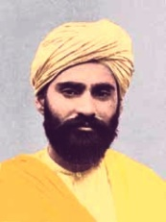
II. Do we have a repetition of this miracle today? 今天我們有同樣的神蹟嗎?
B. Many miracles are to restore God’s beautiful Creation. 神蹟的方向是恢復神創造的美好
孫大信（Sadhu Sundar Singh，1889年9月3日－1929年）

Slide 24
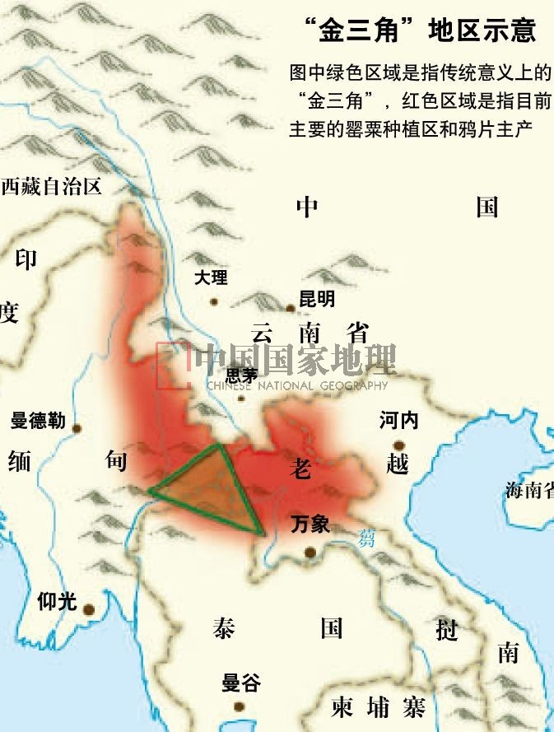
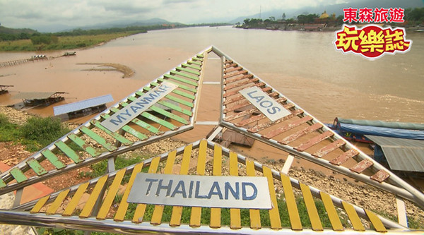

Slide 25
¹²耶穌聽見，就說：康健的人用不著醫生，有病的人才用得著。【太 9:12】
¹²On hearing this, Jesus said, "It is not the healthy who need a doctor, but the sick. 【Matt 9:12】

Slide 26
II. Do we have a repetition of this miracle today? 今天我們有同樣的神蹟嗎?
C. Miracles are to further God’s Kingdom. 神蹟是為了進一步引進上帝的國度.
²⁰門徒出去，到處宣傳福音。主和他們同工，用神蹟隨著，證實所傳的道。阿們！【可 16:20】
²⁰Then the disciples went out and preached everywhere, and the Lord worked with them and confirmed his word by the signs that accompanied it. 【Mark 16:20】

Slide 27
¹⁸西門看見使徒按手，便有聖靈賜下，就拿錢給使徒，¹⁹說：把這權柄也給我，叫我手按著誰，誰就可以受聖靈。²⁰彼得說：你的銀子和你一同滅亡罷！因你想神的恩賜是可以用錢買的。²¹你在這道上無分無關；因為在神面前，你的心不正。²²你當懊悔你這罪惡，祈求主，或者你心裡的意念可得赦免。²³我看出你正在苦膽之中，被罪惡捆綁。²⁴西門說：願你們為我求主，叫你們所說的，沒有一樣臨到我身上。【徒 8:18~24】
¹⁸When Simon saw that the Spirit was given at the laying on of the apostles' hands, he offered them money ¹⁹and said, "Give me also this ability so that everyone on whom I lay my hands may receive the Holy Spirit." ²⁰Peter answered: "May your money perish with you, because you thought you could buy the gift of God with money! ²¹You have no part or share in this ministry, because your heart is not right before God. ²²Repent of this wickedness and pray to the Lord. Perhaps he will forgive you for having such a thought in your heart. ²³For I see that you are full of bitterness and captive to sin." ²⁴Then Simon answered, "Pray to the Lord for me so that nothing you have said may happen to me." 【Acts 8:18~24】

Slide 28
III. Do we have miracles today?
我們今天有神蹟嗎?
A. Increase in Quantity量的增加
B. Increase in Quality 質量的改進
C. Transformation 性質的改變

Slide 29
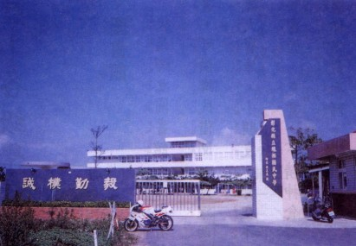
線西國中

Slide 30
Re: Advent: Testimony from David 2 messages Emily Yang <emilyyang2002@me.com> Fri, Sep 8, 2017 at 9:37 AM To: Joseph Chang 張玉明牧師 <prjosephchang@gmail.com>, Esther Chang 李少鳳師母 <estherc777@gmail.com>, Priscilla Chang <priscilla.chang77@gmail.com>, David Ding <david.ding@biola.edu>, Richard Loon LTC 黃定波 <rpvdad@gmail.com> Dear all Thanks for the leadership and hard work. Here is David Lam’s testimony! Connie is the Mom who faithfully supported the whole ADVENT with the prayers from the whole family (grandparents & two siblings) in Toronto. May the heart of our Lord be pleased in all that we are and all that we do for His sake…... In Christ, Emily Yang Loon ++++++++++++++++++++++++++++++++ The fear of the LORD is the beginning of wisdom (Ps 111:10) 敬畏耶和華是智慧的開端 (詩 111:10) Vincent Lam <vlam278@gmail.com>, Connie <hywongca@yahoo.ca> > On Sep 8, 2017, at 8:34 AM, Connie <hywongca@yahoo.ca> wrote: > > Dear Emily, > > Glory to our Lord Jesus! His transforming power and work are having a ripple effects already as many ppl approached us to ask for our experience with Advent. And more ppl showed interests in joining David to go on missions for His kingdom! Amazing! > > I witnessed the changes in David's life after the mission trip. When he was willing to yield to the Holy Spirit and step out of his comfort zone time after time, he repeatedly unfolded His blessing upon blessing! What a joyful exciting discovery God has gifted him at his age! After he has tasted the sweetness and greatness of God's, God has evidently altered his desire and appetite... He is longing for being part of something more purposeful and meaningful in Christ now. Given Jesus' lens and heart, he can perceive more clearly of himself, his own peers and of the culture around him... wow! God has surprised him indeed by blessing and connecting him to His Advent family! He once told me proudly that he has many new believer friends in the US and here in Toronto now. He is staying in touch and even hanging out with the Toronto team! What a treat from God! Before the trip, he stopped listening to Christian songs for a while. After, he told us he loved them. He is now listening to them and singing out loud often as he really appreciated and enjoyed the Advent worship! The seeds of Jesus' love for the lost were also planted in his heart... He treasured so dearly of his Advent Tee because it has his student's signatures and memories! He is more fearless as he has been given opportunities to stand, teach and testify Jesus before God and the class and serve different groups of children alone and with his team and with the support of many humble individual grownups. It's very humbling and profound to see and realize as a mother that how much God could and has matured my son when he's away from me. May he be more independent from us but more dependent on Him! > > At the end of the journey, David already told Vincent that he wanted to go back next year by himself! With our support and prayers, He is going to plan and save for the next mission trip if He wills! May God purify and preserve his heart . And my younger twos are waiting for their turns... ha! Though only Vincent and David went, actually my whole family was taken on this humbling and life-changing journey by our Lord Jesus this Summer! Praise His name! Praise God for giving our next generation North American born chinese a unique role and place in His kingdom plan thru Advent! May this emerging kingdom warriors be grounded in the Gospel, transformed by His truth to face forward and face outward for His glory and risk for Jesus! Thank you Emily and Richard! > > Vincent's testimony is on the way... He takes it very seriously so he's still refining it. :D > > Pray that all the Advent leaders are having a vibrant fellowship w God everyday and God is preserving the hearts of all
9/8/2017 Gmail - Re: Advent: Testimony from David
https://mail.google.com/mail/u/0/?ui=2&ik=fde3a5db1e&jsver=6H9snhMqLA8.en.&view=pt&search=inbox&th=15e646e10d40d8fc&siml=15e625a7d46c… 2/2
young people and their families as we are now in a generation of distraction! > > Connie > ____________________________________________________________________________________ > Haha... his age is very authentic :) > > Advent Testimony by David Lam > > Boot Camp: > When I first heard about Advent, I really didn’t want to go. I didn’t want to leave all my friends back home and go to a place where I knew no one but my dad. I was really hesitant but God worked in me and softened my heart. When I got to the boot camp I was really anxious. I remember really wanting to go home and being mad that I came on the trip. But God blessed me with a great team leader (Jonathan) who approached me the first day. God also allowed me to make a lot of new friends during the boot camp training. I really enjoyed Pastor Chang’s teaching. It was the first time I was taught how to present the Gospel and make my testimony more relatable to the local students. > > Week 1: > The first time I got to the house that we were staying in I thought it was really amazing because I had not expected such a great place. I felt God’s love and provision as He gave me a more comfortable setting for my first time going on a mission. Our team all got along very well. When it was my first day teaching, I was really scared because I didn’t know how to speak Mandarin. But I was blessed with a great teaching partner and friend who helped me in translating and encouraging me when I was feeling discouraged. I remember one night I was going through a spiritual struggle and one of the team leaders talked to me until 2:00 in the morning. I thank God for that and I really appreciated how caring my team was. I got along well with most of my local students because we both liked to have fun and play around. This was the first time I had preached the Gospel to anyone. I was so grateful that I could do this work for God! > > Week 2: > On the second week, our team split into two separate teams. The team that I was on went to Hsinchu. There I felt left out of the team as everyone seemed to already have close friends there. Most of my closer friends that I had made were still in Changhua. Throughout the week I felt really discouraged and useless as my teaching partner seemed to be doing all the work. One thing that encouraged me was how the students still talked to me and played basketball with me even though they knew I can’t speak the same language as them.. God certainly showed me His love and grace through the students. > > Debriefing: > Before coming to the mission trip, I thought that my summer would be wasted and that I wouldn't be able to hang out with friends. In my mind I was missing out. But God had such a better plan than I did. This mission trip showed me that there was so much more than just hanging out with friends at home or playing sports. There was something more purposeful that I could do with my life. I saw God through my team and the students. God strengthened my relationship with Him through seeing the lives of the students change. I was thrilled that the students accepted Jesus and that they could spend an eternity with God. I really did not expect that many of them to say yes! I also saw God through my Dad. He played games with our group and prepared so much behind the scenes. I am extremely thankful to God for letting my dad be my translator. He was very careful not to embarrass me even though I was a bit rude to him at some times. I’m so joyful that God used me in this way. And I got to be a part of something much bigger than myself. > > > > Sent from my iPad > > .
Joseph Chang <prjosephchang@gmail.com> Fri, Sep 8, 2017 at 7:18 PM To: Emily Yang <emilyyang2002@me.com> Cc: Esther Chang 李少鳳師母 <estherc777@gmail.com>, Priscilla Chang <priscilla.chang77@gmail.com>, David Ding <david.ding@biola.edu>, Richard Loon LTC 黃定波 <rpvdad@gmail.com> Thank you for sharing this very moving and encouraging testimony! God is so wonderful, isn't he? Joining his mission is to experience his miracles first hand. Joseph

Slide 31
Transformation of David Lam of Toronto
Singing (Advent Worship a positive input)
T-Shirt (A wonderful memory)
Fellowship with Advent Family
Gospel Presentation
Relating Personal Testimony
Reluctant to go→Saving for next year, 2 siblings waiting for their turns

Slide 32
Conclusion結論
Greater Miracle demands Greater Accountability

Slide 33
³⁸當時，有幾個文士和法利賽人對耶穌說：夫子，我們願意你顯個神蹟給我們看。³⁹耶穌回答說：一個邪惡淫亂的世代求看神蹟，除了先知約拿的神蹟以外，再沒有神蹟給他們看。⁴⁰約拿三日三夜在大魚肚腹中，人子也要這樣三日三夜在地裡頭。【太 12:38~40】
³⁸Then some of the Pharisees and teachers of the law said to him, "Teacher, we want to see a miraculous sign from you." ³⁹He answered, "A wicked and adulterous generation asks for a miraculous sign! But none will be given it except the sign of the prophet Jonah. ⁴⁰For as Jonah was three days and three nights in the belly of a huge fish, so the Son of Man will be three days and three nights in the heart of the earth. 【Matt 12:38~40】

Slide 34
⁴¹當審判的時候，尼尼微人要起來定這世代的罪，因為尼尼微人聽了約拿所傳的就悔改了。看哪，在這裡有一人比約拿更大！⁴²當審判的時候，南方的女王要起來定這世代的罪，因為他從地極而來，要聽所羅門的智慧話。看哪！在這裡有一人比所羅門更大。【太 12:41~42】
³⁸Then some of the Pharisees and teachers of the law said to him, "Teacher, we want to see a miraculous sign from you." ³⁹He answered, "A wicked and adulterous generation asks for a miraculous sign! But none will be given it except the sign of the prophet Jonah. ⁴⁰For as Jonah was three days and three nights in the belly of a huge fish, so the Son of Man will be three days and three nights in the heart of the earth. 【Matt 12:38~40】

Slide 35
¹¹他們去的時候，看守的兵有幾個進城去，將所經歷的事都報給祭司長。¹²祭司長和長老聚集商議，就拿許多銀錢給兵丁，說：¹³你們要這樣說：夜間我們睡覺的時候，他的門徒來，把他偷去了。¹⁴倘若這話被巡撫聽見，有我們勸他，保你們無事。¹⁵兵丁受了銀錢，就照所囑咐他們的去行。這話就傳說在猶太人中間，直到今日。【太 28:11~15】
¹¹While the women were on their way, some of the guards went into the city and reported to the chief priests everything that had happened. ¹²When the chief priests had met with the elders and devised a plan, they gave the soldiers a large sum of money, ¹³telling them, "You are to say, 'His disciples came during the night and stole him away while we were asleep.' ¹⁴If this report gets to the governor, we will satisfy him and keep you out of trouble." ¹⁵So the soldiers took the money and did as they were instructed. And this story has been widely circulated among the Jews to this very day. 【Matt 28:11~15】

