Slide 1
Be Still and Know that I am God! 你要安靜, 要知道我是神!
1 Kings 17 列王記上17章
1/28/2018
BOLGPC 爾灣大公園靈糧堂
Rev. Joseph Chang 張玉明牧師

Slide 3
In quietness. 在安靜中預備
Gideon Method. 基甸的方式

Slide 4
I. God will respond to this busy provoking world. 神對這個忙碌且惹祂怒的世代必有反應.
¹基列寄居的提斯比人以利亞對亞哈說：我指著所事奉永生耶和華─以色列的 神起誓，這幾年我若不禱告，必不降露，不下雨。²耶和華的話臨到以利亞說：³你離開這裡往東去，藏在約但河東邊的基立溪旁。⁴你要喝那溪裡的水，我已吩咐烏鴉在那裡供養你。¹Now Elijah the Tishbite, from Tishbe in Gilead, said to Ahab, "As the LORD, the God of Israel, lives, whom I serve, there will be neither dew nor rain in the next few years except at my word." ²Then the word of the LORD came to Elijah: ³"Leave here, turn eastward and hide in the Kerith Ravine, east of the Jordan. ⁴You will drink from the brook, and I have ordered the ravens to feed you there." 【1King 17:1~4】

Slide 5
I. God will respond to this provoking busy world. 神對這個惹祂怒的世代必有反應.
⁵於是以利亞照著耶和華的話，去住在約但河東的基立溪旁。⁶烏鴉早晚給他叼餅和肉來，他也喝那溪裡的水。⁷過了些日子，溪水就乾了，因為雨沒有下在地上。【王上 17:5~7】
⁵So he did what the LORD had told him. He went to the Kerith Ravine, east of the Jordan, and stayed there. ⁶The ravens brought him bread and meat in the morning and bread and meat in the evening, and he drank from the brook. ⁷Some time later the brook dried up because there had been no rain in the land. 【1King 17:5~7】

Slide 6
A. The person that God uses 神所使用的人
¹Now Elijah the Tishbite, from Tishbe in Gilead,
¹基列寄居的提斯比人以利亞

Slide 10
B. The places that God trains us 神訓練我們的地方
Elijah 以利亞
Kerith Ravine 基利溪
Zarephath of Sidon 西頓的撒勒法

Slide 11
B. The places that God trains us 神訓練我們的地方
Paul 保羅
¹⁷也沒有上耶路撒冷去見那些比我先作使徒的，惟獨往亞拉伯去，後又回到大馬色。¹⁸過了三年，才上耶路撒冷去見磯法，和他同住了十五天。【加 1:17~18】 ¹⁷nor did I go up to Jerusalem to see those who were apostles before I was, but I went immediately into Arabia and later returned to Damascus. ¹⁸Then after three years, I went up to Jerusalem to get acquainted with Peter and stayed with him fifteen days. 【Gal 1:17~18】

Slide 12
II. God trains us to trust in his word. 神訓練我們認識神的話語 (1 Kings 17:1-7).
¹基列寄居的提斯比人以利亞對亞哈說：我指著所事奉永生耶和華─以色列的 神起誓，這幾年我若不禱告，必不降露，不下雨。【王上 17:1】 ¹Now Elijah the Tishbite, from Tishbe in Gilead, said to Ahab, "As the LORD, the God of Israel, lives, whom I serve, there will be neither dew nor rain in the next few years except at my word." 【1King 17:1】

Slide 13
A. The weather obeys God’s command. 天氣聽神的話.
¹⁷以利亞與我們是一樣性情的人，他懇切禱告，求不要下雨，雨就三年零六個月不下在地上。【雅 5:17】 ¹⁷Elijah was a man just like us. He prayed earnestly that it would not rain, and it did not rain on the land for three and a half years. 【Jam 5:17】

Slide 14
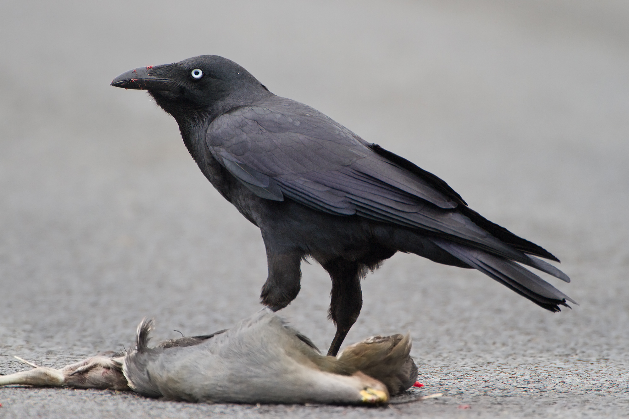
B. The bird obeys God’s command. 烏鴉聽神的話語.

Slide 15
C. QT

Slide 16
III. God trains us to have faith 神訓練我們有信心 (1 Kings 17:8-16)
⁸耶和華的話臨到他說：⁹你起身往西頓的撒勒法去(撒勒法與路加福音四章二十六節同)，住在那裡；我已吩咐那裡的一個寡婦供養你。¹⁰以利亞就起身往撒勒法去。到了城門，見有一個寡婦在那裡撿柴，以利亞呼叫他說：求你用器皿取點水來給我喝。 ⁸Then the word of the LORD came to him: ⁹"Go at once to Zarephath of Sidon and stay there. I have commanded a widow in that place to supply you with food." ¹⁰So he went to Zarephath. When he came to the town gate, a widow was there gathering sticks. He called to her and asked, "Would you bring me a little water in a jar so I may have a drink?" 【1King 17:8~10】

Slide 17
III. God trains us to have faith 神訓練我們有信心 (1 Kings 17:8-16)
¹¹他去取水的時候，以利亞又呼叫他說：也求你拿點餅來給我！¹²他說：我指著永生耶和華─你的 神起誓，我沒有餅，罈內只有一把麵，瓶裡只有一點油；我現在找兩根柴，回家要為我和我兒子做餅；我們吃了，死就死罷！【王上 17:11~12】 ¹¹As she was going to get it, he called, "And bring me, please, a piece of bread." ¹²"As surely as the LORD your God lives," she replied, "I don't have any bread--only a handful of flour in a jar and a little oil in a jug. I am gathering a few sticks to take home and make a meal for myself and my son, that we may eat it--and die." 【1King 17:11~12】

Slide 18
III. God trains us to have faith 神訓練我們有信心 (1 Kings 17:8-16)
¹³以利亞對他說：不要懼怕！可以照你所說的去做罷！只要先為我做一個小餅拿來給我，然後為你和你的兒子做餅。¹⁴因為耶和華─以色列的 神如此說：罈內的麵必不減少，瓶裡的油必不缺短，直到耶和華使雨降在地上的日子。【王上 17:13-14】 ¹³Elijah said to her, "Don't be afraid. Go home and do as you have said. But first make a small cake of bread for me from what you have and bring it to me, and then make something for yourself and your son. ¹⁴For this is what the LORD, the God of Israel, says: 'The jar of flour will not be used up and the jug of oil will not run dry until the day the LORD gives rain on the land.'" 【1King 17:13-14】

Slide 19
III. God trains us to have faith 神訓練我們有信心 (1 Kings 17:8-16)
¹⁵婦人就照以利亞的話去行。他和他家中的人，並以利亞，吃了許多日子。¹⁶罈內的麵果不減少，瓶裡的油也不缺短，正如耶和華藉以利亞所說的話。【王上 17:15~16】 ¹⁵She went away and did as Elijah had told her. So there was food every day for Elijah and for the woman and her family. ¹⁶For the jar of flour was not used up and the jug of oil did not run dry, in keeping with the word of the LORD spoken by Elijah. 【1King 17:15~16】

Slide 20
A. Zarephath of Sidon is the center of Baal worship.希頓的撒勒法是巴力崇拜的中心.

Slide 21
B. The widow will be blessed. 這寡婦要蒙福.
¹²他說：我指著永生耶和華─你的 神起誓，我沒有餅，罈內只有一把麵，瓶裡只有一點油；我現在找兩根柴，回家要為我和我兒子做餅；我們吃了，死就死罷！【王上 17:12】 ¹²"As surely as the LORD your God lives," she replied, "I don't have any bread--only a handful of flour in a jar and a little oil in a jug. I am gathering a few sticks to take home and make a meal for myself and my son, that we may eat it--and die." 【1King 17:12】

Slide 22
⁹你要以財物和一切初熟的土產尊榮耶和華。¹⁰這樣，你的倉房必充滿有餘；你的酒醡有新酒盈溢。【箴 3:9~10】 ⁹Honor the LORD with your wealth, with the firstfruits of all your crops; ¹⁰then your barns will be filled to overflowing, and your vats will brim over with new wine. 【Prov 3:9~10】

Slide 23
¹⁴因為耶和華─以色列的 神如此說：罈內的麵必不減少，瓶裡的油必不缺短，直到耶和華使雨降在地上的日子。【王上 17:14】 ¹⁴For this is what the LORD, the God of Israel, says: 'The jar of flour will not be used up and the jug of oil will not run dry until the day the LORD gives rain on the land.'" 【1King 17:14】

Slide 24
IV. God trains us to experience the resurrected power. 神訓練我們經歷復活的能力 (1 Kings 17:17-24).
³豈不知我們這受洗歸入基督耶穌的人是受洗歸入他的死麼？⁴所以，我們藉著洗禮歸入死，和他一同埋葬，原是叫我們一舉一動有新生的樣式，像基督藉著父的榮耀從死裡復活一樣。⁵我們若在他死的形狀上與他聯合，也要在他復活的形狀上與他聯合； ³Or don't you know that all of us who were baptized into Christ Jesus were baptized into his death? ⁴We were therefore buried with him through baptism into death in order that, just as Christ was raised from the dead through the glory of the Father, we too may live a new life. ⁵If we have been united with him like this in his death, we will certainly also be united with him in his resurrection. 【Rom 6:3~5】

Slide 25
IV. God trains us to experience the resurrected power. 神訓練我們經歷復活的能力 (1 Kings 17:17-24).
¹⁷這事以後，作那家主母的婦人，他兒子病了；病得甚重，以致身無氣息。¹⁸婦人對以利亞說： 神人哪，我與你何干？你竟到我這裡來，使神想念我的罪，以致我的兒子死呢？¹⁹以利亞對他說：把你兒子交給我。以利亞就從婦人懷中將孩子接過來，抱到他所住的樓中，放在自己的床上，【王上 17:17~19】 ¹⁷Some time later the son of the woman who owned the house became ill. He grew worse and worse, and finally stopped breathing. ¹⁸She said to Elijah, "What do you have against me, man of God? Did you come to remind me of my sin and kill my son?" ¹⁹"Give me your son," Elijah replied. He took him from her arms, carried him to the upper room where he was staying, and laid him on his bed. 【1King 17:17~19】

Slide 26
IV. God trains us to experience the resurrected power. 神訓練我們經歷復活的能力 (1 Kings 17:17-24).
²⁰就求告耶和華說：耶和華─我的 神啊，我寄居在這寡婦的家裡，你就降禍與他，使他的兒子死了麼？²¹以利亞三次伏在孩子的身上，求告耶和華說：耶和華─我的 神啊，求你使這孩子的靈魂仍入他的身體！²²耶和華應允以利亞的話，孩子的靈魂仍入他的身體，他就活了。【王上 17:20~22】 ²⁰Then he cried out to the LORD, "O LORD my God, have you brought tragedy also upon this widow I am staying with, by causing her son to die?" ²¹Then he stretched himself out on the boy three times and cried to the LORD, "O LORD my God, let this boy's life return to him!" ²²The LORD heard Elijah's cry, and the boy's life returned to him, and he lived. 【1King 17:20~22】

Slide 27
IV. God trains us to experience the resurrected power. 神訓練我們經歷復活的能力 (1 Kings 17:17-24).
²³以利亞將孩子從樓上抱下來，進屋子交給他母親，說：看哪，你的兒子活了！²⁴婦人對以利亞說：現在我知道你是 神人，耶和華藉你口所說的話是真的。【王上 17:23~24】 ²³Elijah picked up the child and carried him down from the room into the house. He gave him to his mother and said, "Look, your son is alive!" ²⁴Then the woman said to Elijah, "Now I know that you are a man of God and that the word of the LORD from your mouth is the truth." 【1King 17:23~24】

Slide 28
Nazarite Vow 拿細耳人的願
⁶在他離俗歸耶和華的一切日子，不可挨近死屍。⁷他的父母或是弟兄姊妹死了的時候，他不可因他們使自己不潔淨，因為那離俗歸 神的憑據是在他頭上。【民 6:6~7】
⁶Throughout the period of his separation to the LORD he must not go near a dead body. ⁷Even if his own father or mother or brother or sister dies, he must not make himself ceremonially unclean on account of them, because the symbol of his separation to God is on his head. 【Num 6:6~7】

Slide 29
Conclusion 結論
²⁴婦人對以利亞說：現在我知道你是 神人，耶和華藉你口所說的話是真的。【王上 17:24】 ²⁴Then the woman said to Elijah, "Now I know that you are a man of God and that the word of the LORD from your mouth is the truth." 【1King 17:24】
¹⁰你們要休息，要知道我是 神！我必在外邦中被尊崇，在遍地上也被尊崇。【詩 46:10】 ¹⁰"Be still, and know that I am God; I will be exalted among the nations, I will be exalted in the earth." 【Ps 46:10】

