Slide 1
An Eye for an Eye, a Tooth for a Tooth
以眼還眼, 以牙還牙
列王記上 1 Kings:15-29
5/6/2018
BOLGPC 爾灣大公園靈糧堂
Rev. Joseph Chang, 張玉明牧師

Slide 2
Q1: Too Severe? 太嚴厲了?
“If we all carry out the principle of an eye for an eye, and a tooth for a tooth, then we will become eyeless and toothless world!”
如果我們都以眼還眼, 以牙還牙, 那麼這個世界將成為沒有眼, 沒有牙的世界.

Slide 3
“If we do not carry out the principle of an eye for an eye and a tooth for a tooth. Then the bullies will all have natural teeth and the victims all have implants!” 如果我們不以眼還眼, 以牙還牙, 那麼這個世界的壞人都有滿嘴的好牙, 這個世界的弱者, 都有滿嘴的植牙.

Slide 4
Q2: Law of the past? 過去的律法?
Law of the Past. 過去的律法.
Love is the Law of NT. 新約的時代只講愛.

Slide 5
¹⁵人無論犯甚麼罪，作甚麼惡，不可憑一個人的口作見證，總要憑兩三個人的口作見證才可定案。¹⁶若有兇惡的見證人起來，見證某人作惡，¹⁷這兩個爭訟的人就要站在耶和華面前，和當時的祭司，並審判官面前，¹⁸審判官要細細的查究，若見證人果然是作假見證的，以假見證陷害弟兄，【申 19:15~18】
¹⁵One witness is not enough to convict a man accused of any crime or offense he may have committed. A matter must be established by the testimony of two or three witnesses. ¹⁶If a malicious witness takes the stand to accuse a man of a crime, ¹⁷the two men involved in the dispute must stand in the presence of the LORD before the priests and the judges who are in office at the time. ¹⁸The judges must make a thorough investigation, and if the witness proves to be a liar, giving false testimony against his brother, 【Deut 19:15~18】

Slide 6
¹⁹你們就要待他如同他想要待的弟兄。這樣，就把那惡從你們中間除掉。²⁰別人聽見都要害怕，就不敢在你們中間再行這樣的惡了。²¹你眼不可顧惜，要以命償命，以眼還眼，以牙還牙，以手還手，以腳還腳。【申 19:19~21】
¹⁹then do to him as he intended to do to his brother. You must purge the evil from among you. ²⁰The rest of the people will hear of this and be afraid, and never again will such an evil thing be done among you. ²¹Show no pity: life for life, eye for eye, tooth for tooth, hand for hand, foot for foot. 【Deut 19:19~21】

Slide 7
³⁸你們聽見有話說：以眼還眼，以牙還牙。³⁹只是我告訴你們，不要與惡人作對。有人打你的右臉，連左臉也轉過來由他打；⁴⁰有人想要告你，要拿你的裡衣，連外衣也由他拿去；⁴¹有人強逼你走一里路，你就同他走二里；⁴²有求你的，就給他；有向你借貸的，不可推辭。【太 5:38~42】
³⁸"You have heard that it was said, 'Eye for eye, and tooth for tooth.' ³⁹But I tell you, Do not resist an evil person. If someone strikes you on the right cheek, turn to him the other also. ⁴⁰And if someone wants to sue you and take your tunic, let him have your cloak as well. ⁴¹If someone forces you to go one mile, go with him two miles. ⁴²Give to the one who asks you, and do not turn away from the one who wants to borrow from you. 【Matt 5:38~42】

Slide 8
Scenario 1—Seminary Sex Offense
神學生犯罪
²¹那時，彼得進前來，對耶穌說：主阿，我弟兄得罪我，我當饒恕他幾次呢？到七次可以麼？²²耶穌說：我對你說，不是到七次，乃是到七十個七次。【太 18:21~22】
²¹Then Peter came to Jesus and asked, "Lord, how many times shall I forgive my brother when he sins against me? Up to seven times?" ²²Jesus answered, "I tell you, not seven times, but seventy-seven times. 【Matt 18:21~22】

Slide 9
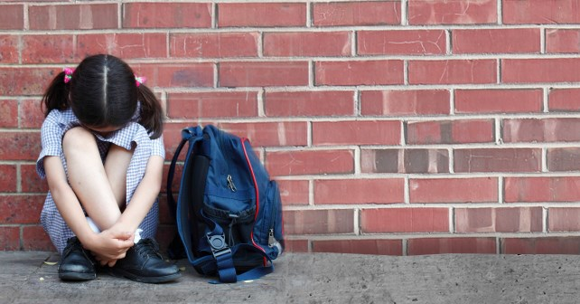
Scenario 2—School Bully Case 學校的學霸

Slide 10
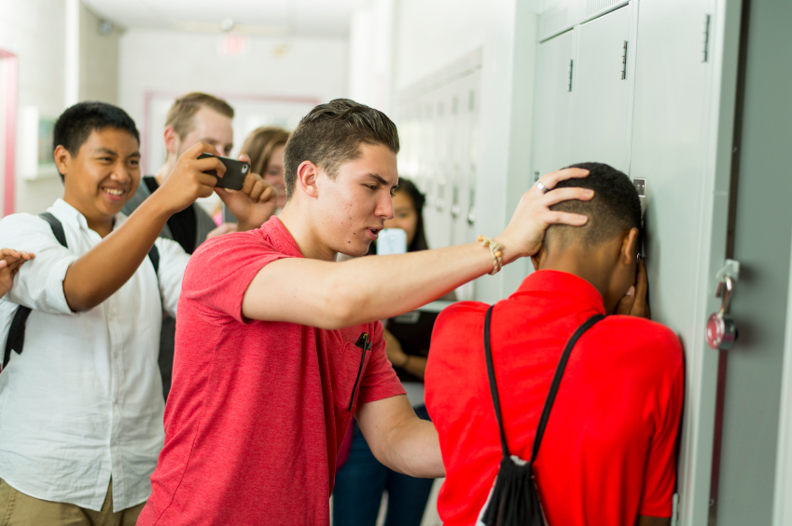

Slide 11
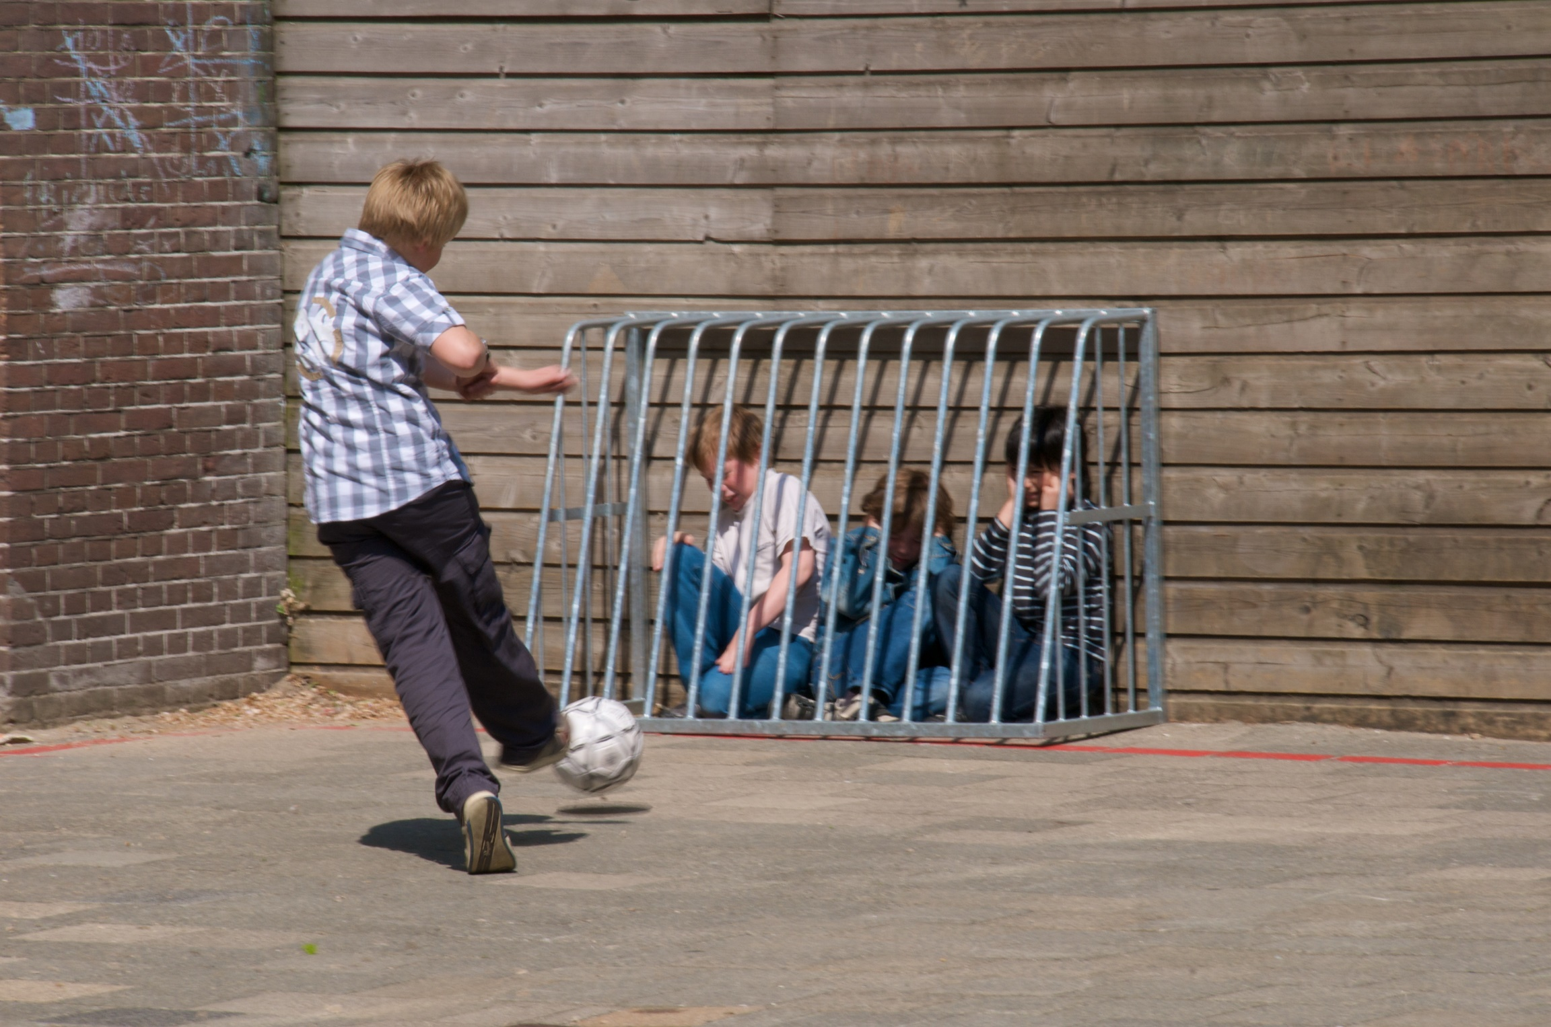

Slide 12
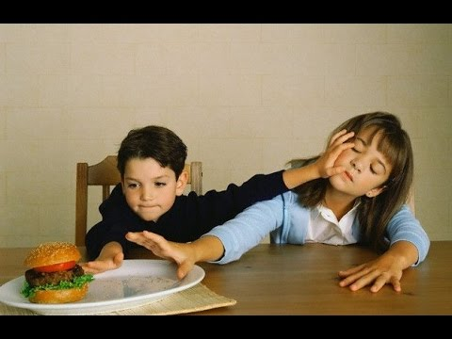
Scenario 3—Sibling Fight弟兄爭鬥

Slide 13
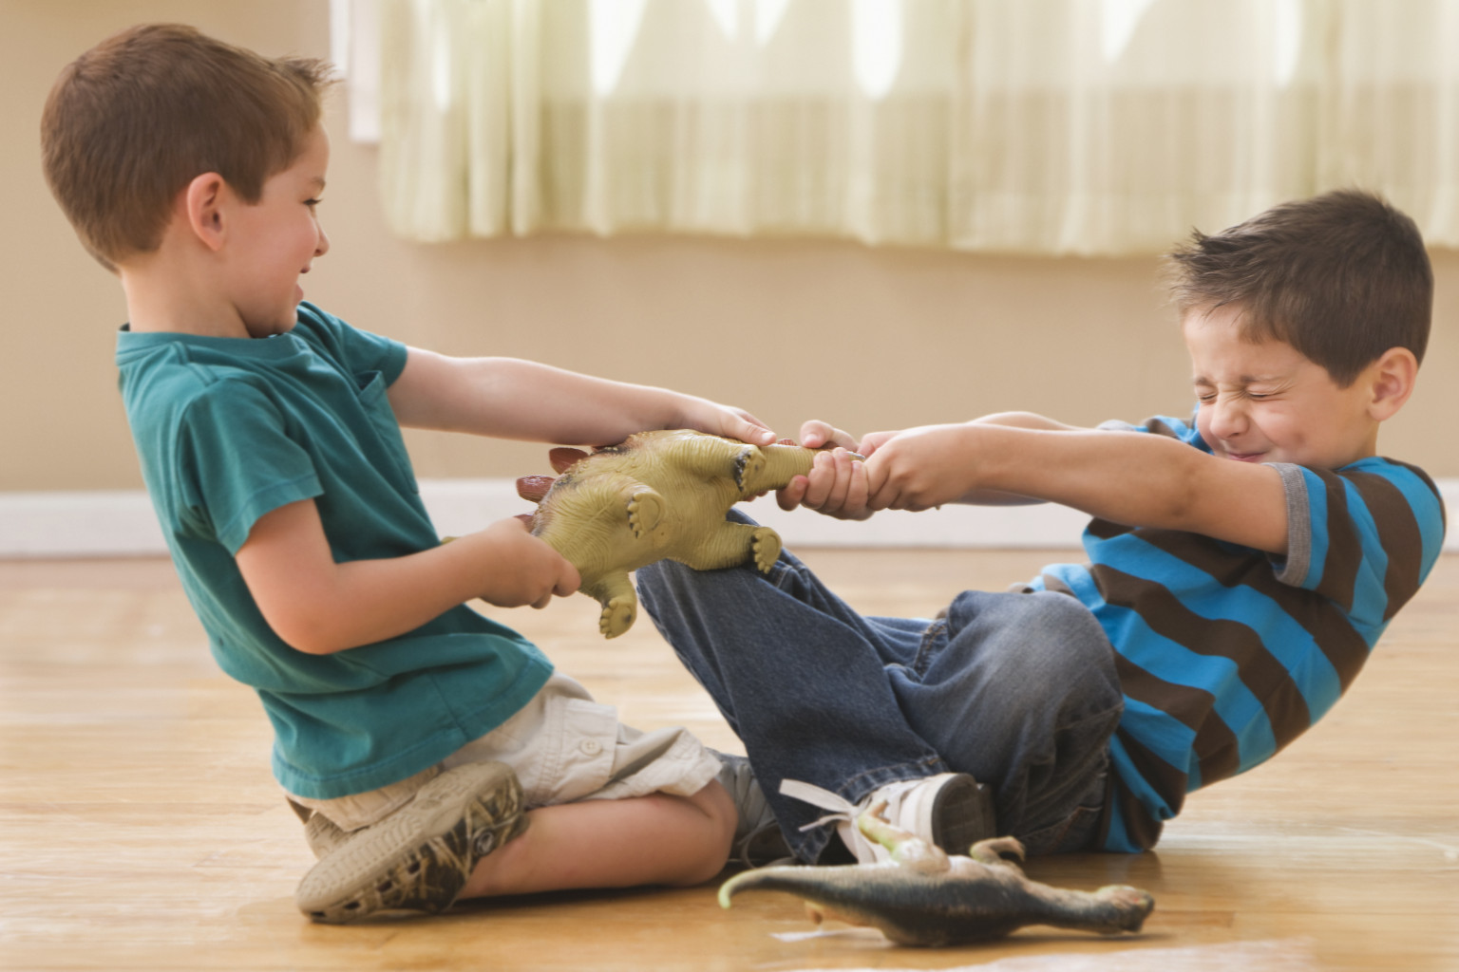

Slide 14
Common Problem共同的問題:
1. No Righteousness 沒有公義.

Slide 15
Common Problem共同的問題:
1. No Righteousness 沒有公義.
2. Confusion of the Role角色混亂

Slide 16
¹⁵耶洗別聽見拿伯被石頭打死，就對亞哈說：你起來得耶斯列人拿伯不肯為價銀給你的葡萄園罷！現在他已經死了。¹⁶亞哈聽見拿伯死了，就起來，下去要得耶斯列人拿伯的葡萄園。¹⁷耶和華的話臨到提斯比人以利亞說：¹⁸你起來，去見住撒瑪利亞的以色列王亞哈，他下去要得拿伯的葡萄園，現今正在那園裡。【王上 21:15~18】
¹⁵As soon as Jezebel heard that Naboth had been stoned to death, she said to Ahab, "Get up and take possession of the vineyard of Naboth the Jezreelite that he refused to sell you. He is no longer alive, but dead." ¹⁶When Ahab heard that Naboth was dead, he got up and went down to take possession of Naboth's vineyard. ¹⁷Then the word of the LORD came to Elijah the Tishbite: ¹⁸"Go down to meet Ahab king of Israel, who rules in Samaria. He is now in Naboth's vineyard, where he has gone to take possession of it. 【 1King 21:15~18】

Slide 17
¹⁹你要對他說：耶和華如此說：你殺了人，又得他的產業麼？又要對他說：耶和華如此說：狗在何處舔拿伯的血，也必在何處舔你的血。²⁰亞哈對以利亞說：我仇敵啊，你找到我麼？他回答說：我找到你了；因為你賣了自己，行耶和華眼中看為惡的事。²¹耶和華說：我必使災禍臨到你，將你除盡。凡屬你的男丁，無論困住的、自由的，都從以色列中剪除。【王上 21:19-21】
¹⁹Say to him, 'This is what the LORD says: Have you not murdered a man and seized his property?' Then say to him, 'This is what the LORD says: In the place where dogs licked up Naboth's blood, dogs will lick up your blood--yes, yours!'" ²⁰Ahab said to Elijah, "So you have found me, my enemy!" "I have found you," he answered, "because you have sold yourself to do evil in the eyes of the LORD. ²¹'I am going to bring disaster on you. I will consume your descendants and cut off from Ahab every last male in Israel--slave or free. 【1King 21:19-21】

Slide 18
²²我必使你的家像尼八的兒子耶羅波安的家，又像亞希雅的兒子巴沙的家；因為你惹我發怒，又使以色列人陷在罪裡。²³論到耶洗別，耶和華也說：狗在耶斯列的外郭必吃耶洗別的肉。²⁴凡屬亞哈的人，死在城中的必被狗吃，死在田野的必被空中的鳥吃。²⁵（從來沒有像亞哈的，因他自賣，行耶和華眼中看為惡的事，受了王后耶洗別的聳動；【王上 21:22-25】
²²I will make your house like that of Jeroboam son of Nebat and that of Baasha son of Ahijah, because you have provoked me to anger and have caused Israel to sin.' ²³"And also concerning Jezebel the LORD says: 'Dogs will devour Jezebel by the wall of Jezreel.' ²⁴"Dogs will eat those belonging to Ahab who die in the city, and the birds of the air will feed on those who die in the country." ²⁵(There was never a man like Ahab, who sold himself to do evil in the eyes of the LORD, urged on by Jezebel his wife. 【1King 21:22-25】

Slide 19
²⁶就照耶和華在以色列人面前所趕出的亞摩利人，行了最可憎惡的事，信從偶像。）²⁷亞哈聽見這話，就撕裂衣服，禁食，身穿麻布，睡臥也穿著麻布，並且緩緩而行。²⁸耶和華的話臨到提斯比人以利亞說：²⁹亞哈在我面前這樣自卑，你看見了麼？因他在我面前自卑，他還在世的時候，我不降這禍；到他兒子的時候，我必降這禍與他的家。【王上 21:26~29】
²⁶He behaved in the vilest manner by going after idols, like the Amorites the LORD drove out before Israel.) ²⁷When Ahab heard these words, he tore his clothes, put on sackcloth and fasted. He lay in sackcloth and went around meekly. ²⁸Then the word of the LORD came to Elijah the Tishbite: ²⁹"Have you noticed how Ahab has humbled himself before me? Because he has humbled himself, I will not bring this disaster in his day, but I will bring it on his house in the days of his son." 【1King 21:26~29】

Slide 20
I. God’s Judgment is Lex Talionis Judgment.
神的審判是以眼還眼, 以牙還牙的審判.
'This is what the LORD says: In the place where dogs licked up Naboth's blood, dogs will lick up your blood--yes, yours!'"耶和華如此說：狗在何處舔拿伯的血，也必在何處舔你的血。(1 Kings 21:19)

Slide 21
II. God will defend the defenseless.
神要為受屈者說話.
對話順序
Dialogue Sequence
亞哈→←拿伯(21:2-4)
耶洗別→←亞哈(21:5-7)
耶洗別(亞哈)→長老(21:8-10)
長老→耶洗別(21:11-14)
耶洗別→亞哈 (21:15-16)
以利亞(耶和華)→亞哈 (21:17-24)
Ahab→←Naboth (21:2-4)
Jezebel→←Ahab (21:5-7)
Jezebel (Ahab)→Elders (21:8-10)
Elder→Jezebel (21:11-14)
Jezebel→ Ahab (21:15-16)
Elijah (God)→ Ahab (21:17-24)

Slide 22
II. God will defend the defenseless.
神要為受屈者說話.
對話順序
Dialogue Sequence
亞哈→←拿伯(21:2-4)
耶洗別→←亞哈(21:5-7)
耶洗別(亞哈)→長老(21:8-10)
長老→耶洗別(21:11-14)
耶洗別→亞哈 (21:15-16)
以利亞(耶和華)→亞哈 (21:17-24)
Ahab→←Naboth (21:2-4)
Jezebel→←Ahab (21:5-7)
Jezebel (Ahab)→Elders (21:8-10)
Elder→Jezebel (21:11-14)
Jezebel→ Ahab (21:15-16)
Elijah (God)→ Ahab (21:17-24)

Slide 23
¹⁹向寄居的和孤兒寡婦屈枉正直的，必受咒詛！百姓都要說：阿們！【申 27:19】
¹⁹"Cursed is the man who withholds justice from the alien, the fatherless or the widow." Then all the people shall say, "Amen!" 【Deut 27:19】

Slide 24
III. God’s Judgment is righteous.
神的審判是公義的.
³⁴公義使邦國高舉；罪惡是人民的羞辱。【箴 14:34】
³⁴Righteousness exalts a nation, but sin is a disgrace to any people. 【Prov 14:34】

Slide 25
3 NT Scriptures 3個新約的經文
Scripture 1
⁵⁰使創世以來所流眾先知血的罪都要問在這世代的人身上，⁵¹就是從亞伯的血起，直到被殺在壇和殿中間撒迦利亞的血為止。我實在告訴你們，這都要問在這世代的人身上。【路 11:50~51】
⁵⁰Therefore this generation will be held responsible for the blood of all the prophets that has been shed since the beginning of the world, ⁵¹from the blood of Abel to the blood of Zechariah, who was killed between the altar and the sanctuary. Yes, I tell you, this generation will be held responsible for it all. 【Luke 11:50~51】

Slide 26
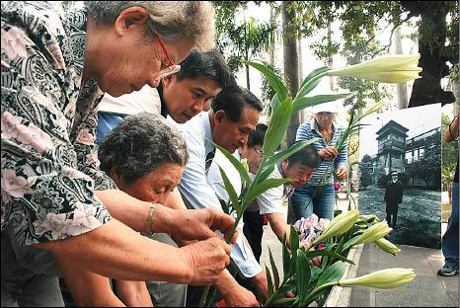
228 Massacre/228 屠殺

Slide 27
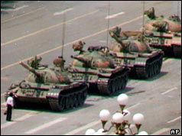
64 Massacre/ 64 天安門屠殺

Slide 28
¹外邦為甚麼爭鬧？萬民為甚麼謀算虛妄的事？²世上的君王一齊起來，臣宰一同商議，要敵擋耶和華並他的受膏者，³說：我們要掙開他們的捆綁，脫去他們的繩索。⁴那坐在天上的必發笑；主必嗤笑他們。【詩 2:1~4】
¹Why do the nations conspire and the peoples plot in vain? ²The kings of the earth take their stand and the rulers gather together against the LORD and against his Anointed One. ³"Let us break their chains," they say, "and throw off their fetters." ⁴The One enthroned in heaven laughs; the Lord scoffs at them. 【Ps 2:1~4】

Slide 29
3 NT Scriptures 3個新約的經文
Scripture 2
¹¹我又看見一個白色的大寶座與坐在上面的；從他面前天地都逃避，再無可見之處了。¹²我又看見死了的人，無論大小，都站在寶座前。案卷展開了，並且另有一卷展開，就是生命冊。死了的人都憑著這些案卷所記載的，照他們所行的受審判。【啟 20:11~12】
¹¹Then I saw a great white throne and him who was seated on it. Earth and sky fled from his presence, and there was no place for them. ¹²And I saw the dead, great and small, standing before the throne, and books were opened. Another book was opened, which is the book of life. The dead were judged according to what they had done as recorded in the books. 【Rev 20:11~12】

Slide 30
不要計算人的惡(keeps no record of wrongs, 1 Cor 13:5)

Slide 31
3 NT Scriptures 3個新約的經文
Scripture 3
⁹揭開第五印的時候，我看見在祭壇底下，有為神的道、並為作見證被殺之人的靈魂，¹⁰大聲喊著說：聖潔真實的主阿，你不審判住在地上的人，給我們伸流血的冤，要等到幾時呢？¹¹於是有白衣賜給他們各人；又有話對他們說，還要安息片時，等著一同作僕人的和他們的弟兄也像他們被殺，滿足了數目。【啟 6:9~11】
⁹When he opened the fifth seal, I saw under the altar the souls of those who had been slain because of the word of God and the testimony they had maintained. ¹⁰They called out in a loud voice, "How long, Sovereign Lord, holy and true, until you judge the inhabitants of the earth and avenge our blood?" ¹¹Then each of them was given a white robe, and they were told to wait a little longer, until the number of their fellow servants and brothers who were to be killed as they had been was completed. 【Rev 6:9~11】

Slide 32
IV. God’s mercy, at times, could postpone his righteous judgment.
神的憐憫, 有時會延遲神公義的審判.
²⁷亞哈聽見這話，就撕裂衣服，禁食，身穿麻布，睡臥也穿著麻布，並且緩緩而行。²⁸耶和華的話臨到提斯比人以利亞說：²⁹亞哈在我面前這樣自卑，你看見了麼？因他在我面前自卑，他還在世的時候，我不降這禍；到他兒子的時候，我必降這禍與他的家。【王上 21:27~29】
²⁷When Ahab heard these words, he tore his clothes, put on sackcloth and fasted. He lay in sackcloth and went around meekly. ²⁸Then the word of the LORD came to Elijah the Tishbite: ²⁹"Have you noticed how Ahab has humbled himself before me? Because he has humbled himself, I will not bring this disaster in his day, but I will bring it on his house in the days of his son." 【1King 21:27~29】

Slide 33
Conclusion 結論
⁹主所應許的尚未成就，有人以為他是耽延，其實不是耽延，乃是寬容你們，不願有一人沉淪，乃願人人都悔改。【彼後 3:9】
⁹The Lord is not slow in keeping his promise, as some understand slowness. He is patient with you, not wanting anyone to perish, but everyone to come to repentance. 【2Pet 3:9】

