Slide 1
Without Giving, Never Owned. 我若不給，就不曾擁有
12/2/2018
BOLGPC 爾灣大公園靈糧堂
Rev. Joseph Chang 張玉明牧師

Slide 2
I. If I never give, I do not own a thing. 我若不給，就不曾擁有
Died at age 33.
33歲死了

Slide 3
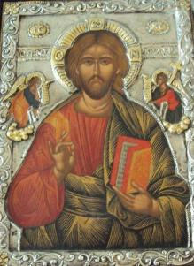
I. If I never give, I do not own a thing. 我若不給，就不曾擁有
Died at age 33.
33歲死了

Slide 4
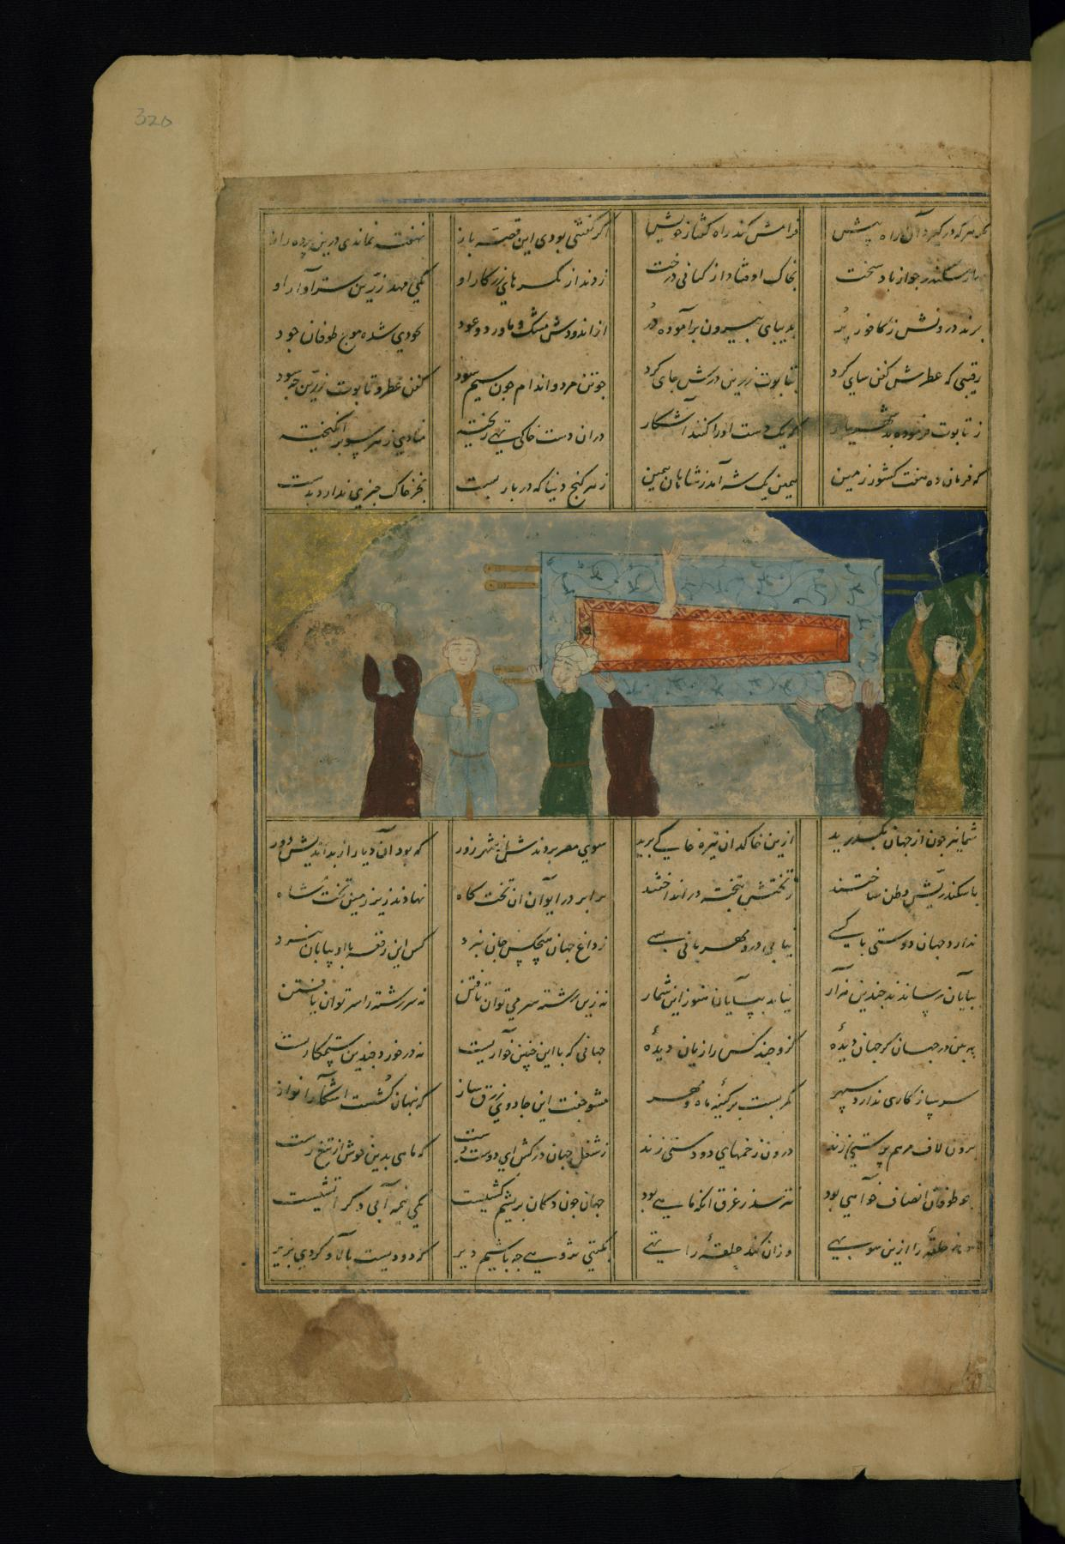
Nizami Ganjavi - The Coffin of Alexander the Great Carried in Procession - Walters W604320A - Full Page.jpg

Slide 5
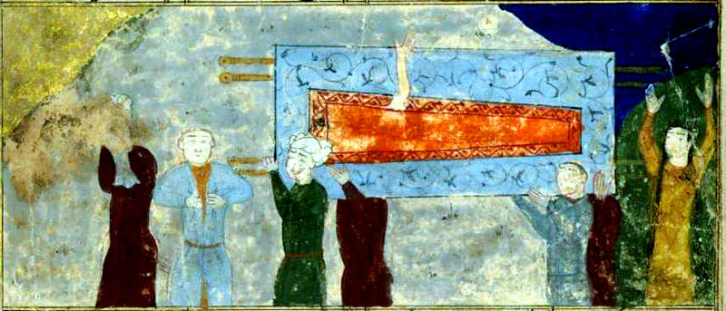

Slide 6
¹⁹不要為自己積攢財寶在地上；地上有蟲子咬，能鏽壞，也有賊挖窟窿來偷。²⁰只要積攢財寶在天上；天上沒有蟲子咬，不能鏽壞，也沒有賊挖窟窿來偷。²¹因為你的財寶在那裡，你的心也在那裡。【太 6:19~21】 ¹⁹""Do not lay up for yourselves treasures on earth, where moth and rust destroy and where thieves break in and steal," ²⁰"but lay up for yourselves treasures in heaven, where neither moth nor rust destroys and where thieves do not break in and steal." ²¹"For where your treasure is, there your heart will be also. " 【Matt 6:19~21】

Slide 7
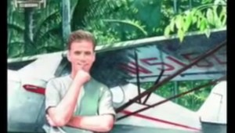
Jim Elliott (1927-1956)

Slide 8
He is no fool who gives what he cannot keep to gain that which he cannot lose.
放棄他不能保有的, 去換取他不能失去的, 這樣的人絕對不會是傻瓜.
Wherever you are - be all there.
你人在哪裡, 就把你的心也放在那裏!
God always gives His best to those who leave the choice with him.
一個讓神為他選擇的人, 神常常把自己最好的給他.

Slide 9
II. Without Faith, you cannot really give. 沒有信心, 你就不可能真正的給.

Slide 10
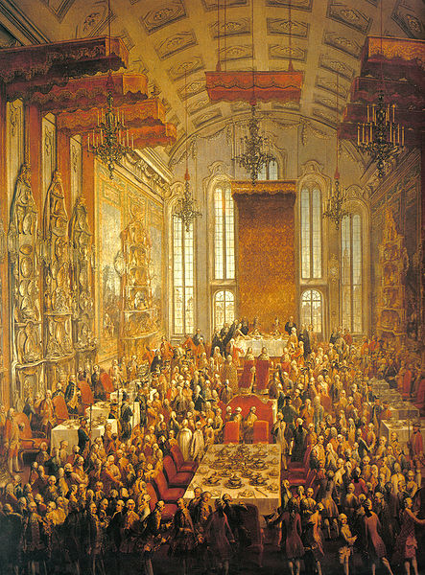
II. Without Faith, you cannot really give. 沒有信心, 你就不可能真正的給.

Slide 11
¹⁹過了許久，那些僕人的主人來了，和他們算賬。²⁰那領五千銀子的又帶著那另外的五千來，說：主阿，你交給我五千銀子。請看，我又賺了五千。²¹主人說：好，你這又良善又忠心的僕人，你在不多的事上有忠心，我要把許多事派你管理；可以進來享受你主人的快樂。【太 25:19~21】 ¹⁹"Now after a long time the master of those servants came and settled accounts with them." ²⁰"And he who had received the five talents came forward, bringing five talents more, saying, 'Master, you delivered to me five talents; here I have made five talents more.'" ²¹"His master said to him, 'Well done, good and faithful servant.You have been faithful over a little; I will set you over much. Enter into the joy of your master.'" 【Matt 25:19~21】

Slide 12
¹⁶頭一個上來，說：主阿，你的一錠銀子已經賺了十錠。¹⁷主人說：好！良善的僕人，你既在最小的事上有忠心，可以有權柄管十座城。【路 19:16~17】 ¹⁶"The first came before him, saying, 'Lord, your mina has made ten minas more.'" ¹⁷"And he said to him, 'Well done, good servant! Because you have been faithful in a very little, you shall have authority over ten cities.'" 【Luke 19:16~17】
¹⁸第二個來，說：主阿！你的一錠銀子，已經賺了五錠。¹⁹主人說：你也可以管五座城。【路 19:18~19】 ¹⁸"And the second came, saying, 'Lord, your mina has made five minas.'" ¹⁹"And he said to him, 'And you are to be over five cities.'" 【Luke 19:18~19】

Slide 13
²⁰又有一個來說：主阿，看哪，你的一錠銀子在這裡，我把他包在手巾裡存著。²¹我原是怕你，因為你是嚴厲的人；沒有放下的，還要去拿；沒有種下的，還要去收。²²主人對他說：你這惡僕，我要憑你的口定你的罪。你既知道我是嚴厲的人，沒有放下的，還要去拿，沒有種下的，還要去收，【路 19:20-22】 ²⁰"Then another came, saying, 'Lord, here is your mina, which I kept laid away in a handkerchief;" ²¹"for I was afraid of you, because you are a severe man. You take what you did not deposit, and reap what you did not sow.'" ²²"He said to him, 'I will condemn you with your own words, you wicked servant! You knew that I was a severe man, taking what I did not deposit and reaping what I did not sow?" 【Luke 19:20-22】

Slide 14
²³為甚麼不把我的銀子交給銀行，等我來的時候，連本帶利都可以要回來呢？²⁴就對旁邊站著的人說：奪過他這一錠來，給那有十錠的。²⁵他們說：主阿，他已經有十錠了。²⁶主人說：我告訴你們，凡有的，還要加給他；沒有的，連他所有的也要奪過來。【路 19:23-26】 ²³"Why then did you not put my money in the bank, and at my coming I might have collected it with interest?'" ²⁴"And he said to those who stood by, 'Take the mina from him, and give it to the one who has the ten minas.'" ²⁵"And they said to him, 'Lord, he has ten minas!'" ²⁶"'I tell you that to everyone who has, more will be given, but from the one who has not, even what he has will be taken away." 【Luke 19:23-26】

Slide 15
III. Where your heart is, your money will be. 你的錢財在那裏，你的心就在那裏。
¹⁹不要為自己積攢財寶在地上；地上有蟲子咬，能鏽壞，也有賊挖窟窿來偷。²⁰只要積攢財寶在天上；天上沒有蟲子咬，不能鏽壞，也沒有賊挖窟窿來偷。²¹因為你的財寶在那裡，你的心也在那裡。【太 6:19~21】 ¹⁹""Do not lay up for yourselves treasures on earth, where moth and rust destroy and where thieves break in and steal," ²⁰"but lay up for yourselves treasures in heaven, where neither moth nor rust destroys and where thieves do not break in and steal." ²¹"For where your treasure is, there your heart will be also. " 【Matt 6:19~21】

Slide 16
III. Where your heart is, your money will be. 你的錢財在那裏，你的心就在那裏。
¹⁹不要為自己積攢財寶在地上；地上有蟲子咬，能鏽壞，也有賊挖窟窿來偷。²⁰只要積攢財寶在天上；天上沒有蟲子咬，不能鏽壞，也沒有賊挖窟窿來偷。²¹因為你的財寶在那裡，你的心也在那裡。【太 6:19~21】 ¹⁹""Do not lay up for yourselves treasures on earth, where moth and rust destroy and where thieves break in and steal," ²⁰"but lay up for yourselves treasures in heaven, where neither moth nor rust destroys and where thieves do not break in and steal." ²¹"For where your treasure is, there your heart will be also. " 【Matt 6:19~21】

Slide 17
Conclusion 結論
1). If I do not give, I do not truly own anything that God has blessed me with. 若我不知道給, 我就不會真正的擁有神給我們的任何東西.
2). Without faith, I do not truly give. 若我沒有信心, 我就不會真正的給. 我給神的是我桌子上吃剩下來的碎片. 將來在神的國度, 主耶穌是不是只給我們吃宴會廳裡面的巧克力糖呢?
3). If I do not place the money in God’s kingdom, my heart could not be in His kingdom. 若我不把錢投資在神國度的事工上, 我的心就不在神國上面, 我就沒有辦法真正在屬靈的事情上成長, 將來怎能夠在神國度裏面承擔責任呢?

