Slide 1
Signs of the Time! Actions of the Time! 這時代的徵兆, 這時代的行動!
12/16/2018
BOLGPC 爾灣大公園靈糧堂
Rev. Joseph Chang 張玉明牧師

Slide 2
New Horizon Upper School

Slide 3
New Horizon Upper School

Slide 4
Why the flag is at half staff today?
今天為什麼降半旗?

Slide 6
I. Signs of the Time, Actions of the Time 這時代的徵兆, 這時代的行動
Sign 1/徵兆1
Pearl Harbor,
Memorial Day,
911,
death of US president and leaders,
Billy Graham.

Slide 7
2018, 4 times
US - 10/27/2018 US flags to Half Staff honoring the victims of the tragedy in Pittsburgh, PA (Tree of Life, synagogue)
US - 7/3/2018 US Flags at Half-Staff -Presidential Proclamation Honoring the Victims of the Tragedy in Annapolis, Maryland
US - 5/18/2018 United States Flag at Half-Staff Immediately until Sunset on Tuesday, May 22, 2018 Honoring the Victims of the Tragedy in Santa Fe, Texas
US - 2/15/2018 US flags at Half-Staff Honoring the Victims of the Tragedy in Parkland, Florida

Slide 8
2017 2 times
US - 11/6/2017 US Flags at half-Staff Honoring the Victims of the Sutherland Springs, Texas Shooting
US - 10/2/2017 US Flags at Half-Staff Honoring Victims of the Las Vegas Tragedy

Slide 9
⁷民要攻打民，國要攻打國；多處必有饑荒、地震。⁸這都是災難的起頭。（災難：原文作生產之難）【太 24:7~8】 ⁷"For nation will rise against nation, and kingdom against kingdom, and there will be famines and earthquakes in various places." ⁸"All these are but the beginning of the birth pains. " 【Matt 24:7~8】

Slide 10
2011, 1 time
2011/1/9 US Flag in Half Staff in Honor of the Victims in Tucson, AZ

Slide 11
2012, 3 times
2012/7/20-7/25 US Flag in Half Staff in Honor of Aurora, Colorado Shooting Victims.
2012/8/6-8/10 US Flag at Half Staff in Honor of Oak Creek, WI Shootings.
2012/12/14-12/18 US Flag at Half Staff in Honor of the victims in Newtown, Connecticut tragedy.

Slide 12
2013, 2次
2013/4/16-4/20 US Flag to Half Staff Honoring Victims of the Tragedy in Boston, MA
2013/9/16-9/20 US Flag at Half Staff for the Victims of the Washington Navy Yard Tragedy.

Slide 13
2015, 4次
2015/7/21-7/25 US Flag at Half Staff Honoring the Victims of the Tragedy in Chattanooga, TN.
2015/10-2-10/6 US Flag at Half Staff Honoring the Victimsof the Tragedy in Roseburg, Oregon.
2015/11/15-11/19 US Flag at Half Staff Honoring Victims of the Paris Terrorist Attack
2015/12/3-12/7 US Flag at Half Staff Honoring Victims of the attack on San Bernardino, CA.

Slide 14
2016, 5 times, 一次未完(7/15-7/19), 另外一次又開始 (7/18-7/22)
2016/3/22-3/26 US Flag at Half Staff Honoring Victims of the attack in Brussels, Belgium.
2016/6/12-6/16 US Flag at Half Staff Honoring Victims of attack in Orlando, FL.
2016/7/8-7/12 US Flag at Half Staff Honoring Victims of attack in Dallas, TX.
2016/7/15-7/19 US Flag at Half Staff Honoring Victims of attack in Nice, France.
2016/7/18-7/22 US Flag at Half Staff Honoring Victims of the attack in Baton Rouge, LA

Slide 15
It is increasing at an alarming rate!
這些悲劇的發生頻率, 實在是太多了!

Slide 16
I. Signs of the Time, Actions of the Time 這時代的徵兆, 這時代的行動
Sign 2/徵兆2
神要從埃及召出自己的兒子來/From Egypt I called my Son.

Slide 17
I. Signs of the Time, Actions of the Time 這時代的徵兆, 這時代的行動
Sign 3/徵兆3
The Jerusalem Embassy Act of 1995

Slide 18
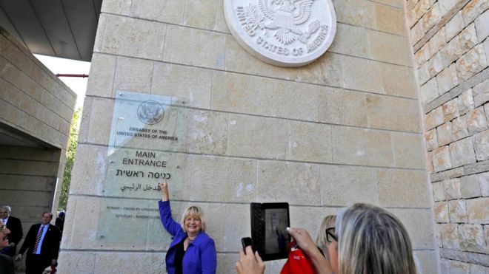

Slide 19
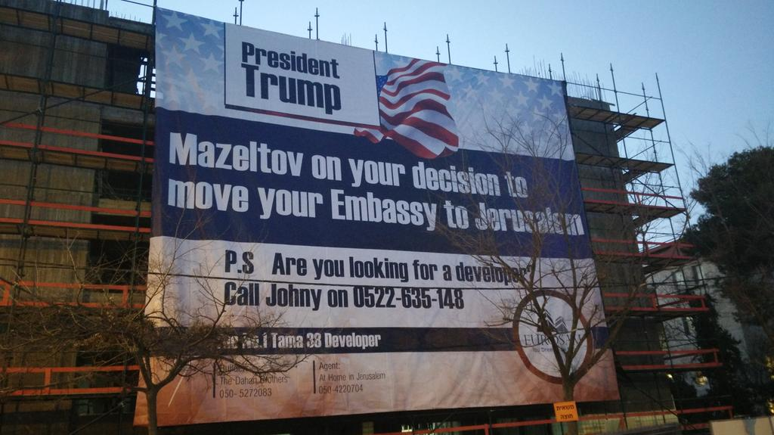

Slide 20
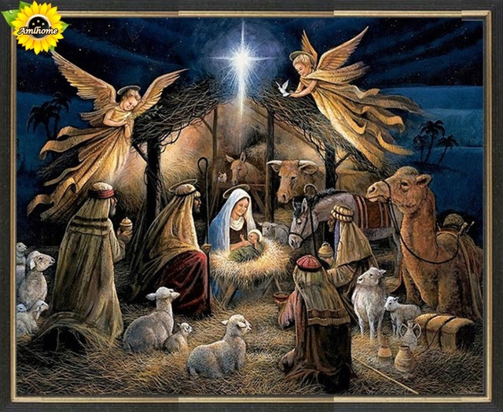
2,000 years ago/2,000 年前
Sign 4/徵兆4

Slide 21
¹當希律王的時候，耶穌生在猶太的伯利恆。有幾個博士從東方來到耶路撒冷，說：²那生下來作猶太人之王的在那裡？我們在東方看見他的星，特來拜他。³希律王聽見了，就心裡不安；耶路撒冷合城的人也都不安。⁴他就召齊了祭司長和民間的文士，問他們說：基督當生在何處？⁵他們回答說：在猶太的伯利恆。因為有先知記著，說：⁶猶大地的伯利恆阿，你在猶大諸城中並不是最小的；因為將來有一位君王要從你那裡出來，牧養我以色列民。【太 2:1~6】 ¹Now after Jesus was born in Bethlehem of Judea in the days of Herod the king, behold, wise men from the east came to Jerusalem, ²saying, "Where is he who has been born king of the Jews? For we saw his star when it rose and have come to worship him." ³When Herod the king heard this, he was troubled, and all Jerusalem with him; ⁴and assembling all the chief priests and scribes of the people, he inquired of them where the Christ was to be born. ⁵They told him, "In Bethlehem of Judea, for so it is written by the prophet: ⁶"' And you, O Bethlehem, in the land of Judah, are by no means least among the rulers of Judah; for from you shall come a ruler who will shepherd my people Israel.'" 【Matt 2:1~6】

Slide 22
⁸在伯利恆之野地裡有牧羊的人，夜間按著更次看守羊群。⁹有主的使者站在他們旁邊，主的榮光四面照著他們；牧羊的人就甚懼怕。¹⁰那天使對他們說：不要懼怕！我報給你們大喜的信息，是關乎萬民的；¹¹因今天在大衛的城裡，為你們生了救主，就是主基督。¹²你們要看見一個嬰孩，包著布，臥在馬槽裡，那就是記號了。¹³忽然，有一大隊天兵同那天使讚美神說：¹⁴在至高之處榮耀歸與神！在地上平安歸與他所喜悅的人（有古卷作：喜悅歸與人）！【路 2:8~14】 ⁸And in the same region there were shepherds out in the field, keeping watch over their flock by night. ⁹And an angel of the Lord appeared to them, and the glory of the Lord shone around them, and they were filled with fear. ¹⁰And the angel said to them, "Fear not, for behold, I bring you good news of a great joy that will be for all the people. ¹¹For unto you is born this day in the city of David a Savior, who is Christ the Lord. ¹²And this will be a sign for you: you will find a baby wrapped in swaddling cloths and lying in a manger." ¹³And suddenly there was with the angel a multitude of the heavenly host praising God and saying, ¹⁴" Glory to God in the highest, and on earth peace among those with whom he is pleased!" 【Luke 2:8~14】

Slide 23
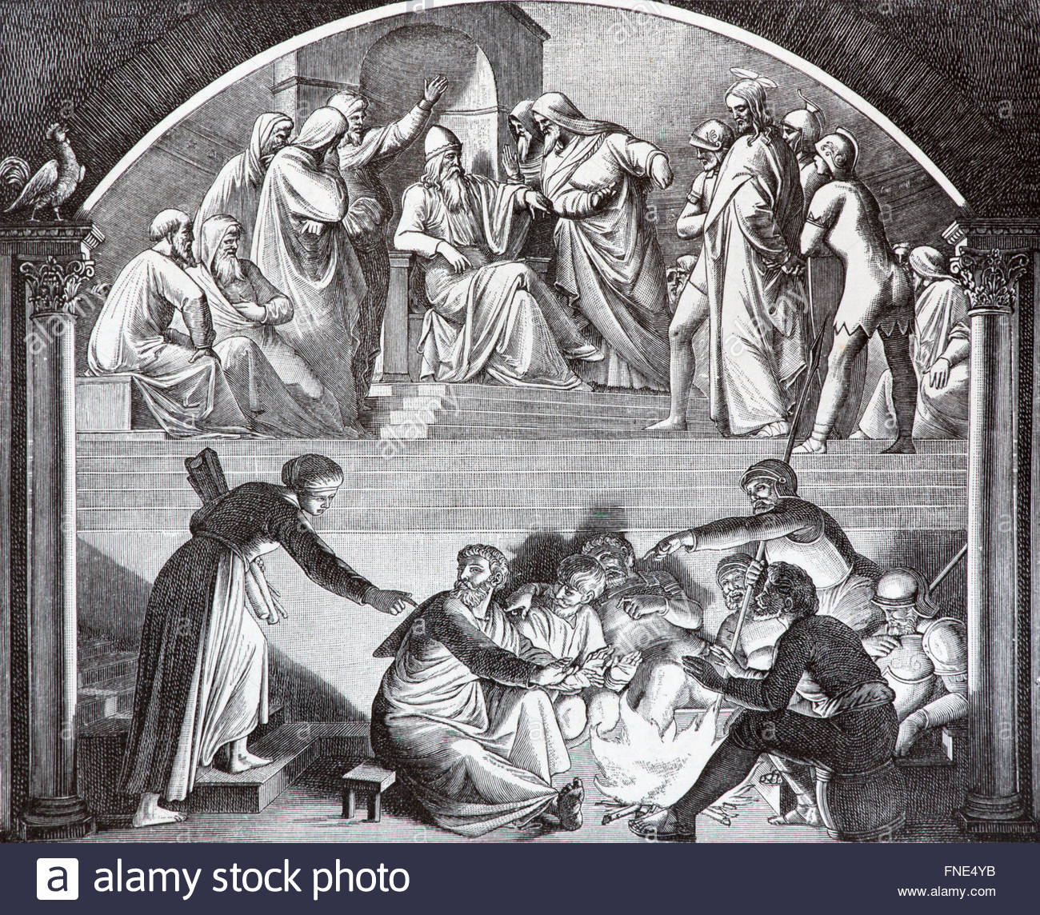
I. Signs of the Time, Actions of the Time 這時代的徵兆, 這時代的行動
Sign 5/徵兆5
33 years later/33年後

Slide 24
⁵⁷拿耶穌的人把他帶到大祭司該亞法那裡去；文士和長老已經在那裡聚會。⁵⁸彼得遠遠的跟著耶穌，直到大祭司的院子，進到裡面，就和差役同坐，要看這事到底怎樣。【太 26:57~58】 ⁵⁷Then those who had seized Jesus led him to Caiaphas the high priest, where the scribes and the elders had gathered. ⁵⁸And Peter was following him at a distance, as far as the courtyard of the high priest, and going inside he sat with the guards to see the end. 【Matt 26:57~58】

Slide 25
³⁴耶穌說：我實在告訴你，今夜雞叫以先，你要三次不認我。【太 26:34】
³⁴Jesus said to him, ""Truly, I tell you, this very night, before the rooster crows, you will deny me three times."" 【Matt 26:34】

Slide 26
⁷⁴彼得就發咒起誓的說：我不認得那個人。立時，雞就叫了。⁷⁵彼得想起耶穌所說的話：雞叫以先，你要三次不認我。他就出去痛哭。^{27:1}到了早晨，眾祭司長和民間的長老大家商議要治死耶穌，²就把他捆綁，解去，交給巡撫彼拉多。【太 26:74~27:2】 ⁷⁴Then he began to invoke a curse on himself and to swear, "I do not know the man." And immediately the rooster crowed. ⁷⁵And Peter remembered the saying of Jesus, ""Before the rooster crows, you will deny me three times." "And he went out and wept bitterly. ^{27:1}When morning came, all the chief priests and the elders of the people took counsel against Jesus to put him to death. ²And they bound him and led him away and delivered him over to Pilate the governor. 【Matt 26:74~27:2】

Slide 27
Signs of the Time! Actions of the Time!
這時代的徵兆, 這時代的行動!

Slide 28
II. Be Brave, Don’t be afraid! 要勇敢, 不要害怕!
1. Peter at Caiaphas’. 彼得在該亞法的地方.
2. Israelites in Negev. 以色列人在南地.
3. Temple building in Haggai’s time. 哈該時期建殿.
²萬軍之耶和華如此說：這百姓說，建造耶和華殿的時候尚未來到。【該 1:2】 ²"Thus says the Lord of hosts: These people say the time has not yet come to rebuild the house of the Lord." 【Hag 1:2】

Slide 29
4. Church time/教會時期
God’s election神的揀選.

Slide 30
III. Expect reward from God, not a generation too early. 期待神的獎賞, 但不能早一個世代!
Future Eternal Life 將來永恆的生命
²¹十二個門是十二顆珍珠，每門是一顆珍珠。城內的街道是精金，好像明透的玻璃。【啟 21:21】 ²¹And the twelve gates were twelve pearls, each of the gates made of a single pearl, and the street of the city was pure gold, transparent as glass. 【Rev 21:21】

Slide 31
III. Expect reward from God, not a generation too early. 期待神的獎賞, 但不能早一個世代!
Current Temporal Life 現在暫時的生命
²傳道者說：虛空的虛空，虛空的虛空，凡事都是虛空。³人一切的勞碌，就是他在日光之下的勞碌，有甚麼益處呢？【傳 1:2~3】 ²Vanity of vanities, says the Preacher, vanity of vanities! All is vanity. ³What does man gain by all the toil at which he toils under the sun? 【Eccl 1:2~3】

Slide 32
¹⁶當時有一個出名的囚犯叫巴拉巴。¹⁷眾人聚集的時候，彼拉多就對他們說：你們要我釋放那一個給你們？是巴拉巴呢？是稱為基督的耶穌呢？¹⁸巡撫原知道他們是因為嫉妒才把他解了來。【太 27:16~18】 ¹⁶And they had then a notorious prisoner called Barabbas. ¹⁷So when they had gathered, Pilate said to them, "Whom do you want me to release for you: Barabbas, or Jesus who is called Christ?" ¹⁸For he knew that it was out of envy that they had delivered him up. 【Matt 27:16~18】

Slide 33
⁵⁸所以，我親愛的弟兄們，你們務要堅固，不可搖動，常常竭力多做主工；因為知道，你們的勞苦在主裡面不是徒然的。【林前 15:58】
⁵⁸Therefore, my beloved brothers, be steadfast, immovable, always abounding in the work of the Lord, knowing that in the Lord your labor is not in vain. 【1Cor 15:58】

Slide 34
Signs of the Time 時代的徵兆

Slide 35
Signs of the Time 時代的徵兆
A. He came as a baby without any defect. 完美的嬰孩.
B. He came as a baby without any demand. 沒有任何要求的嬰孩.
C. He came as a baby without any defense. 沒有任何防衛能力的嬰孩.

Slide 36
Actions of the Time 時代的行動
What is your action?
你的行動是甚麼?

