Slide 1
不再定罪
Romans 8:1-4
6/30/2019
Rev. Joseph Chang
BOLGPC 爾灣大公園靈糧堂

Slide 2
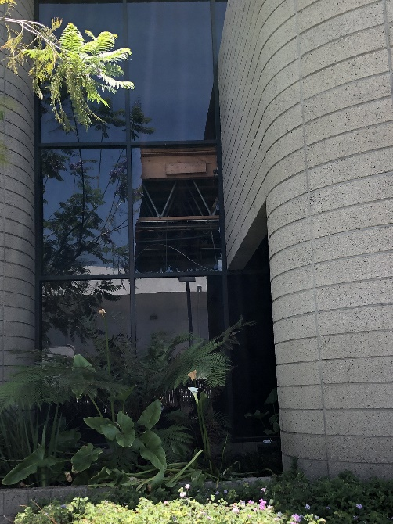
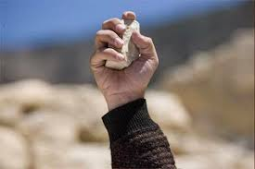
Illustration 2:
➔
➔

Slide 3
➔我們心中的感覺就是Condemnation.
The feeling in our hearts is condemnation.
➔
➔
這就是condemnation. 我自己定罪自己
This is condemnation. I am condemning myself.

Slide 5
讓我們來讀羅馬書8:1-4這一段對基督徒很重
要的信息:
Let us read the message that is important to
Christians in Romans 8:1-4:

Slide 6
¹如今，那些在基督耶穌裡的就不定罪了。²因為賜生命聖靈的律，在基督耶穌裡釋放了我，使我脫離罪和死的律了。³律法既因肉體軟弱，有所不能行的，神就差遣自己的兒子，成為罪身的形狀，作了贖罪祭，在肉體中定了罪案，⁴使律法的義成就在我們這不隨從肉體、只隨從聖靈的人身上。【羅 8:1~4】 ¹There is therefore now no condemnation for those who are in Christ Jesus. ²For the law of the Spirit of life has set you free in Christ Jesus from the law of sin and death. ³For God has done what the law, weakened by the flesh, could not do. By sending his own Son in the likeness of sinful flesh and for sin, he condemned sin in the flesh, ⁴in order that the righteous requirement of the law might be fulfilled in us, who walk not according to the flesh but according to the Spirit. 【Rom 8:1~4】

Slide 7
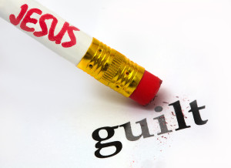
I. Freedom from the law of sin and death.
從罪和死的律上得到自由了.

Slide 8
保羅在和罪的掙扎中這樣子說:
Paul said this in his struggle with sins:
²⁴我真是苦阿！誰能救我脫離這取死的身體呢？²⁵感謝神，靠著我們的主耶穌基督就能脫離了。這樣看來，我以內心順服神的律，我肉體卻順服罪的律了。【羅 7:24~25】
²⁴Wretched man that I am! Who will deliver me from this body of death? ²⁵Thanks be to God through Jesus Christ our Lord! So then, I myself serve the law of God with my mind, but with my flesh I serve the law of sin. 【Rom 7:24~25】

Slide 9
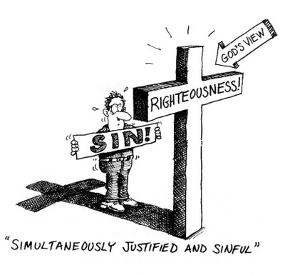
但是上帝是怎麼樣看我們的呢?
However, how does God view us?
➔上帝看我們是看我們將來得到復活身體無罪的樣式.
God views us as a form of the resurrection of our bodies from sin and death.

Slide 10
保羅從主耶穌的眼光來看我們自己. 他就說,
Paul looked at us from the perspective of the Lord Jesus.
He said,
¹如今，那些在基督耶穌裡的就不定罪了。²因為賜生命聖靈的律，在基督耶穌裡釋放了我，使我脫離罪和死的律了。【羅 8:1~2】 ¹There is therefore now no condemnation for those who are in Christ Jesus. ²For the law of the Spirit of life has set you free in Christ Jesus from the law of sin and death. 【Rom 8:1~2】

Slide 11
➔教會鼓勵大家做見證
The church encourages everyone to share his personal
testimony with others.
➔
我不需要有定罪. 我不需要每一天活在罪惡感之中.
I don't need to be condemned. I don't need to live in guilt every day.

Slide 12
➔能夠不活在罪惡感之中是對自己很快樂的一件事情.
Being able not to live in guilt is a very happy thing for
yourself.
➔能夠不活在罪惡感之中, 對別人也是很快樂的一件事情.
Being able not to live in guilt is also a very happy thing for
others.
➔因為會定罪自己的人, 也是很會定罪別人的人!
It is because people who will condemn themselves will
also condemn others!

Slide 13
Illustration 3:
我們的行為, 有一種防衛機制叫做Projection. 我們把自己的弱點投射到旁邊的人的身上, 而有很大的反應.
Projection is a psychological defense mechanism in which individuals attribute characteristics they find unacceptable in themselves to another person.

Slide 14
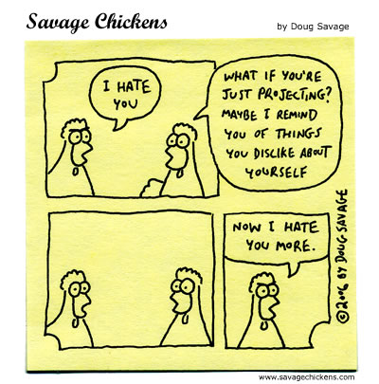

Slide 15
II. We lived in condemnation, but now in love.
過去我們是活在苛責之中, 現在我們是活在愛之中.
保羅用了一個羅馬上流社會的一個例子.
Paul used an example of a Roman upper class to illustrate
the point.
²⁴這樣，律法是我們訓蒙的師傅，引我們到基督那裡，使我們因信稱義。²⁵但這因信得救的理既然來到，我們從此就不在師傅的手下了。【加 3:24~25】 ²⁴So then, the law was our guardian until Christ came, in order that we might be justified by faith. ²⁵But now that faith has come, we are no longer under a guardian, 【Gal 3:24~25】

Slide 16
➔所以神派聖靈來住在我們的心裡. 所以保羅說,
Therefore, God sent the Holy Spirit to live in our hearts.
So Paul said,
¹⁵你們所受的，不是奴僕的心，仍舊害怕；所受的，乃是兒子的心，因此我們呼叫：阿爸！父！¹⁶聖靈與我們的心同證我們是神的兒女；【羅 8:15~16】 ¹⁵For you did not receive the spirit of slavery to fall back into fear, but you have received the Spirit of adoption as sons, by whom we cry, "Abba! Father!" ¹⁶The Spirit himself bears witness with our spirit that we are children of God, 【Rom 8:15~16】

Slide 17
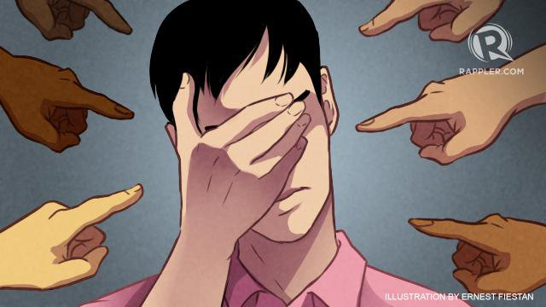
Illustration 4:
我們要避免拆毀上帝辛辛苦苦建立起來的根基.
We must avoid tearing down the foundations that God has
worked hard to build.

Slide 18
➔我們要學習, “在基督裡面沒有了定罪” 讓我們不要去定
罪別人, 但是去造就他, 讓他能夠愈來愈好. 愈來愈像上
帝的孩子.
We have to learn, “Therefore there is no condemnation to
those who are in Christ Jesus.” Let us not condemn others,
but make them better and better, and more and more like
the children of God.

Slide 19
Illustration 5:
⁵我第八天受割禮；我是以色列族、便雅憫支派的人，是希伯來人所生的希伯來人。就律法說，我是法利賽人；⁶就熱心說，我是逼迫教會的；就律法上的義說，我是無可指摘的。⁷只是我先前以為與我有益的，我現在因基督都當作有損的。⁸不但如此，我也將萬事當作有損的，因我以認識我主基督耶穌為至寶。我為他已經丟棄萬事，看作糞土，為要得著基督；【腓 3:5~8】 ⁵circumcised on the eighth day, of the people of Israel, of the tribe of Benjamin, a Hebrew of Hebrews; as to the law, a Pharisee; ⁶as to zeal, a persecutor of the church; as to righteousness, under the lawblameless. ⁷But whatever gain I had, I counted as loss for the sake of Christ. ⁸Indeed, I count everything as loss because of the surpassing worth of knowing Christ Jesus my Lord. For his sake I have suffered the loss of all things and count them as rubbish, in order that I may gain Christ 【Phil 3:5~8】

Slide 20
III. 在愛的關係中, 一點一點的成長.
Growing little by little in the relationship of love
Illustration 6:
⁴使律法的義成就在我們這不隨從肉體、只隨從聖靈的人身上。【羅 8:4】 ⁴in order that the righteous requirement of the law might be fulfilled in us, who walk not according to the flesh but according to the Spirit. 【Rom 8:4】

Slide 21
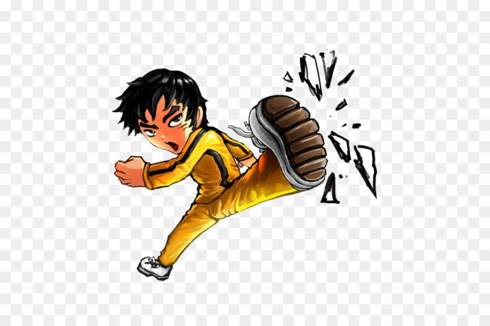
Conclusion
Illustration 7:
➔
神不condemn 我們, 因為在耶穌裡面, 神是化腐朽為神奇的神.
God does not condemn us because in Jesus God can turn bad into good.

