Slide 1
Bring Up Your Children
養大你的兒女
1/12/2020
Rev. Joseph Chang
BOLGPC 爾灣大公園靈糧堂

Slide 2
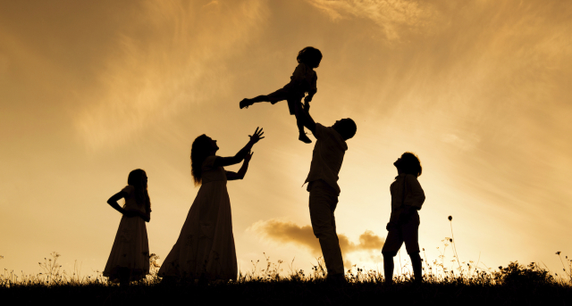
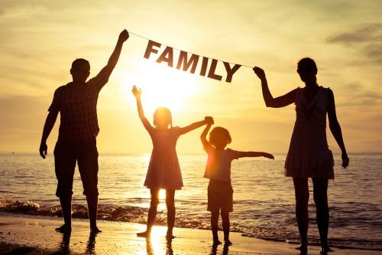
我們將有三個家庭來分享這個重要主題。
We are going to have three families share
this important topic.

Slide 3
今天，我們將專注於三個重要領域：
Today, we are going to focus on three
important areas:

Slide 4
I. Child Rearing is not for the coward.
養大兒女不是懦夫的工作.

Slide 5
Illustration 1:

Slide 6
²⁴不忍用杖打兒子的，是恨惡他；疼愛兒子的，隨時管教。【箴 13:24】 ²⁴Whoever spares the rod hates his son, but he who loves him is diligent to discipline him. 【Prov 13:24】

Slide 7
¹³不可不管教孩童；你用杖打他，他必不至於死。¹⁴你要用杖打他，就可以救他的靈魂免下陰間。 【箴 23:13~14】 ¹³Do not withhold discipline from a child; if you strike him with a rod, he will not die. ¹⁴If you strike him with the rod, you will save his soul from Sheol. 【Prov 23:13~14】

Slide 8
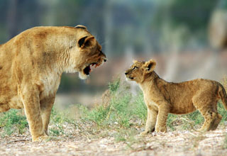
➔管教不是給懦夫的, 是給勇敢的父母的.
Discipline is not for cowards, but for brave parents.

Slide 9
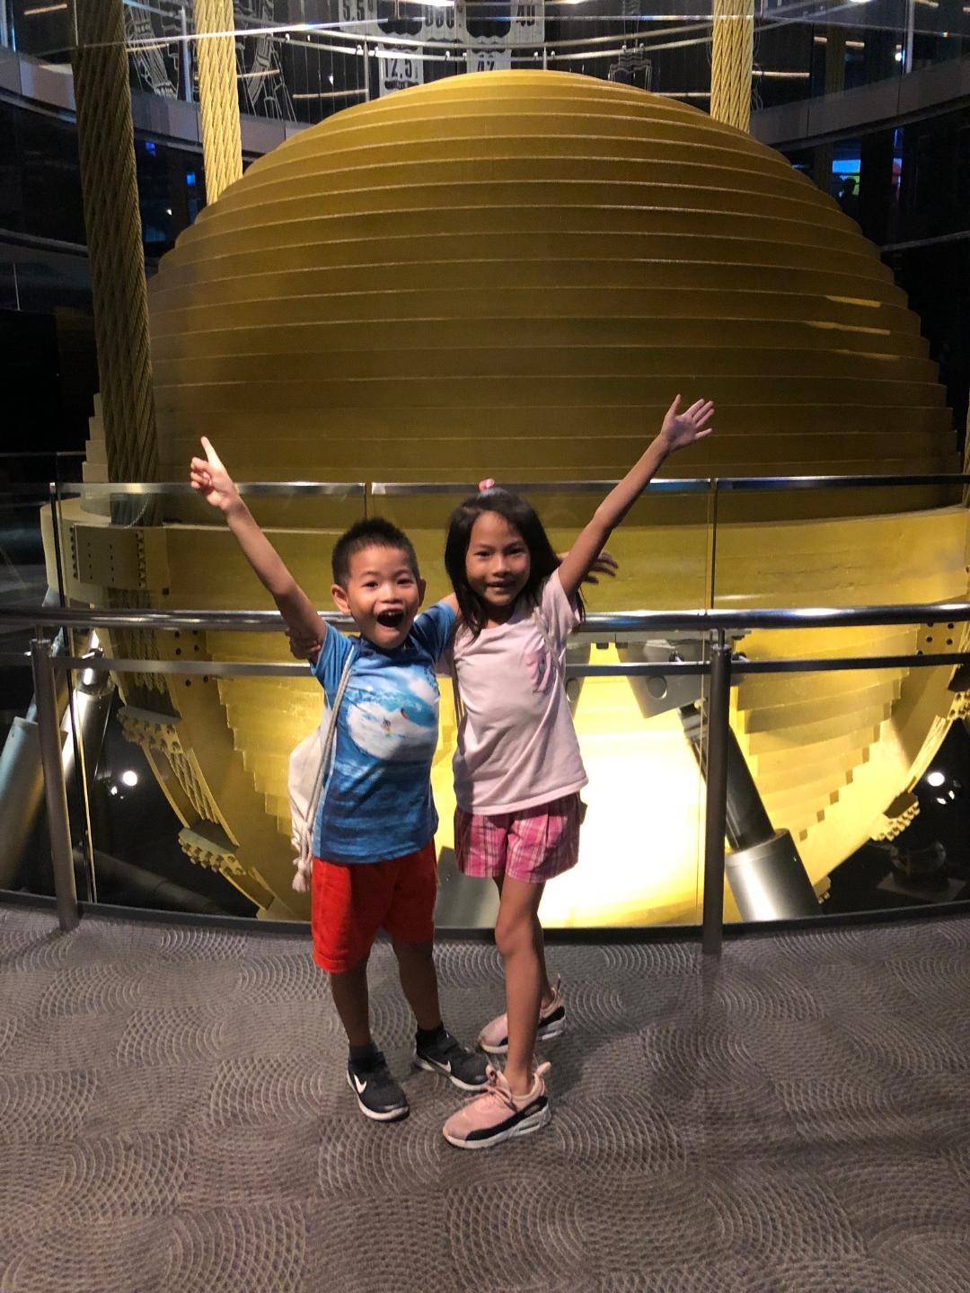
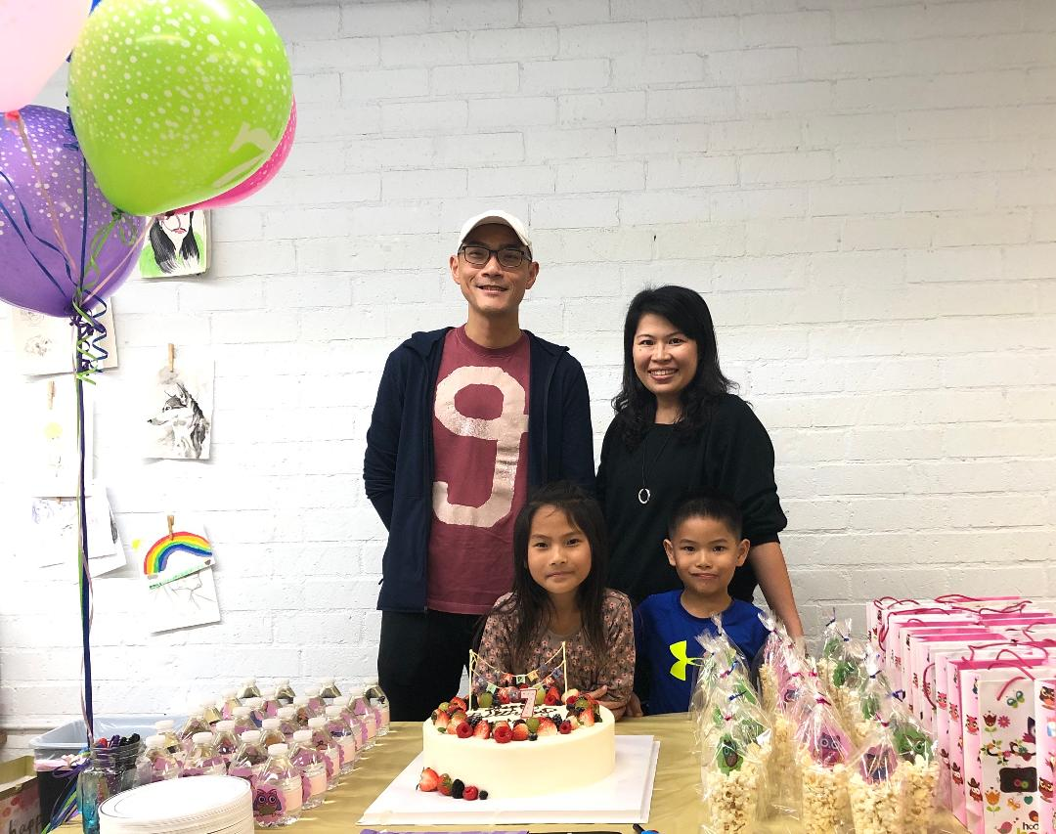
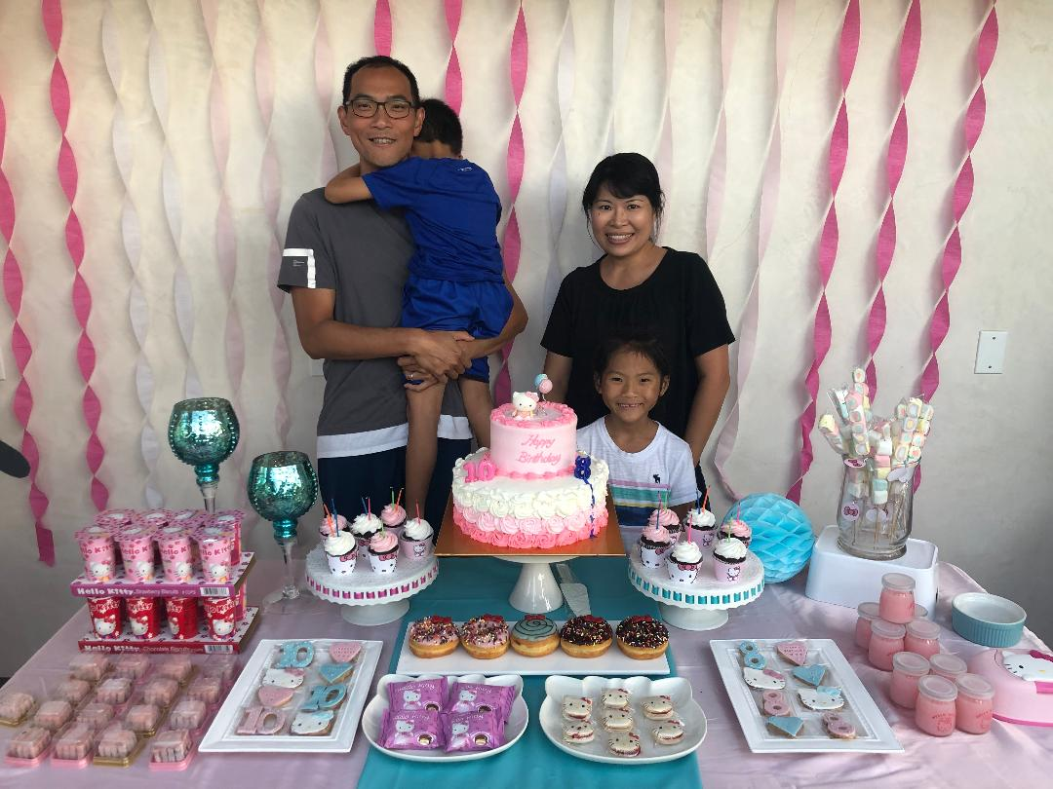
Testimony: Albert & Niki Lin

Slide 10
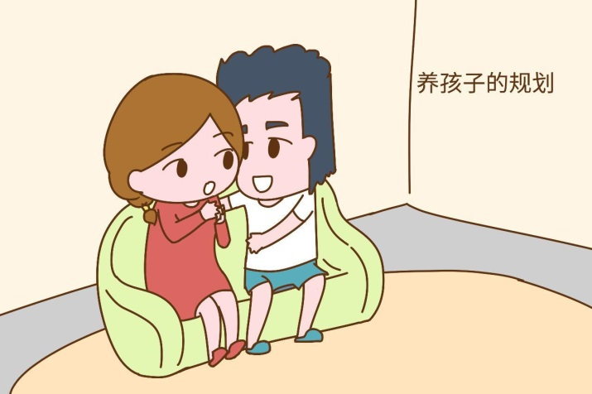
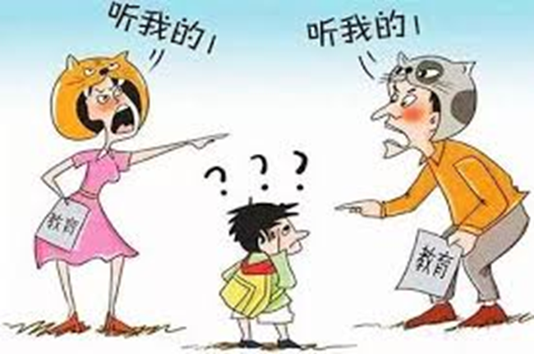
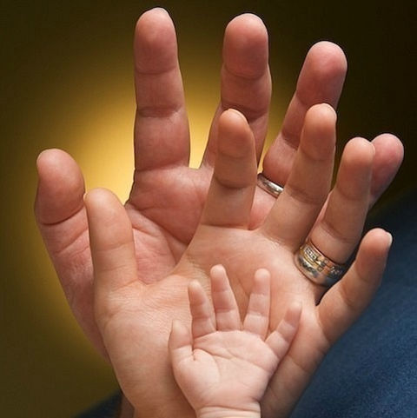
II. Wives, follow your husbands’ direction.
太太們,要跟從丈夫們的方向.
☒
☑

Slide 11
Testimony: Howard & Ling Chen/陳家豪, 高淑玲.

Slide 12
●
又對女人說：我必多多加增你懷胎的苦楚；你生產兒女必多受苦楚。你必戀慕你丈夫；你丈夫必管轄你。
【創3:16】
Unto the woman he said, I will greatly multiply thy sorrow and thy conception; in sorrow thou shalt bring forth children; and thy desire shall be to thy husband, and he shall rule over thee. 【Genesis 3:16】
●
你們作丈夫的，要愛你們的妻子，不可苦待他們。
【歌羅西3:19】
Husbands, love your wives and do not be harsh with them.

Slide 13
●
他 必 使 父 親 的 心 轉 向 兒 女 ， 兒 女 的 心 轉 向 父 親 ， 免 得 我 來 咒 詛 遍 地 。【瑪 拉 基 書 4:5-6】
And he will turn the hearts of fathers to their children and the hearts of children to their fathers,
lest I come and strike the land with a decree of utter destruction.” 【Malachi 4: 5-6】
●
你們作妻子的，當順服自己的丈夫，如同順服主。
【以弗所書5:22】
Wives, submit yourselves to your own husbands as you do to the Lord. 【 Ephesians 5:22】

Slide 15
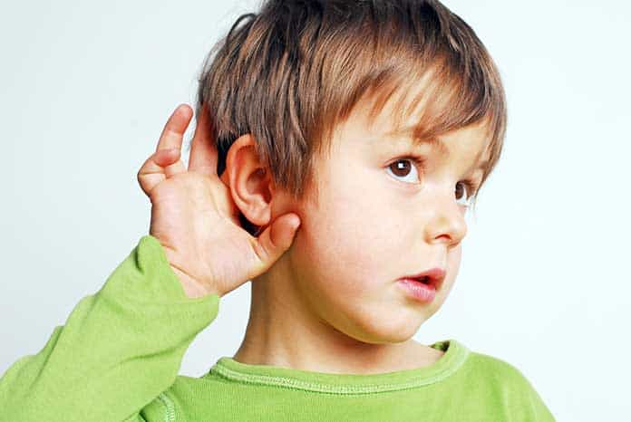
III. Help Your Children to Hear the Voice of God.
幫助你的孩子聽到神的聲音.

Slide 16
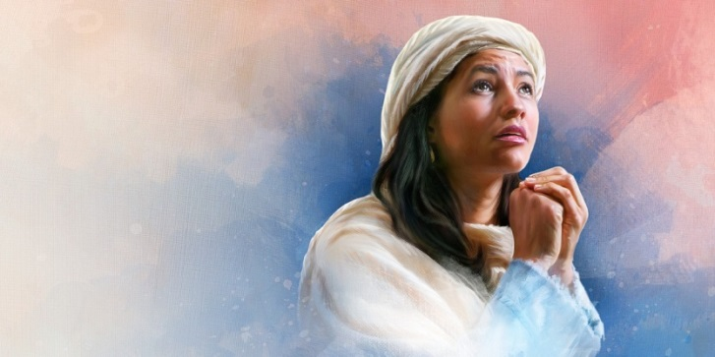
¹⁰哈拿心裡愁苦，就痛痛哭泣，祈禱耶和華，¹¹許願說：萬軍之耶和華啊，你若垂顧婢女的苦情，眷念不忘婢女，賜我一個兒子，我必使他終身歸與耶和華，不用剃頭刀剃他的頭。
【撒上 1:10~11】 ¹⁰She was deeply distressed and prayed to the Lord and wept bitterly. ¹¹And she vowed a vow and said, "O Lord of hosts, if you will indeed look on the affliction of your servant and remember me and not forget your servant, but will give to your servant a son, then I will give him to the Lord all the days of his life, and no razor shall touch his head." 【1Sam 1:10~11】

Slide 17
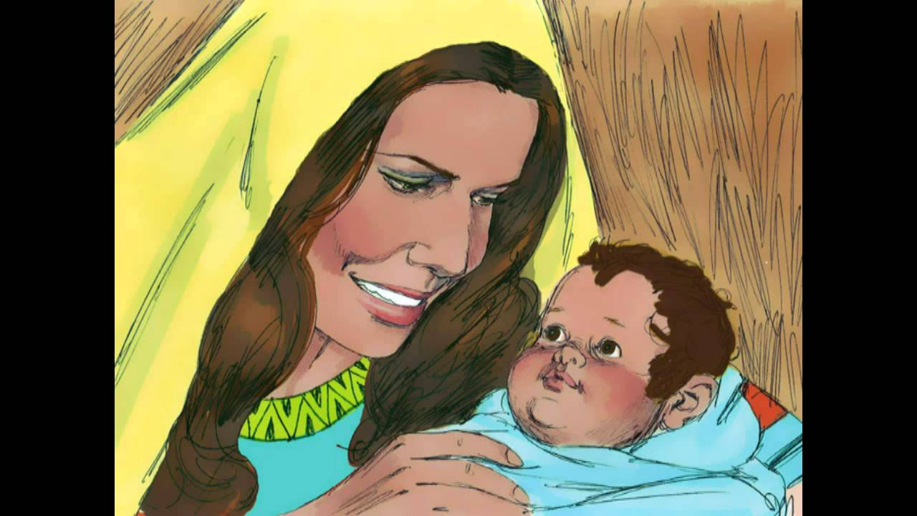
²⁰哈拿就懷孕。日期滿足，生了一個兒子，給他起名叫撒母耳，說：這是我從耶和華那裡求來的。
【撒上 1:20】 ²⁰And in due time Hannah conceived and bore a son, and she called his name Samuel, for she said, "I have asked for him from the Lord." 【1Sam 1:20】

Slide 18
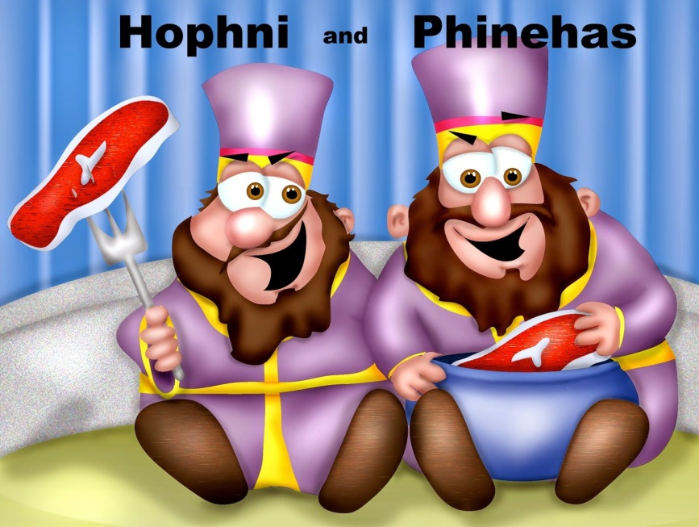
¹²以利的兩個兒子是惡人，不認識耶和華。【撒上 2:12】 ¹²Now the sons of Eli were worthless men. They did not know the Lord. 【1Sam 2:12】

Slide 19
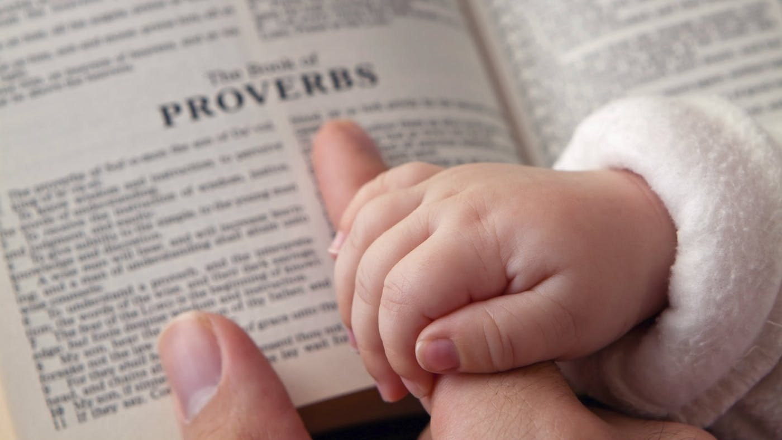
Q:Are we training our children to a point they can
hear the voice from God?
我們是否正在訓練我們的孩子可以聽見上 帝的
聲音？

Slide 20
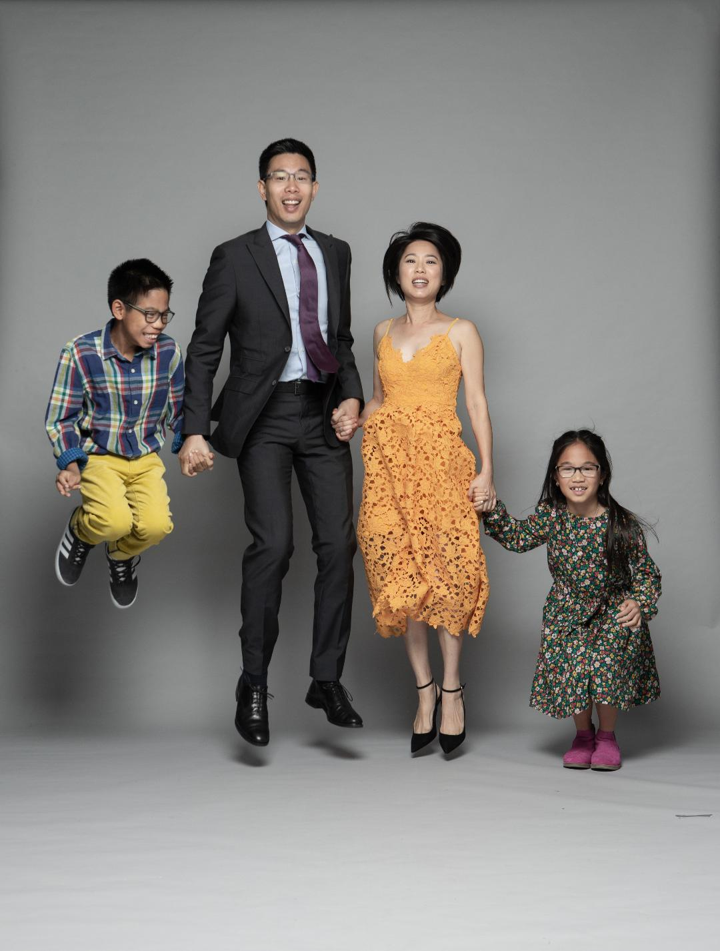
Testimony:
Dennis & Wendy Hwang

