Slide 1
20/20
2 Peter 1:3-11
2/2/2020
Rev. Joseph Chang
BOLGPC 爾灣大公園靈糧堂

Slide 3
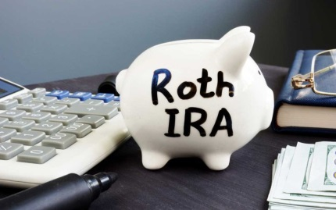
Illustration 1:
現在市值是 $4,462. 63%的增值.
The current market cap is $ 4,462,
63% value added.
now @227.62
now @$57.09
$32.98
$158.58
4/25/2017
54 shares
台積電TSM
5/25/2017
5 shares
雷神Raytheon
當時投資是$2,600
The investment was $ 2,600.

Slide 4
20/20
20/40

Slide 5
Illustration 2:

Slide 6
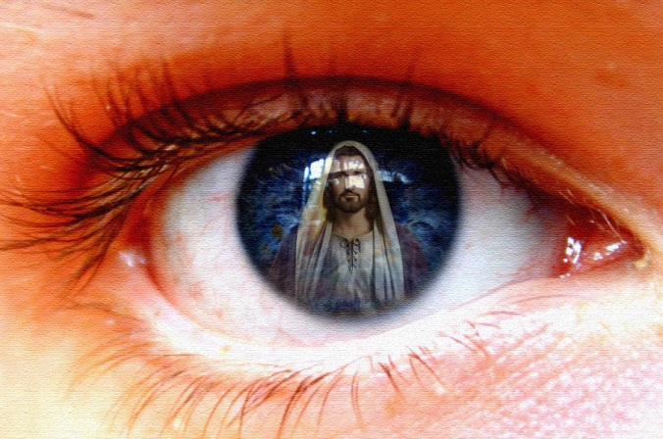
Q: 我們在屬靈上面是有20/20的眼力, 還是我們是20/100?
Is your spiritual vision 20/20?
屬靈的眼睛/ spiritual eyesight

Slide 7
彼得勉勵我們在屬靈上面要有20/20 的眼光:
Peter encourages us to have the spiritual vision 20/20.
³神的神能已將一切關乎生命和虔敬的事賜給我們，皆因我們認識那用自己榮耀和美德召我們的主。⁴因此，他已將又寶貴又極大的應許賜給我們，叫我們既脫離世上從情慾來的敗壞，就得與神的性情有分。
³His divine power has granted to us all things that pertain to life and godliness, through the knowledge of him who called us to his own glory and excellence, ⁴by which he has granted to us his precious and very great promises, so that through them you may become partakers of the divine nature, having escaped from the corruption that is in the world because of sinful desire.

Slide 8
⁵正因這緣故，你們要分外地殷勤；有了信心，又要加上德行；有了德行，又要加上知識；⁶有了知識，又要加上節制；有了節制，又要加上忍耐；有了忍耐，又要加上虔敬；⁷有了虔敬，又要加上愛弟兄的心；有了愛弟兄的心，又要加上愛眾人的心；
⁵For this very reason, make every effort to supplement your faith with virtue, and virtue with knowledge, ⁶and knowledge with self-control, and self-control with steadfastness, and steadfastness with godliness, ⁷and godliness with brotherly affection, and brotherly affection with love.

Slide 9
⁸你們若充充足足的有這幾樣，就必使你們在認識我們的主耶穌基督上不至於閒懶不結果子了。⁹人若沒有這幾樣，就是眼瞎，只看見近處的，忘了他舊日的罪已經得了潔淨。
⁸For if these qualities are yours and are increasing, they keep you from being ineffective or unfruitful in the knowledge of our Lord Jesus Christ. ⁹For whoever lacks these qualities is so nearsighted that he is blind, having forgotten that he was cleansed from his former sins.

Slide 10
¹⁰所以弟兄們，應當更加殷勤，使你們所蒙的恩召和揀選堅定不移。你們若行這幾樣，就永不失腳。¹¹這樣，必叫你們豐豐富富的得以進入我們主─救主耶穌基督永遠的國。【彼後 1:3~11】
¹⁰Therefore, brothers, be all the more diligent to make your calling and election sure, for if you practice these qualities you will never fall. ¹¹For in this way there will be richly provided for you an entrance into the eternal kingdom of our Lord and Savior Jesus Christ. 【2Pet 1:3~11】

Slide 12
7個步驟的存錢計劃 (Verses 5-8):
the 7-step saving plan( Verses 5-8):

Slide 13
I. 德行/ Goodness/ ἀρετήν (v. 5a)
⁹惟有你們是被揀選的族類，是有君尊的祭司，是聖潔的國度，是屬神的子民，要叫你們宣揚那召你們出黑暗入奇妙光明者的美德。【彼前 2:9】 ⁹But you are a chosen race, a royal priesthood, a holy nation, a people for his own possession, that you may proclaim the excellencies of him who called you out of darkness into his marvelous light. 【1Pet 2:9】

Slide 14
Illustration 3:
Howard & Ling Chen/陳家豪, 高淑玲.

Slide 15
II. 知識/Knowledge/γνῶσιν (v. 5b)
⁵正因這緣故，你們要分外地殷勤；有了信心，又要加上德行；有了德行，又要加上谷歌；【彼後 1:5】 ⁵For this very reason, make every effort to supplement your faith with virtue, and virtue with Google, 【2Pet 1:5】
→聖經上所寫的知識, 是讓你愈認識神, 也愈加的博學,
但是愈加的謙卑, 愈加的不會自己驕傲.
The knowledge written in the Bible is to make you know
more about God and become more knowledgeable.
However, you are humbler.

Slide 16
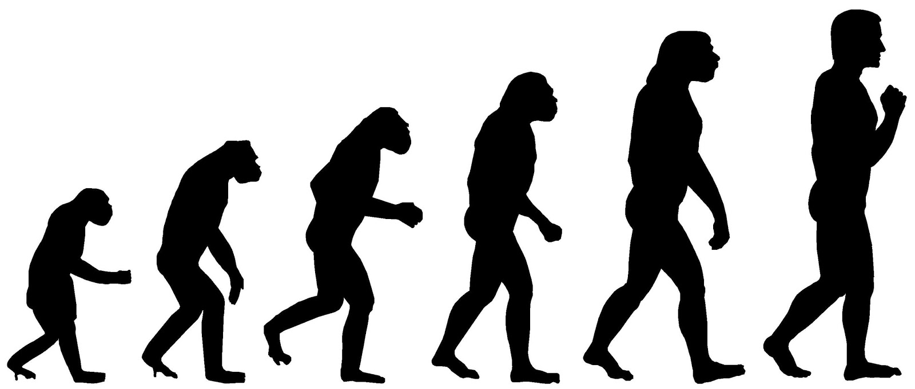
Illustration 5:
進化論/Evolution

Slide 17
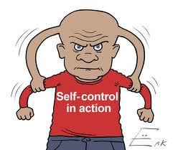
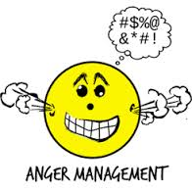
III. 節制/self-control/ἐγκράτειαν (v. 6a)
³²不輕易發怒的，勝過勇士；治服己心的，強如取城。【箴 16:32】 ³²Whoever is slow to anger is better than the mighty, and he who rules his spirit than he who takes a city. 【Prov 16:32】

Slide 18
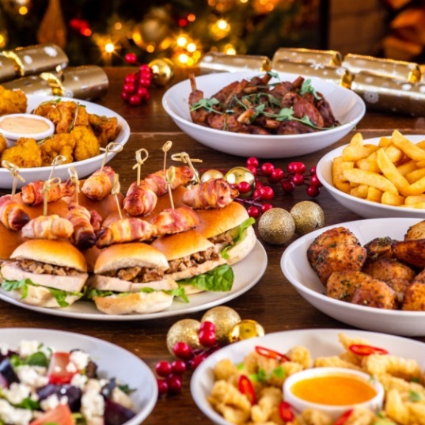
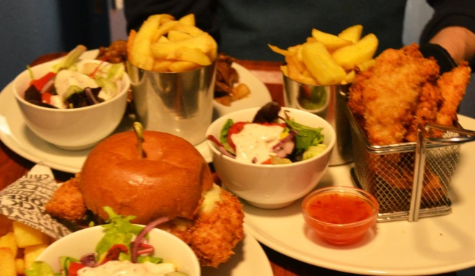
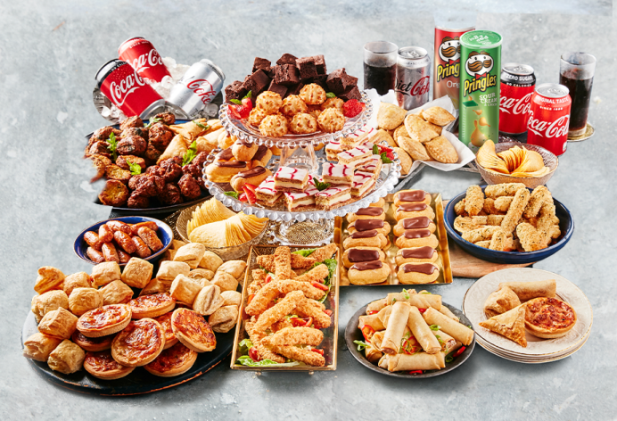
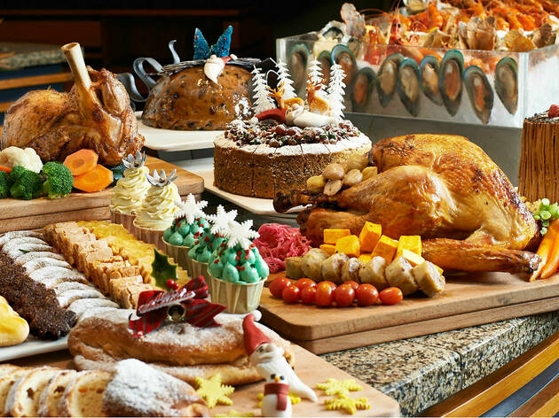
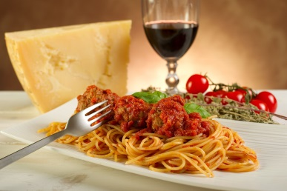
Illustration 6:

Slide 19
IV. 忍耐/Perseverance/ὑπομονήν (v. 6b)
忍耐和時間離不了關係.
因為許多的德行必須在長時間才能夠形成.
Perseverance is inseparable from time because many virtues must take a long time to form.

Slide 20
→30 歲開始儲蓄, 70歲退休: / Start saving at 30 and retire at 70:
每個月存$100. 8% interest / save $ 100 per month at 8% interest rate
Age | Plan 1 Principle, P | Plan 2 Principle, P | Interest Rate, r | Year, t | (1+r)^{t} | Plan 1 Yield | Plan 2 Yield
30 | $1,200 |  | 8% | 40 | 21.72 | $26,064
31 | $1,200 |  | 8% | 39 | 20.12 | $24,144
32 | $1,200 |  | 8% | 38 | 18.63 | $22,356
33 | $1,200 |  | 8% | 37 | 17.25 | $20,700
34 | $1,200 |  | 8% | 36 | 15.97 | $19,164
35 | $1,200 |  | 8% | 35 | 14.79 | $17,748
36 | $1,200 |  | 8% | 34 | 13.69 | $16,428
37 | $1,200 |  | 8% | 33 | 12.68 | $15,216
38 | $1,200 |  | 8% | 32 | 11.74 | $14,088
39 | $1,200 |  | 8% | 31 | 10.87 | $13,044
40 | $1,200 |  | 8% | 30 | 10.06 | $12,072
41 | $1,200 |  | 8% | 29 | 9.32 | $11,184
42 | $1,200 |  | 8% | 28 | 8.63 | $10,356
43 | $1,200 |  | 8% | 27 | 7.99 | $9,588
44 | $1,200 |  | 8% | 26 | 7.4 | $8,880
45 | $1,200 |  | 8% | 25 | 6.85 | $8,220
46 | $1,200 |  | 8% | 24 | 6.34 | $7,608
47 | $1,200 |  | 8% | 23 | 5.87 | $7,044
48 | $1,200 |  | 8% | 22 | 5.44 | $6,528

Slide 21
49 | $1,200 |  | 8% | 21 | 5.03 | $6,036
50 | $1,200 |  | 8% | 20 | 4.66 | $5,592
51 | $1,200 |  | 8% | 19 | 4.32 | $5,184
52 | $1,200 |  | 8% | 18 | 4 | $4,800
53 | $1,200 |  | 8% | 17 | 3.7 | $4,440
54 | $1,200 |  | 8% | 16 | 3.43 | $4,116
55 | $1,200 |  | 8% | 15 | 3.17 | $3,804
56 | $1,200 |  | 8% | 14 | 2.94 | $3,528
57 | $1,200 |  | 8% | 13 | 2.72 | $3,264
58 | $1,200 |  | 8% | 12 | 2.52 | $3,024
59 | $1,200 |  | 8% | 11 | 2.33 | $2,796
60 | $1,200 |  | 8% | 10 | 2.16 | $2,592
61 | $1,200 | $5,000 | 8% | 9 | 2 | $2,400 | $10,000
62 | $1,200 | $5,000 | 8% | 8 | 1.85 | $2,220 | $9,250
63 | $1,200 | $5,000 | 8% | 7 | 1.71 | $2,052 | $8,550
64 | $1,200 | $5,000 | 8% | 6 | 1.59 | $1,908 | $7,950
65 | $1,200 | $5,000 | 8% | 5 | 1.47 | $1,764 | $7,350
66 | $1,200 | $5,000 | 8% | 4 | 1.36 | $1,632 | $6,800
67 | $1,200 | $5,000 | 8% | 3 | 1.26 | $1,512 | $6,300
68 | $1,200 | $5,000 | 8% | 2 | 1.17 | $1,404 | $5,850
69 | $1,200 | $5,000 | 8% | 1 | 1.08 | $1,296 | $5,400
70 | $1,200 | $5,000 | 8% | 0 | 1 | $1,200 | $5,000
 | $49,200 | $50,000 |  |  |  | $336,996 | $72,450

Slide 22
Illustration 7:

Slide 23
Illustration 8:
Q: 有甚麼樣的好的品德可以有perseverance的方式學習的?
What kinds of good character can be learned in a perseverance
way?
→學習尊重人. Learn to respect people.
→學習聽人家講話. Learn to listen to others.
→為人家禱告. Pray for others.
→講話都講積極造就別人的話, 而不是消極悲觀的話.
Speak positively, not negatively.
→鼓勵自己的孩子, 讓他們知道你愛他們.
Encourage your children and let them know you love them.
→十一奉獻/tithe

Slide 24
V. 虔敬, godliness, εὐσέβειαν (v. 6c)
¹這一切既然都要如此銷化，你們為人該當怎樣聖潔，怎樣敬虔，¹²切切仰望神的日子來到。在那日，天被火燒就銷化了，有形質的都要被烈火鎔化。
【彼後 3:11~12】 ¹¹Since all these things are thus to be dissolved, what sort of people ought you to be in lives of holiness and godliness, ¹²waiting for and hastening the coming of the day of God, because of which the heavens will be set on fire and dissolved, and the heavenly bodies will melt as they burn! 【2Pet 3:11~12】

Slide 25
²⁷在神我們的父面前，那清潔沒有玷污的虔誠，就是看顧在患難中的孤兒寡婦，並且保守自己不沾染世俗。【雅 1:27】 ²⁷Religion that is pure and undefiled before God, and the Father, is this: to visit orphans and widows in their affliction, and to keep oneself unstained from the world. 【Jam 1:27】

Slide 26
VI. 愛弟兄的心, brotherly kindness, φιλαδελφίαν (v. 7a)
²²你們既因順從真理，潔淨了自己的心，以致愛弟兄沒有虛假，就當從心裡彼此切實相愛。（從心裡：有古卷作從清潔的心）【彼前 1:22】 ²² Having purified your souls by your obedience to the truth for a sincere brotherly love, love one another earnestly from a pure heart, 【1Pet 1:22】

Slide 27
VII. 愛, Love, ἀγάπην (v. 7b)
¹⁶「神愛世人，甚至將他的獨生子賜給他們，叫一切信他的，不至滅亡，反得永生。【約 3:16】 ¹⁶""For God so loved the world,that he gave his only Son, that whoever believes in him should not perish but have eternal life." 【John 3:16】

Slide 28
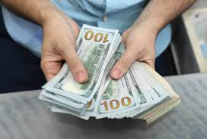
Illustration 9:
HOW TO GIVE?
1. 到South Coast Plaza 站在入口接待10,000人, 每一個人給$100 as Christmas gift of 2020.
Give 10,000 people each $ 100 as Christmas gift of 2020 at the South Coast Plaza
entrance.
2. 給一個需要的家庭, 讓他能夠用來生活20年左右.
Give it to a family in need so that it can support the family for about 20 years.
3. 資助幾個需要的學生, 讓他finish 他的學位, 可以供養自己的家庭.
Fund a few needy students to help them finish their degrees so that they will
be able to support their own families in the future.

Slide 29
Conclusion 結論
彼得告訴我們有七件事情我們要努力:
Peter tells us seven things we need to work on:
I. 德行/ Goodness/ ἀρετήν (v. 5a)
II. 知識/Knowledge/γνῶσιν (v. 5b)
III. 節制/self-control/ἐγκράτειαν (v. 6a)
IV. 忍耐/Perseverance/ὑπομονήν (v. 6b)
V. 虔敬, godliness, εὐσέβειαν (v. 6c)
VI. 愛弟兄的心, brotherly kindness, φιλαδελφίαν (v. 7a)
VII. 愛, Love, ἀγάπην (v. 7b)

