Slide 1
Give Me that Red Red Stuff
把那紅咚咚給我
Gen 25:27-34
2/23/2019
Rev. Joseph Chang
BOLGPC 爾灣大公園靈糧堂

Slide 2
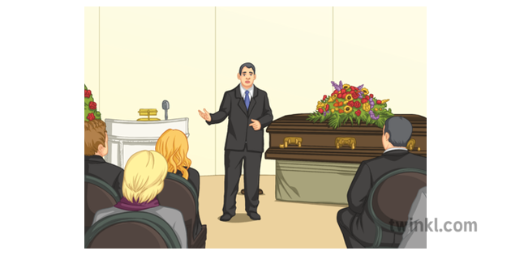
Illustration 1:

Slide 3
講故事時，有四種故事處理方式：
In telling a story, there are 4 modes to go about a story:
1. Description/描述/背景
2. Direct Narrative/直接敘述/旁白
3. Dramatic Narrative/戲劇性敘述/自白
4. Commentary/註解

Slide 4
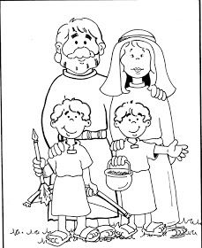
²⁷兩個孩子漸漸長大，以掃善於打獵，常在田野；雅各為人安靜，常住在帳棚裡。²⁸以撒愛以掃，因為常吃他的野味；利百加卻愛雅各。
²⁷When the boys grew up, Esau was a skillful hunter, a man of the field, while Jacob was a quiet man, dwelling in tents. ²⁸Isaac loved Esau because he ate of his game, but Rebekah loved Jacob.
(背景/Description)

Slide 5
²⁹有一天，雅各熬湯，以掃從田野回來累昏了。²⁹Once when Jacob was cooking stew, Esau came in from the field, and he was exhausted.
(旁白/Direct Narrative)

Slide 6
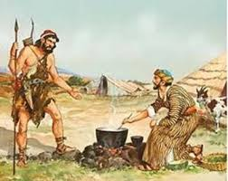
³⁰以掃對雅各說：我累昏了，求你把這紅湯給我喝。³⁰And Esau said to Jacob, "Let me eat some of that red stew, for I am exhausted!"
(自白/Dramatic Narrative)
因此以掃又叫以東(就是紅的意思)。(Therefore his name was called Edom.)
(註解/Commentary, 中文註解 “就是紅的意思” 不是聖經的原作)

Slide 7
³¹雅各說：你今日把長子的名分賣給我罷。³²以掃說：我將要死，這長子的名分於我有甚麼益處呢？³³雅各說：你今日對我起誓罷。
³¹Jacob said, "Sell me your birthright now." ³²Esau said, "I am about to die; of what use is a birthright to me?" ³³Jacob said, "Swear to me now.“
(自白/Dramatic Narrative)

Slide 8
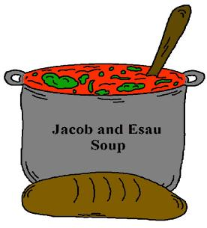
以掃就對他起了誓，把長子的名分賣給雅各。³⁴於是雅各將餅和紅豆湯給了以掃，以掃吃了喝了，便起來走了。
So he swore to him and sold his birthright to Jacob. ³⁴Then Jacob gave Esau bread and lentil stew, and he ate and drank and rose and went his way.
(旁白/Directive Narrative)
這就是以掃輕看了他長子的名分。
Thus Esau despised his birthright.
(註解/Commentary)

Slide 9
Exegetical Points釋經重點:
1. v. 27 וַיְהִי עֵשָׂו אִישׁ יֹדֵעַ צַיִד
以掃是一個知道野味的人, צַיִד- -game.
v. 29 וַיָּזֶד יַעֲקֹב נָזִיד
Boiling Jacob pottage, נָזִיד- -pottage, actually Esau is
Jacob’s game. זִיד--boiling, Jacob had a thought, a
presumptive thought, a thought boiling over the
confinement of the pot.

Slide 10
2. v. 30 הָאָדֹם הָאָדֹם הַזֶּה-הַלְעִיטֵנִי נָא מִן -
Stuff me with this Red Red stuff. Don’t take off the
double words, the repetition is the emphatic way of
showing his impulsiveness.
3. v. 35 וַיָּקָם וַיֵּלַךְ - וַיֹּאכַל וַיֵּשְׁתְּ --and he ate and drank and
raised up and walked away. The four verbs in consecutive
orders symbolizing the swift and fast motion. He is not
dying, he takes quick efficiency in finishing what his flesh
desires. This is simply having no regard of the spiritual
thing.

Slide 11
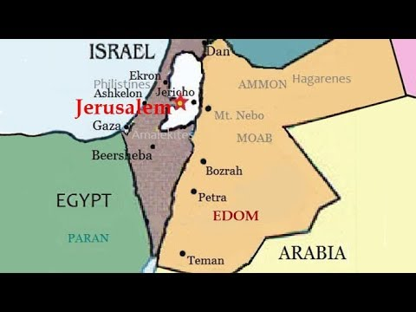
I. Therefore his name is called Edom/因此以掃又叫以東
→以掃的個性浮躁, 衝動(He is impulsive.), 連帶到整個國
家 “以東” 都是以以掃所講的話來命名.
Esau was impulsive. "Edom" was named after Esau's
words.

Slide 12
¹⁷王就吩咐左右的侍衛說：你們去殺耶和華的祭司；因為他們幫助大衛，又知道大衛逃跑，竟沒有告訴我。掃羅的臣子卻不肯伸手殺耶和華的祭司。¹⁸王吩咐多益說：你去殺祭司罷！以東人多益就去殺祭司，那日殺了穿細麻布以弗得的八十五人；¹⁹又用刀將祭司城挪伯中的男女、孩童、吃奶的，和牛、羊、驢盡都殺滅。 ¹⁷And the king said to the guard who stood about him, “Turn and kill the priests of the Lord, because their hand also is with David, and they knew that he fled and did not disclose it to me.” But the servants of the king would not put out their hand to strike the priests of the Lord. ¹⁸Then the king said to Doeg, “You turn and strike the priests.” And Doeg the Edomite turned and struck down the priests, and he killed on that day eighty-five persons who wore the linen ephod. ¹⁹And Nob, the city of the priests, he put to the sword; both man and woman, child and infant, ox, donkey and sheep, he put to the sword. (撒上1Sam22:17~19)

Slide 13
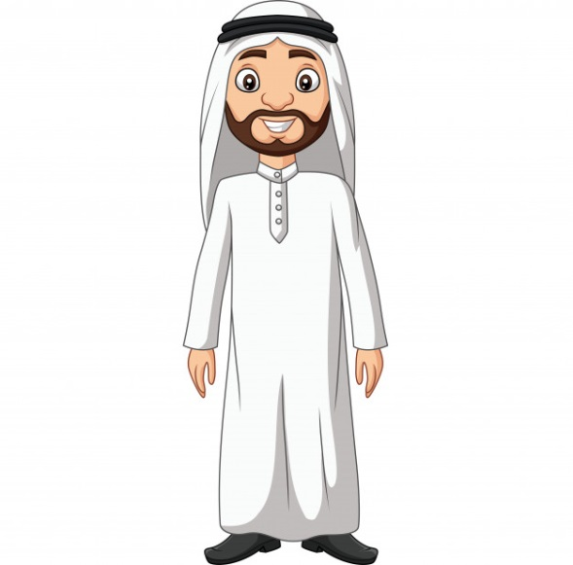
Illustration 2:

Slide 14
1)第一個聖經上注入阿拉伯人的血液的就是約坍Joktan
²⁵希伯生了兩個兒子，一個名叫法勒(法勒就是分的意思)，因為那時人就分地居住；法勒的兄弟名叫約坍。²⁶約坍生亞摩答、沙列、哈薩瑪非、耶拉、²⁷哈多蘭、烏薩、德拉、²⁸俄巴路、亞比瑪利、示巴、²⁹阿斐、哈腓拉、約巴，這都是約坍的兒子。³⁰他們所住的地方是從米沙直到西發東邊的山。【創 10:25~30】 ²⁵To Eber were born two sons: the name of the one was Peleg, for in his days the earth was divided, and his brother's name was Joktan. ²⁶Joktan fathered Almodad, Sheleph, Hazarmaveth, Jerah, ²⁷Hadoram, Uzal, Diklah, ²⁸Obal, Abimael, Sheba, ²⁹Ophir, Havilah, and Jobab; all these were the sons of Joktan. ³⁰The territory in which they lived extended from Mesha in the direction of Sephar to the hill country of the east. 【Gen 10:25~30】

Slide 15
2)第二個聖經上注入阿拉伯人的血液的就是以實瑪利Ishmael
¹²撒拉的使女埃及人夏甲給亞伯拉罕所生的兒子是以實瑪利。¹³以實瑪利兒子們的名字，按著他們的家譜記在下面。以實瑪利的長子是尼拜約，又有基達、亞德別、米比衫、¹⁴米施瑪、度瑪、瑪撒、¹⁵哈大、提瑪、伊突、拿非施、基底瑪。
¹²These are the generations of Ishmael, Abraham's son, whom Hagar the Egyptian, Sarah's servant, bore to Abraham. ¹³These are the names of the sons of Ishmael, named in the order of their birth: Nebaioth, the firstborn of Ishmael; and Kedar, Adbeel, Mibsam, ¹⁴Mishma, Dumah, Massa, ¹⁵Hadad, Tema, Jetur, Naphish, and Kedemah.

Slide 16
¹⁶這是以實瑪利眾子的名字，照著他們的村莊、營寨，作了十二族的族長。¹⁷以實瑪利享壽一百三十七歲，氣絕而死，歸到他列祖(原文作本民)那裡。¹⁸他子孫的住處在他眾弟兄東邊，從哈腓拉直到埃及前的書珥，正在亞述的道上。
【創 25:12~18】
¹⁶These are the sons of Ishmael and these are their names, by their villages and by their encampments, twelve princes according to their tribes. ¹⁷(These are the years of the life of Ishmael: 137 years. He breathed his last and died, and was gathered to his people.) ¹⁸They settled from Havilah to Shur, which is opposite Egypt in the direction of Assyria. He settled over against all his kinsmen. 【Gen 25:12~18】

Slide 17
3)第三個注入阿拉伯人血液的就是以掃/Esau.
⁸以掃就曉得他父親以撒看不中迦南的女子，⁹便往以實瑪利那裡去，在他二妻之外又娶了瑪哈拉為妻。他是亞伯拉罕兒子以實瑪利的女兒，尼拜約的妹子。
【創 28:8~9】 ⁸So when Esau saw that the Canaanite women did not please Isaac his father, ⁹Esau went to Ishmael and took as his wife, besides the wives he had, Mahalath the daughter of Ishmael, Abraham's son, the sister of Nebaioth.
【Gen 28:8~9】

Slide 18
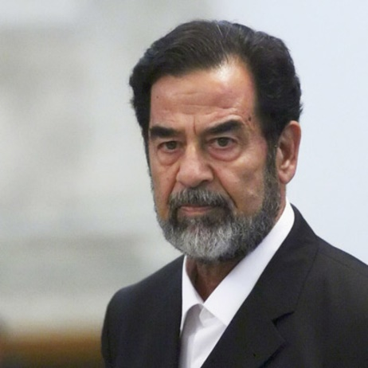
Illustration 3:
Saddam Hussein (1937-2006)
他是阿拉伯人

Slide 19
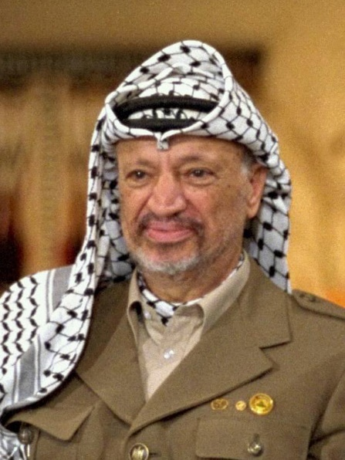
Illustration 4:
Yasser Arafat (1929-2004)
Full Name: Mohammed Yasser Abdel Rahman Abdel Raouf
Arafat al-Qudwa al-Husseini

Slide 20
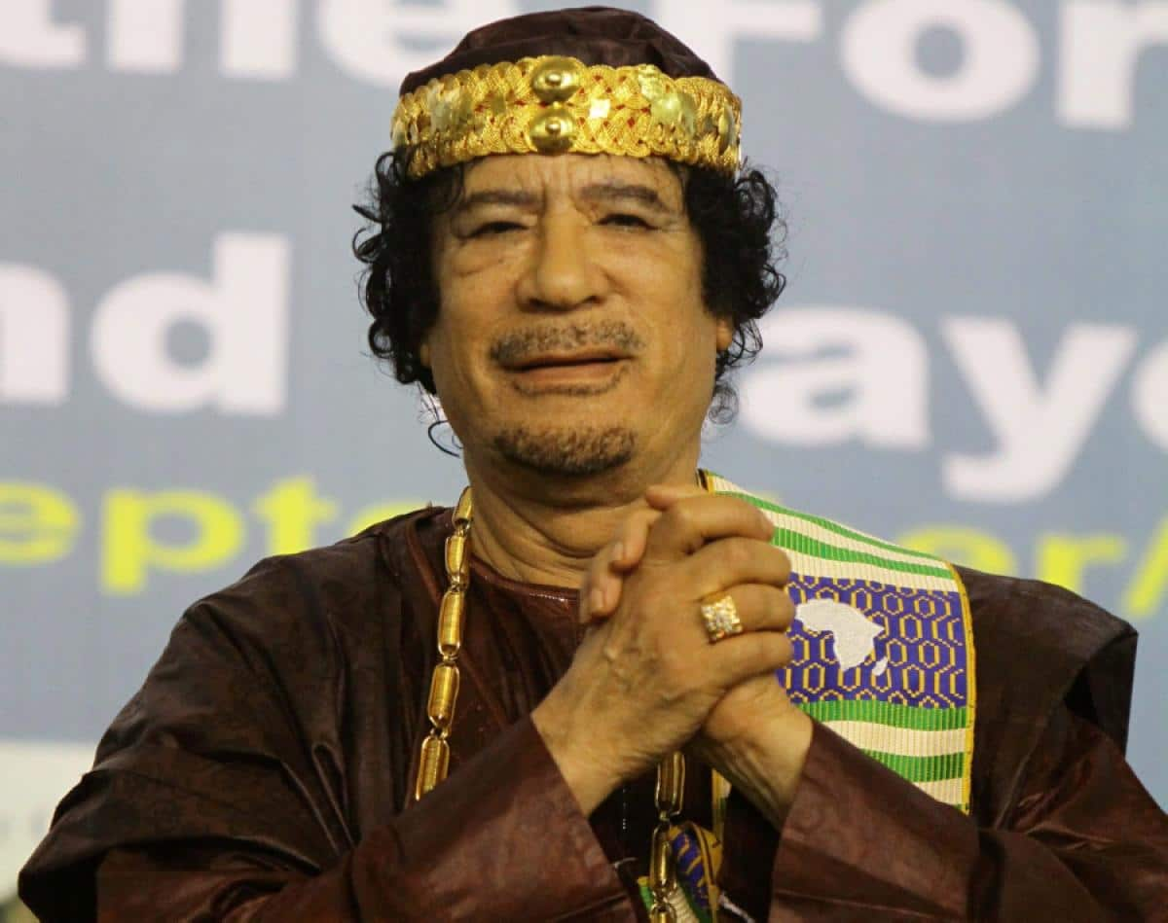
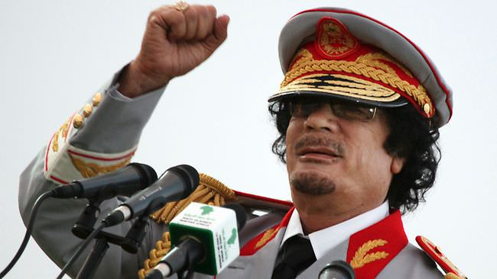
Illustration 5:
Muammar Gaddafi: Libya (1942-2011)

Slide 21
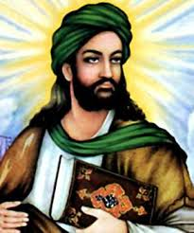
Illustration 6:
Muhammad (570 AD – 8 June 632 AD).
The name could be translated as "praised, commendable, laudable".

Slide 22
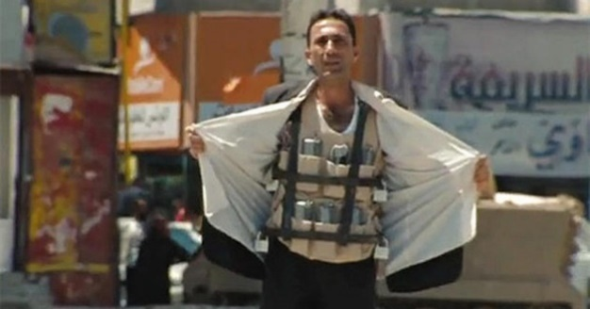
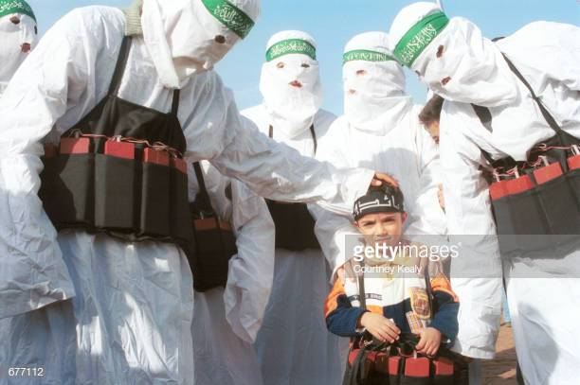
Illustration 7:

Slide 23
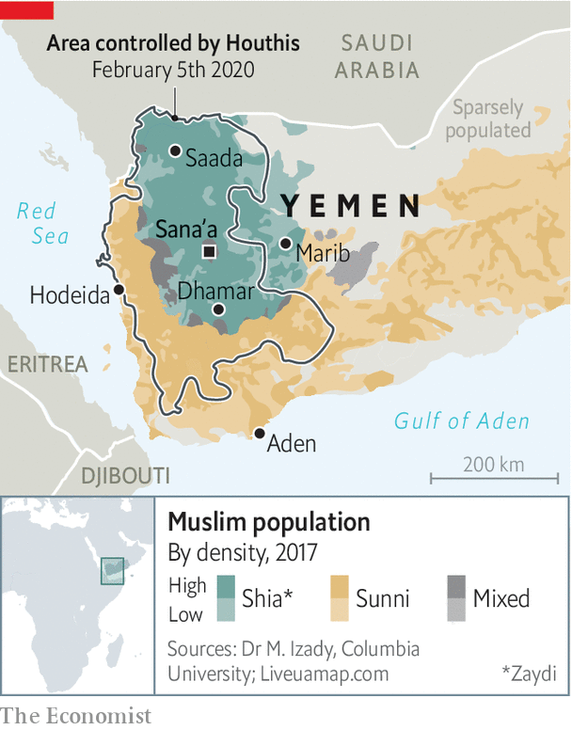
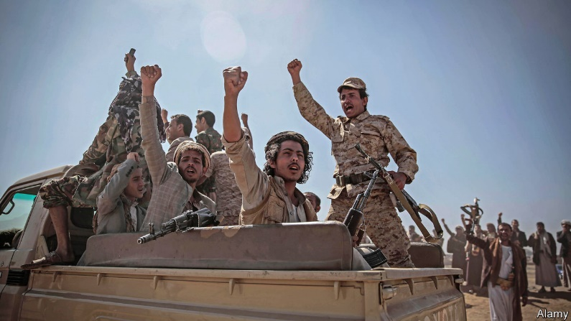
Illustration 8:

Slide 24
II. Disregard the birthright/輕看長子的名分.
Q:即使以掃沒有長子的名分, 但是他能夠在屬靈的產
業上有份嗎?
Could Esau, even if he had no birthright, have a part
in the spiritual inheritance?
→當然可以. Of course.

Slide 25
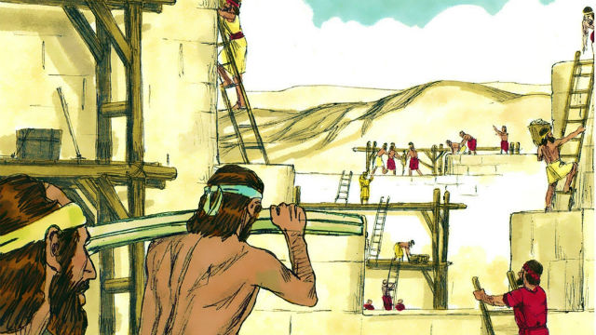
Illustration 9:
基遍人(Gibeonites)

Slide 26
Illustration 10:
耶穌的族譜/the genealogy of Jesus
⁵撒門從喇合氏生波阿斯；波阿斯從路得氏生俄備得；俄備得生耶西；【太 1:5】 ⁵and Salmon the father of Boaz by Rahab, and Boaz the father of Obed by Ruth, and Obed the father of Jesse, 【Matt 1:5】

Slide 27
Illustration 11:
Q:是不是我們的觀念裡面會告訴孩子們說:
Are we telling our children the following ?
→“教會又不能夠讓你上好的大學! “
“Going to church cannot get you to a good university!"
→“上教會又不能夠讓你找到好的工作!”
“Going to church cannot get you a good job! "
→“你為什麼要浪費時間去做那些和耶穌有關的事情呢? 耶穌能
夠當飯吃嗎?”
"Why do you waste time doing things that are related to Jesus?
Can you make a living on Jesus?"

Slide 28
Illustration 12:

Slide 29
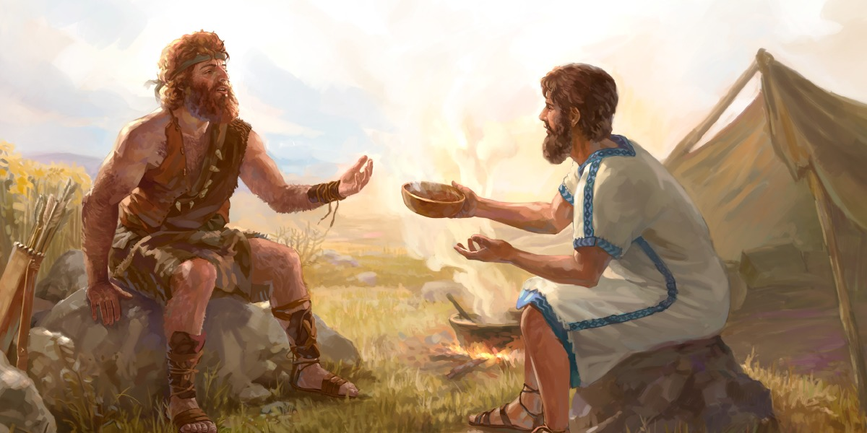
Conclusion
像Esau這樣的有肌肉的男人或運動型男人較不願意注意精神上的東西A muscle man or a sporty man like Esau is more prone to pay little attention to the spiritual things
像Jacob一樣的家庭男人則較傾向於精神上的東西
A more domestic man like Jacob is more prone to the spiritual things.
那是不正確的/That is not true.

Slide 30
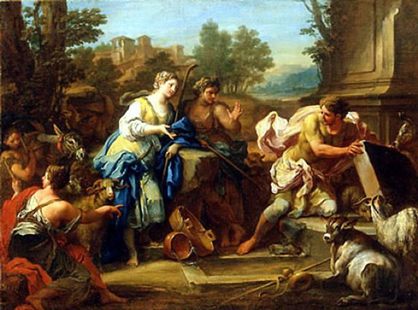
→ 雅各本人是個很強壯的人。
Jacob was a very strong man himself.

Slide 31
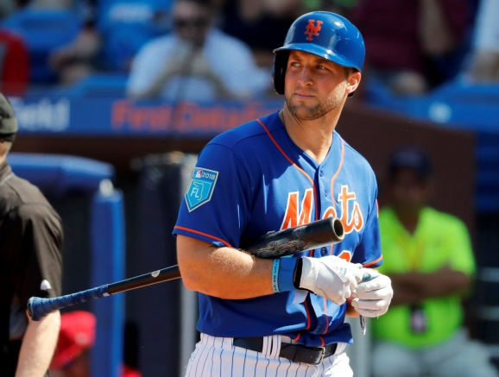
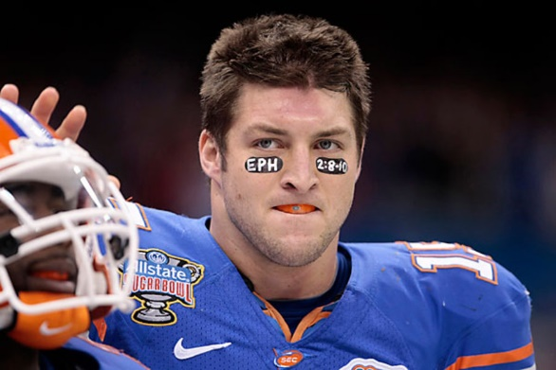
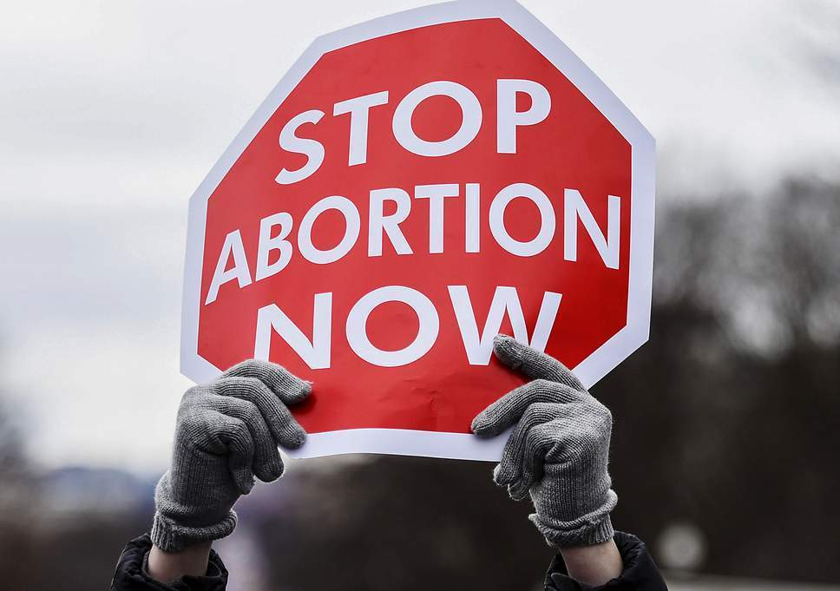
Illustration 13:
Tim Tebow, the Heisman trophy winning quarterback (2007), led Florida Gators into National Championship twice in three years (2007, 2009).

Slide 32
⁵因為隨從肉體的人體貼肉體的事，隨從聖靈的人體貼聖靈的事。⁶體貼肉體的，就是死；體貼聖靈的，乃是生命、平安。
【羅 8:5~6】 ⁵For those who live according to the flesh set their minds on the things of the flesh, but those who live according to the Spirit set their minds on the things of the Spirit. ⁶To set the mind on the flesh is death, but to set the mind on the Spirit is life and peace. 【Rom 8:5~6】

