Slide 1
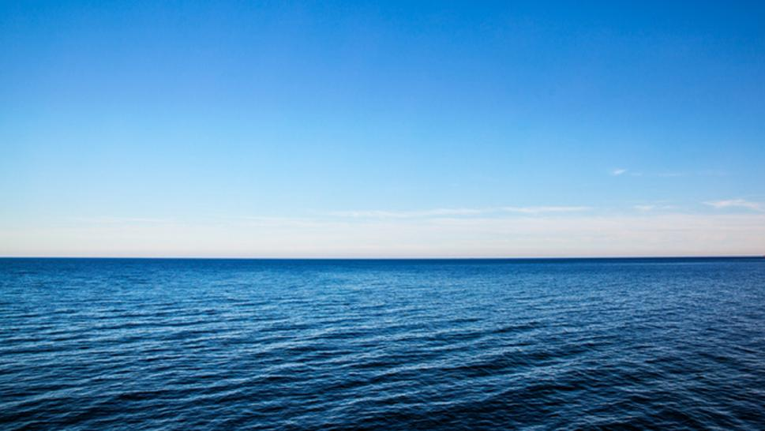
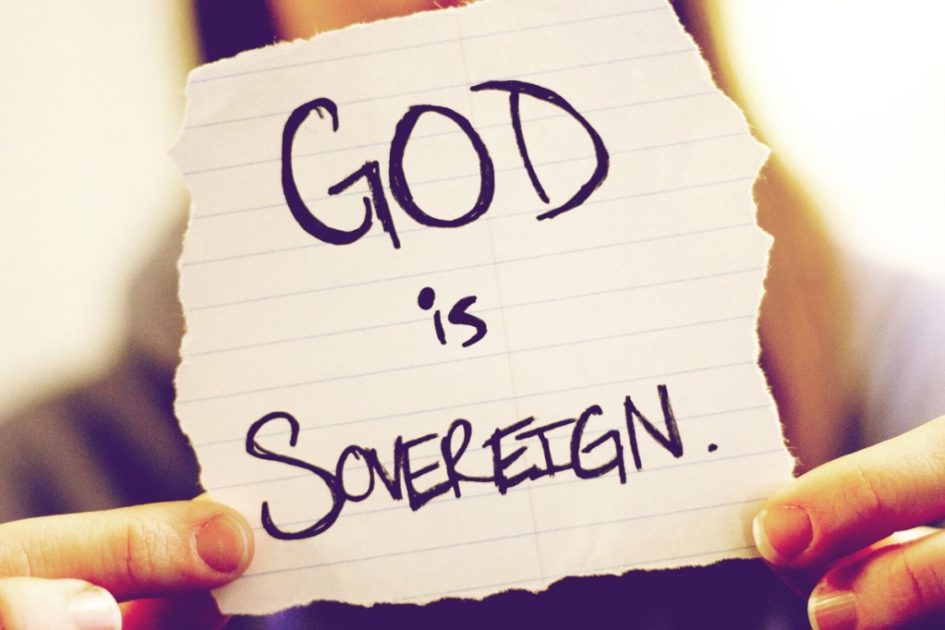
神不能讓你控制
1 Samuel 4,5, 6
3/1/2020 Rev. Joseph Chang BOLGPC 爾灣 大公園靈糧堂

Slide 2
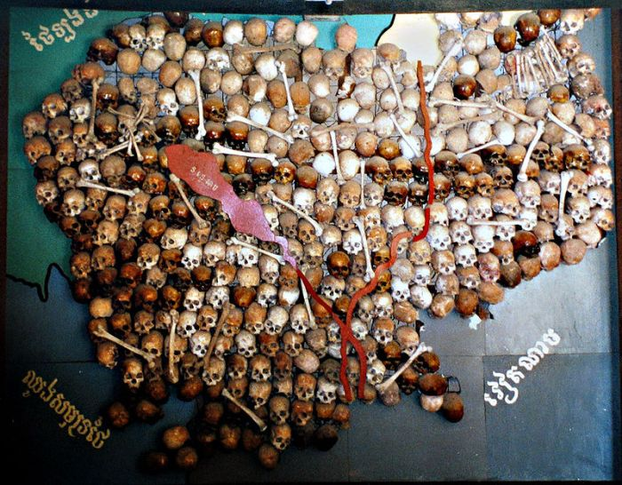
柬埔塞/Cambodia

Slide 3
上帝高於人類, 君權是從上帝給世界上國家的領袖的.
有上帝所訂的boundary.
God is above mankind, and governing authority is from God to the leaders of nations in the world. There is a boundary set by God.
¹在上有權柄的，人人當順服他，因為沒有權柄不是出於神的。凡掌權的都是神所命的。【羅 13:1】 ¹Let every person be subject to the governing authorities. For there is no authority except from God, and those that exist have been instituted by God. 【Rom 13:1】

Slide 4
上帝也是Sovereign God.祂有整個世界掌管的主權, 沒有人可
以干涉祂的內政. 所以詩篇的作者說:
God is sovereign. So He has sovereignty over the entire world,
and no one can interfere in His internal affairs. So the author
of the Psalms says:
³然而，我們的 神在天上，都隨自己的意旨行事。【詩 115:3】 ³Our God is in the heavens; he does all that he pleases.
【Ps 115:3】
⁶耶和華在天上，在地下，在海中，在一切的深處，都隨自己的意旨而行。【詩 135:6】 ⁶Whatever the Lord pleases, he does, in heaven and on earth, in the seas and all deeps. 【Ps 135:6】

Slide 5
¹³誰曾測度耶和華的心（或作：誰曾指示耶和華的靈），或作他的謀士指教他呢？【賽 40:13】 ¹³Who has measured the Spirit of the Lord, or what man shows him his counsel? 【Isa 40:13】
Q:在歷史上, 神有沒有允許人類干涉過祂的內政呢?
Has God ever allowed humans to interfere in His internal
affairs?

Slide 6
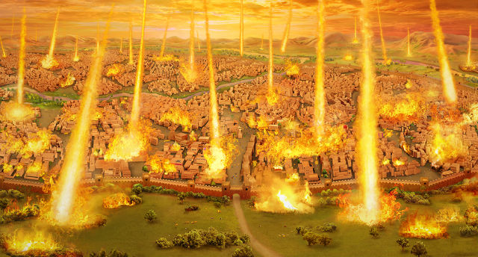
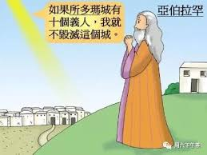
→亞伯拉罕干涉神對所多瑪, 蛾摩拉的審判.
Abraham meddled in God's judgment on Sodom,
Gomorrah.

Slide 8
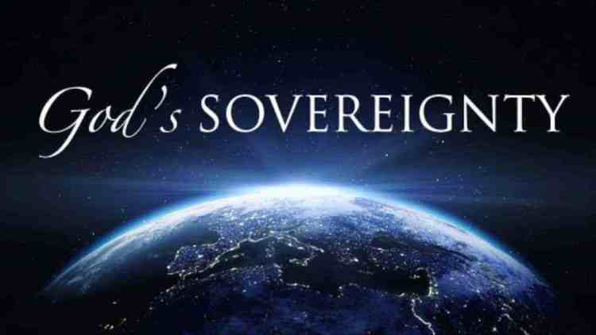
我們要藉著撒母耳記4, 5, 6章, 三章的經文來看看神 怎麼樣運用祂的主權:
Let's see how God uses His sovereignty through the
passages in Samuel 4, 5, & 6.

Slide 9
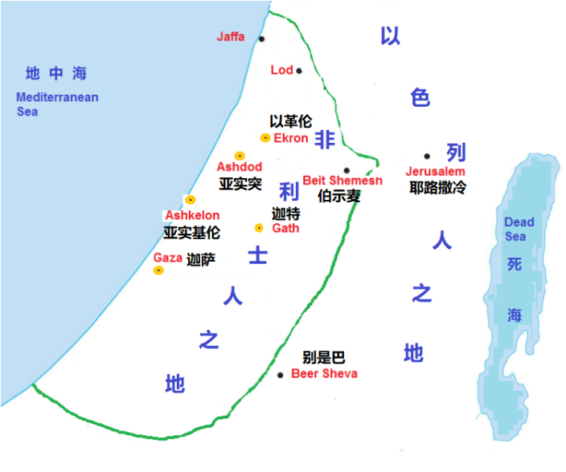
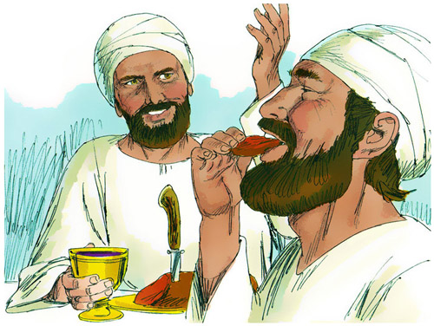
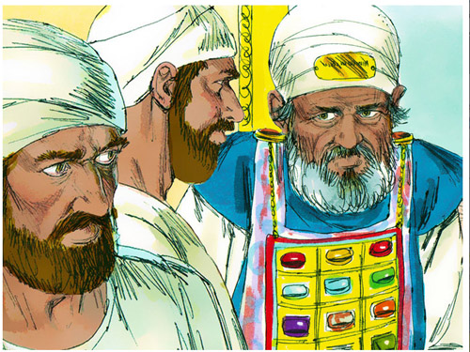
(背景/background)
神已經藉著撒母耳預言要除掉以利這個家族
Samuel had a revelation that God would punish the house of the High Priest Eli, because he did not restrain the impiety of his two sons, Hophni and Phinehas.

Slide 10
¹以色列人出去與非利士人打仗，安營在以便以謝；非利士人安營在亞弗。²非利士人向以色列人擺陣。兩軍交戰的時候，以色列人敗在非利士人面前；非利士人在戰場上殺了他們的軍兵約有四千人。³百姓回到營裡，以色列的長老說：耶和華今日為何使我們敗在非利士人面前呢？
¹And the word of Samuel came to all Israel. Now Israel went out to battle against the Philistines. They encamped at Ebenezer, and the Philistines encamped at Aphek. ²The Philistines drew up in line against Israel, and when the battle spread, Israel was defeated by the Philistines, who killed about four thousand men on the field of battle. ³And when the troops came to the camp, the elders of Israel said, "Why has the Lord defeated us today before the Philistines?

Slide 11
我們不如將耶和華的約櫃從示羅抬到我們這裡來，好在我們中間救我們脫離敵人的手。⁴於是百姓打發人到示羅，從那裡將坐在二基路伯上萬軍之耶和華的約櫃抬來。以利的兩個兒子何弗尼、非尼哈與 神的約櫃同來。⁵耶和華的約櫃到了營中，以色列眾人就大聲歡呼，地便震動。
Let us bring the ark of the covenant of the Lord here from Shiloh, that it may come among us and save us from the power of our enemies." ⁴So the people sent to Shiloh and brought from there the ark of the covenant of the Lord of hosts, who is enthroned on the cherubim. And the two sons of Eli, Hophni and Phinehas, were there with the ark of the covenant of God. ⁵As soon as the ark of the covenant of the Lord came into the camp, all Israel gave a mighty shout, so that the earth resounded.

Slide 12
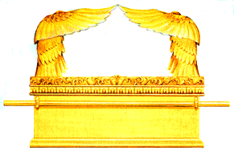
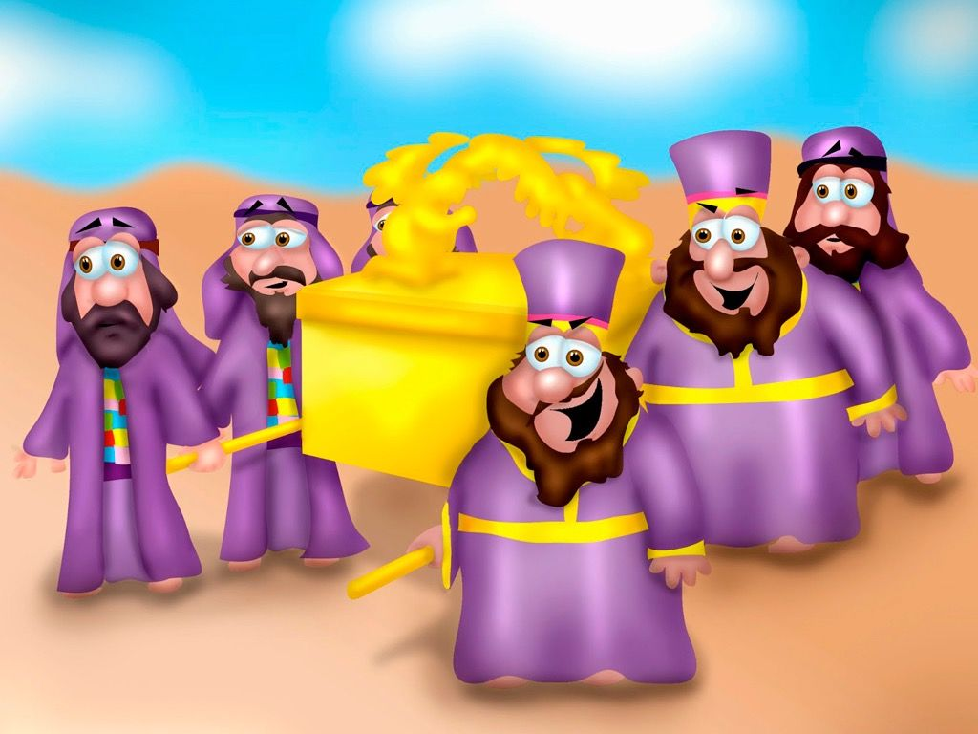
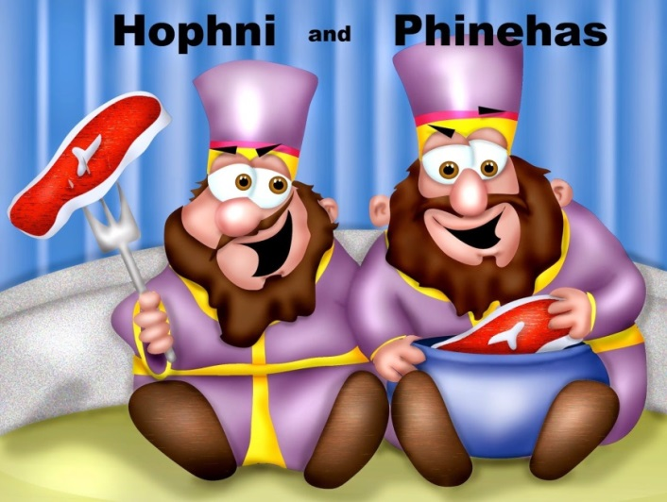

Slide 13
⁶非利士人聽見歡呼的聲音，就說：在希伯來人營裡大聲歡呼，是甚麼緣故呢？隨後就知道耶和華的約櫃到了營中。⁷非利士人就懼怕起來，說：有 神到了他們營中；又說：我們有禍了！向來不曾有這樣的事。⁸我們有禍了！誰能救我們脫離這些大能之 神的手呢？從前在曠野用各樣災殃擊打埃及人的，就是這些 神。
⁶And when the Philistines heard the noise of the shouting, they said, "What does this great shouting in the camp of the Hebrews mean?" And when they learned that the ark of the Lord had come to the camp, ⁷the Philistines were afraid, for they said, "A god has come into the camp." And they said, "Woe to us! For nothing like this has happened before. ⁸Woe to us! Who can deliver us from the power of these mighty gods? These are the gods who struck the Egyptians with every sort of plague in the wilderness.

Slide 14
⁹非利士人哪，你們要剛強，要作大丈夫，免得作希伯來人的奴僕，如同他們作你們的奴僕一樣。你們要作大丈夫，與他們爭戰。¹⁰非利士人和以色列人打仗，以色列人敗了，各向各家奔逃，被殺的人甚多，以色列的步兵仆倒了三萬。¹¹ 神的約櫃被擄去，以利的兩個兒子何弗尼、非尼哈也都被殺了。
【撒上 4:1~11】 ⁹Take courage, and be men, O Philistines, lest you become slaves to the Hebrews as they have been to you; be men and fight." ¹⁰So the Philistines fought, and Israel was defeated, and they fled, every man to his home. And there was a very great slaughter, for there fell of Israel thirty thousand foot soldiers. ¹¹And the ark of God was captured, and the two sons of Eli, Hophni and Phinehas, died. 【1Sam 4:1~11 】

Slide 15
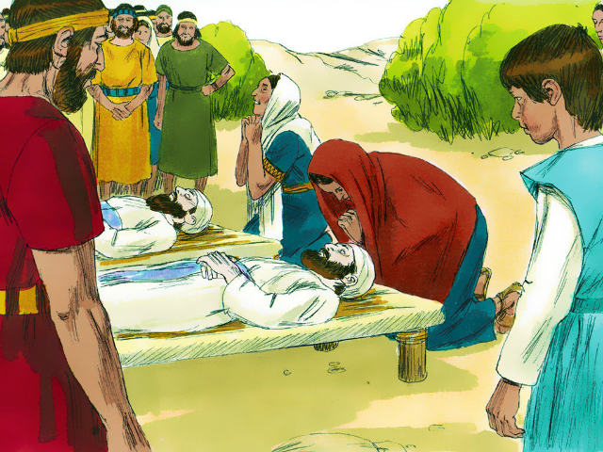
I. Sovereign Lord will not allow Israelites to control Him.
主權的神不受以色列人的控制.

Slide 16
¹³約書亞靠近耶利哥的時候，舉目觀看，不料，有一個人手裡有拔出來的刀，對面站立。約書亞到他那裡，問他說：你是幫助我們呢，是幫助我們敵人呢？¹⁴他回答說：不是的，我來是要作耶和華軍隊的元帥。約書亞就俯伏在地下拜，說：我主有甚麼話吩咐僕人。
¹³When Joshua was by Jericho, he lifted up his eyes and looked, and behold, a man was standing before him with his drawn sword in his hand. And Joshua went to him and said to him, "Are you for us, or for our adversaries?" ¹⁴And he said, "No; but I am the commander of the army of the Lord. Now I have come." And Joshua fell on his face to the earth and worshiped and said to him, "What does my lord say to his servant?"

Slide 17
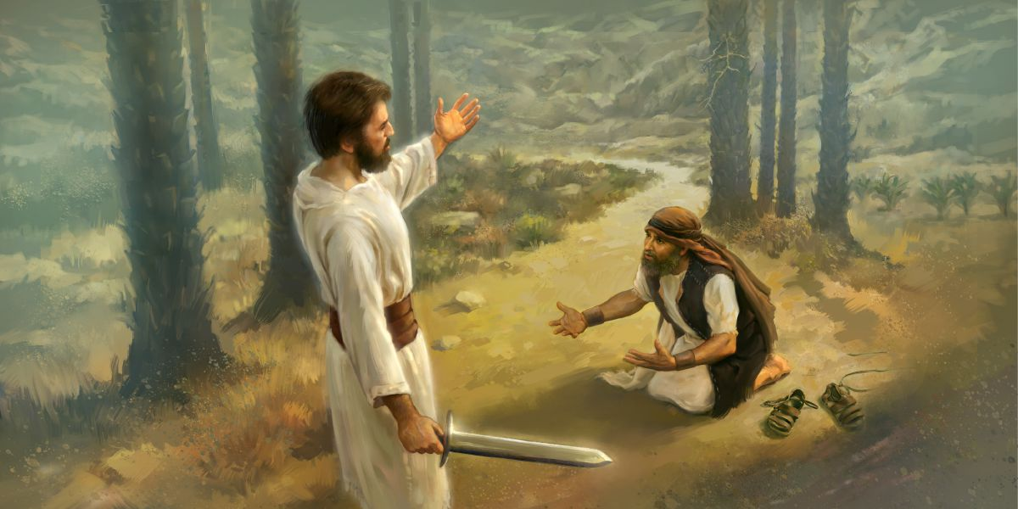
¹⁵耶和華軍隊的元帥對約書亞說：把你腳上的鞋脫下來，因為你所站的地方是聖的。約書亞就照著行了。
【書 5:13~15】 ¹⁵And the commander of the Lord's army said to Joshua, "Take off your sandals from your feet, for the place where you are standing is holy." And Joshua did so. 【Josh 5:13~15】

Slide 18
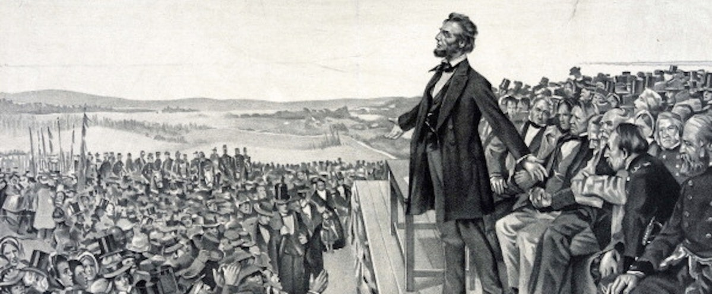
Illustration 1:
During the Civil War, Abraham Lincoln was purportedly asked if God was on his side. 但是林肯說, “Sir, my concern is not whether God is on our side; my greatest concern is to be on God's side, for God is always right.” (我所關心的不是上帝是不是在我們這邊, 我最關心的乃是我們是不是在上帝這邊. 因為上帝永遠是對的.)

Slide 19
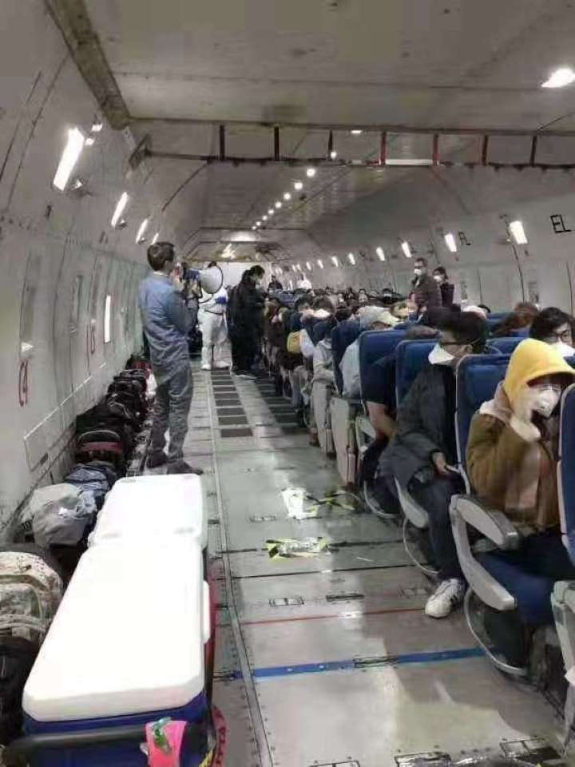
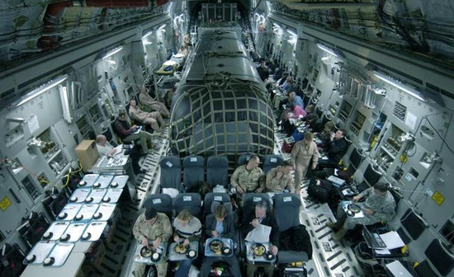
Illustration 2:

Slide 20
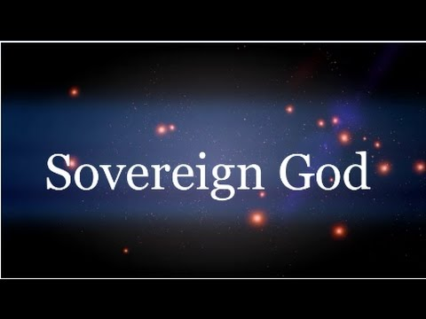
II. The Sovereign Lord allows no rival.
主權的神不允許它神竊取榮耀.

Slide 21
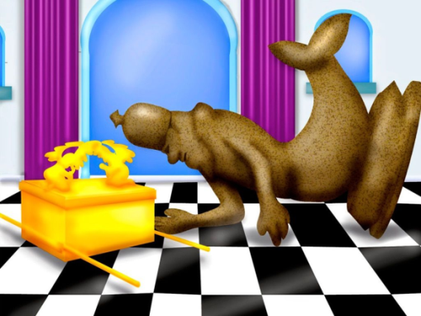
¹非利士人將 神的約櫃從以便以謝抬到亞實突。²非利士人將 神的約櫃抬進大袞廟，放在大袞的旁邊。³次日清早，亞實突人起來，見大袞仆倒在耶和華的約櫃前，臉伏於地，就把大袞仍立在原處。¹When the Philistines captured the ark of God, they brought it from Ebenezer to Ashdod. ²Then the Philistines took the ark of God and brought it into the house of Dagon and set it up beside Dagon. ³And when the people of Ashdod rose early the next day, behold, Dagon had fallen face downward on the ground before the ark of the Lord. So they took Dagon and put him back in his place.

Slide 22
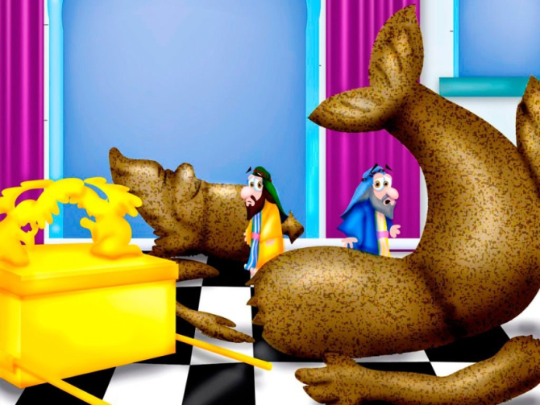
⁴又次日清早起來，見大袞仆倒在耶和華的約櫃前，臉伏於地，並且大袞的頭和兩手都在門檻上折斷，只剩下大袞的殘體。⁵（因此，大袞的祭司和一切進亞實突、大袞廟的人都不踏大袞廟的門檻，直到今日。）【撒上 5:1~5】
⁴But when they rose early on the next morning, behold, Dagon had fallen face downward on the ground before the ark of the Lord, and the head of Dagon and both his hands were lying cut off on the threshold. Only the trunk of Dagon was left to
him. ⁵This is why the priests of Dagon and all
who enter the house of Dagon do not tread
on the threshold of Dagon in Ashdod to this
day.【1Sam 5:1~5】

Slide 23
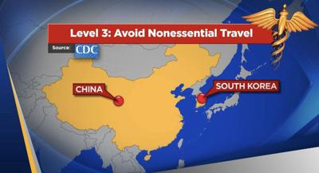
Illustration 3:
CDC Travel Warning
Level 2
Iran,
Italy,
Japan
Level 1
Hong Kong
Under Observation
Singapore, Thailand, Taiwan, Vietnam

Slide 24
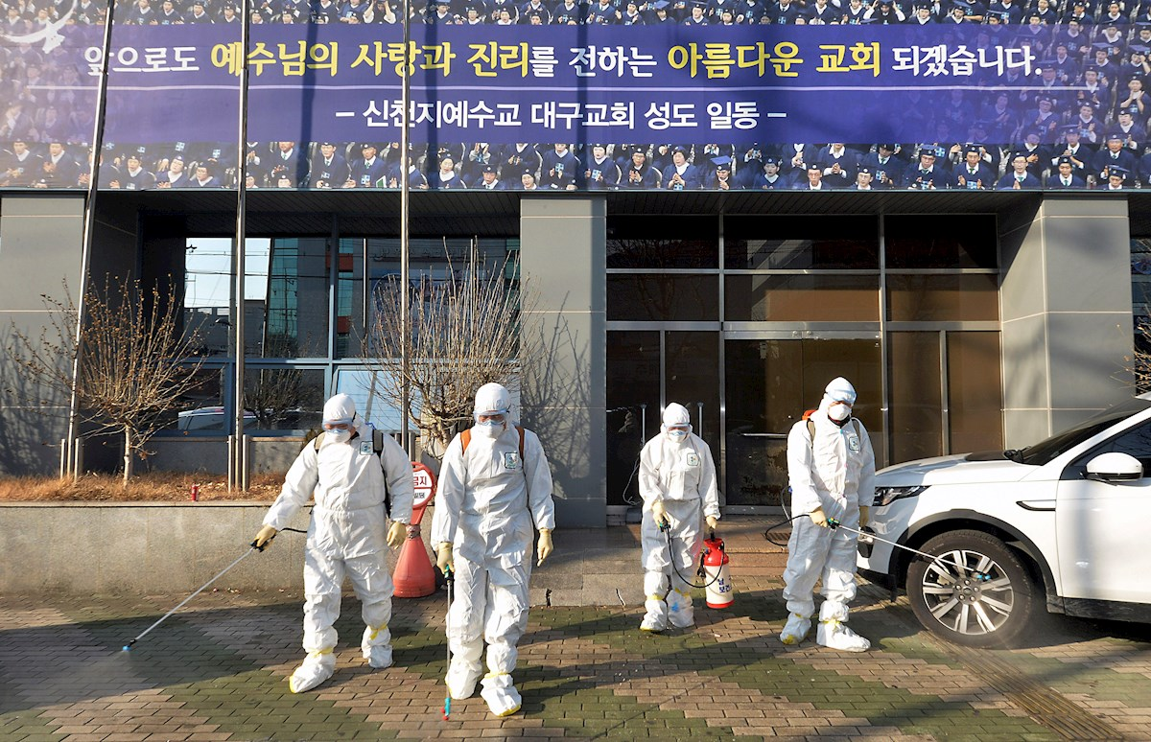

Slide 25
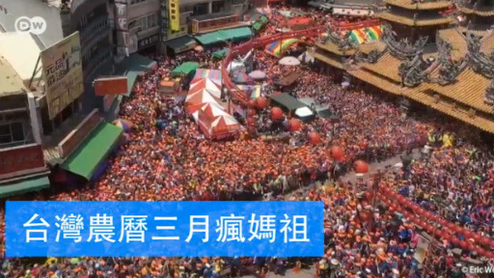
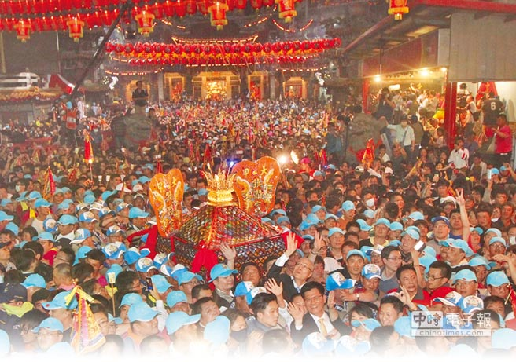
Illustration 4:

Slide 26
Illustration 5:

Slide 27
III. The sovereign Lord deposed of the human sovereign.
主權的神撤換人的領導.

Slide 28
⁶耶和華的手重重加在亞實突人身上，敗壞他們，使他們生痔瘡。亞實突和亞實突的四境都是如此。⁷亞實突人見這光景，就說：以色列 神的約櫃不可留在我們這裡，因為他的手重重加在我們和我們 神大袞的身上；⁸就打發人去請非利士的眾首領來聚集，問他們說：我們向以色列 神的約櫃應當怎樣行呢？
⁶The hand of the Lord was heavy against the people of Ashdod, and he terrified and afflicted them with tumors, both Ashdod and its territory. ⁷And when the men of Ashdod saw how things were, they said, "The ark of the God of Israel must not remain with us, for his hand is hard against us and against Dagon our god." ⁸So they sent and gathered together all the lords of the Philistines and said, "What shall we do with the ark of the God of Israel?"

Slide 29
他們回答說：可以將以色列 神的約櫃運到迦特去。於是將以色列 神的約櫃運到那裡去。⁹運到之後，耶和華的手攻擊那城，使那城的人大大驚慌，無論大小都生痔瘡。¹⁰他們就把 神的約櫃送到以革倫。 神的約櫃到了，以革倫人就喊嚷起來說：他們將以色列 神的約櫃運到我們這裡，要害我們和我們的眾民！ They answered, "Let the ark of the God of Israel be brought around to Gath." So they brought the ark of the God of Israel there. ⁹But after they had brought it around, the hand of the Lord was against the city, causing a very great panic, and he afflicted the men of the city, both young and old, so that tumors broke out on them. ¹⁰So they sent the ark of God to Ekron. But as soon as the ark of God came to Ekron, the people of Ekron cried out, "They have brought around to us the ark of the God of Israel to kill us and our people."

Slide 30
¹¹於是打發人去請非利士的眾首領來，說：願你們將以色列 神的約櫃送回原處，免得害了我們和我們的眾民！原來 神的手重重攻擊那城，城中的人有因驚慌而死的；¹²未曾死的人都生了痔瘡。合城呼號，聲音上達於天。
【撒上 5:6~12】
¹¹They sent therefore and gathered together all the lords of the Philistines and said, "Send away the ark of the God of Israel, and let it return to its own place, that it may not kill us and our people." For there was a deathly panic throughout the whole city. The hand of God was very heavy there. ¹²The men who did not die were struck with tumors, and the cry of the city went up to heaven. 【1Sam 5:6~12】

Slide 31
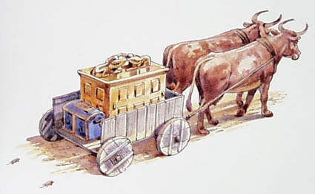
Q:非利士人的首領怎麼能夠確認這個鼠疫和痔瘡是從約櫃所代
表的神來的呢? How could the Philistine leader confirm that
the plague and hemorrhoids came from the God represented
by the Ark?

Slide 32
¹耶和華的約櫃在非利士人之地七個月。²非利士人將祭司和占卜的聚了來，問他們說：我們向耶和華的約櫃應當怎樣行？請指示我們用何法將約櫃送回原處。³他們說：若要將以色列 神的約櫃送回去，不可空空地送去，必要給他獻賠罪的禮物，然後你們可得痊愈，並知道他的手為何不離開你們。
¹The ark of the Lord was in the country of the Philistines seven months. ²And the Philistines called for the priests and the diviners and said, "What shall we do with the ark of the Lord? Tell us with what we shall send it to its place." ³They said, "If you send away the ark of the God of Israel, do not send it empty, but by all means return him a guilt offering. Then you will be healed, and it will be known to you why his hand does not turn away from you."

Slide 33
⁴非利士人說：應當用甚麼獻為賠罪的禮物呢？他們回答說：當照非利士首領的數目，用五個金痔瘡，五個金老鼠，因為在你們眾人和你們首領的身上都是一樣的災。⁵所以當製造你們痔瘡的像和毀壞你們田地老鼠的像，並要歸榮耀給以色列的 神，或者他向你們和你們的 神，並你們的田地，把手放輕些。
⁴And they said, "What is the guilt offering that we shall return to him?" They answered, "Five golden tumors and five golden mice, according to the number of the lords of the Philistines, for the same plague was on all of you and on your lords. ⁵So you must make images of your tumors and images of your mice that ravage the land, and give glory to the God of Israel. Perhaps he will lighten his hand from off you and your gods and your land.

Slide 34
⁶你們為何硬著心像埃及人和法老一樣呢？ 神在埃及人中間行奇事，埃及人豈不釋放以色列人，他們就去了麼？⁷現在你們應當造一輛新車，將兩隻未曾負軛有乳的母牛套在車上，使牛犢回家去，離開母牛。⁸把耶和華的約櫃放在車上，將所獻賠罪的金物裝在匣子裡，放在櫃旁，將櫃送去。
⁶Why should you harden your hearts as the Egyptians and Pharaoh hardened their hearts? After he had dealt severely with them, did they not send the people away, and they departed? ⁷Now then, take and prepare a new cart and two milk cows on which there has never come a yoke, and yoke the cows to the cart, but take their calves home, away from them. ⁸And take the ark of the Lord and place it on the cart and put in a box at its side the figures of gold, which you are returning to him as a guilt offering. Then send it off and let it go its way

Slide 35
⁹你們要看看：車若直行以色列的境界到伯示麥去，這大災就是耶和華降在我們身上的；若不然，便可以知道不是他的手擊打我們，是我們偶然遇見的。¹⁰非利士人就這樣行：將兩隻有乳的母牛套在車上，將牛犢關在家裡，¹¹把耶和華的約櫃和裝金老鼠並金痔瘡像的匣子都放在車上。
⁹and watch. If it goes up on the way to its own land, to Beth-shemesh, then it is he who has done us this great harm, but if not, then we shall know that it is not his hand that struck us; it happened to us by coincidence." ¹⁰The men did so, and took two milk cows and yoked them to the cart and shut up their calves at home. ¹¹And they put the ark of the Lord on the cart and the box with the golden mice and the images of their tumors.

Slide 36
¹²牛直行大道，往伯示麥去，一面走一面叫，不偏左右。非利士的首領跟在後面，直到伯示麥的境界。¹³伯示麥人正在平原收割麥子，舉目看見約櫃，就歡喜了。¹⁴車到了伯示麥人約書亞的田間，就站住了。在那裡有一塊大磐石，他們把車劈了，將兩隻母牛獻給耶和華為燔祭。
¹²And the cows went straight in the direction of Beth-shemesh along one highway, lowing as they went. They turned neither to the right nor to the left, and the lords of the Philistines went after them as far as the border of Beth- shemesh. ¹³Now the people of Beth-shemesh were reaping their wheat harvest in the valley. And when they lifted up their eyes and saw the ark, they rejoiced to see it.

Slide 37
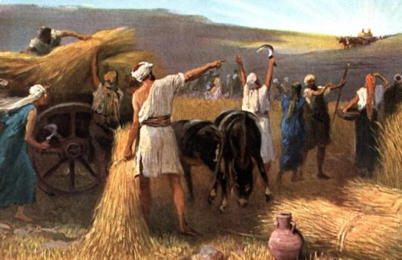

Slide 38
¹⁵利未人將耶和華的約櫃和裝金物的匣子拿下來，放在大磐石上。當日伯示麥人將燔祭和平安祭獻給耶和華。¹⁶非利士人的五個首領看見，當日就回以革倫去了。¹⁷非利士人獻給耶和華作賠罪的金痔瘡像，就是這些：一個是為亞實突，一個是為迦薩，一個是為亞實基倫，一個是為迦特，一個是為以革倫。
¹⁵And the Levites took down the ark of the Lord and the box that was beside it, in which were the golden figures, and set them upon the great stone. And the men of Beth- shemesh offered burnt offerings and sacrificed sacrifices on that day to the Lord. ¹⁶And when the five lords of the Philistines saw it, they returned that day to Ekron. ¹⁷These are the golden tumors that the Philistines returned as a guilt offering to the Lord: one for Ashdod, one for Gaza, one for Ashkelon, one for Gath, one for Ekron,

Slide 39
¹⁸金老鼠的數目是照非利士五個首領的城邑，就是堅固的城邑和鄉村，以及大磐石。這磐石是放耶和華約櫃的，到今日還在伯示麥人約書亞的田間。【撒上 6:1~18】 ¹⁸and the golden mice, according to the number of all the cities of the Philistines belonging to the five lords, both fortified cities and unwalled villages. The great stone beside which they set down the ark of the Lord is a witness to this day in the field of Joshua of Beth-shemesh. 【1Sam 6:1~18】

Slide 40
非利士人必須在上帝面前臣服, 否則他們要面臨
滅亡的厄運.
The Philistine’s showed homage. Otherwise they
might be extinguished.

Slide 41
→神處理非利士人的方法充滿了黑色的幽默. 這次的疫情, 神處理共產黨的方法也是充滿了黑色的幽默:
God ’s approach to the Philistines was filled with black humor. In this outbreak, God ’s approach to the Communist Party was also filled with black humor.

Slide 42
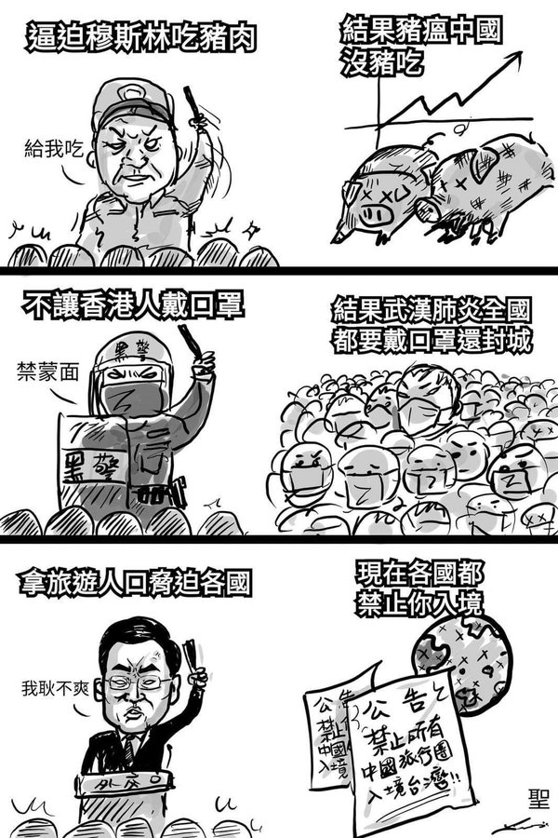
A.

Slide 43
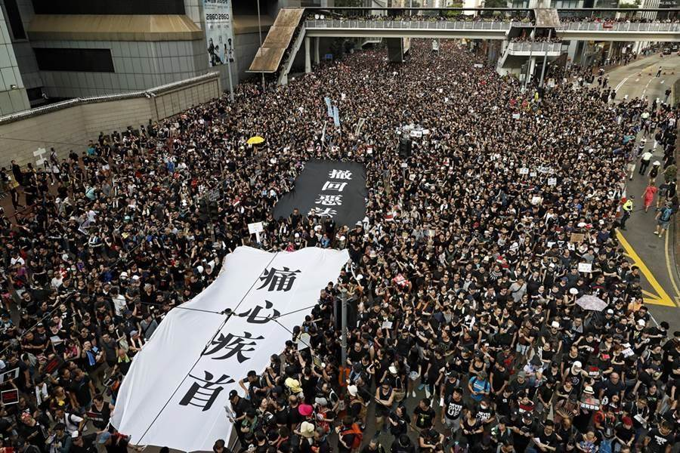
B.

Slide 44
C.

Slide 45
The communist’s regime is facing toppling if
they do not show homage.
若中國共產黨不在上帝面前謙卑下來, 很可
能時日不多了!

Slide 46
IV. The sovereign Lord punishes Israelites for their
presumptuous action.
主權的主處罰以色列人的擅自越位.
¹⁹耶和華因伯示麥人擅觀他的約櫃，就擊殺了他們七十人；那時有五萬人在那裡（原文作七十人加五萬人）。百姓因耶和華大大擊殺他們，就哀哭了。
¹⁹And he struck some of the men of Beth-shemesh, because they looked upon the ark of the Lord. He struck seventy men of them, and the people mourned because the Lord had struck the people with a great blow.

Slide 47
²⁰伯示麥人說：誰能在耶和華這聖潔的 神面前侍立呢？這約櫃可以從我們這裡送到誰那裡去呢？²¹於是打發人去見基列耶琳的居民，說：非利士人將耶和華的約櫃送回來了，你們下來將約櫃接到你們那裡去罷！
²⁰Then the men of Beth-shemesh said, "Who is able to stand before the Lord, this holy God? And to whom shall he go up away from us?" ²¹So they sent messengers to the inhabitants of Kiriath-jearim, saying, "The Philistines have returned the ark of the Lord. Come down and take it up to you."

Slide 48
^{7:1}基列耶琳人就下來，將耶和華的約櫃接上去，放在山上亞比拿達的家中，分派他兒子以利亞撒看守耶和華的約櫃。【撒上 6:19~7:1】
^{7:1}And the men of Kiriath-jearim came and took up the ark of the Lord and brought it to the house of Abinadab on the hill. And they consecrated his son Eleazar to have charge of the ark of the Lord. 【1Sam 6:19~7:1】

Slide 49
Conclusion
上帝是有全然主權的主, 這整個世界都是祂的權柄範圍, 祂不站在誰那邊, 而是看誰站在祂那邊, 世上的偶像不能夠竊取祂的榮耀, 世上的君王也無法與祂抗衡. 祂不需要我們的保護, 不管是在我們這邊, 或是在敵人那邊, 我們的上帝仍然是按照祂所喜悅的工作. “洪水之上, 祂坐著為王!” “瘟疫之上, 祂同樣坐著為王!”
God is the Lord with total sovereignty. The whole world is within his authority. He does not stand on whose side, but the greatest concern is who is on his side. The idols of the world cannot steal his glory, and there is no way any kings are able to contend with Him. He does not need our protection, whether on our side or on the enemy's side, and our God is still working according to his delight. "On the flood, He sits as King!" "On the plague, He also sits as King!"

