Slide 1
Royal Priesthood君尊的祭司 (3)
5/17/2020 Rev. Joseph Chang BOLGPC 爾灣大公園靈糧堂

Slide 2
我們今天要來看三個祭, 燔祭, 素祭, 平安祭.
Today we are going to look at three offerings,
burnt offering, cereal offering, and peace offering.

Slide 3
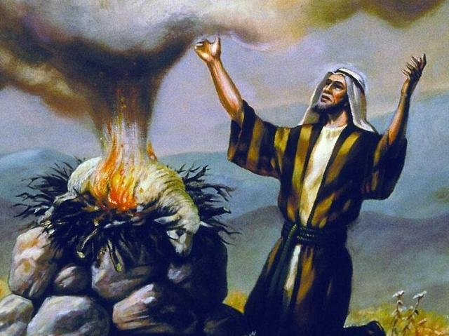
1. 燔祭 burnt offering
¹⁶「神愛世人，甚至將他的獨生子賜給他們，叫一切信他的，不至滅亡，反得永生。【約 3:16】 ¹⁶"For God so loved the world,that he gave his only Son, that whoever believes in him should not perish but have eternal life." 【John 3:16】

Slide 4
³又要對他們說：你們要獻給耶和華的火祭，就是沒有殘疾、一歲的公羊羔，每日兩隻，作為常獻的燔祭。⁴早晨要獻一隻，黃昏的時候要獻一隻；⁵又用細麵伊法十分之一，並搗成的油一欣四分之一，調和作為素祭。⁶這是在西乃山所命定為常獻的燔祭，是獻給耶和華為馨香的火祭。【民 28:3~6】 ³And you shall say to them, This is the food offering that you shall offer to the Lord: two male lambs a year old without blemish, day by day, as a regular offering. ⁴The one lamb you shall offer in the morning, and the other lamb you shall offer at twilight; ⁵also a tenth of an ephah of fine flour for a grain offering, mixed with a quarter of a hin of beaten oil. ⁶It is a regular burnt offering, which was ordained at Mount Sinai for a pleasing aroma, a food offering to the Lord. 【Num 28:3~6】

Slide 5
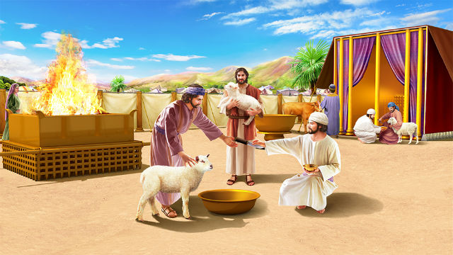

Slide 6
¹⁴他對我說：到二千三百日，聖所就必潔淨。【但 8:14】 ¹⁴And he said to me, "For 2,300 evenings and mornings. Then the sanctuary shall be restored to its rightful state." 【Dan 8:14】

Slide 7
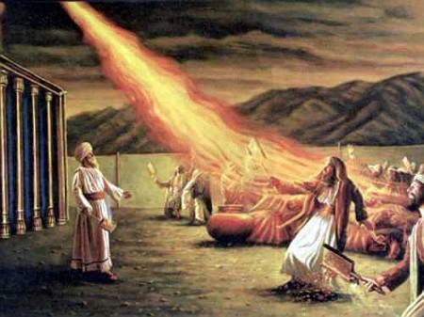
A. From Heaven 從天上而言
²⁴有火從耶和華面前出來，在壇上燒盡燔祭和脂油；眾民一見，就都歡呼，俯伏在地。【利 9:24】 ²⁴And fire came out from before the Lord and consumed the burnt offering and the pieces of fat on the altar, and when all the people saw it, they shouted and fell on their faces. 【Lev 9:24】

Slide 8
B. From Earth 從地上而言
⁸耶和華曉諭摩西說：⁹你要吩咐亞倫和他的子孫說，燔祭的條例乃是這樣：燔祭要放在壇的柴上，從晚上到天亮，壇上的火要常常燒著。¹⁰祭司要穿上細麻布衣服，又要把細麻布褲子穿在身上，把壇上所燒的燔祭灰收起來，倒在壇的旁邊；
⁸ The Lord spoke to Moses, saying, ⁹"Command Aaron and his sons, saying, This is the law of the burnt offering. The burnt offering shall be on the hearth on the altar all night until the morning, and the fire of the altar shall be kept burning on it. ¹⁰And the priest shall put on his linen garment and put his linen undergarment on his body, and he shall take up the ashes to which the fire has reduced the burnt offering on the altar and put them beside the altar.

Slide 9
¹¹隨後要脫去這衣服，穿上別的衣服，把灰拿到營外潔淨之處。¹²壇上的火要在其上常常燒著，不可熄滅。祭司要每日早晨在上面燒柴，並要把燔祭擺在壇上，在其上燒平安祭牲的脂油。¹³在壇上必有常常燒著的火，不可熄滅。【利 6:8~13】 ¹¹Then he shall take off his garments and put on other garments and carry the ashes outside the camp to a clean place. ¹²The fire on the altar shall be kept burning on it; it shall not go out. The priest shall burn wood on it every morning, and he shall arrange the burnt offering on it and shall burn on it the fat of the peace offerings. ¹³Fire shall be kept burning on the altar continually; it shall not go out. 【Lev 6:8~13】

Slide 10
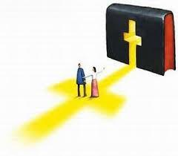
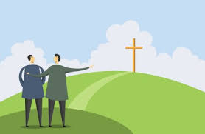
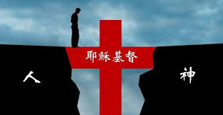
Illustration 1:

Slide 11
→所以從天上而言, 神自己:
So from heaven, God himself:
⁹主所應許的尚未成就，有人以為他是耽延，其實不是耽延，乃是寬容你們，不願有一人沉淪，乃願人人都悔改。【彼後 3:9】 ⁹The Lord is not slow to fulfill his promise as some count slowness, but is patient toward you, not wishing that any should perish, but that all should reach repentance.
【2Pet 3:9】

Slide 12
→從地上而言, 神要我們:
From the earth, God wants us to:
²務要傳道，無論得時不得時，總要專心；並用百般的忍耐，各樣的教訓，責備人、警戒人、勸勉人。
【提後 4:2】 ²preach the word; be ready in season and out of season; reprove, rebuke, and exhort, with complete patience and teaching. 【2Tim 4:2】

Slide 13
II. Cereal Offering素祭
素祭就是我們今天所講的十一奉獻
The cereal offering is the tithe we are talking about today.

Slide 14
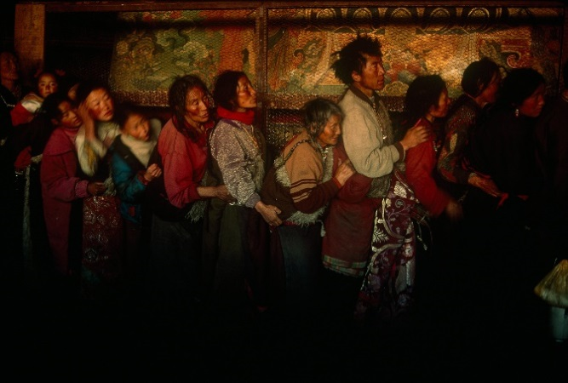
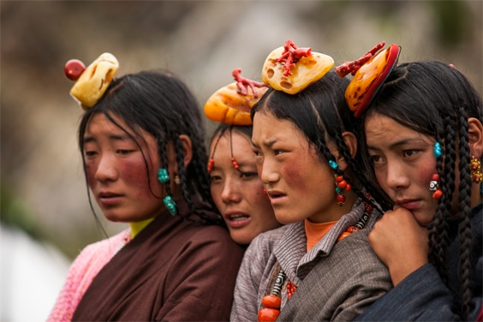
Illustration 2:
西藏/Tibet

Slide 15
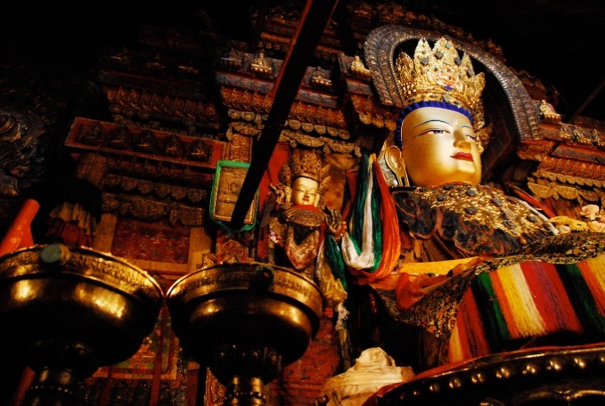
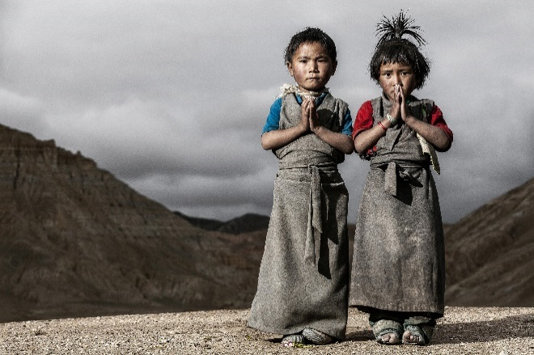

Slide 16
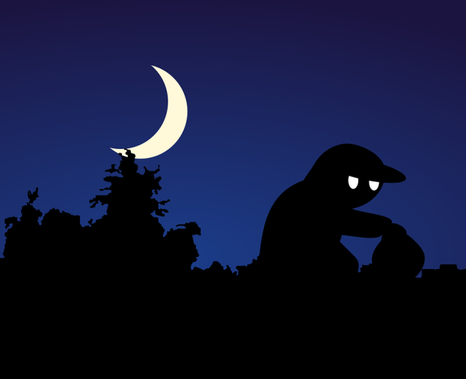
¹⁰盜賊來，無非要偷竊，殺害，毀壞；我來了，是要叫羊（或作：人）得生命，並且得的更豐盛。
【約 10:10】 ¹⁰"The thief comes only to steal and kill and destroy. I came that they may have life and have it abundantly." 【John 10:10】

Slide 17
¹⁰萬軍之耶和華說：你們要將當納的十分之一全然送入倉庫，使我家有糧，以此試試我，是否為你們敞開天上的窗戶，傾福與你們，甚至無處可容。【瑪 3:10】 ¹⁰Bring the full tithes into the storehouse, that there may be food in my house. And thereby put me to the test, says the Lord of hosts, if I will not open the windows of heaven for you and pour down for you a blessing until there is no more need. 【Mal 3:10】

Slide 18
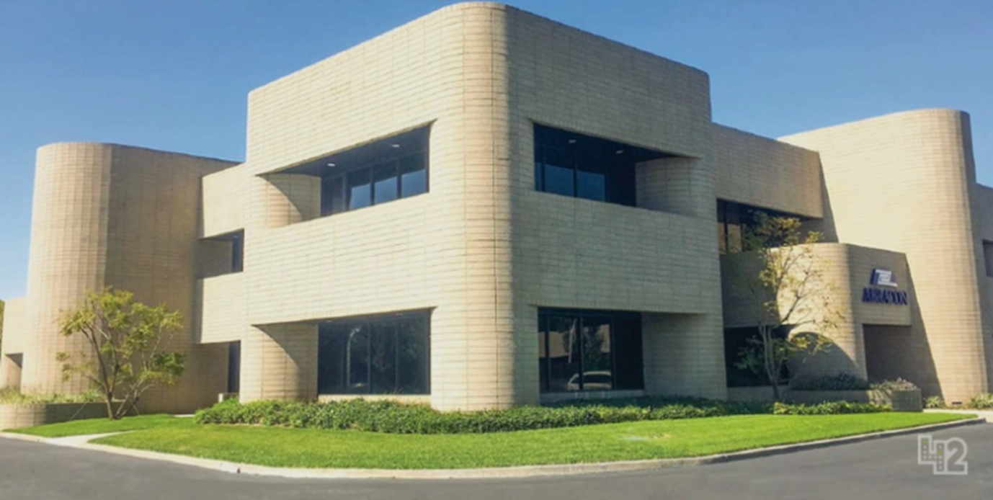
Illustration 3:

Slide 19
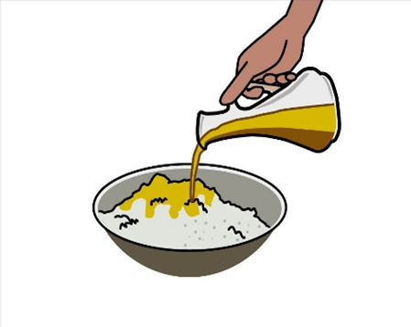
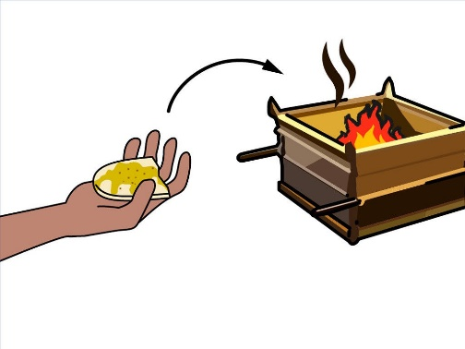
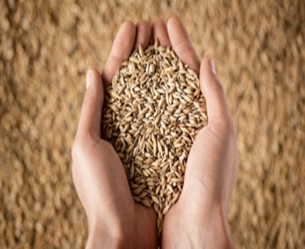
我們來看看在素祭上面的教導:
Let's take a look at the teaching on the cereal offering:

Slide 20
A. 10%--The First Fruit, 初熟的果實

Slide 21
1. To Israelites對以色列人:
¹⁴無論是餅，是烘的子粒，是新穗子，你們都不可吃，直等到把你們獻給 神的供物帶來的那一天才可以吃(這一天就是初熟節)。這在你們一切的住處作為世世代代永遠的定例。【利 23:14】 ¹⁴And you shall eat neither bread nor grain parched or fresh until this same day, until you have brought the offering of your God (This is First Fruits) : it is a statute forever throughout your generations in all your dwellings. 【Lev 23:14

Slide 22
2. To descendants of Aaron對於亞倫的子孫
¹⁹耶和華曉諭摩西說：²⁰當亞倫受膏的日子，他和他子孫所要獻給耶和華的供物，就是細麵伊法十分之一，為常獻的素祭：早晨一半，晚上一半。²¹要在鐵鏊上用油調和做成，調勻了，你就拿進來；烤好了分成塊子，獻給耶和華為馨香的素祭。
The Lord spoke to Moses, saying, ²⁰"This is the offering that Aaron and his sons shall offer to the Lord on the day when he is anointed: a tenth of an ephah of fine flour as a regular grain offering, half of it in the morning and half in the evening. ²¹It shall be made with oil on a griddle. You shall bring it well mixed, in baked pieces like a grain offering, and offer it for a pleasing aroma to the Lord.

Slide 23
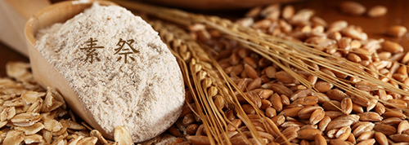
²²亞倫的子孫中，接續他為受膏的祭司，要把這素祭獻上，要全燒給耶和華。這是永遠的定例。²³祭司的素祭都要燒了，卻不可吃。【利 6:19~23】
²The priest from among Aaron's sons, who is anointed to succeed him, shall offer it to the Lord as decreed forever. The whole of it shall be burned. ²³Every grain offering of a priest shall be wholly burned. It shall not be eaten." 【Lev 6:19~23】

Slide 24
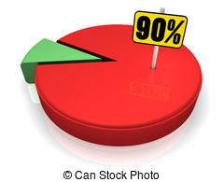
B. 90%--The Rest, 其餘的90%

Slide 25
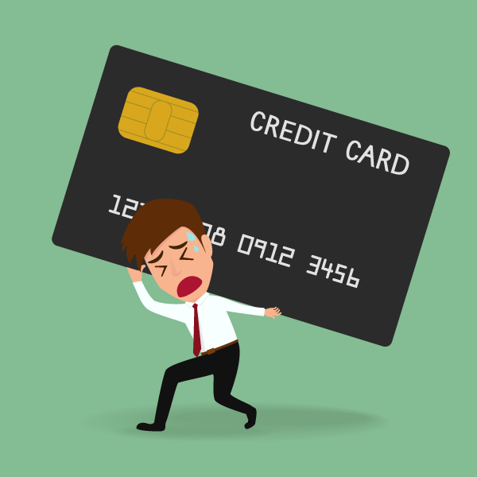
A. Do not get into debt. 不要負債.
Illustration 4:

Slide 26
⁷富戶管轄窮人；欠債的是債主的僕人。
【箴 22:7】 ⁷The rich rules over the poor, and the borrower is the slave of the lender. 【Prov 22:7】

Slide 27
Illustration 5:

Slide 28
B. Do not cosign. 不要為人作保.
²⁶不要與人擊掌，不要為欠債的作保。²⁷你若沒有甚麼償還，何必使人奪去你睡臥的床呢？【箴 22:26~27】 ²⁶Be not one of those who give pledges, who put up security for debts. ²⁷If you have nothing with which to pay, why should your bed be taken from under you? 【Prov 22:26~27】

Slide 29
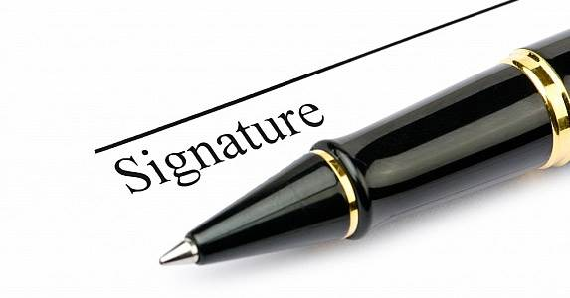
Illustration 6:

Slide 30
Illustration 7:

Slide 31
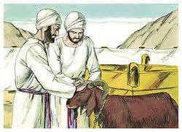
3. 平安祭 peace offering
平安祭所表達的觀念, 就是獻祭者 要 “盡心, 盡性, 盡意, 盡力” 愛主你的神/Love the Lord your God with all your soul, strength, will, and your heart!

Slide 32
⁸你們得救是本乎恩，也因著信；這並不是出於自己，乃是神所賜的；⁹也不是出於行為，免得有人自誇。¹⁰我們原是他的工作，在基督耶穌裡造成的，為要叫我們行善，就是神所預備叫我們行的。
【弗 2:8~10】 ⁸For by grace you have been saved through faith. And this is not your own doing; it is the gift of God, ⁹not a result of works, so that no one may boast. ¹⁰For we are his workmanship, created in Christ Jesus for good works, which God prepared beforehand, that we should walk in them. 【Eph 2:8~10】

Slide 33
路加寫了兩本書, 上册是路加福音
Luke wrote two books, the first one is the Gospel of Luke.
¹提阿非羅大人哪，有好些人提筆作書，述說在我們中間所成就的事，是照傳道的人從起初親眼看見又傳給我們的。【路 1:1】 ¹Inasmuch as many have undertaken to compile a narrative of the things that have been accomplished among us, 【Luke 1:1】

Slide 34
第二本書是使徒行傳/The second book is Acts.
¹提阿非羅阿，我已經作了前書，論到耶穌開頭一切所行所教訓的，【徒 1:1】 ¹In the first book, O Theophilus, I have dealt with all that Jesus began to do and teach, 【Acts 1:1】

Slide 35
第一本書是祭司所獻的燔祭,
那麼第二本書就是平安祭了.
The first book is the burnt offering offered by the priest, and the second book is the peace offering.

