Slide 1
Treasure from Hardships
困苦中出來的財富
8/23/2020 Rev. Joseph Chang BOLGPC 爾灣大公園靈糧堂

Slide 2
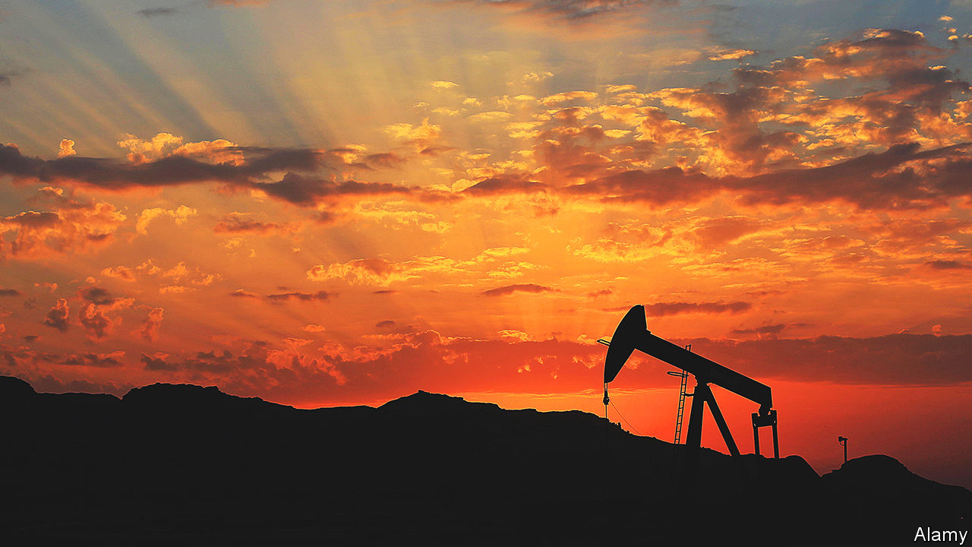
Illustration 1:
中東國家的財政困難
the Mid-Eastern countries financial hardship
“Twilight of the petrostates.” -Middle East&Africa
7/18/2020
Economist

Slide 3
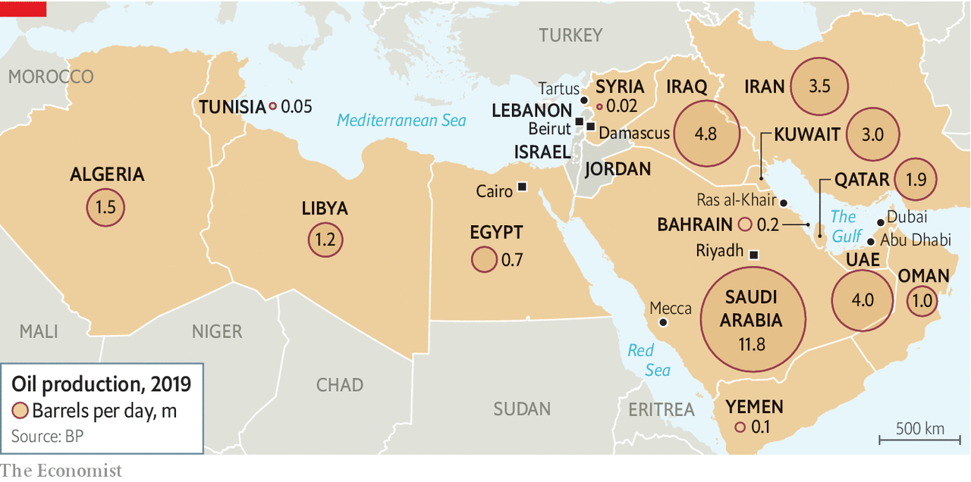

Slide 4
Middle East and North Africa
中東和北非的阿拉伯產油國家
2012
$1 trn
2019
$575 bn
2020
$300 bn

Slide 5
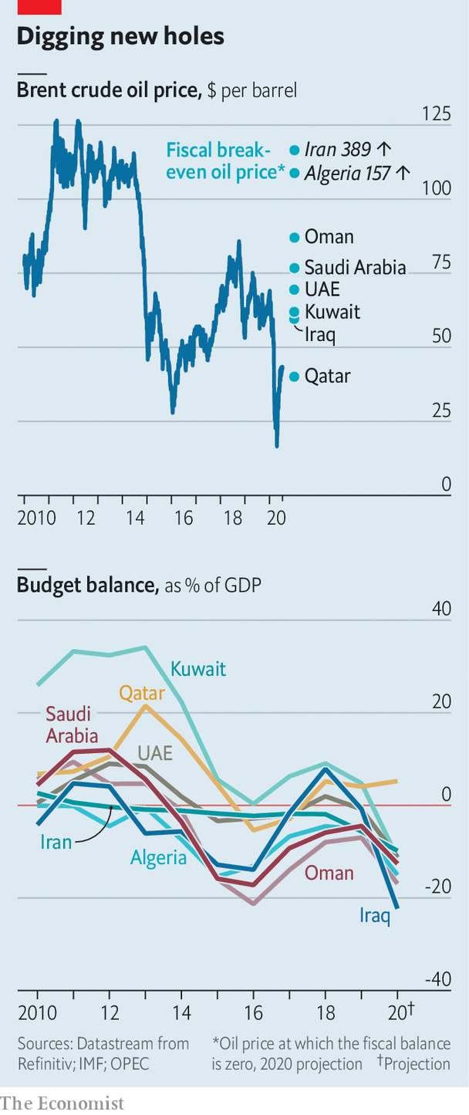
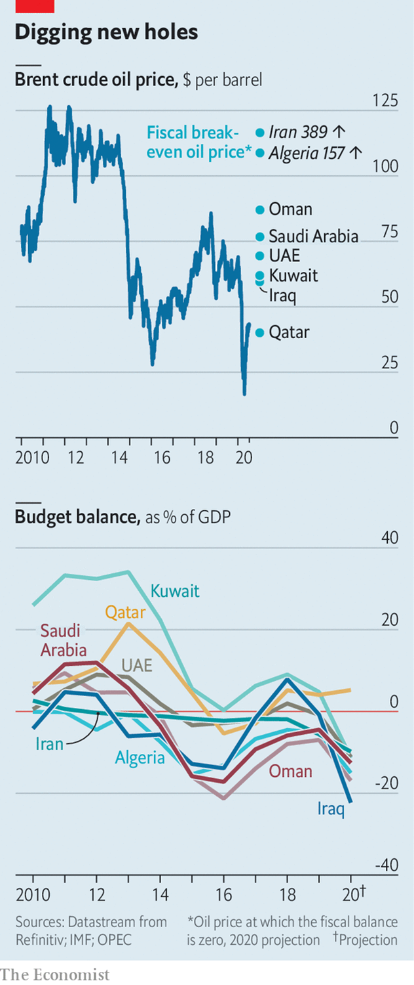

Slide 6
¹⁰我們在你們那裡的時候，曾吩咐你們說，若有人不肯做工，就不可吃飯。【帖後 3:10】 ¹⁰For even when we were with you, we would give you this command: If anyone is not willing to work, let him not eat. 【2Thess 3:10】

Slide 7
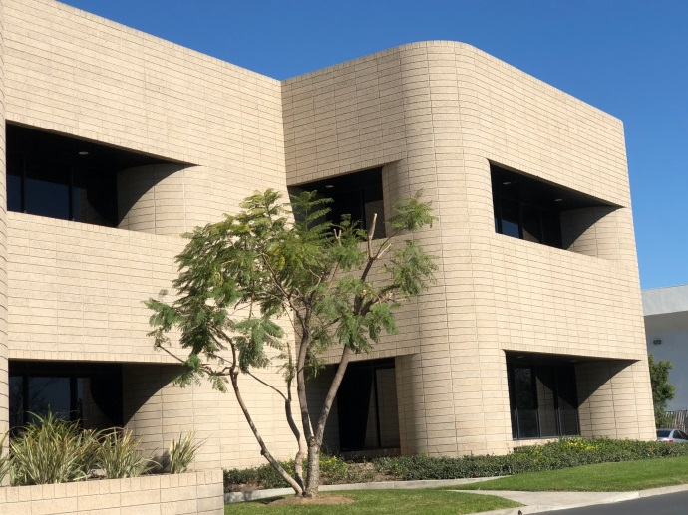
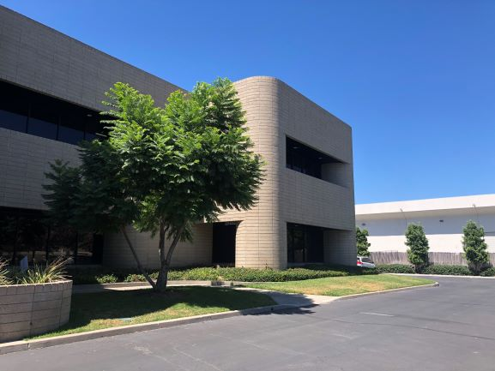
Illustration 2:
The trimming of the trees in our church made them stronger.
修剪我們教堂的樹木使它們更強健。
一月/January
八月/August

Slide 8
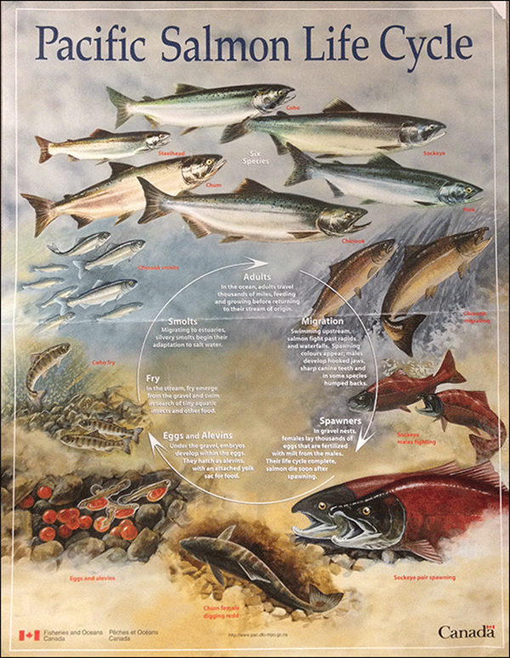
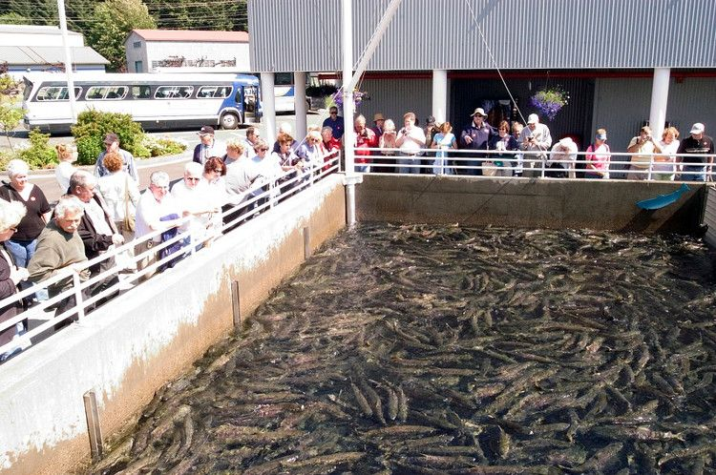
Illustration 3:
The salmon hatchery in the Alaska
coast.
阿拉斯加海岸的鮭魚孵化場。

Slide 9
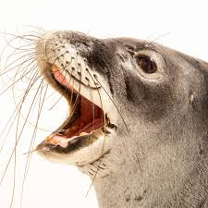
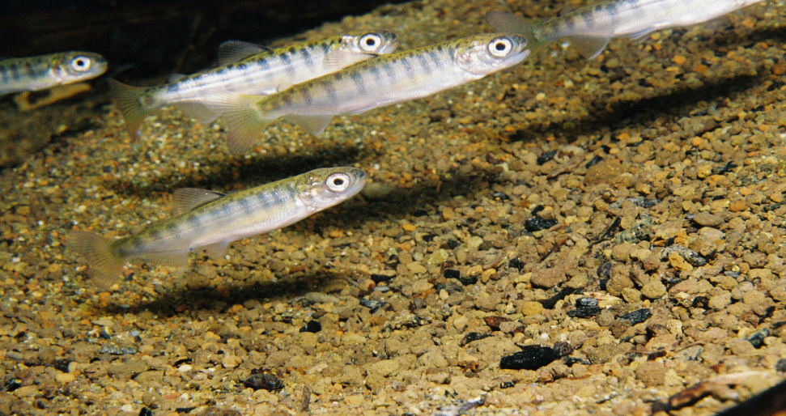

Slide 10
What is the pastor going to share about today?
牧師今天要分享什麼？
Finance.
Or, more precisely, the best economic system for a country.
金融。
或者，更確切地說，是一個國家的最佳經濟體系。

Slide 11
我們要來談到兩種經濟制度
Communism 共產制度
Capitalism 資本主義(私有制度)

Slide 12
→我們來看看上帝選擇哪個制度:
Let's see which system God has chosen.
⁶ . . . . 耶和華曾向他們起誓， . . . . 應許賜給我們的地，就是流奶與蜜之地。【書 5:6】 ⁶. . . . For the LORD had sworn to them . . . . that he had solemnly promised their fathers to give us, a land flowing with milk and honey. 【Josh 5:6b】

Slide 13
Q: 神用甚麼制度?
What system did God use?
God Used Capitalism (Private Ownership)
上帝採用了資本制度 (私有制度).

Slide 14
I. 上帝自己用私有制度, 在這個適合人類罪的制
度裡面, 訓練人的德行.
Via Private Ownership, the system suited for human sinful nature, God trains Human Virtue.

Slide 16
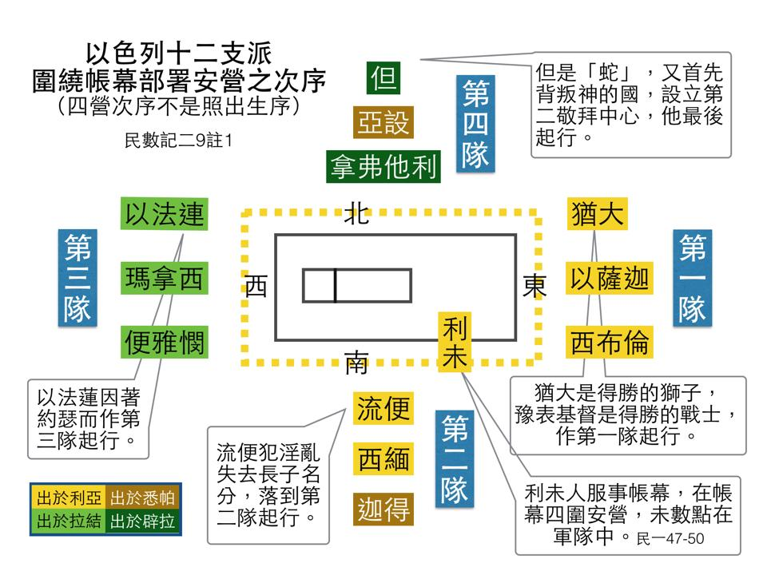

Slide 17
¹祭司利未人和利未全支派必在以色列中無分無業；他們所吃用的就是獻給耶和華的火祭和一切所捐的。²他們在弟兄中必沒有產業；耶和華是他們的產業，正如耶和華所應許他們的。【申 18:1~2】 ¹The priests, who are Levites--indeed the whole tribe of Levi--are to have no allotment or inheritance with Israel. They shall live on the offerings made to the LORD by fire, for that is their inheritance. ²They shall have no inheritance among their brothers; the LORD is their inheritance, as he promised them. 【Deut 18:1~2】

Slide 18
對於利未人呢, 上帝訓練他們的信心.
For the Levites, God strengthened their faith.
Q:但是對於12個支派的人呢? 上帝訓練他們甚麼?
But what about the 12 tribes?
What did God train them to do?
上帝訓練他們給予, 上帝訓練他們慷慨.
God trained them to give, and God trained them to be generous.

Slide 19
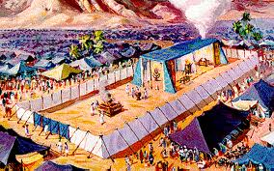
²¹凡以色列中出產的十分之一，我已賜給利未的子孫為業；因他們所辦的是會幕的事，所以賜給他們為酬他們的勞。【民 18:21】 ²¹"I give to the Levites all the tithes in Israel as their inheritance in return for the work they do while serving at the Tent of Meeting. 【Num 18:21】

Slide 20
第一, 他們要給, 而且這個給是自願的。
First, they had to give, and this giving was voluntary.
第二, 神要他們慷慨.
Second, God wanted them to be generous.

Slide 21
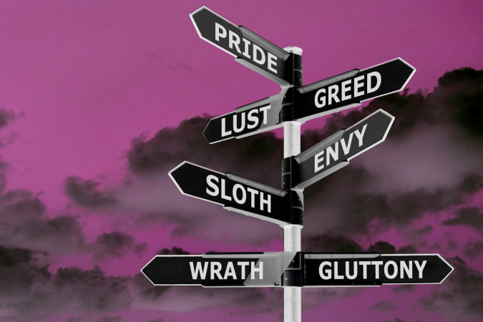
II. 無神論者用共產制度, 在這個只會是天上才有的
制度裡面, 培養人類的罪行.
Via Communism, the system that only Heaven can afford, the atheists cultivate the Human Viles.

Slide 22
Q: 共產主義的問題是甚麼?
What is the problem with communism?
用意良善, 沒有智慧.
Good intentions, but no wisdom.

Slide 23
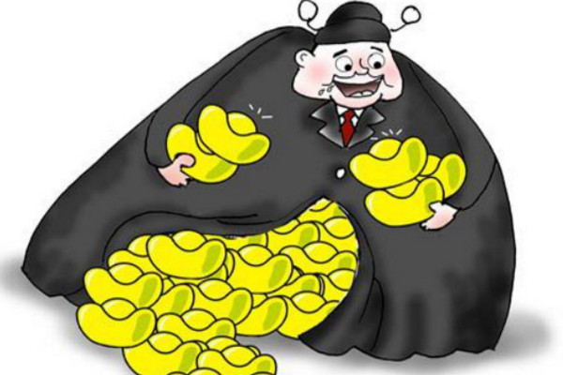
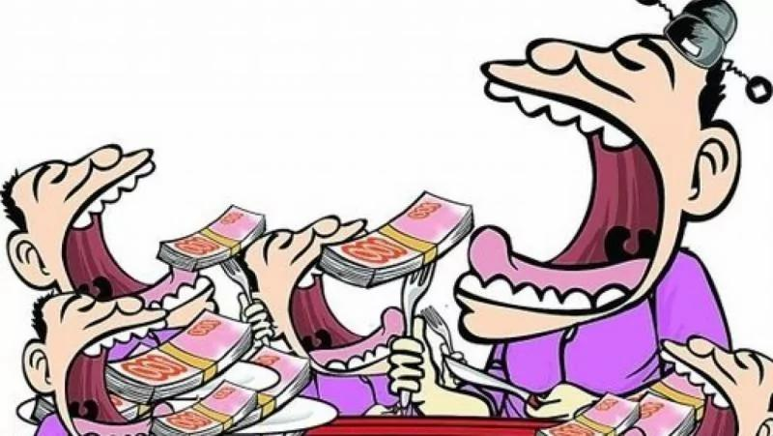
→各取所需的實際情形: the real situation of distribution of goods based on the
individuals’ needs:

Slide 24
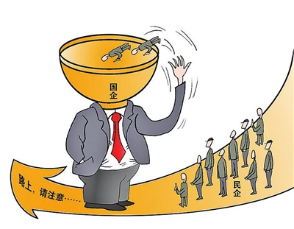
→“國進民退”
"the state enterprises advance, the private sectors retreat"

Slide 25
III. 社會主義Socialism
社會主義Socialism
共產主義 Communism

Slide 26
IV. 但是上帝也是孤兒寡婦寄居者的上帝. 國家可
以幫助這些沒有依靠的人, 但是不能完全拿掉
親人的責任.
God of the fatherless, the widow and the sojourner encourages public/ private assistance to the needy, nevertheless, not to deprive the filial responsibility of the children.

Slide 27
¹⁸他為孤兒寡婦伸冤，又憐愛寄居的，賜給他衣食。
【申 10:18】 ¹⁸He executes justice for the fatherless and the widow, and loves the sojourner, giving him food and clothing.
【Deut 10:18】

Slide 28
²⁷在神我們的父面前，那清潔沒有玷污的虔誠，就是看顧在患難中的孤兒寡婦，並且保守自己不沾染世俗。
【雅 1:27】 ²⁷Religion that is pure and undefiled before God, and the Father, is this: to visit orphans and widows in their affliction, and to keep oneself unstained from the world. 【Jam 1:27】

Slide 29
⁴若寡婦有兒女，或有孫子孫女，便叫他們先在自己家中學著行孝，報答親恩，因為這在神面前是可悅納的。⁵那獨居無靠、真為寡婦的，是仰賴神，晝夜不住的祈求禱告。
⁴But if a widow has children or grandchildren, let them first learn to show godliness to their own household and to make some return to their parents, for this is pleasing in the sight of God. ⁵She who is truly a widow, left all alone, has set her hope on God and continues in supplications and prayers night and day,

Slide 30
⁶但那好宴樂的寡婦正活著的時候也是死的。⁷這些事你要囑咐他們，叫他們無可指責。⁸人若不看顧親屬，就是背了真道，比不信的人還不好，不看顧自己家裡的人，更是如此。【提前 5:4~8】
⁶but she who is self-indulgent is dead even while she lives. ⁷Command these things as well, so that they may be without reproach. ⁸But if anyone does not provide for his relatives, and especially for members of his household, he has denied the faith and is worse than an unbeliever. 【1Tim 5:4~8】

Slide 31
Conclusion結論
神一則對人類還是存在很高的盼望, 所以神賜給人救恩, 鼓勵人類能夠活出神的形象, 譬如讓他的子民學習慷慨. 神對人的罪性也是很清楚, 所以神防止給人類犯罪的機會. 人若不工作, 就不給他飯吃.
With high hopes for mankind, God granted salvation to mankind and encouraged mankind to live out the image of God, such as making his people learn generosity. God is also very clear about the sinful nature of man, so God prevents it from giving mankind the opportunity to sin. If a person does not work, he will not be given food.

Slide 32
人類呢則是對自己存在了極高的評價. 以為靠人的操守, 人可以各取所需, 把自己的工作果效全部都獻給人類, 就產生了共產主義. 但是人類低估了自己的罪性可以帶來的破壞. 所以沒有料到人類不為自己工作時, 每一個人都不願意好好工作. 產生了均窮, 而不是均富.
Human beings overestimate human goodness. They fancy of devoting all the results of their work to mankind and distributing goods based on the individual needs. Thus, communism was born. But human beings underestimate the destruction their sinful nature can bring. Unexpectedly, everyone is unwilling to work hard when they cannot keep the fruit of their labor. It produces equal poverty, not equal wealth.

Slide 33
真正的財富, 來自人類的努力和神的祝福.
Real wealth comes from human efforts and God's blessing.

