Slide 1
10/11/2020 主日歡慶
大公園靈糧堂

Slide 2
以詩歌來敬拜
我的救贖者活著
因他活著
像我這樣
從未求告

Slide 3
以奉獻來敬拜

Slide 4
上帝不打烊
Yes, we are open

Slide 5
不好的環境 擋不住福音. Circumstances can’t stop Gospel
12 弟兄們，我願意你們知道，我所遭遇的事更是叫福音興旺，
13 以致我受的捆鎖在御營全軍和其餘的人中，已經顯明是為基督的緣故。(腓利比書 1:12-13)
12 Now I want you to know, brothers and sisters, that what has happened to me has actually served to advance the gospel.
13 As a result, it has become clear throughout the whole palace guard and to everyone else that I am in chains for Christ.
20 我為這福音的奧祕作了帶鎖鍊的使者，並使我照著當盡的本分放膽講論。(以弗所書 6:20)
20 for which I am an ambassador in chains. Pray that I may declare it fearlessly, as I should.
16 進了羅馬城，保羅蒙准和一個看守他的兵另住在一處。(使徒行傳 28:16)
16 When we got to Rome, Paul was allowed to live by himself, with a soldier to guard him.

Slide 6
不好的動機 擋不住福音. Wrong Motives can’t stop Gospel
15 有的傳基督是出於嫉妒紛爭，也有的是出於好意。
16 這一等是出於愛心，知道我是為辯明福音設立的；
17 那一等傳基督是出於結黨，並不誠實，意思要加增我捆鎖的苦楚。
18 這有何妨呢？或是假意，或是真心，無論怎樣，基督究竟被傳開了。
為此，我就歡喜。(腓利比書1:15-18)
15 It is true that some preach Christ out of envy and rivalry, but others out of goodwill.
16 The latter do so out of love, knowing that I am put here for the defense of the gospel.
17 The former preach Christ out of selfish ambition, not sincerely, supposing that they can stir up trouble for me while I am in chains.
18 But what does it matter? The important thing is that in every way, whether from false motives or true, Christ is preached. And because of this I rejoice.

Slide 7
福音的好夥伴. Good Partner in the Gospel
3 我每逢想念你們，就感謝我的上帝；
4 每逢為你們眾人祈求的時候，常是歡歡喜喜地祈求。
5 因為從頭一天直到如今，你們是同心合意地興旺福音。
6 我深信那在你們心裏動了善工的，必成全這工，直到耶穌基督的日子。
(腓利比書1:3-6)
3 I thank my God every time I remember you.
4 In all my prayers for all of you, I always pray with joy
5 because of your partnership in the gospel from the first day until now,
6 being confident of this, that he who began a good work in you will carry it on to completion until the day of Christ Jesus.

Slide 8
那人撒種，這人收割. One sows and another reaps
36 收割的人得工價，積蓄五榖到永生，叫撒種的和收割的一同快樂。
37 俗語說：『那人撒種，這人收割』，這話可見是真的。
38 我差你們去收你們所沒有勞苦的；別人勞苦，你們享受他們所勞苦的。」
36 Even now the one who reaps draws a wage and harvests a crop for eternal life, so that the sower and the reaper may be glad together.
37 Thus the saying ‘One sows and another reaps’ is true.
38 I sent you to reap what you have not worked for. Others have done the hard work, and you have reaped the benefits of their labor.”
(John 4:36–38)

Slide 9
放膽傳上帝的道, 無所懼怕. Dare more, without fear
14 並且那在主裏的弟兄多半因我受的捆鎖就篤信不疑，越發放膽傳上帝的道，無所懼怕。 (腓利比書1:14)
14 And because of my chains, most of the brothers and sisters have become confident in the Lord and dare all the more to proclaim the gospel without fear.

Slide 10
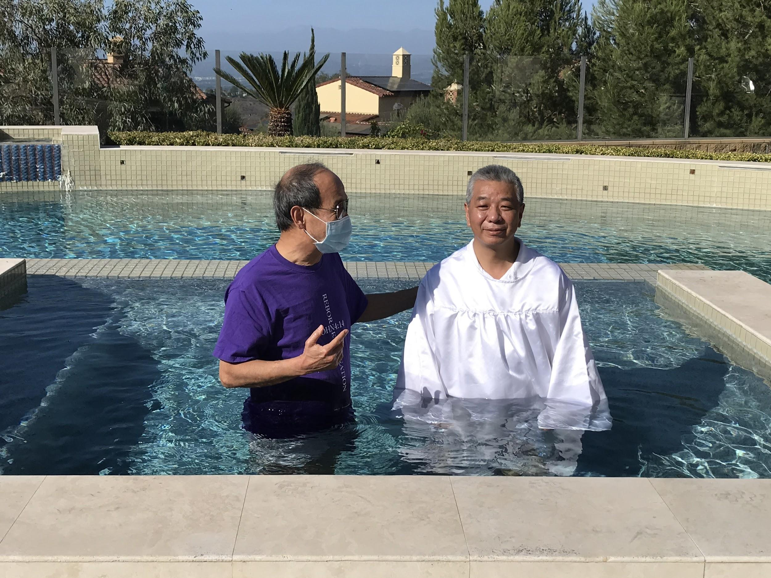
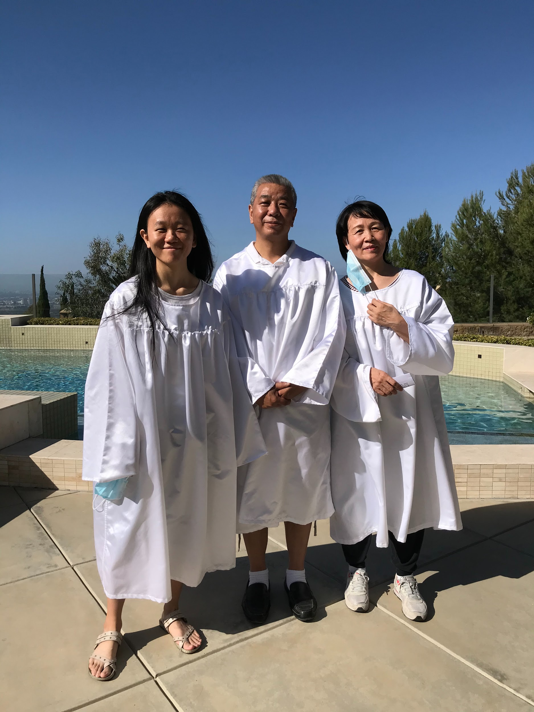

Slide 11
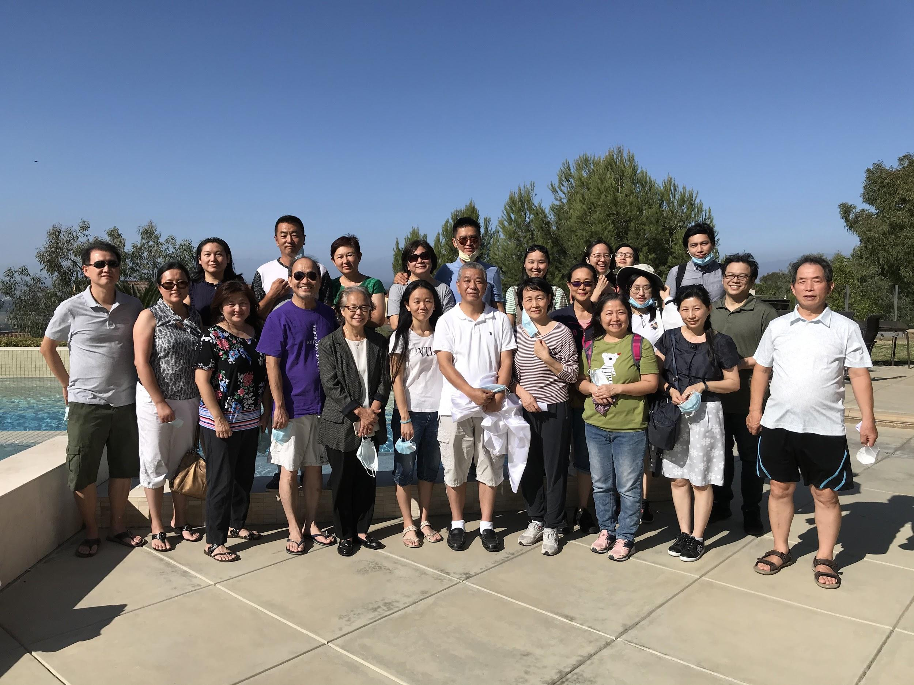

Slide 12
歡迎你!
我們很開心和你一起敬拜
與我們聯繫 bolgpchurch@gmail.com

Slide 13
報告與代禱
成人主日學：聖經課程 <腓力比書> 將於下週日(10/18) 起，9:15~10:45am 開始上課，上課請登入教會zoom #7780 視訊會議
北美靈糧堂神學院2020秋季班最新課程 : 啟示文學 (10/13-12/15)。每週二6:00~8:45pm. 教師 :張玉明 博士。詳情請洽尤志文弟兄(949-245-9769) 或網上報名http://bolts-na-org/最新課程。

Slide 14
報告與代禱
肢體代禱 (1) Andy Lo 弟兄的父母，羅伯伯、羅媽媽車禍手術後的復原、復健代禱。(2) 高亮星弟兄、朱克莊老師兒子Chris Kao在Lake Tahoe發生嚴重車禍、全身癱瘓，感謝主的憐憫，目前Chris 肢體稍有感覺，已於 9/13回台灣準備接受神經繞道手術，以期能重新站立、自主行動。需要大家繼續迫切代禱。
請為11/3美國總統大選迫切代禱。所有權柄都是出於上帝，求主來主導這個大選，賜美國一位能帶領國家回到 神面前的領袖!
徵求直播同工。主日現場直播目前需要您的加入，目前直播設備已簡化只需一個人即可操作，有興趣加入主日服事的弟兄姊妹請跟Albert Lin 聯絡 <an042804@yahoo.com> ，方便安排操作訓練

