Slide 1
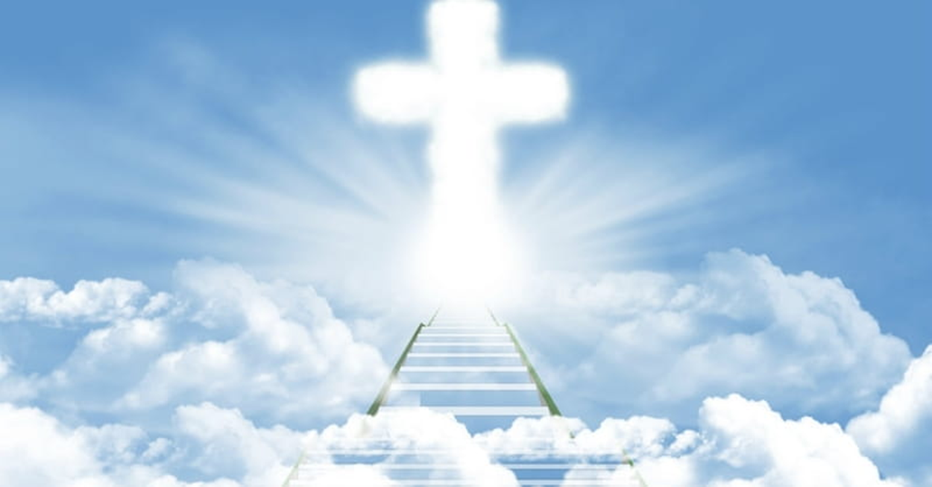
2 Phases of the 2nd Advent
主耶穌第二次降臨的兩個階段
12/13/2020
Rev. Joseph Chang
BOLGPC 爾灣大公園靈糧堂

Slide 2
主耶穌的兩次降臨/Two comings of the Lord Jesus
1. 第一次的降臨已經發生, 我們都經歷了祂的恩典, 我們的生
命不致滅亡, 反而可以得到永生.
The first coming has already happened. We all have experienced
His grace. Our lives will not perish so that we can get eternal life.
2. 第二次降臨即將發生, 我們要得到他的賞賜, 得勝的要與祂
一同作王.
The second coming is about to happen. We will receive his
reward and reign with him.

Slide 3
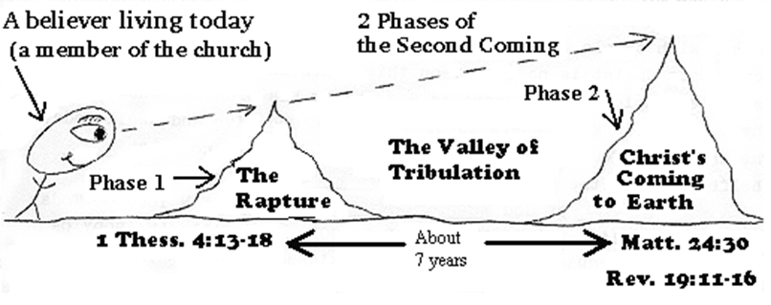
第二次降臨是可以分為兩個階段:
The second coming can be divided into two phases:

Slide 4
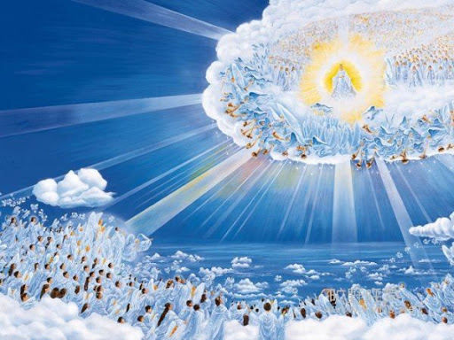
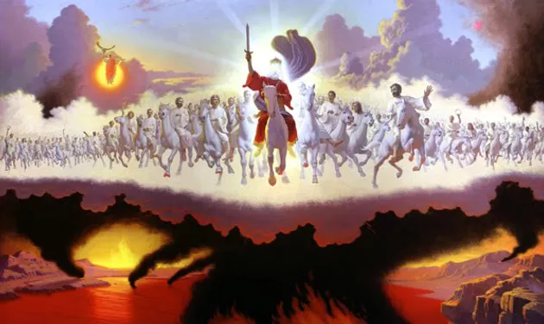
Phase 1: the rapture
Phase 2: Christ’s coming to earth

Slide 5
第一個階段就是基督徒的被提.
The first phase is the rapture of Christians.
¹³論到睡了的人，我們不願意弟兄們不知道，恐怕你們憂傷，像那些沒有指望的人一樣。¹⁴我們若信耶穌死而復活了，那已經在耶穌裡睡了的人，神也必將他與耶穌一同帶來。
¹³But we do not want you to be uninformed, brothers, about those who are asleep, that you may not grieve as others do who have no hope. ¹⁴For since we believe that Jesus died and rose again, even so, through Jesus, God will bring with him those who have fallen asleep.

Slide 6
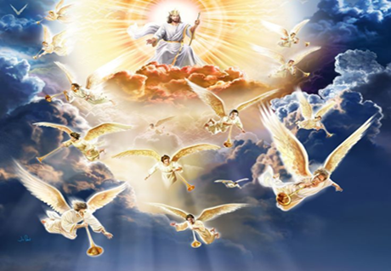
¹⁵我們現在照主的話告訴你們一件事：我們這活著還存留到主降臨的人，斷不能在那已經睡了的人之先。¹⁶因為主必親自從天降臨，有呼叫的聲音和天使長的聲音，又有神的號吹響；那在基督裡死了的人必先復活。
¹⁵For this we declare to you by a word from the Lord, that we who are alive, who are left until the coming of the Lord, will not precede those who have fallen asleep. ¹⁶For the Lord himself will descend from heaven with a cry of
command, with the voice of an
archangel, and with the sound of
the trumpet of God. And the dead
in Christ will rise first.

Slide 7
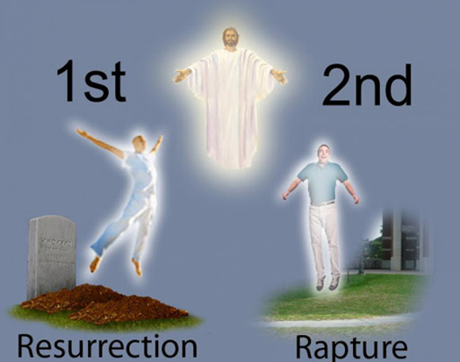
¹⁷以後我們這活著還存留的人必和他們一同被提到雲裡，在空中與主相遇。這樣，我們就要和主永遠同在。¹⁸所以，你們當用這些話彼此勸慰。【帖前 4:13~18】 ¹⁷Then we who are alive, who are left,
will be caught up together with them
in the clouds to meet the Lord in the
air, and so we will always be with the
Lord. ¹⁸Therefore encourage one
another with these words.
【1Thess 4:13~18】

Slide 8
Q: 為什麼主耶穌要來把基督徒提走?
Why is the Lord Jesus coming to take His believers to heaven?
1. 要免除我們經歷世界上最可怕的災難
Save us from experiencing the Great Tribulation.
2. 要裝備我們來進行七年後的哈馬吉多頓的大戰.
Equip us for the battle of Armageddon coming seven years
later.

Slide 9
這大災難又稱為 Jacob’s Trouble

Slide 10
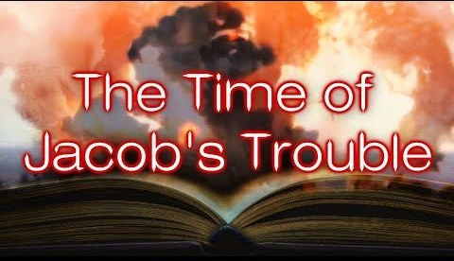
I. Earthly happenings during the Great Tribulation:
大災難時期地上的光景:

Slide 11
Jacob’s Trouble/雅各的大災難:
⁴以下是耶和華論到以色列和猶大所說的話：⁵耶和華如此說：我們聽見聲音，是戰抖懼怕而不平安的聲音。⁶你們且訪問看看，男人有產難麼？我怎麼看見人人用手掐腰，像產難的婦人，臉面都變青了呢？⁷哀哉！那日為大，無日可比；這是雅各遭難的時候，但他必被救出來。【耶 30:4~7】 ⁴These are the words that the Lord spoke concerning Israel and Judah: ⁵" Thus says the Lord: We have heard a cry of panic, of terror, and no peace. ⁶Ask now, and see, can a man bear a child? Why then do I see every man with his hands on his stomach like a woman in labor? Why has every face turned pale? ⁷Alas! That day is so great there is none like it; it is a time of distress for Jacob; yet he shall be saved out of it. 【Jer 30:4~7】

Slide 12
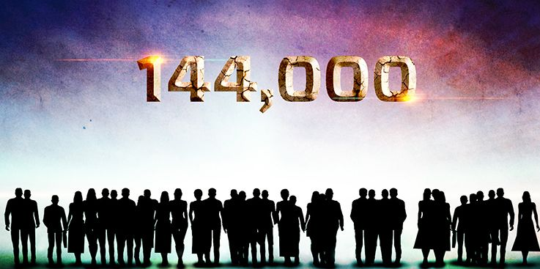
神要在以色列的12個支派當中, 每一個支派選擇12,000個人, 作為祂在大災難時期的特種作戰部隊, 把耶穌基督救恩的信息傳揚給世界上的人。
God wants to choose 12,000 people from each of the 12 tribes of Israel as His Special Force(Delta, Seal, Ranger type of people) to spread the message of salvation during the Great Tribulation.

Slide 13
¹此後，我看見四位天使站在地的四角，執掌地上四方的風，叫風不吹在地上、海上，和樹上。²我又看見另有一位天使，從日出之地上來，拿著永生神的印。他就向那得著權柄能傷害地和海的四位天使大聲喊著說：³地與海並樹木，你們不可傷害，等我們印了我們神眾僕人的額。
¹After this I saw four angels standing at the four corners of the earth, holding back the four winds of the earth, that no wind might blow on earth or sea or against any tree. ²Then I saw another angel ascending from the rising of the sun, with the seal of the living God, and he called with a loud voice to the four angels who had been given power to harm earth and sea, ³saying, "Do not harm the earth or the sea or the trees, until we have sealed the servants of our God on their foreheads."

Slide 14
⁴我聽見以色列人各支派中受印的數目有十四萬四千。⁵猶大支派中受印的有一萬二千；流便支派中有一萬二千；迦得支派中有一萬二千；⁶亞設支派中有一萬二千；拿弗他利支派中有一萬二千；瑪拿西支派中有一萬二千；⁷西緬支派中有一萬二千；利未支派中有一萬二千；以薩迦支派中有一萬二千；
⁴And I heard the number of the sealed, 144,000, sealed from every tribe of the sons of Israel: ⁵12,000 from the tribe of Judah were sealed, 12,000 from the tribe of Reuben, 12,000 from the tribe of Gad, ⁶12,000 from the tribe of Asher, 12,000 from the tribe of Naphtali, 12,000 from the tribe of Manasseh, ⁷12,000 from the tribe of Simeon, 12,000 from the tribe of Levi, 12,000 from the tribe of Issachar,

Slide 15
⁸西布倫支派中有一萬二千；約瑟支派中有一萬二千；便雅憫支派中受印的有一萬二千。⁹此後，我觀看，見有許多的人，沒有人能數過來，是從各國、各族、各民、各方來的，站在寶座和羔羊面前，身穿白衣，手拿棕樹枝，¹⁰大聲喊著說：願救恩歸與坐在寶座上我們的神，也歸與羔羊！
⁸12,000 from the tribe of Zebulun, 12,000 from the tribe of Joseph, 12,000 from the tribe of Benjamin were sealed. ⁹After this I looked, and behold, a great multitude that no one could number, from every nation, from all tribes and peoples and languages, standing before the throne and before the Lamb, clothed in white robes, with palm branches in their hands, ¹⁰and crying out with a loud voice, "Salvation belongs to our God who sits on the throne, and to the Lamb!"

Slide 16
¹¹眾天使都站在寶座和眾長老並四活物的周圍，在寶座前，面伏於地，敬拜神，¹²說：阿們！頌讚、榮耀、智慧、感謝、尊貴、權柄、大力都歸與我們的神，直到永永遠遠。阿們！¹³長老中有一位問我說：這些穿白衣的是誰？是從那裡來的？¹¹And all the angels were standing around the throne and around the elders and the four living creatures, and they fell on their faces before the throne and worshiped God, ¹²saying, "Amen! Blessing and glory and wisdom and thanksgiving and honor and power and might be to our God forever and ever! Amen." ¹³Then one of the elders addressed me, saying, "Who are these, clothed in white robes, and from where have they come?"

Slide 17
¹⁴我對他說：我主，你知道。他向我說：這些人是從大患難中出來的，曾用羔羊的血把衣裳洗白淨了。¹⁵所以，他們在神寶座前，晝夜在他殿中事奉他。坐寶座的要用帳幕覆庇他們。¹⁶他們不再飢，不再渴；日頭和炎熱也必不傷害他們。
¹⁴I said to him, "Sir, you know." And he said to me, "These are the ones coming out of the great tribulation. They have washed their robes and made them white in the blood of the Lamb. ¹⁵"Therefore they are before the throne of God, and serve him day and night in his temple; and he who sits on the throne will shelter them with his presence. ¹⁶They shall hunger no more, neither thirst anymore; the sun shall not strike them, nor any scorching heat.

Slide 18
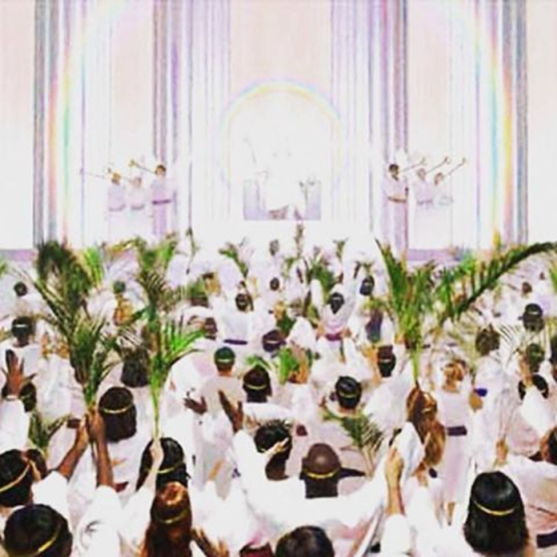
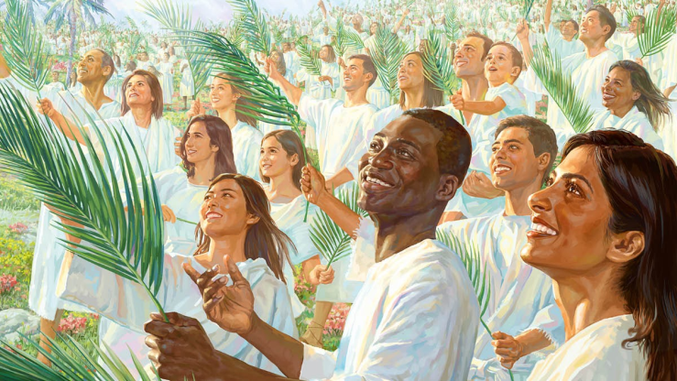
¹⁷因為寶座中的羔羊必牧養他們，領他們到生命水的泉源；神也必擦去他們一切的眼淚。【啟 7:1~17】
¹⁷For the Lamb in the midst of the throne will be their shepherd, and he will guide them to springs of living water, and God will wipe away every tear from their eyes." 【Rev 7:1~17】

Slide 19
我認為, 這些忠心的見證人都殉道了.
I think these faithful witnesses were martyred.
¹我又觀看，見羔羊站在錫安山，同他又有十四萬四千人，都有他的名和他父的名寫在額上。²我聽見從天上有聲音，像眾水的聲音和大雷的聲音，並且我所聽見的好像彈琴的所彈的琴聲。
¹Then I looked, and behold, on Mount Zion stood the Lamb, and with him 144,000 who had his name and his Father's name written on their foreheads. ²And I heard a voice from heaven like the roar of many waters and like the sound of loud thunder. The voice I heard was like the sound of harpists playing on their harps,

Slide 20
³他們在寶座前，並在四活物和眾長老前唱歌，彷彿是新歌；除了從地上買來的那十四萬四千人以外，沒有人能學這歌。⁴這些人未曾沾染婦女，他們原是童身。羔羊無論往那裡去，他們都跟隨他。他們是從人間買來的，作初熟的果子歸與神和羔羊。⁵在他們口中察不出謊言來；他們是沒有瑕疵的。【啟 14:1~5】 ³and they were singing a new song before the throne and before the four living creatures and before the elders. No one could learn that song except the 144,000 who had been redeemed from the earth. ⁴It is these who have not defiled themselves with women, for they are virgins. It is these who follow the Lamb wherever he goes. These have been redeemed from mankind as firstfruits for God and the Lamb, ⁵and in their mouth no lie was found, for they are blameless. 【Rev 14:1~5】

Slide 21
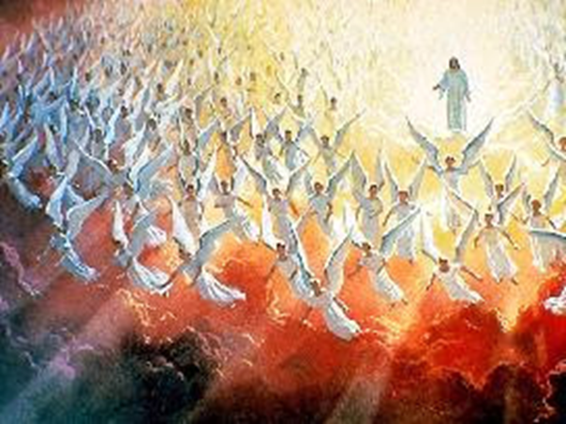
II. Heavenly happenings during the Great Tribulation:
大災難時期天上的光景:

Slide 22
⁵⁰弟兄們，我告訴你們說，血肉之體不能承受神的國，必朽壞的不能承受不朽壞的。⁵¹我如今把一件奧祕的事告訴你們：我們不是都要睡覺，乃是都要改變，⁵²就在一霎時，眨眼之間，號筒末次吹響的時候。因號筒要響，死人要復活成為不朽壞的，我們也要改變
⁵⁰I tell you this, brothers: flesh and blood cannot inherit the kingdom of God, nor does the perishable inherit the imperishable. ⁵¹Behold! I tell you a mystery. We shall not all sleep, but we shall all be changed, ⁵²in a moment, in the twinkling of an eye, at the last trumpet. For the trumpet will sound, and the dead will be raised imperishable, and we shall be changed.

Slide 23
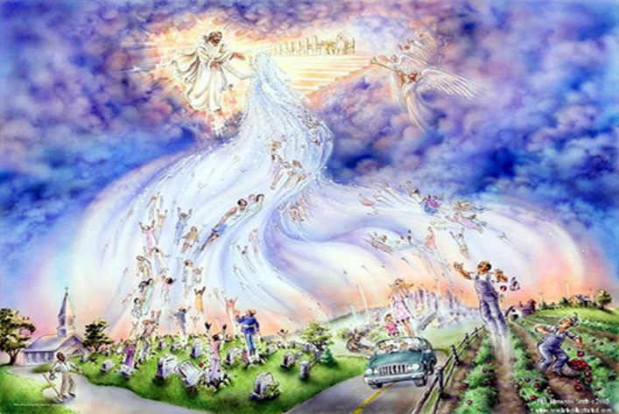
。⁵³這必朽壞的總要變成（變成：原文作穿；下同）不朽壞的，這必死的總要變成不死的。【林前 15:50~53】
⁵³For this perishable body must put on the imperishable, and this mortal body must put on immortality. 【1Cor 15:50~53】

Slide 24
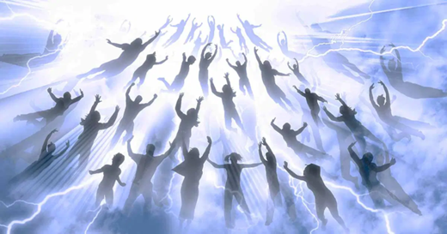
Q: 被提的基督徒都要改變, 這改變有多快呢?
The raptured Christians will change.
How quickly will this change?
A: 一眨眼之間，就是忽然間。
In the blinking on an eye .
It is very sudden.

Slide 25
保羅提到不同榮光的復活身體:
Paul mentioned the resurrected bodies of different glory:
³⁵或有人問：死人怎樣復活，帶著甚麼身體來呢？³⁶無知的人哪，你所種的，若不死就不能生。³⁷並且你所種的不是那將來的形體，不過是子粒，即如麥子，或是別樣的穀。³⁸但神隨自己的意思給他一個形體，並叫各等子粒各有自己的形體。
³⁵But someone will ask, "How are the dead raised? With what kind of body do they come?" ³⁶You foolish person! What you sow does not come to life unless it dies. ³⁷And what you sow is not the body that is to be, but a bare kernel, perhaps of wheat or of some other grain. ³⁸But God gives it a body as he has chosen, and to each kind of seed its own body.

Slide 26
³⁹凡肉體各有不同：人是一樣，獸又是一樣，鳥又是一樣，魚又是一樣。⁴⁰有天上的形體，也有地上的形體；但天上形體的榮光是一樣，地上形體的榮光又是一樣。⁴¹日有日的榮光，月有月的榮光，星有星的榮光。這星和那星的榮光也有分別。⁴²死人復活也是這樣：所種的是必朽壞的，復活的是不朽壞的；【林前 15:35~42】 ³⁹For not all flesh is the same, but there is one kind for humans, another for animals, another for birds, and another for fish. ⁴⁰There are heavenly bodies and earthly bodies, but the glory of the heavenly is of one kind, and the glory of the earthly is of another. ⁴¹There is one glory of the sun, and another glory of the moon, and another glory of the stars; for star differs from star in glory. ⁴²So is it with the resurrection of the dead. What is sown is perishable; what is raised is imperishable. 【1Cor 15:35~42】

Slide 27
主耶穌說, 我們將來復活的時候, 要像天使一樣。
The Lord Jesus said that we shall be like angels when we are resurrected in the future.
³⁴耶穌說：這世界的人有娶有嫁；³⁵惟有算為配得那世界，與從死裡復活的人也不娶也不嫁；³⁶因為他們不能再死，和天使一樣；既是復活的人，就為神的兒子。【路 20:34~36】 ³⁴And Jesus said to them, ""The sons of this age marry and are given in marriage," ³⁵"but those who are considered worthy to attain to that age and to the resurrection from the dead neither marry nor are given in marriage," ³⁶"for they cannot die anymore, because they are equal to angels and are sons of God, being sons of the resurrection." 【Luke 20:34~36】

Slide 28
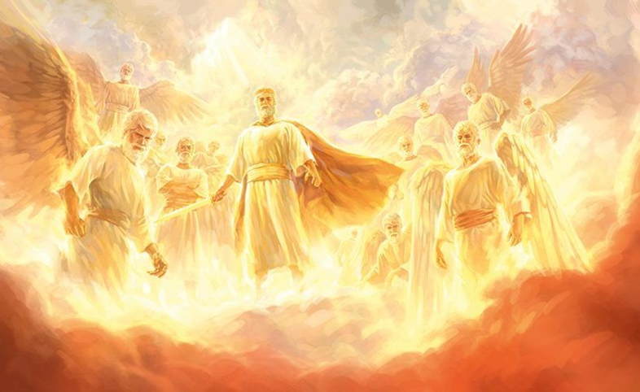
天使有不同的等次/Angels have different orders
²¹遠超過一切執政的、掌權的、有能的、主治的，和一切有名的；不但是今世的，連來世的也都超過了。【弗 1:21】 ²¹far above all rule and authority and power and dominion, and above every name that is named, not only in this age but also in the one to come. 【Eph 1:21】

Slide 29
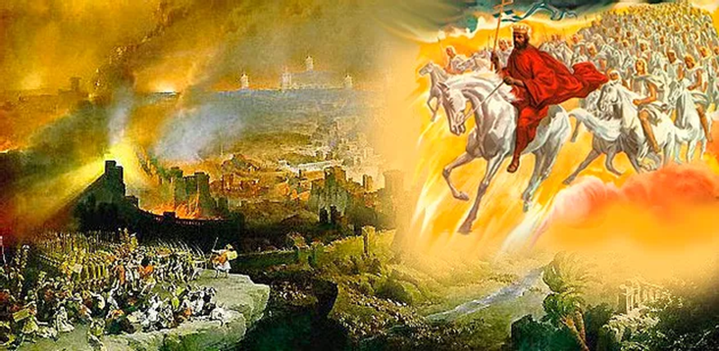
III. Christ’s Coming to Earth/耶穌來到地上—
The merge of the heavenly and earthly happenings
天上的工作和地上的工作合在一起.

Slide 30
哈米吉多頓的大戰/ the battle of Armageddon:
³⁰那時，人子的兆頭要顯在天上，地上的萬族都要哀哭。他們要看見人子，有能力，有大榮耀，駕著天上的雲降臨。【太 24:30】 ³⁰"Then will appear in heaven the sign of the Son of Man, and then all the tribes of the earth will mourn, and they will see the Son of Man coming on the clouds of heaven with power and great glory." 【Matt 24:30】

Slide 31
¹¹我觀看，見天開了。有一匹白馬，騎在馬上的稱為誠信真實，他審判，爭戰，都按著公義。¹²他的眼睛如火焰，他頭上戴著許多冠冕；又有寫著的名字，除了他自己沒有人知道。¹³他穿著濺了血的衣服；他的名稱為神之道。¹⁴在天上的眾軍騎著白馬，穿著細麻衣，又白又潔，跟隨他。
¹¹Then I saw heaven opened, and behold, a white horse! The one sitting on it is called Faithful and True, and in righteousness he judges and makes war. ¹²His eyes are like a flame of fire, and on his head are many diadems, and he has a name written that no one knows but himself. ¹³He is clothed in a robe dipped in blood, and the name by which he is called is The Word of God. ¹⁴And the armies of heaven, arrayed in fine linen, white and pure, were following him on white horses.

Slide 32
¹⁵有利劍從他口中出來，可以擊殺列國。他必用鐵杖轄管他們，（轄管：原文作牧）並要踹全能神烈怒的酒醡。¹⁶在他衣服和大腿上有名寫著說：萬王之王，萬主之主。
【啟 19:11~16】
¹⁵From his mouth comes a sharp sword with which to strike down the nations, and he will rule them with a rod of iron. He will tread the winepress of the fury of the wrath of God the Almighty. ¹⁶On his robe and on his thigh he has a name written, King of kings and Lord of lords. 【Rev 19:11~16】

Slide 33
這個戰爭的慘烈/the fierceness of this war
¹⁷又有一位天使從天上的殿中出來，他也拿著快鐮刀。¹⁸又有一位天使從祭壇中出來，是有權柄管火的，向拿著快鐮刀的大聲喊著說：伸出快鐮刀來，收取地上葡萄樹的果子，因為葡萄熟透了！
¹⁷Then another angel came out of the temple in heaven, and he too had a sharp sickle. ¹⁸And another angel came out from the altar, the angel who has authority over the fire, and he called with a loud voice to the one who had the sharp sickle, "Put in your sickle and gather the clusters from the vine of the earth, for its grapes are ripe."

Slide 34
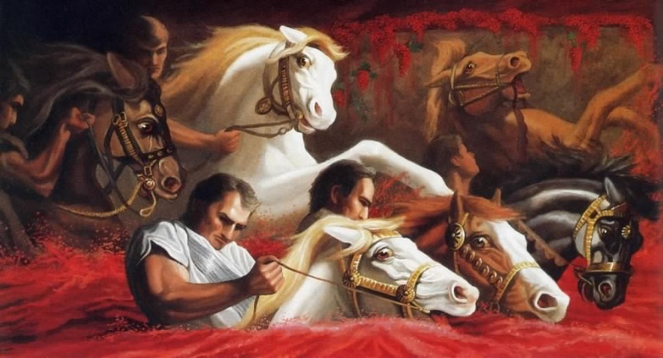
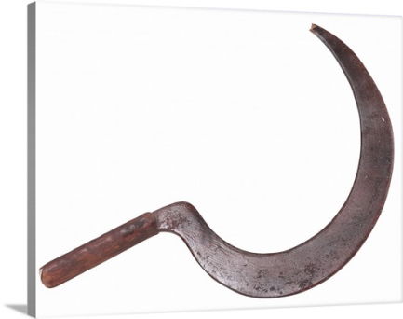
¹⁹那天使就把鐮刀扔在地上，收取了地上的葡萄，丟在神忿怒的大酒醡中。²⁰那酒醡踹在城外，就有血從酒醡裡流出來，高到馬的嚼環，遠有六百里。【啟 14:17~20】 ¹⁹So the angel swung his sickle across the earth and gathered the grape harvest of the earth and threw it into the great winepress of the wrath of God. ²⁰And the winepress was trodden outside the city, and blood flowed from the winepress, as high as a horse's bridle, for 1,600 stadia. 【Rev 14:17~20】

Slide 35
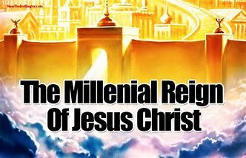
→千禧年度/Millennium:
表示主耶穌要在這個世界上親自治理這個世界1,000年.
It means that the Lord Jesus will personally govern this world
for 1,000 years.

Slide 36
主耶穌 第二次再來 有兩個phases:
The 2nd Advent of Jesus Christ has two phases:
Phase 1: coming in the air and rapturing away the Christians
來到天空, 提走基督徒.
Phase 2: descending to the earth and declaring his return to
his kingdom
降到地上, 來宣告得回祂的國度.

Slide 37
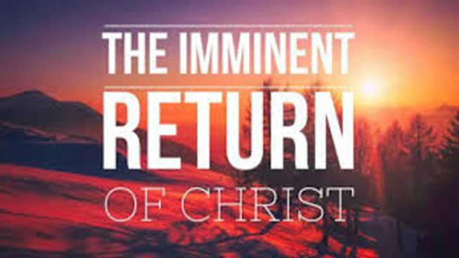
我們需要深深記住在心裡的就是:
What we need to keep in our mind is:
“Imminent Return of Jesus Christ”
“主耶穌任何時候都會來臨”. 這個特別是指第1個phase.

Slide 38
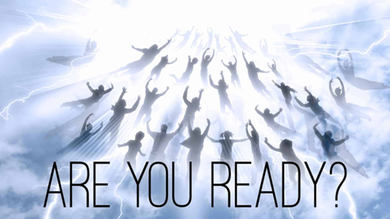
IV. The imminent return of Jesus Christ
主耶穌任何時候都會來臨

Slide 39
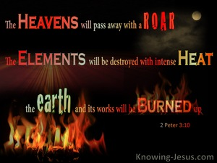
¹⁰但主的日子要像賊來到一樣。那日，天必大有響聲廢去，有形質的都要被烈火銷化，地和其上的物都要燒盡了。
【彼後 3:10】 ¹⁰But the day of the Lord will come like a thief, and then the heavens will pass away with a roar, and the heavenly bodies will be burned up and dissolved, and the earth and the works that are done on it will be exposed. 【2Pet 3:10】

Slide 40
³⁵你們腰裡要束上帶，燈也要點著，³⁶自己好像僕人等候主人從婚姻的筵席上回來。他來到，叩門，就立刻給他開門。³⁷主人來了，看見僕人儆醒，那僕人就有福了。我實在告訴你們，主人必叫他們坐席，自己束上帶，進前伺候他們。
³⁵""Stay dressed for action and keep your lamps burning," ³⁶"and be like men who are waiting for their master to come home from the wedding feast, so that they may open the door to him at once when he comes and knocks." ³⁷"Blessed are those servants whom the master finds awake when he comes. Truly, I say to you, he will dress himself for service and have them recline at table, and he will come and serve them."

Slide 41
³⁸或是二更天來，或是三更天來，看見僕人這樣，那僕人就有福了。³⁹家主若知道賊甚麼時候來，就必儆醒，不容賊挖透房屋，這是你們所知道的。⁴⁰你們也要預備；因為你們想不到的時候，人子就來了。【路 12:35~40】
³⁸"If he comes in the second watch, or in the third, and finds them awake, blessed are those servants!" ³⁹"But know this, that if the master of the house had known at what hour the thief was coming, he would not have left his house to be broken into." ⁴⁰"You also must be ready, for the Son of Man is coming at an hour you do not expect." " 【Luke 12:35~40】

Slide 42
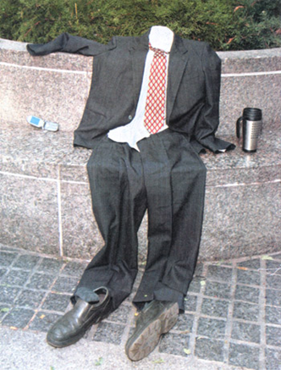
Illustration:

Slide 43
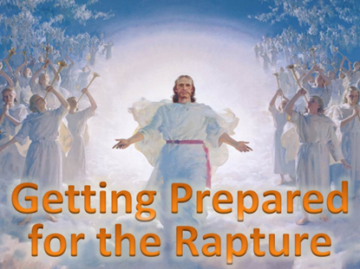
→我們要預備好的是甚麼呢?
What are we going to prepare?
⁵²耶穌的智慧和身量（身量或作：年紀），並神和人喜愛他的心，都一齊增長。【路 2:52】 ⁵²And Jesus increased in wisdom and in stature and in favor with God and man. 【Luke 2:52】

Slide 44
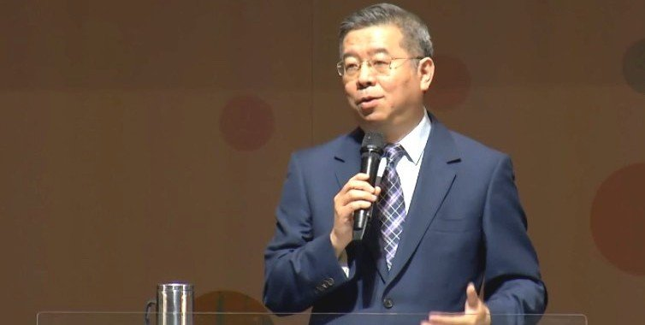
Illustration:
“讓我們可以優先做祂要我們做的事情.”
“Let’s do what He wants us to do first.”
台中旌旗教會的蕭翔修牧師

