Slide 1
Justice
正義

Slide 2
God desires justice
上帝渴望公義

Slide 3
Micah 6: 6-8 / 彌迦書 6:6-8
Micah 6:8
What Does the Lord Require?
6 “With what shall I come before the Lord,
and bow myself before God on high?
Shall I come before him with burnt offerings,
with calves a year old?
7 Will the Lord be pleased with[a] thousands of rams,
with ten thousands of rivers of oil?
Shall I give my firstborn for my transgression,
the fruit of my body for the sin of my soul?”
8 He has told you, O man, what is good;
and what does the Lord require of you
but to do justice, and to love kindness,[b]
and to walk humbly with your God?
神要求的不是外表的獻祭
⁶ 我朝見耶和華，
在至高的 神面前叩拜，當獻上甚麼呢？
我朝見他的時候，當獻上燔祭，
當獻上一歲的牛犢嗎？
⁷ 耶和華喜悅千千的公羊，
或是萬萬的油河嗎？
為我的過犯，我可以獻上我的長子嗎？
為我的罪惡，獻上我親生的孩子嗎？
⁸ 世人哪！耶和華已經指示你甚麼是善，
他向你所要的又是甚麼；
無非是要你行公義，好憐憫，
謙虛謹慎與你的 神同行。

Slide 4
Romans 3:9-20 / 罗马书 3:9-20
No One Is Righteous
⁹ What then? Are we Jews^{[a]} any better off?^{[b]} No, not at all. For we have already charged that all, both Jews and Greeks, are under sin, ¹⁰ as it is written:
“None is righteous, no, not one; ¹¹ no one understands; no one seeks for God. ¹² All have turned aside; together they have become worthless; no one does good, not even one.” ¹³ “Their throat is an open grave; they use their tongues to deceive.” “The venom of asps is under their lips.” ¹⁴ “Their mouth is full of curses and bitterness.” ¹⁵ “Their feet are swift to shed blood; ¹⁶ in their paths are ruin and misery, ¹⁷ and the way of peace they have not known.” ¹⁸ “There is no fear of God before their eyes.”
¹⁹ Now we know that whatever the law says it speaks to those who are under the law, so that every mouth may be stopped, and the whole world may be held accountable to God. ²⁰ For by works of the law no human being^{[c]} will be justified in his sight, since through the law comes knowledge of sin.
世上一個義人也沒有
⁹ 那又怎麼樣呢？我們比他們強嗎？絕不是的。因為我們已經控訴過，無論是猶太人或是希臘人，都在罪惡之下， ¹⁰ 正如經上所說：
“沒有義人，連一個也沒有，
¹¹ 沒有明白的，沒有尋求 神的；
¹² 人人都偏離了正道，一同變成污穢；
沒有行善的，連一個也沒有。
¹³ 他們的喉嚨是敞開的墳墓，
他們用舌頭弄詭詐，
他們嘴裡有虺蛇的毒，
¹⁴ 滿口是咒罵和惡毒；
¹⁵ 為了殺人流血，他們的腳步飛快，
¹⁶ 在經過的路上留下毀滅和悲慘。
¹⁷ 和睦之道，他們不曉得，
¹⁸ 他們的眼中也不怕 神。”
¹⁹ 然而我們曉得，凡律法所說的，都是對在律法之下的人說的，好讓每一個人都沒有話可講，使全世界的人都伏在 神的審判之下。 ²⁰ 沒有一個人可以靠行律法，在 神面前得稱為義，因為藉著律法，人對於罪才有充分的認識。

Slide 5
Romans 3:21-25 / 罗马书 3:21-25
The Righteousness of God Through Faith
²¹ But now the righteousness of God has been manifested apart from the law, although the Law and the Prophets bear witness to it— ²² the righteousness of God through faith in Jesus Christ for all who believe. For there is no distinction: ²³ for all have sinned and fall short of the glory of God, ²⁴ and are justified by his grace as a gift, through the redemption that is in Christ Jesus, ²⁵ whom God put forward as a propitiation by his blood, to be received by faith. This was to show God's righteousness, because in his divine forbearance he had passed over former sins.
因信基督白白稱義
²¹ 現在，有律法和先知的話可以證明： 神的義在律法之外已經顯明出來， ²² 就是 神的義，因著信耶穌基督，毫無區別地臨到所有信的人。 ²³ 因為人人都犯了罪，虧缺了 神的榮耀， ²⁴ 但他們卻因著 神的恩典，藉著在基督耶穌裡的救贖，就白白地稱義。 ²⁵ 神設立了耶穌為贖罪祭（“贖罪祭”直譯作“贖罪或使 神息怒之法”），是憑著他的血，藉著人的信，為的是要顯明 神的義；因為 神用忍耐的心寬容了人從前所犯的罪

Slide 6
Romans 3:27 / 罗马书 3:27
²⁷ Then what becomes of our boasting? It is excluded. By what kind of law? By a law of works? No, but by the law of faith.
²⁷ 這樣，有甚麼可誇的呢？沒有可誇的了。憑甚麼準則說沒有的呢？憑行為嗎？不是的，而是以信心為準則說的。

Slide 7
Galatians 3:23-29 / 加拉太书 3:23-29
²³ Now before faith came, we were held captive under the law, imprisoned until the coming faith would be revealed. ²⁴ So then, the law was our guardian until Christ came, in order that we might be justified by faith. ²⁵ But now that faith has come, we are no longer under a guardian, ²⁶ for in Christ Jesus you are all sons of God, through faith. ²⁷ For as many of you as were baptized into Christ have put on Christ. ²⁸ There is neither Jew nor Greek, there is neither slave^{[g]} nor free, there is no male and female, for you are all one in Christ Jesus. ²⁹ And if you are Christ's, then you are Abraham's offspring, heirs according to promise.
²³ 但信的道理還沒有來到以前，我們在律法下被囚禁、被圍困，直到那要來的信的道理顯明出來。 ²⁴ 這樣，律法成了我們的啟蒙教師，領我們到基督那裡，使我們可以因信稱義。 ²⁵ 但信的道理既然來到，我們就不再在啟蒙教師之下了。
因信作承受產業的兒子
²⁶ 你們因著信，在基督耶穌裡都作了 神的兒子。 ²⁷ 你們所有受洗歸入基督的人，都是披戴基督的， ²⁸ 並不分猶太人或希臘人，作奴僕的或自由人，男的或女的，因為你們在基督耶穌裡都成為一體了。 ²⁹ 如果你們屬於基督，就是亞伯拉罕的後裔，是按照應許承受產業的了。

Slide 8
Social Justice
社會正義

Slide 9
Classical Marxism Cultural Marxism Critical Theory Critical Social Justice Critical Race Theory
古典馬克思主義 文化馬克思主義 批判理論 批判的社會正義 批判種族理論

Slide 10
Hegemony (霸權 )
The social, cultural, ideological, or economic influence exerted by a dominant group
主導群體施加的社會、文化、意識形態或經濟影響

Slide 11
Critical Social Justice
批判的社會正義

Slide 12
Critical Social Justice - Goals
Seeks to address issues of prejudice and discrimination on a defined set of characteristics (race, sex, sexuality, gender identity, etc.).
Identifies oppressive power systems, "hegemonies," that are established by a ruling group. These hegemonies exist to benefit the powerful/oppressors, and oppress all others.
Ultimately aims to overthrow these oppressive systems of power.
1. 尋求解決對一組明確特徵（種族、性別、性取向、性別認同等）的偏見和歧視問題。
2. 識別由統治集團建立的壓迫性權力系統，即“霸權”。 這些霸權的存在是為了有利於強者/壓迫者，並壓迫所有其他人
3. 最終目的是推翻這些壓迫性的權力體系。

Slide 13
Critical Social Justice - Method
1. Identify disparate groups
識別不同的群體

Slide 14
Critical Social Justice - Method
Identify disparate groups
Examine for lack of equity
識別不同的群體
檢查缺乏公平性

Slide 15
Critical Social Justice - Method
Identify disparate groups
Examine for lack of equity
Assign blame for disparate outcomes.
識別不同的群體
檢查缺乏公平性
為不同的結果分配責任。

Slide 16
Critical Social Justice - Method
Identify disparate groups
Examine for lack of equity
Assign blame for disparate outcomes.
Redistribute power/resources to address those disparate outcomes.
識別不同的群體
檢查缺乏公平性
為不同的結果分配責任。
重新分配權力/資源以解決這些不同的結果。

Slide 17
Critical race theory
批判種族理論

Slide 18
Critical Race Theory
Racism is normal. It is everywhere.
種族主義是正常的。 它無處不在。

Slide 19
Critical Race Theory
Racism is normal. It is everywhere.
[Interest] convergence theory
種族主義是正常的。 它無處不在。
【興趣】收斂理論

Slide 20
Critical Race Theory
Racism is normal. It is everywhere.
[Interest] convergence theory
Anti-liberalism
種族主義是正常的。 它無處不在。
【興趣】收斂理論
反自由主義

Slide 21
Critical Race Theory
Racism is normal. It is everywhere.
[Interest] convergence theory
Anti-liberalism
Knowledge is socially constructed
種族主義是正常的。 它無處不在。
【興趣】收斂理論
反自由主義
知識是社會建構的

Slide 22
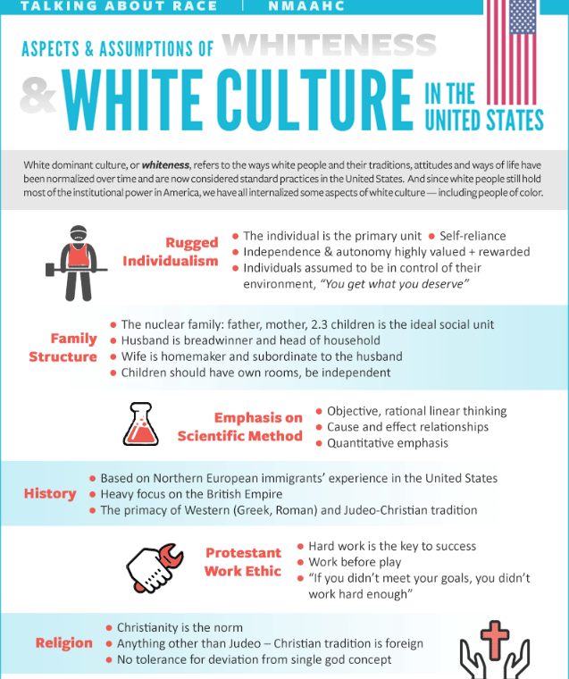
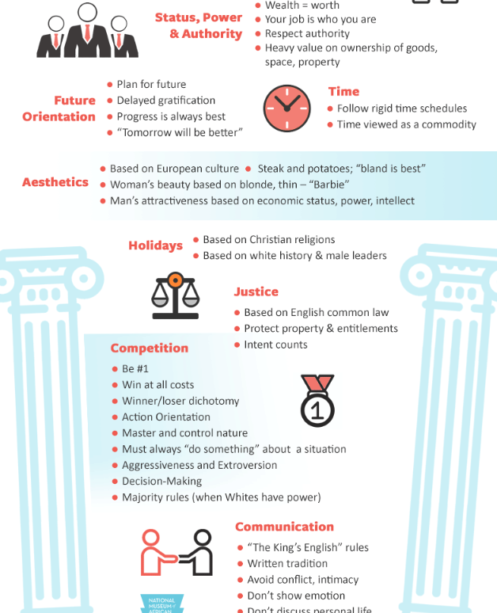

Slide 23
Ibram X. Kendi How to Be an Antiracist 如何成為一個反種族主義者
To fix the original sin of racism, Americans should pass an anti-racist amendment to the U.S. Constitution that enshrines two guiding anti-racist principals: Racial inequity is evidence of racist policy and the different racial groups are equals. The amendment would make unconstitutional racial inequity over a certain threshold, as well as racist ideas by public officials (with “racist ideas” and “public official” clearly defined). It would establish and permanently fund the Department of Anti-racism (DOA) comprised of formally trained experts on racism and no political appointees. The DOA would be responsible for preclearing all local, state and federal public policies to ensure they won’t yield racial inequity, monitor those policies, investigate private racist policies when racial inequity surfaces, and monitor public officials for expressions of racist ideas. The DOA would be empowered with disciplinary tools to wield over and against policymakers and public officials who do not voluntarily change their racist policy and ideas.

Slide 24
Romans 1:21-23 / 罗马书 1:21-23
²¹ For although they knew God, they did not honor him as God or give thanks to him, but they became futile in their thinking, and their foolish hearts were darkened. ²² Claiming to be wise, they became fools, ²³ and exchanged the glory of the immortal God for images resembling mortal man and birds and animals and creeping things.
²¹ 因為他們雖然知道 神，卻不尊他為 神，也不感謝他，反而心思變為虛妄，愚頑的心就迷糊了。 ²² 他們自以為是聰明的，卻成了愚蠢的。 ²³ 他們用必朽壞的人、飛禽、走獸和昆蟲的形象，取代了永不朽壞的 神的榮耀。

Slide 25
Romans 1:16 / 罗马书 1:16
The Righteous Shall Live by Faith
¹⁶ For I am not ashamed of the gospel, for it is the power of God for salvation to everyone who believes, to the Jew first and also to the Greek.
福音是 神的大能
¹⁶ 我不以福音為恥；這福音是 神的大能，要救所有相信的，先是猶太人，後是希臘人。

Slide 26
Proverbs 22:6 / 箴言 22:6
⁶ Train up a child in the way he should go; even when he is old he will not depart from it.
⁶ 教養孩童走他當行的路，
就是到老，他也不會偏離。

Slide 28
Galatians 3:23-29 / 加拉太书 3:23-29
²³ Now before faith came, we were held captive under the law, imprisoned until the coming faith would be revealed. ²⁴ So then, the law was our guardian until Christ came, in order that we might be justified by faith. ²⁵ But now that faith has come, we are no longer under a guardian, ²⁶ for in Christ Jesus you are all sons of God, through faith. ²⁷ For as many of you as were baptized into Christ have put on Christ. ²⁸ There is neither Jew nor Greek, there is neither slave^{[g]} nor free, there is no male and female, for you are all one in Christ Jesus. ²⁹ And if you are Christ's, then you are Abraham's offspring, heirs according to promise.
²³ 但信的道理還沒有來到以前，我們在律法下被囚禁、被圍困，直到那要來的信的道理顯明出來。 ²⁴ 這樣，律法成了我們的啟蒙教師，領我們到基督那裡，使我們可以因信稱義。 ²⁵ 但信的道理既然來到，我們就不再在啟蒙教師之下了。
因信作承受產業的兒子
²⁶ 你們因著信，在基督耶穌裡都作了 神的兒子。 ²⁷ 你們所有受洗歸入基督的人，都是披戴基督的， ²⁸ 並不分猶太人或希臘人，作奴僕的或自由人，男的或女的，因為你們在基督耶穌裡都成為一體了。 ²⁹ 如果你們屬於基督，就是亞伯拉罕的後裔，是按照應許承受產業的了。

Slide 29
Leviticus 23:22 / 利未记 23:22
²² “And when you reap the harvest of your land, you shall not reap your field right up to its edge, nor shall you gather the gleanings after your harvest. You shall leave them for the poor and for the sojourner: I am the Lord your God.”
²² “你們收割你們的莊稼的時候，不可把角落的穀物割盡，也不可拾取你收割時遺下的；把它們留給窮人和寄居的外人；我是耶和華你們的 神。”

Slide 30
Deuteronomy 24:19-22 / 申命记 24:19-22
¹⁹ “When you reap your harvest in your field and forget a sheaf in the field, you shall not go back to get it. It shall be for the sojourner, the fatherless, and the widow, that the Lord your God may bless you in all the work of your hands. ²⁰ When you beat your olive trees, you shall not go over them again. It shall be for the sojourner, the fatherless, and the widow. ²¹ When you gather the grapes of your vineyard, you shall not strip it afterward. It shall be for the sojourner, the fatherless, and the widow.
¹⁹ “你在田間收割莊稼的時候，如果遺留一捆在田裡，就不可再回去拾取，要留給寄居的、孤兒和寡婦；好使耶和華你的 神，在你手裡所辦的一切事上，賜福給你。 ²⁰ 你打橄欖樹以後，枝上剩下的不可再打，要留給寄居的、孤兒和寡婦。 ²¹ 你收取葡萄園的葡萄以後，剩下的不可再摘，要留給寄居的、孤兒和寡婦。 ²² 你要記住你在埃及作過奴僕，所以我吩咐你遵行這話。”

Slide 31
Romans 1:18-23 / 羅馬書 1:18-23
God's Wrath on Unrighteousness
¹⁸ For the wrath of God is revealed from heaven against all ungodliness and unrighteousness of men, who by their unrighteousness suppress the truth. ¹⁹ For what can be known about God is plain to them, because God has shown it to them. ²⁰ For his invisible attributes, namely, his eternal power and divine nature, have been clearly perceived, ever since the creation of the world,^{[a]} in the things that have been made. So they are without excuse. ²¹ For although they knew God, they did not honor him as God or give thanks to him, but they became futile in their thinking, and their foolish hearts were darkened. ²² Claiming to be wise, they became fools, ²³ and exchanged the glory of the immortal God for images resembling mortal man and birds and animals and creeping things.
人類不尊 神為 神
¹⁸ 神的震怒，從天上向所有不虔不義的人顯露出來，就是向那些以不義壓制真理的人顯露出來。 ¹⁹ 神的事情，人所能知道的，在他們裡面原是明顯的，因為 神已經向他們顯明了。 ²⁰ 其實自從創世以來， 神那看不見的事，就如他永恆的大能和神性，都是看得見的，就是從他所造的萬物中可以領悟，叫人沒有辦法推諉。 ²¹ 因為他們雖然知道 神，卻不尊他為 神，也不感謝他，反而心思變為虛妄，愚頑的心就迷糊了。 ²² 他們自以為是聰明的，卻成了愚蠢的。 ²³ 他們用必朽壞的人、飛禽、走獸和昆蟲的形象，取代了永不朽壞的 神的榮耀。

Slide 32
Romans 1:28-32 / 罗马书 1:28-32
²⁸ And since they did not see fit to acknowledge God, God gave them up to a debased mind to do what ought not to be done. ²⁹ They were filled with all manner of unrighteousness, evil, covetousness, malice. They are full of envy, murder, strife, deceit, maliciousness. They are gossips, ³⁰ slanderers, haters of God, insolent, haughty, boastful, inventors of evil, disobedient to parents, ³¹ foolish, faithless, heartless, ruthless. ³² Though they know God's righteous decree that those who practice such things deserve to die, they not only do them but give approval to those who practice them.
²⁸ 他們既然故意不認識 神， 神就任憑他們存著敗壞的心，去作那些不正當的事。 ²⁹ 這些人充滿了各樣的不義、邪惡、貪心、陰險；滿懷嫉妒、兇殺、好鬥、欺詐、幸災樂禍；又是好說讒言的、 ³⁰ 毀謗人的、憎恨 神的、凌辱人的、傲慢的、自誇的、製造惡事的、忤逆父母的、 ³¹ 冥頑不靈的、不守信用的、冷酷無情的、沒有惻隱之心的。 ³² 他們雖然明明知道行這些事的人， 神判定他們是該死的，然而他們不單自己去行，也喜歡別人去行。

