Slide 1
Generosity 慷慨
12/17/2017
BOLGPC 爾灣大公園靈糧堂
Rev. Joseph Chang 張玉明牧師

Slide 2
I. Generosity is God’s desire for us. 慷慨是上帝要訓練我們的美德.
⁶ . . . . 耶和華曾向他們起誓， . . . . 應許賜給我們的地，就是流奶與蜜之地。【書 5:6】 ⁶. . . . For the LORD had sworn to them . . . . that he had solemnly promised their fathers to give us, a land flowing with milk and honey. 【Josh 5:6b】

Slide 3
What system did God use? 神用甚麼樣的經濟制度?
Communism 共產制度?
Capitalism 資本制度?

Slide 4
God Used Capitalism 神用了資本主義
¹祭司利未人和利未全支派必在以色列中無分無業；他們所吃用的就是獻給耶和華的火祭和一切所捐的。²他們在弟兄中必沒有產業；耶和華是他們的產業，正如耶和華所應許他們的。【申 18:1~2】 ¹The priests, who are Levites--indeed the whole tribe of Levi--are to have no allotment or inheritance with Israel. They shall live on the offerings made to the LORD by fire, for that is their inheritance. ²They shall have no inheritance among their brothers; the LORD is their inheritance, as he promised them. 【Deut 18:1~2】

Slide 5
God Used Capitalism 神用了資本主義
²¹凡以色列中出產的十分之一，我已賜給利未的子孫為業；因他們所辦的是會幕的事，所以賜給他們為酬他們的勞。【民 18:21】 ²¹"I give to the Levites all the tithes in Israel as their inheritance in return for the work they do while serving at the Tent of Meeting. 【Num 18:21】

Slide 6
The Problem of Communism 共產主義的問題
Good Intention, no wisdom.用意良善, 沒有智慧.

Slide 7
Acts 2 的問題
⁴¹於是領受他話的人就受了洗。那一天，門徒約添了三千人，⁴²都恆心遵守使徒的教訓，彼此交接，擘餅，祈禱。⁴³眾人都懼怕；使徒又行了許多奇事神蹟。【徒 2:41~47】 ⁴¹Those who accepted his message were baptized, and about three thousand were added to their number that day. ⁴²They devoted themselves to the apostles' teaching and to the fellowship, to the breaking of bread and to prayer. ⁴³Everyone was filled with awe, and many wonders and miraculous signs were done by the apostles. 【Acts 2:41~47】

Slide 8
Acts 2 的問題
⁴⁴信的人都在一處，凡物公用；⁴⁵並且賣了田產，家業，照各人所需用的分給各人。⁴⁶他們天天同心合意恆切的在殿裡，且在家中擘餅，存著歡喜、誠實的心用飯，⁴⁷讚美神，得眾民的喜愛。主將得救的人天天加給他們。【徒 2:41~47】 ⁴⁴All the believers were together and had everything in common. ⁴⁵Selling their possessions and goods, they gave to anyone as he had need. ⁴⁶Every day they continued to meet together in the temple courts. They broke bread in their homes and ate together with glad and sincere hearts, ⁴⁷praising God and enjoying the favor of all the people. And the Lord added to their number daily those who were being saved. 【Acts 2:41~47】

Slide 9
Acts 2 的問題
⁴⁴信的人都在一處，凡物公用；⁴⁵並且賣了田產，家業，照各人所需用的分給各人。⁴⁶他們天天同心合意恆切的在殿裡，且在家中擘餅，存著歡喜、誠實的心用飯，⁴⁷讚美神，得眾民的喜愛。主將得救的人天天加給他們。【徒 2:41~47】 ⁴⁴All the believers were together and had everything in common. ⁴⁵Selling their possessions and goods, they gave to anyone as he had need. ⁴⁶Every day they continued to meet together in the temple courts. They broke bread in their homes and ate together with glad and sincere hearts, ⁴⁷praising God and enjoying the favor of all the people. And the Lord added to their number daily those who were being saved. 【Acts 2:41~47】

Slide 10
²⁵但現在，我往耶路撒冷去供給聖徒。²⁶因為馬其頓和亞該亞人樂意湊出捐項給耶路撒冷聖徒中的窮人。²⁷這固然是他們樂意的，其實也算是所欠的債；因外邦人既然在他們屬靈的好處上有分，就當把養身之物供給他們。【羅 15:25~27】 ²⁵Now, however, I am on my way to Jerusalem in the service of the saints there. ²⁶For Macedonia and Achaia were pleased to make a contribution for the poor among the saints in Jerusalem. ²⁷They were pleased to do it, and indeed they owe it to them. For if the Gentiles have shared in the Jews' spiritual blessings, they owe it to the Jews to share with them their material blessings. 【Rom 15:25~27】

Slide 11
²⁵但現在，我往耶路撒冷去供給聖徒。²⁶因為馬其頓和亞該亞人樂意湊出捐項給耶路撒冷聖徒中的窮人。²⁷這固然是他們樂意的，其實也算是所欠的債；因外邦人既然在他們屬靈的好處上有分，就當把養身之物供給他們。【羅 15:25~27】 ²⁵Now, however, I am on my way to Jerusalem in the service of the saints there. ²⁶For Macedonia and Achaia were pleased to make a contribution for the poor among the saints in Jerusalem. ²⁷They were pleased to do it, and indeed they owe it to them. For if the Gentiles have shared in the Jews' spiritual blessings, they owe it to the Jews to share with them their material blessings. 【Rom 15:25~27】

Slide 12
II. What is the spirit of generosity? 甚麼是慷慨的精神?
A. Not “I, me, and myself” only. 不是先想到自己, 漠視別人.

Slide 13
²萬軍之耶和華如此說：這百姓說，建造耶和華殿的時候尚未來到。³那時耶和華的話臨到先知哈該說：⁴這殿仍然荒涼，你們自己還住天花板的房屋麼？⁵現在萬軍之耶和華如此說：你們要省察自己的行為。⁶你們撒的種多，收的卻少；你們吃，卻不得飽；喝，卻不得足；穿衣服，卻不得暖；得工錢的，將工錢裝在破漏的囊中。【該 1:2~6】 ²This is what the LORD Almighty says: "These people say, 'The time has not yet come for the Lord's house to be built.'" ³Then the word of the LORD came through the prophet Haggai: ⁴"Is it a time for you yourselves to be living in your paneled houses, while this house remains a ruin?" ⁵Now this is what the LORD Almighty says: "Give careful thought to your ways. ⁶You have planted much, but have harvested little. You eat, but never have enough. You drink, but never have your fill. You put on clothes, but are not warm. You earn wages, only to put them in a purse with holes in it." 【Hag 1:2~6】

Slide 14
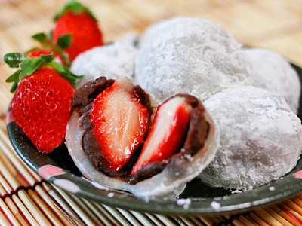
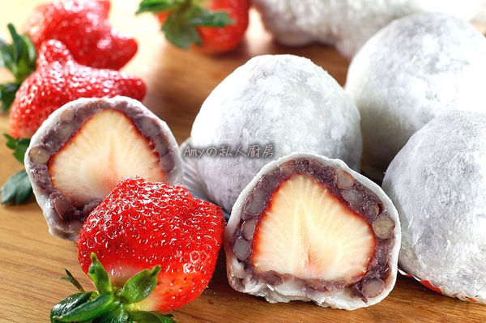
II. What is the spirit of generosity? 甚麼是慷慨的精神?
B. It is You, Him, and Others. 想到別人, 想到後面的人.

Slide 15
II. What is the spirit of generosity? 甚麼是慷慨的精神?
C. God is happy, and I am very happy. 上帝很高興, 我也很高興.
¹³忽然，有一大隊天兵同那天使讚美神說：¹⁴在至高之處榮耀歸與神！在地上平安歸與他所喜悅的人（有古卷作：喜悅歸與人）！【路 2:13~14】 ¹³Suddenly a great company of the heavenly host appeared with the angel, praising God and saying, ¹⁴"Glory to God in the highest, and on earth peace to men on whom his favor rests." 【Luke 2:13~14】

Slide 16
II. What is the spirit of generosity? 甚麼是慷慨的精神?
C. God is happy, and I am very happy. 上帝很高興, 我也很高興.
¹³忽然，有一大隊天兵同那天使讚美神說：¹⁴在至高之處榮耀歸與神！在地上平安歸與他所喜悅的人（有古卷作：喜悅歸與人）！【路 2:13~14】 ¹³Suddenly a great company of the heavenly host appeared with the angel, praising God and saying, ¹⁴“Glory to God in the highest, and on earth peace to men on whom his favor rests." 【Luke 2:13~14】

