Slide 1
DISCERNING GOD’S WILL FOR MY LIFE 尋求神在我生命中的旨意
S
E
R
I
E
S
Knowing God's Will--As Simple as 了解上帝的意志 - 不難
PART 1
A
B
C
By REV. DR. JOHN SIM
Notes:
DISCERNING GOD’S WILL FOR MY LIFE 尋求神在我生命中的旨意
Knowing God's Will--As Simple as 了解上帝的意志 - 不難

Slide 3
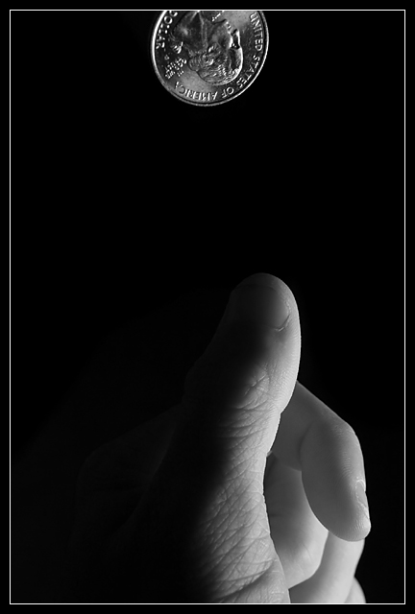

Slide 4
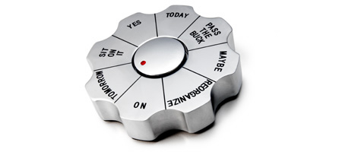
Wheel of Choices DECISION PAPERWEIGHT Let this clever device ease the burden of having to make so many decisions in your life. Balancing all the pros and cons of every call can be tiresome, and we never know all the possible pros and cons anyway, so why not give someone else the responsibility of deciding? Spin this gorgeous aluminum paperweight to have your questions answered - or should you "sit on it" for a bit first, or "pass the buck" to someone else? $15.00
MATERIALS: aluminum SIZE: 3 1/2" W, 3/4" H

Slide 5
download decision maker

Slide 6
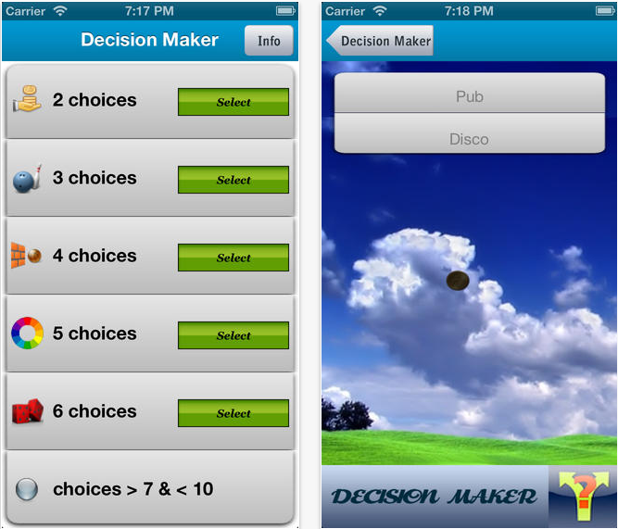

Slide 7
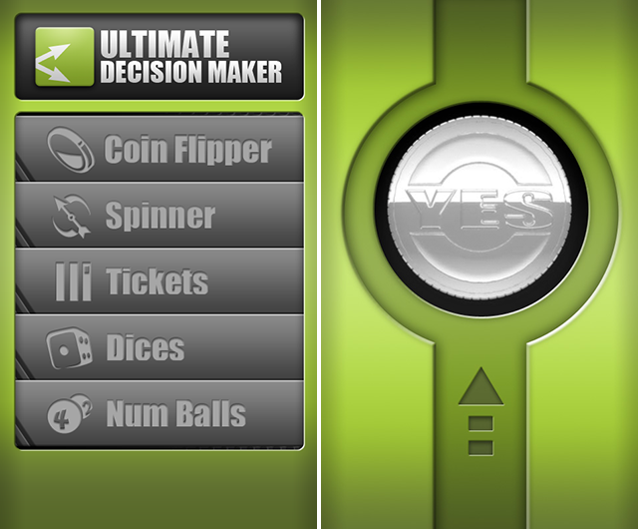

Slide 8
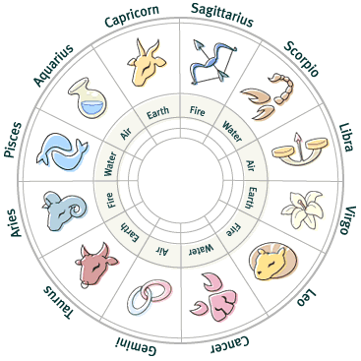
The Horoscope

Slide 9
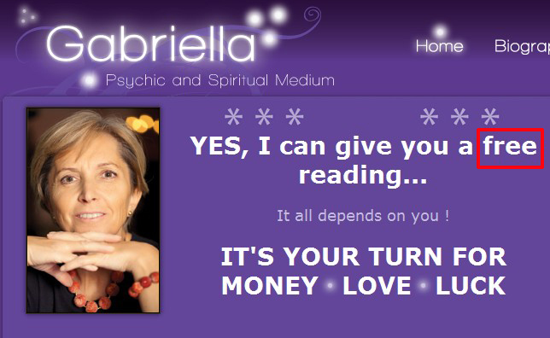

Slide 10
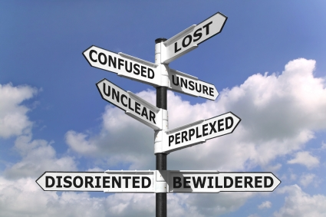
迷失
困惑
不清楚
不確定
迷茫
迷失方向
不知所措
Notes:
Confused 困惑
Lost 迷失
Perplexed 迷茫
Unsure 不知所措
Bewildered 不確定
disoriented 迷失方向
unclear 不清楚

Slide 11
DISCERNING GOD’S WILL FOR MY LIFE 尋求神在我生命中的旨意
S
E
R
I
E
S
Knowing God's Will--As Simple as 了解上帝的意志 - 不難
PART 1
A
B
C
By REV. DR. JOHN SIM
Notes:
DISCERNING GOD’S WILL FOR MY LIFE 尋求神在我生命中的旨意
Knowing God's Will--As Simple as 了解上帝的意志 - 不難

Slide 12
Formula 公式:
A
+
B
=
C
Notes:
Formula: 公式

Slide 13
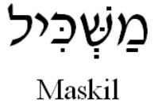
PSALM 32 詩篇 32 篇 The Psalm of Guidance 訓誨詩
King David 大衛王
“to instruct” 指導
Notes:
King David 大衛王
PSALM 32 詩篇 32 篇 The Psalm of Guidance 訓誨詩
to instruct 指導
訓誨詩
詩 32:1 （大衛的訓誨詩。）得赦免其過、遮蓋其罪的，這人是有福的！
詩 32:2 凡心裡沒有詭詐、耶和華不算為有罪的，這人是有福的！
詩 32:3 我閉口不認罪的時候，因終日唉哼而骨頭枯乾。
詩 32:4 黑夜白日，你的手在我身上沉重；我的精液耗盡，如同夏天的乾旱。（細拉）
詩 32:5 我向你陳明我的罪，不隱瞞我的惡。我說：我要向耶和華承認我的過犯，你就赦免我的罪惡。（細拉）
詩 32:6 為此，凡虔誠人都當趁你可尋找的時候禱告你；大水泛溢的時候，必不能到他那裡。
詩 32:7 你是我藏身之處；你必保佑我脫離苦難，以得救的樂歌四面環繞我。（細拉）
詩 32:8 我要教導你，指示你當行的路；我要定睛在你身上勸戒你。
詩 32:9 你不可像那無知的騾馬，必用嚼環轡頭勒住他；不然，就不能馴服。
詩 32:10 惡人必多受苦楚；惟獨倚靠耶和華的必有慈愛四面環繞他。
詩 32:11 你們義人應當靠耶和華歡喜快樂；你們心裡正直的人都當歡呼。
H4905 מַשְׂכִּיל
H4905 maskiyl {mas-keel'}
源自 07919; TWOT - 2263b; 陽性名詞
AV - Maschil 13; 13
1) (Hiphil) 靜思的詩

Slide 14
A
RIGHT RELATIONSHIP WITH GOD 與上帝有正確的關係
1. FOUR WORDS THAT DEFINE OUR PROBLEM (vv. 1-2) 定義我們問題的四個字
“Blessed is he whose transgression is forgiven, Whose sin is covered. Blessed is the man to whom the Lord does not impute iniquity, And in whose spirit there is no deceit.” Psalm 32:1-2
詩 32:1 （大衛的訓誨詩。）得赦免其過、遮蓋其罪的，這人是有福的！
詩 32:2 凡心裡沒有詭詐、耶和華不算為有罪的，這人是有福的！
Notes:
RIGHT RELATIONSHIP WITH GOD 與上帝有正確的關係
FOUR WORDS THAT DEFINE OUR PROBLEM 定義我們問題的四個字 (vv. 1-2)
“Blessed is he whose transgression is forgiven, Whose sin is covered. Blessed is the man to whom the Lord does not impute iniquity, And in whose spirit there is no deceit.” Psalm 32:1-2
詩 32:1 （大衛的訓誨詩。）得赦免其過、遮蓋其罪的，這人是有福的！
詩 32:2 凡心裡沒有詭詐、耶和華不算為有罪的，這人是有福的！

Slide 15
TRANSGRESSION 過犯
SIN 罪惡
INIQUITY 有罪
DECEIT 詭詐
TO OVERSTEP THE MARK 越過標記
DEFIANCE 衊視反抗
TO MISS THE MARK 錯過標記
DEFECT 瑕疵缺陷
LAWLESSNESS, PERVERSITY, MISCHIEF 無法無天, 變態墮落, 胡鬧
DISTORTION 扭曲失真
GUILE, TREACHERY, CLEVER MANIPULATION OF FACTS, INSINCERITY 詭計奸詐,背信棄義, 操縱掌控, 虛情假意
DECEPTION 騙局詭計
Notes:
TRANSGRESSION 過犯 TO OVERSTEP THE MARK 越過標記 defiance 衊視反抗
SIN 罪惡 TO MISS THE MARK錯過標記 defect 瑕疵缺陷
INIQUITY 有罪 LAWLESSNESS, PERVERSITY, MISCHIEF distortion 扭曲失真
無法無天, 變態墮落, 胡鬧
DECEIT 詭詐 GUILE 詭計奸詐, TREACHERY 背信棄義, Deception 騙局詭計
CLEVER MANIPULATION OF FACTS
操縱掌控搬弄是非, INSINCERITY 虛情假意

Slide 16
“If I regard iniquity in my heart, The Lord will not hear.” Psalm 詩 66:18
我若心裡注重罪孽，主必不聽。
Notes:
“If I regard iniquity in my heart, The Lord will not hear.” Psalm 詩 66:18
我若心裡注重罪孽，主必不聽。
“Circumcise your hearts, therefore, and do not be stiff-necked any longer.” Deut. 10:16
申命記 10:16 所以你們要將心裡的汙穢除掉，不可再硬著頸項。

Slide 17
2. Confession of sin releases us to fellowship with God (vv. 3-5) 懺悔認罪使我們能自由的與上帝相交
a. Sin concealed 遮掩罪過
When I kept silent, my bones grew old
Through my groaning all the day long.
For day and night Your hand was heavy upon me;
My vitality was turned into the drought of summer. Psalm 32:3-4
詩 32:3 我閉口不認罪的時候，因終日唉哼而骨頭枯乾。
詩 32:4 黑夜白日，你的手在我身上沉重；我的精液耗盡，如同夏天的乾旱。（細拉）
Notes:
2. Confession of sin releases us to fellowship with God 懺悔認罪使我們能自由的與上帝相交 (vv. 3-5)
a. Sin concealed 遮掩罪過
When I kept silent, my bones grew old
Through my groaning all the day long.
For day and night Your hand was heavy upon me;
My vitality was turned into the drought of summer. Psalm 32:3-4
詩 32:3 我閉口不認罪的時候，因終日唉哼而骨頭枯乾。
詩 32:4 黑夜白日，你的手在我身上沉重；我的精液耗盡，如同夏天的乾旱。（細拉）

Slide 18
b. Sin confessed 懺悔認罪
“I acknowledged my sin to You, And my iniquity I have not hidden. I said, ‘I will confess my transgressions to the Lord,’ And YOU FORGAVE the iniquity of my sin.” Psalm 32:5
詩 32:5 我向你陳明我的罪，不隱瞞我的惡。我說：我要向耶和華承認我的過犯，你就赦免我的罪惡。（細拉）
Donald Tippet
Notes:
b. Sin confessed 懺悔認罪
“I acknowledged my sin to You, And my iniquity I have not hidden. I said, ‘I will confess my transgressions to the Lord,’ And YOU FORGAVE the iniquity of my sin.” Psalm 32:5
詩 32:5 我向你陳明我的罪，不隱瞞我的惡。我說：我要向耶和華承認我的過犯，你就赦免我的罪惡。（細拉）
“If we confess our sins, He is faithful and just to forgive us our sins and to cleanse us from all unrighteousness.” 1 John 1:9
約一 1:9 我們若認自己的罪，神是信實的，是公義的，必要赦免我們的罪，洗淨我們一切的不義。

Slide 19
“If we confess our sins, He is faithful and just to forgive us our sins and to cleanse us from all unrighteousness.” 1 John 1:9
約一 1:9 我們若認自己的罪，神是信實的，是公義的，必要赦免我們的罪，洗淨我們一切的不義。
Notes:
b. Sin confessed 懺悔認罪
“I acknowledged my sin to You, And my iniquity I have not hidden. I said, ‘I will confess my transgressions to the Lord,’ And YOU FORGAVE the iniquity of my sin.” Psalm 32:5
詩 32:5 我向你陳明我的罪，不隱瞞我的惡。我說：我要向耶和華承認我的過犯，你就赦免我的罪惡。（細拉）
“If we confess our sins, He is faithful and just to forgive us our sins and to cleanse us from all unrighteousness.” 1 John 1:9
約一 1:9 我們若認自己的罪，神是信實的，是公義的，必要赦免我們的罪，洗淨我們一切的不義。

Slide 20
B
RIGHT ATTITUDE TOWARD GOD 對上帝有正確的態度
DAVID IS CONFESSING HIS 大衛宣告:
1. DEPENDENCE on God 依賴上帝
“For this cause everyone who is godly shall pray to You in a time when You may be found; Surely in a flood of great waters they shall not come near him.” Psalm 32:6
詩 32:6 為此，凡虔誠人都當趁你可尋找的時候禱告你；大水泛溢的時候，必不能到他那裡。
Notes:
RIGHT ATTITUDE TOWARD GOD 對上帝有正確的態度
DAVID IS CONFESSING HIS 大衛宣告:
1. DEPENDENCE on God 依賴上帝
“For this cause everyone who is godly shall pray to You in a time when You may be found; Surely in a flood of great waters they shall not come near him.” Psalm 32:6
詩 32:6 為此，凡虔誠人都當趁你可尋找的時候禱告你；大水泛溢的時候，必不能到他那裡。

Slide 21
B
RIGHT ATTITUDE TOWARD GOD 對上帝有正確的態度
DAVID IS CONFESSING HIS 大衛宣告:
2. TRUST on God 信靠上帝
“You are my hiding place; You shall preserve me from trouble.” Psalm 32:7a
詩 32:7 你是我藏身之處；你必保佑我脫離苦難
Notes:
RIGHT ATTITUDE TOWARD GOD 對上帝有正確的態度
DAVID IS CONFESSING HIS 大衛宣告:
2. TRUST on God 信靠上帝
“You are my hiding place;
You shall preserve me from trouble.” Psalm 32:7a
詩 32:7 你是我藏身之處；你必保佑我脫離苦難

Slide 22
B
RIGHT ATTITUDE TOWARD GOD 對上帝有正確的態度
DAVID IS CONFESSING HIS 大衛宣告:
3. ADORATION of God 敬拜上帝
“You shall surround me with songs of deliverance.” Psalm 32:7b
詩 32:7 以得救的樂歌四面環繞我。
“As they began to SING AND PRAISE, THE LORD SET AMBUSHES against the men of Ammon and Moab and Mount Seir who were invading Judah, and they were defeated.” 2 Chron. 20:22
代下 20:22 眾人方唱歌讚美的時候，耶和華就派伏兵擊殺那來攻擊猶大人的亞捫人、摩押人，和西珥山人，他們就被打敗了。
Notes:
RIGHT ATTITUDE TOWARD GOD 對上帝有正確的態度
DAVID IS CONFESSING HIS 大衛宣告:
3. ADORATION of God 敬拜上帝
“You shall surround me with songs of deliverance.” Psalm 32:7b
詩 32:7 以得救的樂歌四面環繞我。
“As they began to SING AND PRAISE, THE LORD SET AMBUSHES against the men of Ammon and Moab and Mount Seir who were invading Judah, and they were defeated.” 2 Chron. 20:22
代下 20:22 眾人方唱歌讚美的時候，耶和華就派伏兵擊殺那來攻擊猶大人的亞捫人、摩押人，和西珥山人，他們就被打敗了。

Slide 23
“For day and night Your hand was heavy upon me; My vitality was turned into the drought of summer. Selah.” Psalm 32:4
詩 32:4 黑夜白日，你的手在我身上沉重；我的精液耗盡，如同夏天的乾旱。（細拉）
CONVICTION 定罪
“I acknowledged my sin to You, And my iniquity I have not hidden. I said, ‘I will confess my transgressions to the LORD,’ And You forgave the iniquity of my sin. Selah.” Psalm 32:5
詩 32:5我向你陳明我的罪，不隱瞞我的惡。我說：我要向耶和華承認我的過犯，你就赦免我的罪惡。（細拉）
CONFESSION認罪
“You are my hiding place; You shall preserve me from trouble; You shall surround me with songs of deliverance. Selah.” Psalm 32:7
詩 32:7你是我藏身之處；你必保佑我脫離苦難，以得救的樂歌四面環繞我。（細拉）
CONFIDENCE 信心
Notes:
CONVICTION 定罪
“For day and night Your hand was heavy upon me;
My vitality was turned into the drought of summer. Selah.” Psalm 32:4
詩 32:4 黑夜白日，你的手在我身上沉重；我的精液耗盡，如同夏天的乾旱。（細拉）
CONFESSION認罪
“I acknowledged my sin to You,
And my iniquity I have not hidden.
I said, ‘I will confess my transgressions to the LORD,’
And You forgave the iniquity of my sin. Selah.” Psalm 32:5
詩 32:5 我向你陳明我的罪，不隱瞞我的惡。我說：我要向耶和華承認我的過犯，你就赦免我的罪惡。（細拉）
CONFIDENCE信心
“You are my hiding place;
You shall preserve me from trouble;
You shall surround me with songs of deliverance. Selah.” Psalm 32:7
詩 32:7 你是我藏身之處；你必保佑我脫離苦難，以得救的樂歌四面環繞我。（細拉）

Slide 24
C
RIGHT PLACE TO HEAR FROM GOD 能夠聽到上帝的正確位置
1. PROMISE 應許
TO MAKE INTELLIGENT OR WISE 使人有智慧
TO THROW, SHOOT 投擲, 射箭
“I will instruct you and teach you in the way you should go; I will guide you with My eye.” Psalm 32:8
詩 32:8 我要教導你，指示你當行的路；我要定睛在你身上勸戒你。
Notes:
RIGHT PLACE TO HEAR FROM GOD 能夠聽到上帝的正確位置
1. PROMISE 應許
TO MAKE INTELLIGENT OR WISE 使人有智慧
TO THROW, SHOOT 投擲, 射箭
“I will instruct you and teach you in the way you should go;
I will guide you with My eye.” Psalm 32:8
詩 32:8 我要教導你，指示你當行的路；我要定睛在你身上勸戒你。

Slide 25
C
RIGHT PLACE TO HEAR FROM GOD 能夠聽到上帝的正確位置
2. PROVISO (stipulated condition) 附帶條件
IMPETUOUS, IMPATIENT 急躁魯莽, 沒有耐心
STUBBORN 倔强固執
“Do not be like the horse or like the mule, Which have no understanding...” Psalm 32:9
詩 32:9 你不可像那無知的騾馬，必用嚼環轡頭勒住他；不然，就不能馴服。
Notes:
RIGHT PLACE TO HEAR FROM GOD 能夠聽到上帝的正確位置
2. PROVISO (stipulated condition) 附帶條件
IMPETUOUS, 急躁魯莽
IMPATIENT 沒有耐心
STUBBORN 倔强固執
“Do not be like the horse or like the mule,
Which have no understanding...” Psalm 32:9
詩 32:9 你不可像那無知的騾馬，必用嚼環轡頭勒住他；不然，就不能馴服。

Slide 26
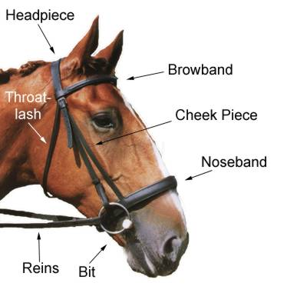
馬籠頭
喉索
眉帶
“…Which must be harnessed with bit and bridle, Else they will not come near you.” Psalm 32:9
詩 32:9 必用嚼環轡頭勒住他；不然，就不能馴服。
下巴帶
鼻箍
韁繩
馬銜
Notes:
Headpiece 馬籠頭
Throat-lash 喉索
Browband 眉帶
Cheek Piece 下巴帶
Noseband 鼻箍
Bit 馬銜
Reins 韁繩
“…Which must be harnessed with bit and bridle, Else they will not come near you.” Psalm 32:9
詩 32:9 必用嚼環轡頭勒住他；不然，就不能馴服。

Slide 27
C
RIGHT PLACE TO HEAR FROM GOD 能夠聽到上帝的正確位置
3. PRECEPT (rule or principle) 訓詞法規 (規則或原則)
(vv. 1-4)
“Many sorrows shall be to the wicked;
But he who trusts in the LORD, mercy shall surround him.” Psalm 32:10
詩 32:10 惡人必多受苦楚； 惟獨倚靠耶和華的必有慈愛四面環繞他。
(vv. 5-7)
Notes:
RIGHT PLACE TO HEAR FROM GOD 能夠聽到上帝的正確位置
3. PRECEPT (rule or principle) 訓詞法規 (規則或原則)
“Many sorrows shall be to the wicked;
But he who trusts in the LORD, mercy shall surround him.” Psalm 32:10
詩 32:10 惡人必多受苦楚；惟獨倚靠耶和華的必有慈愛四面環繞他。

Slide 28
C
RIGHT PLACE TO HEAR FROM GOD 能夠聽到上帝的正確位置
4. PROCEDURE 程序
a. Be free in your spirit. 靈裡得自由
“Be glad in the LORD and rejoice, you righteous; and shout for joy, all you upright in heart.” Psalm 32:11
詩 32:11 你們義人應當靠耶和華歡喜快樂； 你們心裡正直的人都當歡呼。
Notes:
RIGHT PLACE TO HEAR FROM GOD 能夠聽到上帝的正確位置
4. PROCEDURE 程序
a. Be free in your spirit. 靈裡得自由
“Be glad in the LORD and rejoice, you righteous; and shout for joy, all you upright in heart.” Psalm 32:11
詩 32:11 你們義人應當靠耶和華歡喜快樂；你們心裡正直的人都當歡呼。

Slide 29
C
RIGHT PLACE TO HEAR FROM GOD 能夠聽到上帝的正確位置
4. PROCEDURE 程序
a. Be free in your spirit. 靈裡得自由
b. Live in righteousness. 秉公行義
“Be glad in the LORD and rejoice, you righteous; and shout for joy, all you upright in heart.” Psalm 32:11
詩 32:11 你們義人應當靠耶和華歡喜快樂； 你們心裡正直的人都當歡呼。
Notes:
RIGHT PLACE TO HEAR FROM GOD 能夠聽到上帝的正確位置
4. PROCEDURE 程序
a. Be free in your spirit. 靈裡得自由
“Be glad in the LORD and rejoice, you righteous; and shout for joy, all you upright in heart.” Psalm 32:11
詩 32:11 你們義人應當靠耶和華歡喜快樂；你們心裡正直的人都當歡呼。

Slide 30
B
RIGHT ATTITUDE TOWARD GOD 對上帝有正確的態度
“Trust in the Lord with all your heart, And lean not on your own understanding.” Proverbs 3:5
箴 3:5你要專心仰賴耶和華，不可倚靠自己的聰明，
A
RIGHT RELATIONSHIP WITH GOD 與上帝有正確的關係
“In all your ways acknowledge Him.” Proverbs 3:6a
箴 3:6在你一切所行的事上都要認定他
C
Right Place To Hear From God 能夠聽到上帝的正確位置
“And He shall direct your paths.” Proverbs 3:6b
箴 3:6他必指引你的路。
Notes:
RIGHT ATTITUDE TOWARD GOD 對上帝有正確的態度
“Trust in the Lord with all your heart, And lean not on your own understanding.” Proverbs 3:5
箴 3:5 你要專心仰賴耶和華，不可倚靠自己的聰明，
RIGHT RELATIONSHIP WITH GOD 與上帝有正確的關係
“In all your ways acknowledge Him.” Proverbs 3:6a
箴 3:6 在你一切所行的事上都要認定他
Right Place To Hear From God 能夠聽到上帝的正確位置
“And He shall direct your paths.” Proverbs 3:6b
箴 3:6 他必指引你的路。

Slide 31
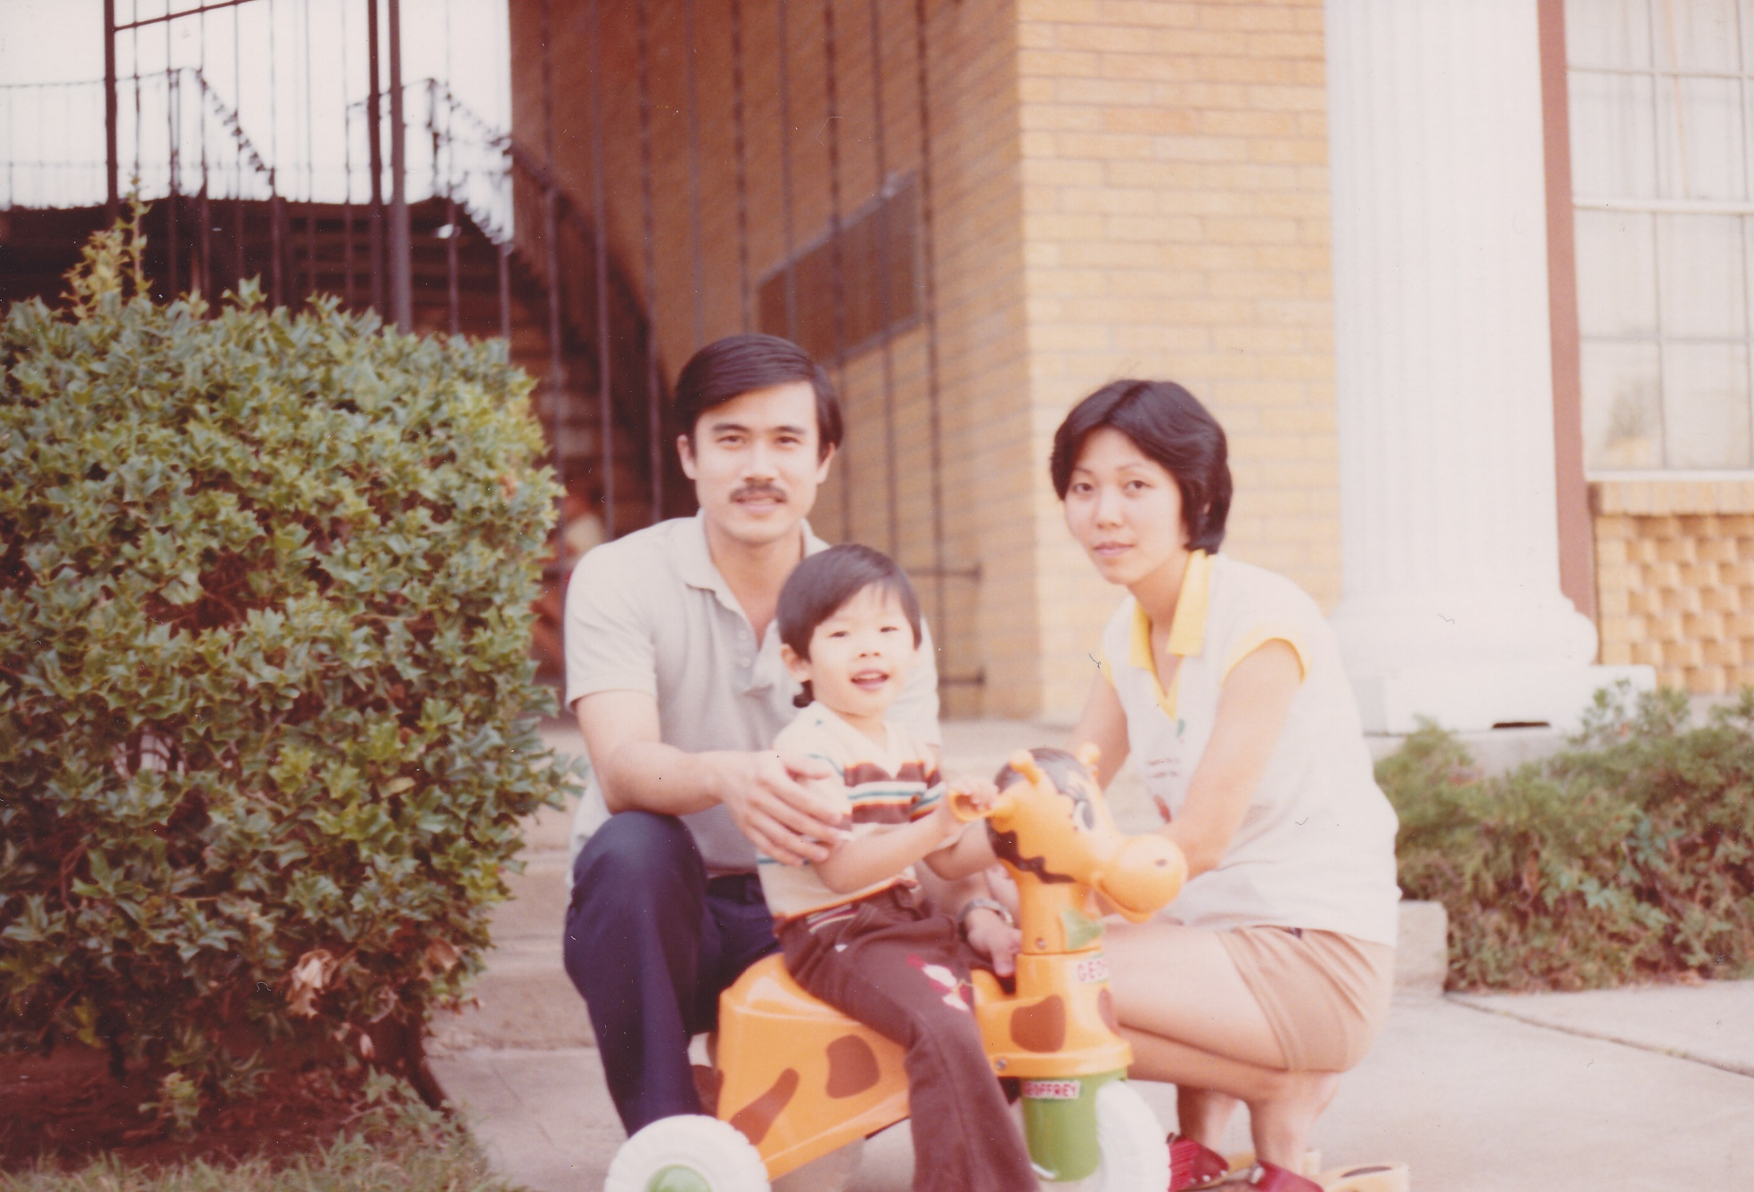
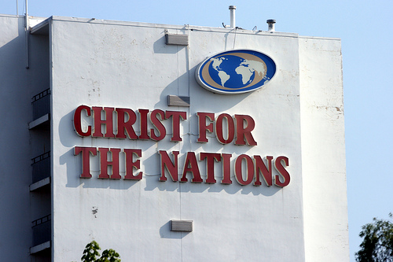

Slide 32
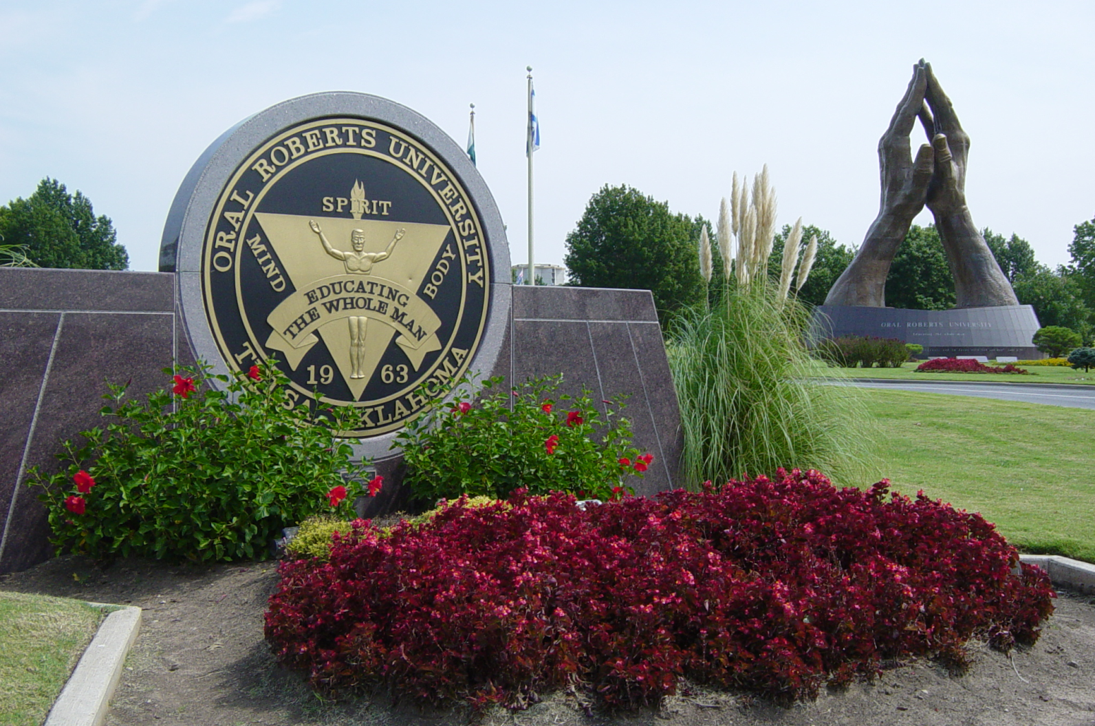
Notes:
It was either LIFE Bible College in Los Angeles, CA or Oral Roberts university in Tulsa, OK. I liked both and just couldn’t decide on which one to go to.
I was still attending class at the Bible Institute and one morning, I went very early to class to pray about my decision. I was the only one in the classroom, and I had brought along the catalogs from both schools and was going through those catalogs again praying that God would direct me to the school of his choice.
Well, when the class started, my professor announced that he would not be lecturing that day but he had invited a guest lecturer to teach us. The lecturer introduced herself and then distributed a 1-page handout to all the students. The moment I read the handout, I immediately knew which school the Lord wanted me to go. The reason is that on the handout, there were only 4 letters on there…

Slide 33
L
I
F
E

Slide 34
A
RIGHT RELATIONSHIP WITH GOD 與上帝有正確的關係
B
RIGHT ATTITUDE TOWARD GOD 對上帝有正確的態度
C
Right Place To Hear From God 能夠聽到上帝的正確位置
Notes:
RIGHT ATTITUDE TOWARD GOD 對上帝有正確的態度
“Trust in the Lord with all your heart, And lean not on your own understanding.” Proverbs 3:5
箴 3:5 你要專心仰賴耶和華，不可倚靠自己的聰明，
RIGHT RELATIONSHIP WITH GOD 與上帝有正確的關係
“In all your ways acknowledge Him.” Proverbs 3:6a
箴 3:6 在你一切所行的事上都要認定他
Right Place To Hear From God 能夠聽到上帝的正確位置
“And He shall direct your paths.” Proverbs 3:6b
箴 3:6 他必指引你的路。

