Slide 1
Salvation in Action
救恩行動
Rev. Joseph Chang 張玉明牧師
10/21/2018
BOLGPC 爾灣大公園靈糧堂

Slide 2
What is Gospel? 甚麼是福音?
¹弟兄們，我如今把先前所傳給你們的福音告訴你們知道；這福音你們也領受了，又靠著站立得住，²並且你們若不是徒然相信，能以持守我所傳給你們的，就必因這福音得救。³我當日所領受又傳給你們的：第一，就是基督照聖經所說，為我們的罪死了，⁴而且埋葬了；【林前 15:1-4a】
¹Now, brothers, I want to remind you of the gospel I preached to you, which you received and on which you have taken your stand. ²By this gospel you are saved, if you hold firmly to the word I preached to you. Otherwise, you have believed in vain. ³For what I received I passed on to you as of first importance : that Christ died for our sins according to the Scriptures, ⁴that he was buried, 【1Cor 15:1-4a】

Slide 3
What is Gospel? 甚麼是福音?
又照聖經所說，第三天復活了，⁵並且顯給磯法看，然後顯給十二使徒看；⁶後來一時顯給五百多弟兄看，其中一大半到如今還在，卻也有已經睡了的。⁷以後顯給雅各看，再顯給眾使徒看，⁸末了也顯給我看；我如同未到產期而生的人一般。【林前 15:4b-8】
that he was raised on the third day according to the Scriptures, ⁵and that he appeared to Peter, and then to the Twelve. ⁶After that, he appeared to more than five hundred of the brothers at the same time, most of whom are still living, though some have fallen asleep. ⁷Then he appeared to James, then to all the apostles, ⁸and last of all he appeared to me also, as to one abnormally born. 【1Cor 15:4b-8】

Slide 4
What is Gospel? 甚麼是福音?
Two Elements of the Gospel/福音是兩個要素:
1. Jesus died for us. Proof: He was buried. 耶穌為了我們的罪死, 它的證明, 就是耶穌被埋葬了.
2. Jesus was raised from the dead. Proof: He appeared to many. 耶穌為了我們而復活, 它的證明, 就是顯給很多的人看.

Slide 5
Participation of Triune God
三位一體的神全然的參與
1. Holy Son: His sacrifice atoned for our sins.
聖子: 祂的犧牲, 使我們的罪得到赦免.
2. Holy Father: He give us birth in the Holy Spirit.
聖父: 祂在聖靈中重生了我們.
3. Holy Spirit: He was in the process of our rebirth, and He dwells inside of us.
聖靈: 居住在信主的人的心中.

Slide 6
Gospel Sharing: Representing the Triune God to share the good news. 傳福音的人: 就是代表三位一體的神, 把這個好消息傳出去的人.

Slide 7
I. Formula of Baptism受洗的公式
⁴所以，我們藉著洗禮歸入死，和他一同埋葬，原是叫我們一舉一動有新生的樣式，像基督藉著父的榮耀從死裡復活一樣。⁵我們若在他死的形狀上與他聯合，也要在他復活的形狀上與他聯合；【羅 6:4~5】
⁴We were therefore buried with him through baptism into death in order that, just as Christ was raised from the dead through the glory of the Father, we too may live a new life. ⁵If we have been united with him like this in his death, we will certainly also be united with him in his resurrection. 【Rom 6:4~5】

Slide 8
II. The Death of Christ耶穌的死
⁵你們當以基督耶穌的心為心：⁶他本有神的形像，不以自己與神同等為強奪的；⁷反倒虛己，取了奴僕的形像，成為人的樣式；⁸既有人的樣子，就自己卑微，存心順服，以至於死，且死在十字架上。【腓 2:5~8】
⁵Your attitude should be the same as that of Christ Jesus: ⁶Who, being in very nature God, did not consider equality with God something to be grasped, ⁷but made himself nothing, taking the very nature of a servant, being made in human likeness. ⁸And being found in appearance as a man, he humbled himself and became obedient to death-- even death on a cross! 【Phil 2:5~8】

Slide 9
II. The Death of Christ耶穌的死
He is willing, He takes active role. 祂是自願的, 是祂主動的
⁵²耶穌對他說：收刀入鞘罷！凡動刀的，必死在刀下。⁵³你想，我不能求我父現在為我差遣十二營多天使來麼？⁵⁴若是這樣，經上所說，事情必須如此的話怎麼應驗呢？【太 26:52~54】
⁵²"Put your sword back in its place," Jesus said to him, "for all who draw the sword will die by the sword. ⁵³Do you think I cannot call on my Father, and he will at once put at my disposal more than twelve legions of angels? ⁵⁴But how then would the Scriptures be fulfilled that say it must happen in this way?" 【Matt 26:52~54】

Slide 10
II. The Death of Christ耶穌的死
He humbles himself. 而且是謙卑自己.
Kenosis 虛己
God神

Slide 11
II. The Death of Christ耶穌的死
He humbles himself. 而且是謙卑自己.
Kenosis 虛己
God神→Man人

Slide 12
II. The Death of Christ耶穌的死
He humbles himself. 而且是謙卑自己.
Kenosis 虛己
God神→Man人→Servant僕人

Slide 13
II. The Death of Christ耶穌的死
He humbles himself. 而且是謙卑自己.
Kenosis 虛己
God神→Man人→Servant僕人→List among Sinners罪人同列

Slide 14
Jesus’ Death & Us 耶穌的死和我們
Active 主動
Humble 謙卑

Slide 15
III. 耶穌的復活 The Resurrection of Christ
⁹所以，神將他升為至高，又賜給他那超乎萬名之上的名，¹⁰叫一切在天上的、地上的，和地底下的，因耶穌的名無不屈膝，¹¹無不口稱耶穌基督為主，使榮耀歸與父神。【腓 2:9~11】
⁹Therefore God exalted him to the highest place and gave him the name that is above every name, ¹⁰that at the name of Jesus every knee should bow, in heaven and on earth and under the earth, ¹¹and every tongue confess that Jesus Christ is Lord, to the glory of God the Father. 【Phil 2:9~11】

Slide 16
Jesus Resurrection and Us耶穌的復活和我們
God’s Work, we are passive. 神的工作, 我們是被動的.

Slide 17
³耶穌回答說：「我實實在在地告訴你，人若不重生，就不能見神的國。」⁴尼哥底母說：「人已經老了，如何能重生呢？豈能再進母腹生出來嗎？」⁵耶穌說：「我實實在在的告訴你，人若不是從水和聖靈生的，就不能進神的國。【約 3:3-5】
³In reply Jesus declared, "I tell you the truth, no one can see the kingdom of God unless he is born again." ⁴"How can a man be born when he is old?" Nicodemus asked. "Surely he cannot enter a second time into his mother's womb to be born!" ⁵Jesus answered, "I tell you the truth, no one can enter the kingdom of God unless he is born of water and the Spirit. 【John 3:3-5】

Slide 18
⁶從肉身生的就是肉身；從靈生的就是靈。⁷我說：『你們必須重生』，你不要以為希奇。⁸風隨著意思吹，你聽見風的響聲，卻不曉得從那裡來，往那裡去；凡從聖靈生的，也是如此。」【約 3:6-8】
⁶Flesh gives birth to flesh, but the Spirit gives birth to spirit. ⁷You should not be surprised at my saying, 'You must be born again.' ⁸The wind blows wherever it pleases. You hear its sound, but you cannot tell where it comes from or where it is going. So it is with everyone born of the Spirit." 【John 3:6-8】

Slide 19
Conclusion 結論
1. Two Elements of the Gospel 福音的兩個要素:
Jesus died for our sins主耶穌為我們的罪死,
Jesus was raised on the third day. 主耶穌第三天復活.

Slide 20
Conclusion 結論
2. How do we receive the benefit of the gospel? 我們如何得到這福音的好處?
Jesus’ Death: We actively, humbly accept that Jesus died for our sins. 耶穌的死: 我們主動的, 謙卑的接受耶穌為我們的罪而死.
Jesus’ Resurrection: God the Father gives us new birth in the Holy Spirit. 耶穌的復活: 父神在聖靈裡面重生了我們.

Slide 21
Conclusion 結論
3. When we participate in Happiness Group, God the Father, God the Son, and God the Holy Spirit all involved in this endeavor. There are 4 persons involved. Father, Son, Spirit and you. What an honor! What a privilege! 當我們在幸福小組裡面, 去做傳福音的工作的時候, 聖父, 聖子, 聖靈, 都參與在這工作裡面了. 有四個位格 (4 persons), Father, Son, Holy Spirit, and me. 這是多麼榮耀的一件事情, 這是多麼被上帝看重的一件事情. 願我們去做的人, 都經歷上帝的同在 (“我就與你們同在”).

Slide 22
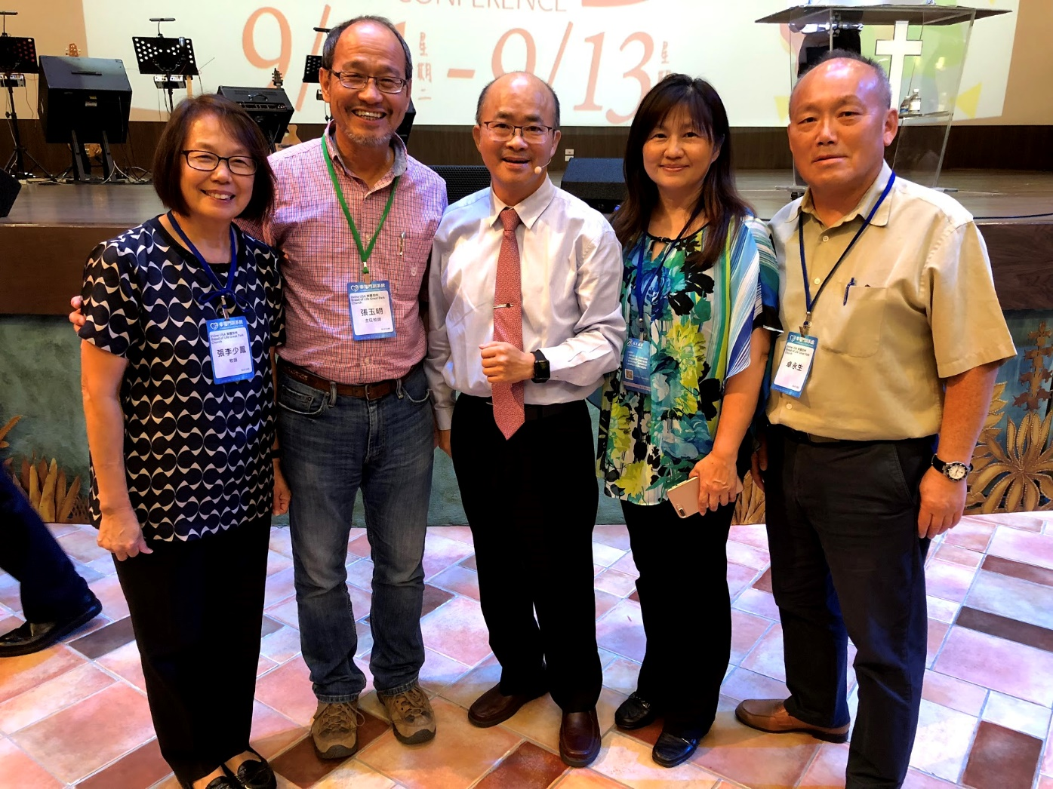
Testimonies 見證

