Slide 1
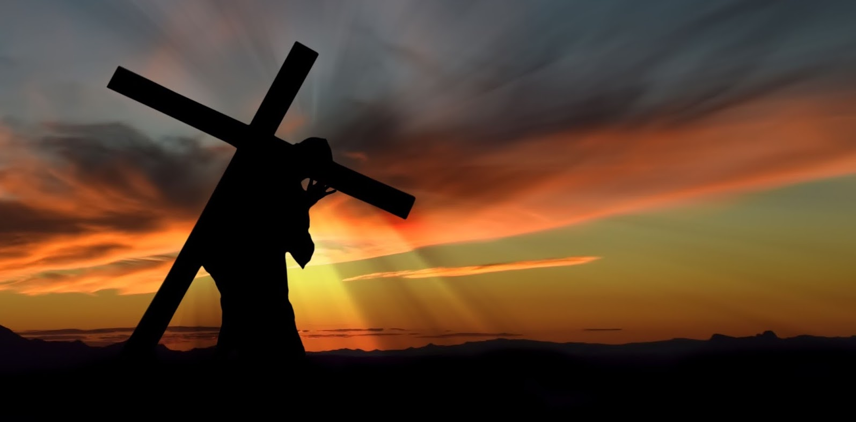
背起十字架跟隨主
Take up the Cross and Follow Jesus
4/14/2019
Rev. Joseph Chang
BOLGPC 爾灣大公園靈糧堂

Slide 2
背起十字架和被釘十字架是有差別的
There is a difference between taking up the cross and
being crucified.
1. 被釘十字架/ crucified
➔表示為自己的行為受罰
Punished for his actions
2. 背起十字架/taking up the cross
➔不但是為自己的行為受罰, 而且內心認同這個刑罰,
認同這個審判。
Not only is he punished for his actions, but he also
agrees with this trial and this punishment.

Slide 3
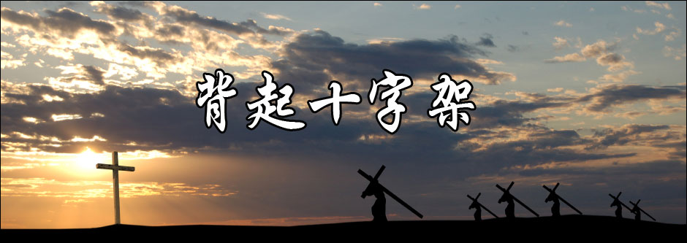
24於是耶穌對門徒說：若有人要跟從我，就當捨己，背起他的十字架來跟從我。【太 16:24】
24Then Jesus told his disciples, ""If anyone would come after me, let him deny himself and take up his cross and follow me." 【Matt 16:24】

Slide 4
和主耶穌同釘十字架表示與耶穌同受苦.
但是主耶穌要求的是背起十字架.
Crucifixion with the Lord Jesus means suffering with Jesus. But the Lord Jesus asks us to take up the cross.

Slide 5
I.聖經的價值標準. Biblical Value.
羅馬人要求犯人自己背著十字架到受刑的地方去. 這就好像逼使受刑人說, 我不但知道我要受十字架的刑罰, 並且我同意我應該受這樣子的刑罰.
The Romans demanded that the condemned one carried his own cross to the place of execution. This is like forcing the prisoner to say that I not only know I am subject to the punishment of crucifixion, but I agree with this punishment.

Slide 6
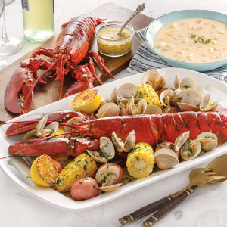
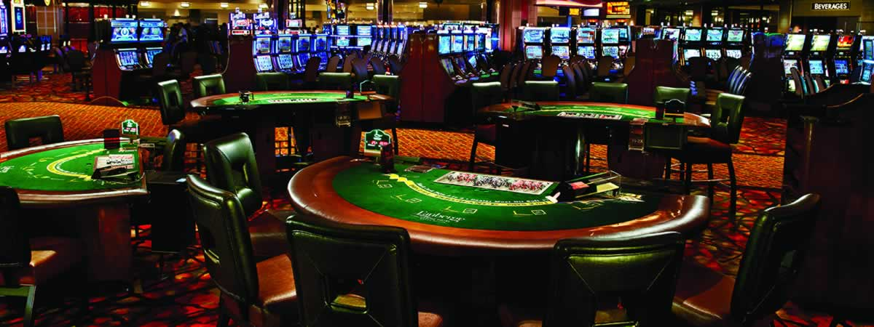
Illustration 1:

Slide 7
4所以，我們藉著洗禮歸入死，和他一同埋葬，原是叫我們一舉一動有新生的樣式，像基督藉著父的榮耀從死裡復活一樣。5我們若在他死的形狀上與他聯合，也要在他復活的形狀上與他聯合；6因為知道我們的舊人和他同釘十字架，使罪身滅絕，叫我們不再作罪的奴僕；【羅 6:4~6】
4We were buried therefore with him by baptism into death, in order that, just as Christ was raised from the dead by the glory of the Father, we too might walk in newness of life. 5For if we have been united with him in a death like his, we shall certainly be united with him in a resurrection like his. 6We know that our old self was crucified with him in order that the body of sin might be brought to nothing, so that we would no longer be enslaved to sin. 【Rom 6:4~6】

Slide 8
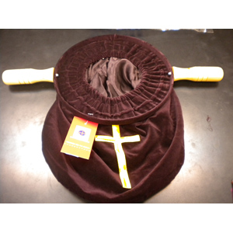
Illustration 2:
10萬軍之耶和華說：你們要將當納的十分之一全然送入倉庫，使我家有糧，以此試試我，是否為你們敞開天上的窗戶，傾福與你們，甚至無處可容。【瑪 3:10】
10Bring the full tithes into the storehouse, that there may be food in my house. And thereby put me to the test, says the Lord of hosts, if I will not open the windows of heaven for you and pour down for you a blessing until there is no more need. 【Mal 3:10】

Slide 9
34你們不要想我來是叫地上太平；我來並不是叫地上太平，乃是叫地上動刀兵。35因為我來是叫人與父親生疏，女兒與母親生疏，媳婦與婆婆生疏。36人的仇敵就是自己家裡的人。【太 10:34~38】
34""Do not think that I have come to bring peace to the earth. I have not come to bring peace, but a sword." 35"For I have come to set a man against his father, and a daughter against her mother, and a daughter-in-law against her mother-in-law." 36"And a person's enemies will be those of his own household.“
【Matt 10:34~38】

Slide 10
37愛父母過於愛我的，不配作我的門徒；愛兒女過於愛我的，不配作我的門徒；38不背著他的十字架跟從我的，也不配作我的門徒。【太 10:34~38】
37"Whoever loves father or mother more than me is not worthy of me, and whoever loves son or daughter more than me is not worthy of me." 38"And whoever does not take his cross and follow me is not worthy of me." 【Matt 10:34~38】

Slide 11
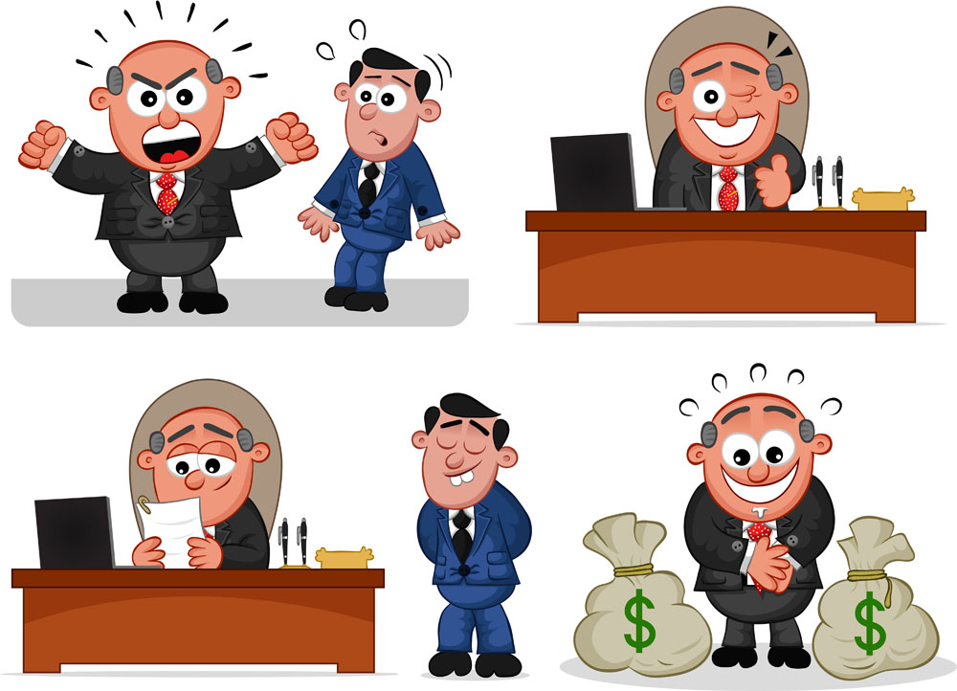
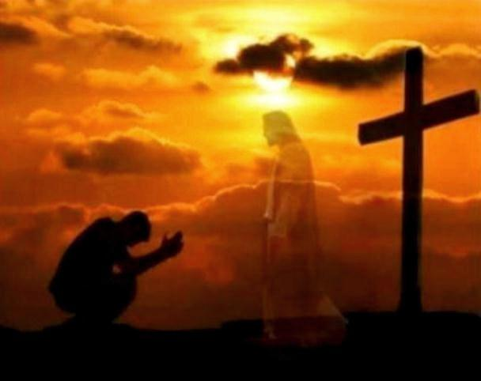
II. 作僕人Servanthood.

Slide 12
25耶穌叫了他們來，說：你們知道外邦人有君王為主治理他們，有大臣操權管束他們。26只是在你們中間，不可這樣；你們中間誰願為大，就必作你們的用人；27誰願為首，就必作你們的僕人。28正如人子來，不是要受人的服事，乃是要服事人，並且要捨命，作多人的贖價。【太 20:25~28】
25But Jesus called them to him and said, ""You know that the rulers of the Gentiles lord it over them, and their great ones exercise authority over them." 26"It shall not be so among you. But whoever would be great among you must be your servant," 27"and whoever would be first among you must be your slave," 28"even as the Son of Man came not to be served but to serve, and to give his life as a ransom for many." " 【Matt 20:25~28】

Slide 13
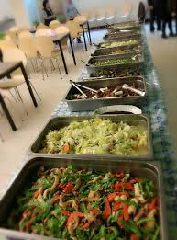
Illustration 3:
➔教會中要作頭的人, 就要作眾人的僕人.
Those who are to be heads in the church
will be servants of all.

Slide 14
Illustration 4:
我們看到Secretary這個字的時候, 我們想到甚麼?
When we saw the word "Secretary", what do we think of?
美國的國務院的部長叫做甚麼?
What is the minister of the US State Department called?
➔ Secretary of State
美國的教育部長叫做甚麼?
What is the US Minister of Education called?
➔ Secretary of Education

Slide 15
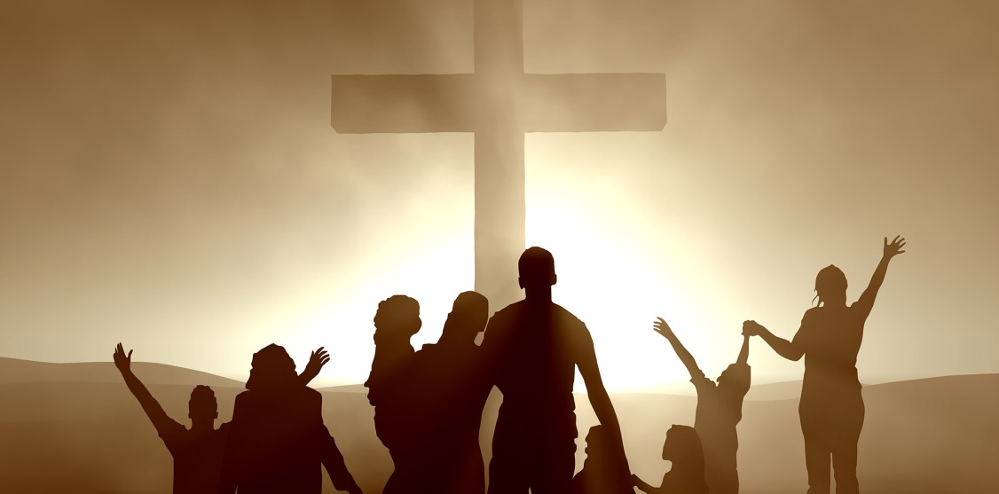
這是美國立國的精神, 這就是基督教的精神.
This is the spirit of the United States,
and this is the spirit of Christianity.

Slide 16
III. 擁有權Ownership
人民公社和我們現在住在美國所生活, 所熟悉的資本主
義制度, 最大的不同就是:
What is the biggest difference between the people’s
commune and the capitalist system we live in now ?
➔擁有權/Ownership

Slide 17
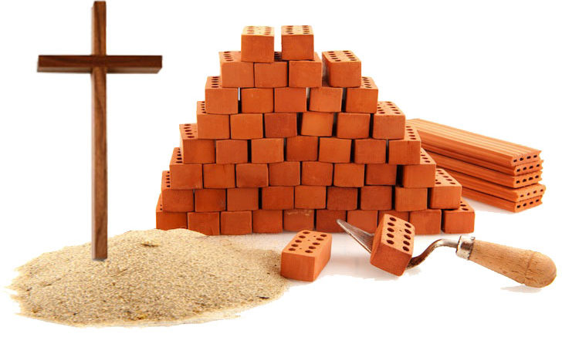

Slide 18
Conclusion結論
39那同釘的兩個犯人有一個譏誚他，說：你不是基督麼？可以救自己和我們罷！40那一個就應聲責備他，說：你既是一樣受刑的，還不怕神麼？41我們是應該的，因我們所受的與我們所做的相稱，但這個人沒有做過一件不好的事。【路 23:39~43】
39One of the criminals who were hanged railed at him, saying, "Are you not the Christ? Save yourself and us!" 40But the other rebuked him, saying, "Do you not fear God, since you are under the same sentence of condemnation? 41And we indeed justly, for we are receiving the due reward of our deeds; but this man has done nothing wrong."【Luke 23:39~43】

Slide 19
42就說：耶穌阿，你得國降臨的時候，求你記念我！43耶穌對他說：我實在告訴你，今日你要同我在樂園裡了。【路 23:39~43】
42And he said, "Jesus, remember me when you come into your kingdom." 43And he said to him, ""Truly, I say to you, today you will be with me in Paradise." " 【Luke 23:39~43】

