Slide 1

What Should I Eat?
我該吃甚麼?
4/7/2019
Rev. Joseph Chang
BOLGPC 爾灣大公園靈糧堂

Slide 2
吃和我們肉體的生命很有關係.
那吃會不會和我們屬靈的生命也有關係呢?
Eating is pretty much related to our physical
life. Will it be related to our spiritual life?
➔當然有啦!
Of course there is!

Slide 3
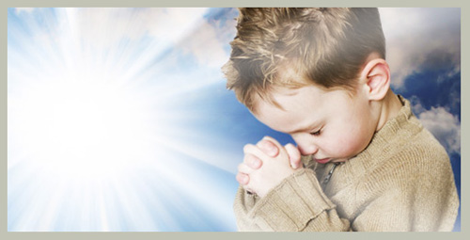
“禁食禱告” "fasting and praying"
➔不滿足我們屬肉體的需要,所以可以讓我們屬靈的感覺
更加敏銳地來親近神.
Don't satisfy the needs of our physical body, so we can
let our spiritual feelings be closer to God with a keen
sense.

Slide 4
聖經上也講我們不可貪食.
The Bible also says that we can't be gluttonous.
²¹因為好酒貪食的，必致貧窮；好睡覺的，必穿破爛衣服。【箴 23:21】
²¹for the drunkard and the glutton will come to poverty, and slumber will clothe them with rags. 【Prov 23:21】

Slide 5
¹⁹情慾的事都是顯而易見的，就如姦淫、污穢、邪蕩、²⁰拜偶像、邪術、仇恨、爭競、忌恨、惱怒、結黨、紛爭、異端、²¹嫉妒（有古卷在此有：兇殺二字）、醉酒、荒宴等類。我從前告訴你們，現在又告訴你們，行這樣事的人必不能承受神的國。【加 5:19~21】
¹⁹Now the works of the flesh are evident: sexual immorality, impurity, sensuality, ²⁰idolatry, sorcery, enmity, strife, jealousy, fits of anger, rivalries, dissensions, divisions, ²¹envy, drunkenness, orgies, and things like these. I warn you, as I warned you before, that those who do such things will not inherit the kingdom of God. 【Gal 5:19~21】

Slide 6
I. 最早的時候/At the Beginning
²⁹ 神說：看哪，我將遍地上一切結種子的菜蔬和一切樹上所結有核的果子全賜給你們作食物。³⁰至於地上的走獸和空中的飛鳥，並各樣爬在地上有生命的物，我將青草賜給他們作食物。事就這樣成了。【創 1:29~30】
²⁹And God said, "Behold, I have given you every plant yielding seed that is on the face of all the earth, and every tree with seed in its fruit. You shall have them for food. ³⁰And to every beast of the earth and to every bird of the heavens and to everything that creeps on the earth, everything that has the breath of life, I have given every green plant for food." And it was so. 【Gen 1:29~30】

Slide 7
➔所以最早的人類是vegeterians
So the earliest human beings are vegetarians.
從我們牙齒的構造, 我們就知道神的創造, 我們
是很合適吃菜蔬果實的。
From the construction of our teeth, we know God
created us to be suitable for eating fruits and
vegetables.

Slide 8
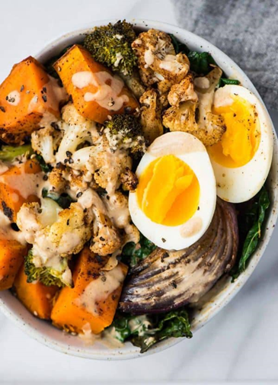
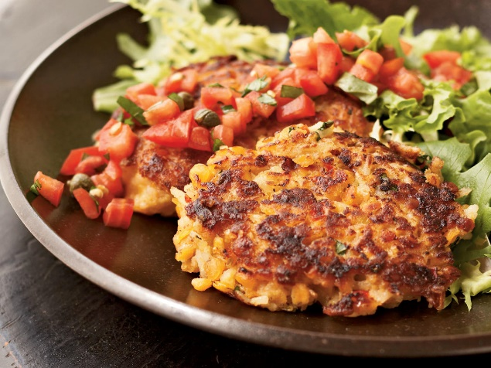
vegetarian (素食主義者) 和vegan(嚴格素食主義者)的差別
The difference between vegetarian and vegan diets.

Slide 9
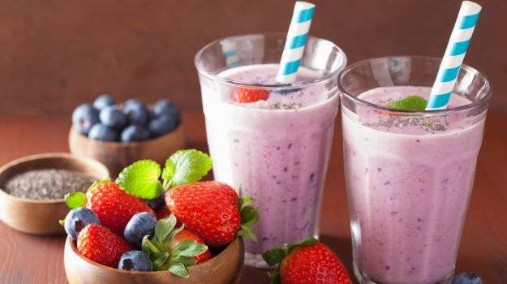
A perfect vegan drink

Slide 10
II. God allowed us to eat meat. 神允許我們吃肉.
洪水之後, 神開始允許我們吃肉, 挪亞從方舟出來之後, 神跟他和他的孩子媳婦們這樣子說:
After the flood, God began to allow us to eat meat. After Noah came out of the ark, God said to him and his children and daughters:

Slide 11
¹ 神賜福給挪亞和他的兒子，對他們說：你們要生養眾多，遍滿了地。²凡地上的走獸和空中的飛鳥都必驚恐，懼怕你們，連地上一切的昆蟲並海裡一切的魚都交付你們的手。³凡活著的動物都可以作你們的食物。這一切我都賜給你們，如同菜蔬一樣。【創 9:1~6】
¹And God blessed Noah and his sons and said to them, "Be fruitful and multiply and fill the earth. ²The fear of you and the dread of you shall be upon every beast of the earth and upon every bird of the heavens, upon everything that creeps on the ground and all the fish of the sea. Into your hand they are delivered. ³Every moving thing that lives shall be food for you. And as I gave you the green plants, I give you everything.
【Gen 9:1~6】

Slide 12
⁴惟獨肉帶著血，那就是他的生命，你們不可吃。⁵流你們血、害你們命的，無論是獸是人，我必討他的罪，就是向各人的弟兄也是如此。⁶凡流人血的，他的血也必被人所流，因為 神造人是照自己的形像造的。【創 9:1~6】
⁴But you shall not eat flesh with its life, that is, its blood. ⁵And for your lifeblood I will require a reckoning: from every beast I will require it and from man. From his fellow man I will require a reckoning for the life of man. ⁶"Whoever sheds the blood of man, by man shall his blood be shed, for God made man in his own image. 【Gen 9:1~6】

Slide 13
為什麼不能夠吃血?
Why are we forbidden to eat blood?
➔因為血代表生命. 神很重視人的生命. 所以拿
掉人生命的, 他就要付上自己的生命.
Blood represents life, and God values human
life. He who murders pays the forfeit of his life.

Slide 14
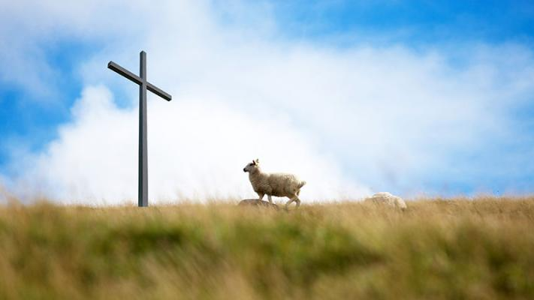
那麼動物的血呢?
What about the blood of animals?
➔動物的血代表贖罪這個功能, 所以我們也
不可以吃.
Animal blood represents the function of
atonement, so we are not allowed to eat it
either.

Slide 15
摩西的時代, 神對以色列人這樣子說:
In the days of Moses, God said to the Israelites:
¹⁰凡以色列家中的人，或是寄居在他們中間的外人，若吃甚麼血，我必向那吃血的人變臉，把他從民中剪除。¹¹因為活物的生命是在血中。我把這血賜給你們，可以在壇上為你們的生命贖罪；因血裡有生命，所以能贖罪。【利 17:10~11】
¹⁰"If any one of the house of Israel or of the strangers who sojourn among them eats any blood, I will set my face against that person who eats blood and will cut him off from among his people. ¹¹For the life of the flesh is in the blood, and I have given it for you on the altar to make atonement for your souls, for it is the blood that makes atonement by the life. 【Lev 17:10~11】

Slide 16
我們現在可以吃血嗎?
Are we allowed to eat blood now?
➔耶路撒冷的大公會議耶穌的弟弟雅各很清楚地講
到, 教會是不可以吃血的:
Jacob, the brother of Jesus in the Great Council of
Jerusalem, spoke very clearly that we should
abstain from blood.

Slide 17
19所以據我的意見，不可難為那歸服神的外邦人；20只要寫信，吩咐他們禁戒偶像的污穢和姦淫，並勒死的牲畜和血。【徒 15:19~20】
19Therefore my judgment is that we should not trouble those of the Gentiles who turn to God, 20but should write to them to abstain from the things polluted by idols, and from sexual immorality, and from what has been strangled, and from blood. 【Acts 15:19~20】

Slide 18
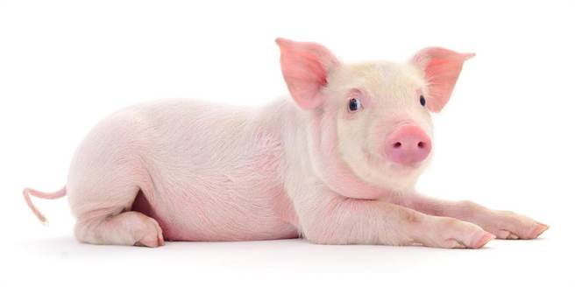
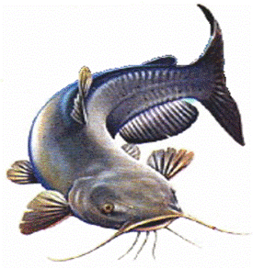
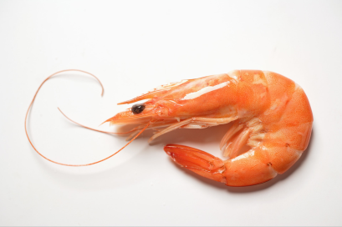
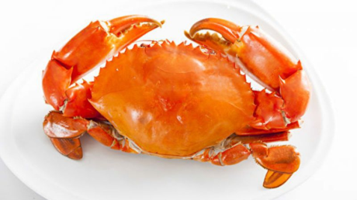
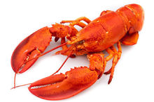
III. Jewish Diet/猶太人的飲食
吃Kosher的食物, 表示來源可靠, 食物的種類被上帝許可, 準備的方法也合乎聖經. 必須是反芻和分蹄的。
For larger animals, kosher laws permit the consumption of species that both chew their cud and have split hooves.
☒
☒
☒
☒
☒

Slide 19
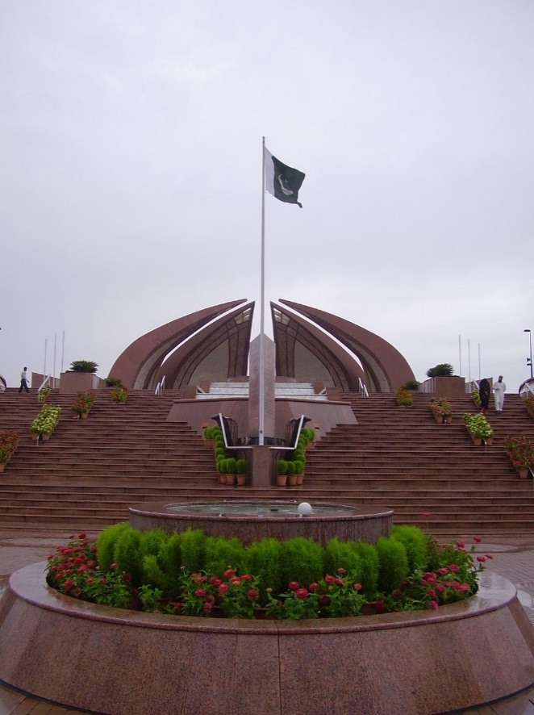
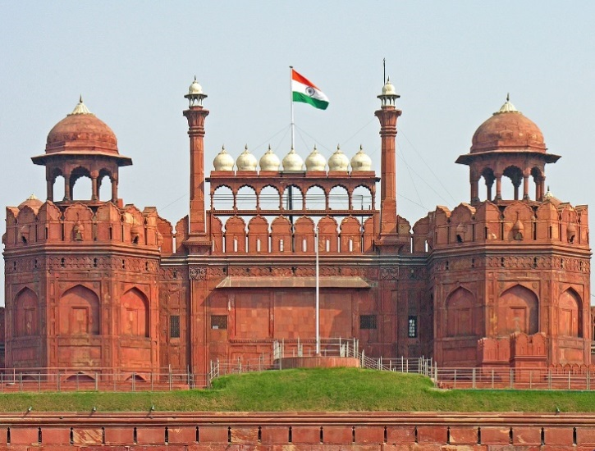
“為什麼” 神要這樣子規定他們?
Why does God stipulate them like this?
Illustration:

Slide 20
佛教/印度教和回教的吃飯習慣 :
Buddhism , Hinduism and Muslim eating habits:

Slide 21
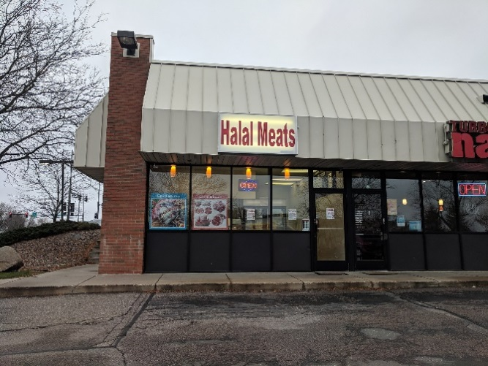
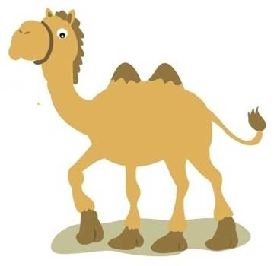
IV. 回教大底承受猶太教的教導
Muslim inherited much Jewish teaching.
➔他們的飲食律法是叫做halal 同樣的要求動物要放血
Their diet is called halal. All blood is drained from
the carcass.
☑

Slide 22

V. 印度教, 佛教 /Hinduism, Buddhism
➔要敬虔的就不能吃肉食. 一般的至少不要吃牛.
Some eat pork. Generally, beef is forbidden.
☒

Slide 23
VI. 基督教/Christians
➔基督徒是甚麼都吃. 只是不能吃血.
Christians eat everything. Just can't eat blood.

Slide 24
為什麼我們可以不遵守舊約的教導, 可以吃豬肉,
可以吃龍蝦呢?
Why can we eat pork and lobster without following
the teachings of the Old Testament?
➔我們要是必須遵守舊約的律法, 基本上, 我們就是
需要先成為猶太人然後才可以信耶穌.
If we must abide by the laws of the Old Testament,
basically, we need to be a Jew before we can believe
in Jesus.

Slide 25
主耶穌這樣子說:
The Lord Jesus said this:
¹⁴耶穌又叫眾人來，對他們說：你們都要聽我的話，也要明白。¹⁵從外面進去的不能污穢人，惟有從裡面出來的乃能污穢人。（有古卷在此有：¹⁶有耳可聽的，就應當聽！）
【可 7:14~19】
¹⁴And he called the people to him again and said to them, ""Hear me, all of you, and understand:" ¹⁵"There is nothing outside a person that by going into him can defile him, but the things that come out of a person are what defile him."" ¹⁶[Same as Above.] 【Mark 7:14~19】

Slide 26
¹⁷耶穌離開眾人，進了屋子，門徒就問他這比喻的意思。 ¹⁸耶穌對他們說：你們也是這樣不明白麼？豈不曉得凡從外面進入的，不能污穢人，¹⁹因為不是入他的心，乃是入他的肚腹，又落到茅廁裡。這是說，各樣的食物都是潔淨的；【可 7:14~19】
¹⁷And when he had entered the house and left the people, his disciples asked him about the parable. ¹⁸And he said to them, ""Then are you also without understanding? Do you not see that whatever goes into a person from outside cannot defile him," ¹⁹"since it enters not his heart but his stomach, and is expelled?""(Thus he declared all foods clean.) 【Mark 7:14~19】

Slide 27
聖靈對彼得所說的話:
What the Holy Spirit said to Peter:
¹¹看見天開了，有一物降下，好像一塊大布，繫著四角，縋在地上，¹²裡面有地上各樣四足的走獸和昆蟲，並天上的飛鳥；¹³又有聲音向他說：彼得，起來，宰了吃！
【徒 10:11~16】
¹¹and saw the heavens opened and something like a great sheet descending, being let down by its four corners upon the earth. ¹²In it were all kinds of animals and reptiles and birds of the air. ¹³And there came a voice to him: ""Rise, Peter; kill and eat."【Acts 10:11~16】

Slide 28
¹⁴彼得卻說：主阿，這是不可的！凡俗物和不潔淨的物，我從來沒有吃過。¹⁵第二次有聲音向他說：神所潔淨的，你不可當作俗物。¹⁶這樣一連三次，那物隨即收回天上去了。【徒 10:11~16】
" ¹⁴But Peter said, "By no means, Lord; for I have never eaten anything that is common or unclean." ¹⁵And the voice came to him again a second time, ""What God has made clean, do not call common."" ¹⁶This happened three times, and the thing was taken up at once to heaven. 【Acts 10:11~16】

Slide 29
最大、最重要的屬靈意義:
The greatest and most important spiritual meaning:
➔就是神直接把救恩帶到外邦人之中, 不再透過猶太人了. 今天我們信上帝, 不需要經過猶太人, 不需要遵守猶太人的飲食習慣, 我們就可以直接來到神的面前了.耶穌成為我們的道路, 真理, 生命.
It is God who brings salvation directly to the Gentiles, no longer through the Jews. Today we believe in God, do not need to go through the Jews, do not need to follow the Jewish eating habits, we can come directly to God. Jesus became Our path, truth, life.

Slide 30
VII. 以愛心為原則的吃. Eat with Love.
²⁵凡市上所賣的，你們只管吃，不要為良心的緣故問甚麼話，²⁶因為地和其中所充滿的都屬乎主。²⁷倘有一個不信的人請你們赴席，你們若願意去，凡擺在你們面前的，只管吃，不要為良心的緣故問甚麼話。 【林前 10:25~29】
²⁵Eat whatever is sold in the meat market without raising any question on the ground of conscience. ²⁶For "the earth is the Lord's, and the fullness thereof." ²⁷If one of the unbelievers invites you to dinner and you are disposed to go, eat whatever is set before you without raising any question on the ground of conscience. 【1Cor 10:25~29】

Slide 31
²⁸若有人對你們說：這是獻過祭的物，就要為那告訴你們的人，並為良心的緣故不吃。²⁹我說的良心不是你的，乃是他的。我這自由為甚麼被別人的良心論斷呢？
【林前 10:25~29】
²⁸But if someone says to you, "This has been offered in sacrifice," then do not eat it, for the sake of the one who informed you, and for the sake of conscience- ²⁹I do not mean your conscience, but his. For why should my liberty be determined by someone else's conscience?
【1Cor 10:25~29】

Slide 32
這裡所說的基督徒吃的兩個原則:
Here are two principles that Christians follow:
1)自由/liberty :
甚麼都可以吃, 甚至連祭過偶像的東西都可以吃. 因為這東西是神所造的, 我只要感謝了, 就可以吃.
Everything can be eaten, even things that have been sacrificed for idols can be eaten. Because they are made by God, we can eat them with thankfulness.
2)愛心/love:
有時候我不吃, 是因為愛心的緣故.
Sometimes I don’t eat it for the sake of love.

Slide 33
Conclusion結論
吃東西的原則/The principle of eating:
1. 健康的原則—有節制.
The principle of health – eating in moderation
2. 敬虔的原則—可以接近神.
The principle of godliness - approaching God
3. 不吃血. Do not eat blood.
4. 自由的原則—甚麼都可吃.
The principle of liberty - everything can be eaten
5. 愛心的原則—為了BEST的良心.
The principle of love - for the conscience of BESTs

