Slide 1
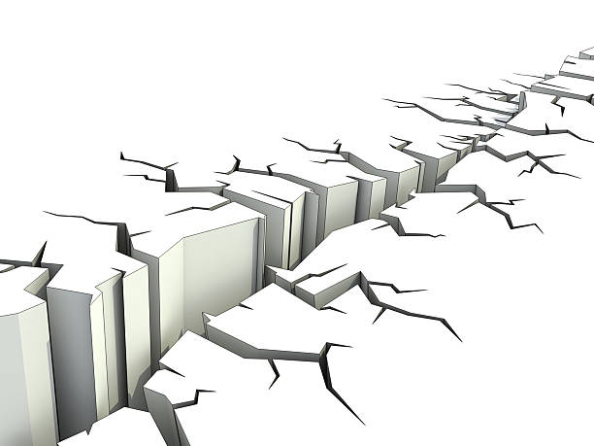
4種地震/
4 Earthquakes
Proverbs 30:21-23
10/6/2019
Rev. Joseph Chang
BOLGPC 爾灣大公園靈糧堂

Slide 2
²¹使地震動的有三樣，連地擔不起的共有四樣：²²就是僕人作王；愚頑人吃飽；²³醜惡的女子出嫁；婢女接續主母。【箴 30:21~23】
²¹Under three things the earth trembles; under four it cannot bear up: ²²a slave when he becomes king, and a fool when he is filled with food; ²³an unloved woman when she gets a husband, and a maidservant when she displaces her mistress. 【Prov 30:21~23】

Slide 3
有四樣事情是讓地都忍受不住的.
我們來談一談:
There are four things that the earth
can’t bear up. Let's talk about them:

Slide 4
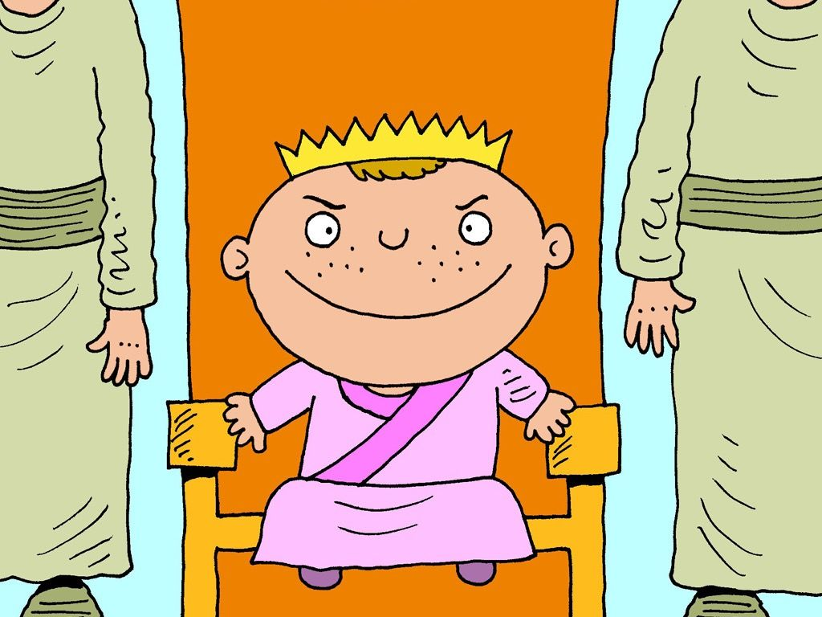
I. A slave when he becomes a king./僕人做王.
☒這裡講的不是出身的問題
This does not relate to one’s class origin or family background.
➔這種問題在於當事人有這個位置, 但是沒有這個重量(不適格)
He has the position but not the quality for it.

Slide 5
①所羅門王/ King Solomon
⁷耶和華─我的 神啊，如今你使僕人接續我父親大衛作王；但我是幼童，不知道應當怎樣出入。⁸僕人住在你所揀選的民中，這民多得不可勝數。⁹所以求你賜我智慧，可以判斷你的民，能辨別是非。不然，誰能判斷這眾多的民呢？¹⁰所羅門因為求這事，就蒙主喜悅。
【王上 3:7~10】 ⁷And now, O Lord my God, you have made your servant king in place of David my father, although I am but a little child. I do not know how to go out or come in. ⁸And your servant is in the midst of your people whom you have chosen, a great people, too many to be numbered or counted for multitude. ⁹Give your servant therefore an understanding mind to govern your people, that I may discern between good and evil, for who is able to govern this your great people?" ¹⁰It pleased the Lord that Solomon had asked this. 【1King 3:7~10】

Slide 6
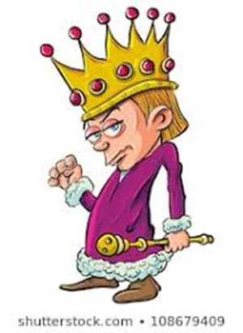
但是僕人做王就不是這樣的一個情形.
But it is not the case when a servant becomes a king.

Slide 7
②所羅門的兒子羅波安作王的時候
when Solomon’s son, Rehoboam, became a king
⁴你父親使我們負重軛，做苦工，現在求你使我們做的苦工、負的重軛輕鬆些，我們就事奉你。⁵羅波安對他們說：你們暫且去，第三日再來見我。民就去了。⁶羅波安之父所羅門在世的日子，有侍立在他面前的老年人，羅波安王和他們商議，說：你們給我出個甚麼主意，我好回覆這民。
⁴"Your father made our yoke heavy. Now therefore lighten the hard service of your father and his heavy yoke on us, and we will serve you." ⁵He said to them, "Go away for three days, then come again to me." So the people went away. ⁶Then King Rehoboam took counsel with the old men, who had stood before Solomon his father while he was yet alive, saying, "How do you advise me to answer this people?"

Slide 8
⁷老年人對他說：現在王若服事這民如僕人，用好話回答他們，他們就永遠作王的僕人。⁸王卻不用老年人給他出的主意，就和那些與他一同長大、在他面前侍立的少年人商議，⁹說：這民對我說：你父親使我們負重軛，求你使我們輕鬆些。你們給我出個甚麼主意，我好回覆他們。
⁷And they said to him, "If you will be a servant to this people today and serve them, and speak good words to them when you answer them, then they will be your servants forever." ⁸But he abandoned the counsel that the old men gave him and took counsel with the young men who had grown up with him and stood before him. ⁹And he said to them, "What do you advise that we answer this people who have said to me, 'Lighten the yoke that your father put on us'?"

Slide 9
¹⁰那同他長大的少年人說：這民對王說：你父親使我們負重軛，求你使我們輕鬆些。王要對他們如此說：我的小拇指頭比我父親的腰還粗。¹¹我父親使你們負重軛，我必使你們負更重的軛！我父親用鞭子責打你們，我要用蠍子鞭責打你們！
【王上 12:4~11】
¹⁰And the young men who had grown up with him said to him, "Thus shall you speak to this people who said to you, 'Your father made our yoke heavy, but you lighten it for us,' thus shall you say to them, 'My little finger is thicker than my father's thighs. ¹¹And now, whereas my father laid on you a heavy yoke, I will add to your yoke. My father disciplined you with whips, but I will discipline you with scorpions.' " 【1King 12:4~11】

Slide 10
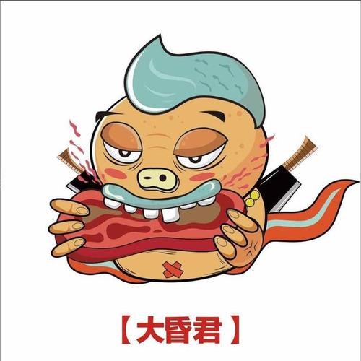
II. A fool when he is filled with food/愚頑人吃飽
Q:愚頑人吃飽的問題是甚麼呢? What is the problem of a fool when he is filled with food?
➔就是顯現出他的愚昧.
He shows his stupidity.

Slide 11
①羅波安王/ Rehoboam
¹²耶羅波安和眾百姓遵著羅波安王所說你們第三日再來見我的那話，第三日他們果然來了。¹³王用嚴厲的話回答百姓，不用老年人給他所出的主意，¹⁴照著少年人所出的主意對民說：我父親使你們負重軛，我必使你們負更重的軛！我父親用鞭子責打你們，我要用蠍子鞭責打你們！【王上 12:12~14】 ¹²So Jeroboam and all the people came to Rehoboam the third day, as the king said, "Come to me again the third day." ¹³And the king answered the people harshly, and forsaking the counsel that the old men had given him, ¹⁴he spoke to them according to the counsel of the young men, saying, "My father made your yoke heavy, but I will add to your yoke. My father disciplined you with whips, but I will discipline you with scorpions." 【1King 12:12~14】

Slide 12
②同樣的故事在澳洲現在也在上演之中:
https://www.youtube.com/watch?v=3M_Iug7a4KM

Slide 14
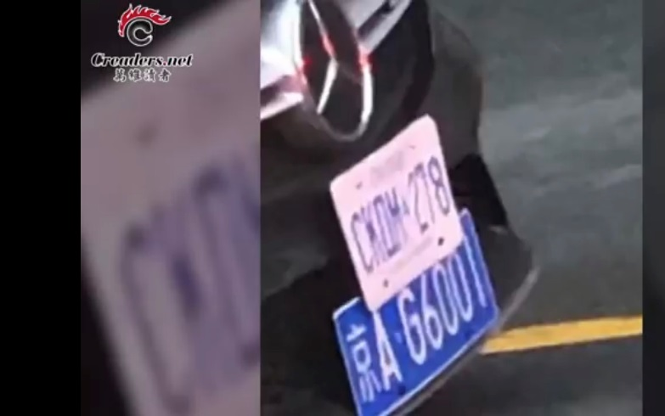
④在Canada

Slide 15
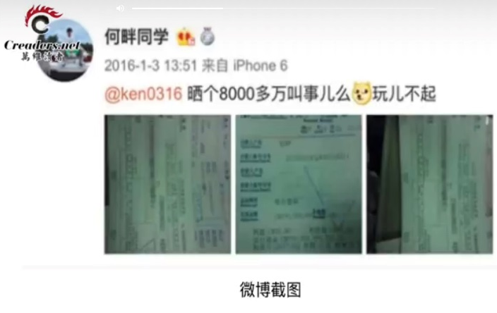
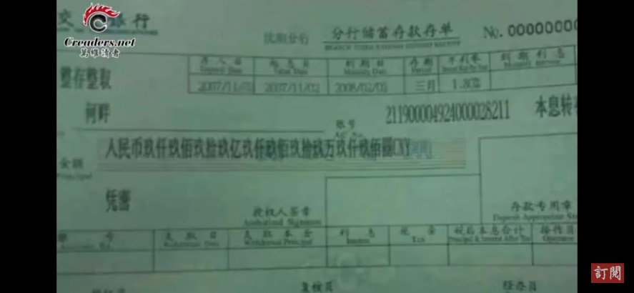
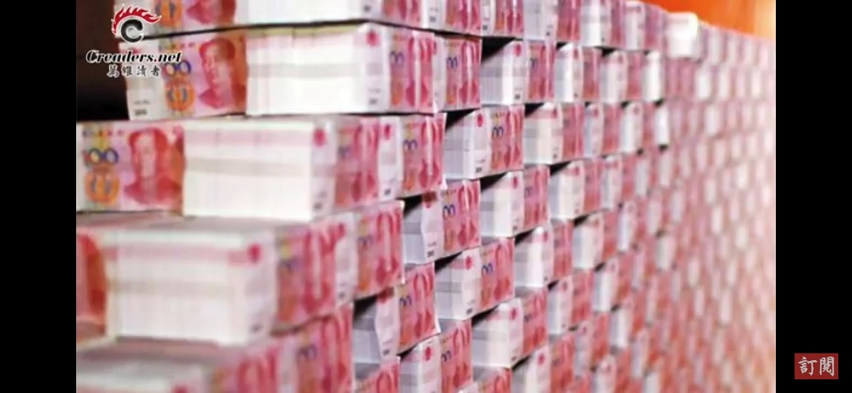

Slide 16
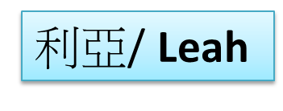
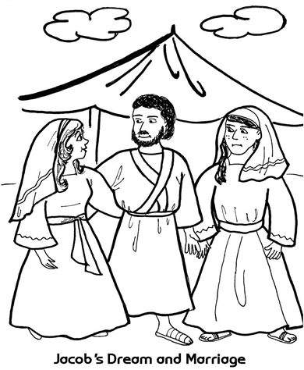
III. An unloved woman when she gets a husband
醜惡的女子出嫁 (“不被愛的女子得到一個丈夫”)

Slide 17
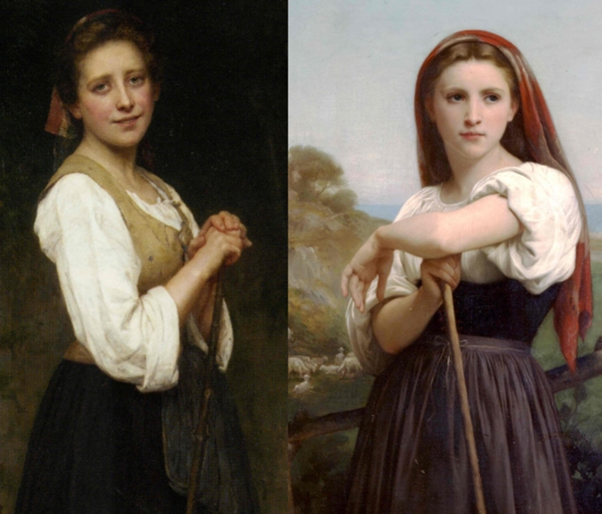
¹⁶拉班有兩個女兒，大的名叫利亞，小的名叫拉結。¹⁷利亞的眼睛沒有神氣，拉結卻生得美貌俊秀。
【創 29:16~17】 ¹⁶Now Laban had two daughters. The name of the older was Leah, and the name of the younger was Rachel. ¹⁷Leah's eyes were weak, but Rachel was beautiful in form and appearance.
【Gen 29:16~17】
Leah/利亞
拉結/Rachel

Slide 18
¹⁸雅各愛拉結，就說：我願為你小女兒拉結服事你七年。【創 29:18】 ¹⁸Jacob loved Rachel. And he said, "I will serve you seven years for your younger daughter Rachel." 【Gen 29:18】

Slide 19
³¹耶和華見利亞失寵(原文作被恨；下同)，就使他生育，拉結卻不生育。
【創 29:31】 ³¹When the Lord saw that Leah was hated, he opened her womb, but Rachel was barren. 【Gen 29:31, ESV】
³¹When the Lord saw that Leah was not loved, he opened her womb, but Rachel was barren. 【Gen 29:31, NIV】
➔earthquake of sympathy

Slide 20
³¹耶和華見利亞失寵(原文作被恨；下同)，就使他生育，拉結卻不生育。³²利亞懷孕生子，就給他起名叫流便(就是有兒子的意思)，因而說：耶和華看見我的苦情，如今我的丈夫必愛我。³³他又懷孕生子，就說：耶和華因為聽見我失寵，所以又賜給我這個兒子，於是給他起名叫西緬(就是聽見的意思)。
³¹When the Lord saw that Leah was hated, he opened her womb, but Rachel was barren. ³²And Leah conceived and bore a son, and she called his name Reuben, for she said, "Because the Lordhas looked upon my affliction; for now my husband will love me." ³³She conceived again and bore a son, and said, "Because the Lord has heard that I am hated, he has given me this son also." And she called his name Simeon.

Slide 21
³⁴他又懷孕生子，起名叫利未(就是聯合的意思)，說：我給丈夫生了三個兒子，他必與我聯合。³⁵他又懷孕生子，說：這回我要讚美耶和華，因此給他起名叫猶大(就是讚美的意思)。這才停了生育。【創 29:31~35】
³⁴Again she conceived and bore a son, and said, "Now this time my husband will be attached to me, because I have borne him three sons." Therefore his name was called Levi. ³⁵And she conceived again and bore a son, and said, "This time I will praise the Lord." Therefore she called his name Judah. Then she ceased bearing. 【Gen 29:31~35】

Slide 22
1. 1st Son, 第一個孩子 流便( Reuben= “Behold, a son”).
2. 2nd Son, 第二個兒子 西緬(Simeon or Shimeon = “heard”).
3. 3rd Son, 第三個兒子利未( Levi = “join to”)
4. 4th Son, 第四個兒子猶大( Judah = “I will praise”)
前面三次/ the first three times
➔她所求的都是要贏得丈夫的心
What she asked for was to win the heart of her husband.
但是第四次/ but for the fourth time
➔“我要讚美耶和華”/ "I want to praise the Lord."

Slide 23
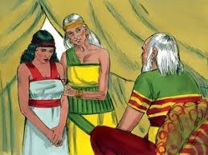
IV. a maidservant when she displaces her mistress.
婢女接續主母
撒拉見自己不能夠生育, 就把婢女夏甲給亞伯拉罕作妾, 就開始了這個family feud.
When Sarah bore Abram no children, she gave the maid, Hagar, to Abraham. The family feud began.

Slide 24
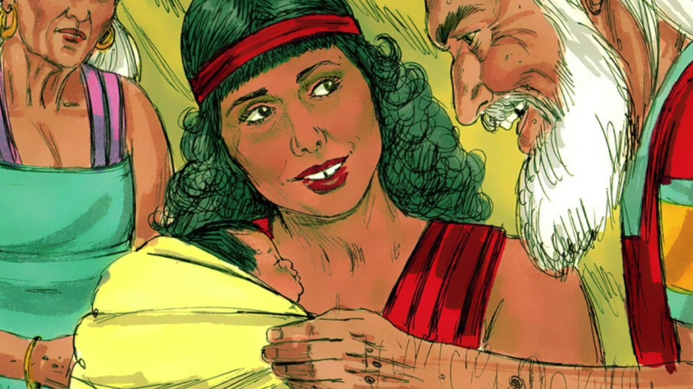
①夏甲的愚昧/the stupidity of Hagar

Slide 25
¹亞伯蘭的妻子撒萊不給他生兒女。撒萊有一個使女，名叫夏甲，是埃及人。²撒萊對亞伯蘭說：耶和華使我不能生育。求你和我的使女同房，或者我可以因他得孩子(得孩子原文作被建立)。亞伯蘭聽從了撒萊的話。³於是亞伯蘭的妻子撒萊將使女埃及人夏甲給了丈夫為妾；那時亞伯蘭在迦南已經住了十年。⁴亞伯蘭與夏甲同房，夏甲就懷了孕；他見自己有孕，就小看他的主母。【創 16:1~4】 ¹Now Sarai, Abram's wife, had borne him no children. She had a female Egyptian servant whose name was Hagar. ²And Sarai said to Abram, "Behold now, the Lord has prevented me from bearing children. Go in to my servant; it may be that I shall obtain children by her." And Abram listened to the voice of Sarai. ³So, after Abram had lived ten years in the land of Canaan, Sarai, Abram's wife, took Hagar the Egyptian, her servant, and gave her to Abram her husband as a wife. ⁴And he went in to Hagar, and she conceived. And when she saw that she had conceived, she looked with contempt on her mistress. 【Gen 16:1~4】

Slide 26
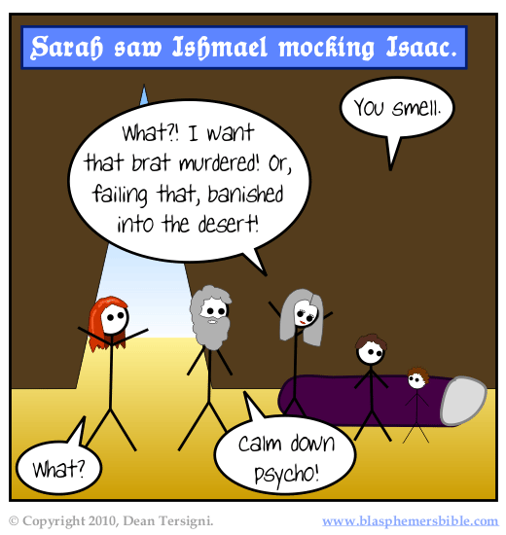
②以實瑪利嘲笑以撒/ Ishmael mocked at Isaac
⁸孩子漸長，就斷了奶。以撒斷奶的日子，亞伯拉罕設擺豐盛的筵席。⁹當時，撒拉看見埃及人夏甲給亞伯拉罕所生的兒子戲笑，
【創 21:8~9】 ⁸And the child grew and was weaned. And Abraham made a great feast on the day that Isaac was weaned. ⁹But Sarah saw the son of Hagar the Egyptian, whom she had borne to Abraham, laughing (NIV: mocking). 【Gen 21:8~9】

Slide 27
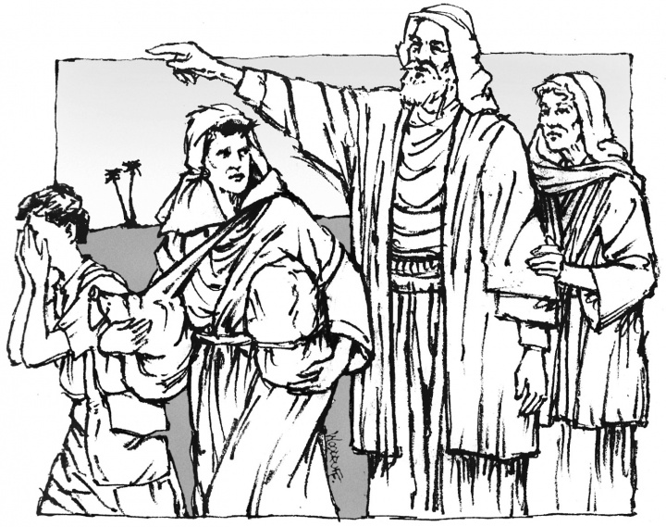

Slide 28
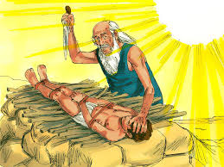
③New Horizon學校慶祝亞伯拉罕獻以實瑪利的節日
the New Horizon School celebrated Abraham’s Ishmael festival
☒回教徒今天還說, 亞伯拉罕獻以實瑪利, 而不是獻以撒,
因為可蘭經如此說
The Muslims say that Abraham offered Ishmael, not Isaac,
because the Koran says so.
He is Isaac not Ishmael

Slide 29
Conclusion/結論:
我以為這些地震帶給地球的破壞, 遠大於今天環境汙染所帶給地球的破壞還要來得大. 治療的方法呢? 是心向上帝. 讓耶穌的寶血洗淨你的心. 讓你能夠有王子的心, 讓你能夠有神孩子的身分, 讓你能夠讚美耶和華, 讓你能夠尊榮別人. 那麼地會是一個更平安的地.
I think that the damage caused by these earthquakes is far greater than the damage resulted in by environmental pollution. How about the treatment? We must turn our heart toward God. Let the blood of Jesus clean us from all sins. Let us come with the prince's heart and the identity of God’s children , so that we can praise the Lord and honor others. Then the place will be a much more peaceful world.

