Slide 1
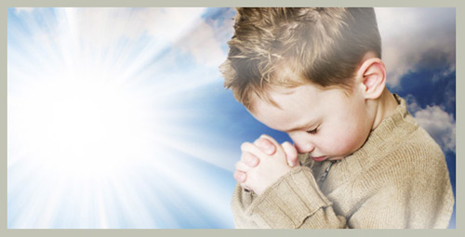
Pray, and then?
禱告, 然後呢?
Habakkuk 3:16-19
10/13/2019
Rev. Joseph Chang
BOLGPC 爾灣大公園靈糧堂

Slide 2
“我已經禱告了, 接下來是甚麼呢?”
“禱告了, 然後呢?”
Pray, and then?

Slide 3
問這樣子問題的有兩種人:
There are two kinds of people who ask such questions:
1.第一種人--是平常不來教會的人, 有了問題就找基督徒談一談.
The first kind of person, who does not usually go to church,
asks a Christian for advice when he has a problem.
2.第二種人--是平常比較來教會的人.
The second kind of person usually comes to church.

Slide 4
神是會聽我們的禱告, 也會答應我們的禱告, 但是
常常不是我們能夠想像, 我們能夠了解的方式.
God will listen to our prayers and will answer our
prayers, but it is not the way we can imagine, the way
we can understand.

Slide 5
三種我們比較常會經歷的方式:
We often experience it in these three ways.

Slide 6
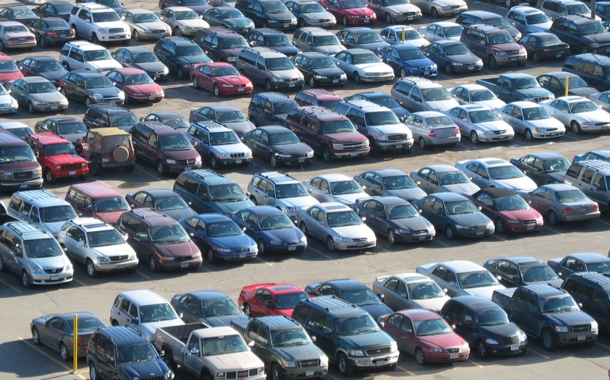
I. Pleasant Surprise/小神蹟
這種回應我們禱告的方式, 目的就是要讓我們知道神愛我們.
This way of responding to our prayers is to let us know that God loves us.
Illustration 1:

Slide 7
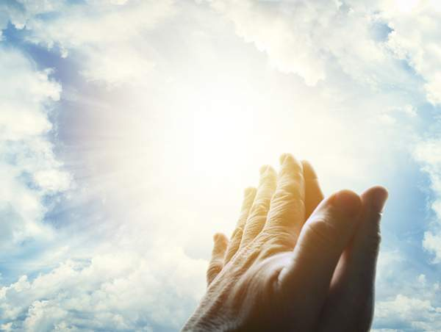
Illustration 2:

Slide 8
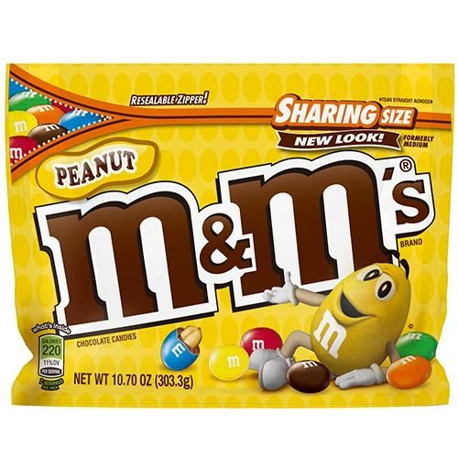

Slide 9
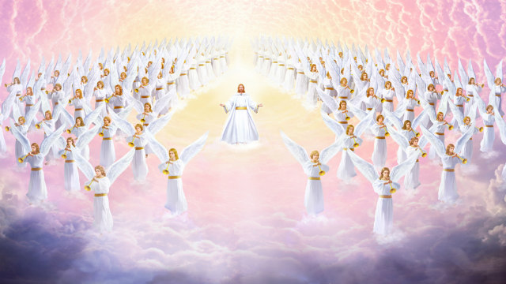
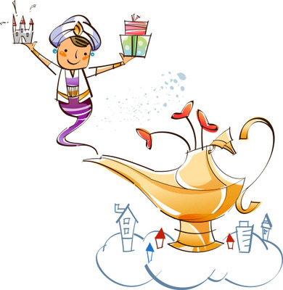
OMG—Oh, My God!
OMG—Oh, My Genie!
➔God和Genie最大的不同, 就是God 是我們的主, 對Genie而言
呢, 我們是Genie的主.
The biggest difference between God and Genie is that God is our
Lord while we are the master of Genie.

Slide 10
II. Answer us according to His Word.
按照祂的話來回答我們.
上帝是信實的. 神藉著聖經, 怎麼跟我們說, 祂就怎麼樣的做
God is faithful. Through the Bible, God tells us He did what He said.

Slide 11
Illustration 3:
¹⁰萬軍之耶和華說：你們要將當納的十分之一全然送入倉庫，使我家有糧，以此試試我，是否為你們敞開天上的窗戶，傾福與你們，甚至無處可容。【瑪 3:10】 ¹⁰Bring the full tithes into the storehouse, that there may be food in my house. And thereby put me to the test, says the Lord of hosts, if I will not open the windows of heaven for you and pour down for you a blessing until there is no more need. 【Mal 3:10】

Slide 12
神還會有甚麼方式可以祝福我嗎?
Is there any way God can bless me?

Slide 14
III. Rejoice even if the pen has no sheep!
圈中沒有羊, 也要因我的主喜樂.
目的是要改變, 深化我們的屬靈的性格.
The purpose is to change and deepen our spiritual character.

Slide 15
這是先知哈巴谷美麗的屬靈的宣告
This is the beautiful spiritual declaration of Habakkuk the prophet.
¹⁷雖然無花果樹不發旺，葡萄樹不結果，橄欖樹也不效力，田地不出糧食，圈中絕了羊，棚內也沒有牛；¹⁸然而，我要因耶和華歡欣，因救我的 神喜樂。¹⁹主耶和華是我的力量；他使我的腳快如母鹿的蹄，又使我穩行在高處。這歌交與伶長，用絲弦的樂器。【哈 3:17~19】 ¹⁷Though the fig tree should not blossom, nor fruit be on the vines, the produce of the olive fail and the fields yield no food, the flock be cut off from the fold and there be no herd in the stalls, ¹⁸yet I will rejoice in the Lord; I will take joy in the God of my salvation. ¹⁹God, the Lord, is my strength; he makes my feet like the deer's; he makes me tread on my high places. To the choirmaster: with stringed instruments. 【Hab 3:17~19】

Slide 16
A.神啊, 為什麼你不作為呢?
God, why are you not dealing with it?
¹先知哈巴谷所得的默示。²他說：耶和華啊！我呼求你，你不應允，要到幾時呢？我因強暴哀求你，你還不拯救。【哈 1:1~2】 ¹The oracle that Habakkuk the prophet saw. ²O Lord, how long shall I cry for help, and you will not hear? Or cry to you "Violence!" and you will not save? 【Hab 1:1~2】

Slide 17
B.神怎麼回答? How did God answer him?
⁵耶和華說：你們要向列國中觀看，大大驚奇；因為在你們的時候，我行一件事，雖有人告訴你們，你們總是不信。⁶我必興起迦勒底人，就是那殘忍暴躁之民，通行遍地，佔據那不屬自己的住處。⁷他威武可畏，判斷和勢力都任意發出。⁸他的馬比豹更快，比晚上的豺狼更猛。馬兵踴躍爭先，都從遠方而來；他們飛跑如鷹抓食，【哈 1:5~8】 ⁵" Look among the nations, and see; wonder and be astounded. For I am doing a work in your days that you would not believe if told. ⁶For behold, I am raising up the Chaldeans, that bitter and hasty nation, who march through the breadth of the earth, to seize dwellings not their own. ⁷They are dreaded and fearsome; their justice and dignity go forth from themselves. ⁸Their horses are swifter than leopards, more fierce than the evening wolves; their horsemen press proudly on. Their horsemen come from afar; they fly like an eagle swift to devour. 【Hab 1:5~8】

Slide 18
C.抗議上帝, 你怎麼可以這樣子做呢?
Habakkuk protested against God.
¹²耶和華─我的 神，我的聖者啊，你不是從亙古而有麼？我們必不致死。耶和華啊，你派定他為要刑罰人；磐石啊，你設立他為要懲治人。¹³你眼目清潔，不看邪僻，不看奸惡；行詭詐的，你為何看著不理呢？惡人吞滅比自己公義的，你為何靜默不語呢？【哈 1:12~13】 ¹²Are you not from everlasting, O Lord my God, my Holy One? We shall not die. O Lord, you have ordained them as a judgment, and you, O Rock, have established them for reproof. ¹³You who are of purer eyes than to see evil and cannot look at wrong, why do you idly look at traitors and are silent when the wicked swallows up the man more righteous than he? 【Hab 1:12~13】

Slide 19
D. 神用完迦勒底人以後, 也會處理迦勒底人.
After God had used the Chaldeans, he also dealt with
the Chaldeans.
1.
¹⁶你滿受羞辱，不得榮耀；你也喝吧，顯出是未受割禮的！耶和華右手的杯必傳到你那裡；你的榮耀就變為大大地羞辱。【哈 2:16】 ¹⁶You will have your fill of shame instead of glory. Drink, yourself, and show your uncircumcision! The cup in the Lord's right hand will come around to you, and utter shame will come upon your glory! 【Hab 2:16】

Slide 20
2. 迦勒底人拜偶像, 受審判的時候, 偶像無能力幫助他們
The Chaldeans worshipped idols. When they were judged, the
idols were unable to help them.
¹⁸雕刻的偶像，人將他刻出來，有甚麼益處呢？鑄造的偶像就是虛謊的師傅。製造者倚靠這啞吧偶像有甚麼益處呢？
【哈 2:18】 ¹⁸" What profit is an idol when its maker has shaped it, a metal image, a teacher of lies? For its maker trusts in his own creation when he makes speechless idols! 【Hab 2:18】

Slide 21
E. 上帝工作的方法 /The way God works:
1. 上帝是掌管著地上所有的事情. 而且知道的很詳細.
God is in charge of all things on the ground and knows them in
great detail.
2. 上帝處理他的子民的事情, 比處理外邦人的事情還來得重要.
It is more important for God to handle his people than deal
with the Gentiles.

Slide 22
F.對神的信心, 對神的信靠, 讓哈巴谷能夠講出這屬靈的美好的言語.
Thanks to his faith in God and trust in God, Habakkuk was able to
proclaim this beautiful spiritual statement.
¹⁶我聽見耶和華的聲音，身體戰兢，嘴唇發顫，骨中朽爛；我在所立之處戰兢。我只可安靜等候災難之日臨到，犯境之民上來。 ¹⁷雖然無花果樹不發旺，葡萄樹不結果，橄欖樹也不效力，田地不出糧食，
¹⁶I hear, and my body trembles; my lips quiver at the sound; rottenness enters into my bones; my legs tremble beneath me. Yet I will quietly wait for the day of trouble to come upon people who invade us. ¹⁷Though the fig tree should not blossom, nor fruit be on the vines, the produce of the olive fail and the fields yield no food,

Slide 23
圈中絕了羊，棚內也沒有牛； ¹⁸然而，我要因耶和華歡欣，因救我的 神喜樂。¹⁹主耶和華是我的力量；他使我的腳快如母鹿的蹄，又使我穩行在高處。這歌交與伶長，用絲弦的樂器。【哈 3:16~19】
the flock be cut off from the fold and there be no herd in the stalls, ¹⁸yet I will rejoice in the Lord; I will take joy in the God of my salvation. ¹⁹God, the Lord, is my strength; he makes my feet like the deer's; he makes me tread on my high places. To the choirmaster: with stringed instruments. 【Hab 3:16~19】

Slide 24
Conclusion結論
我們的神是Shalom的神, 我們是祂的子民, 所以我們的生命裡面是有Shalom. 這個Shalom是不會因為外面的環境而變化的.
Our God is the God of Shalom. We are His people, so there is Shalom in our lives. This Shalom will not change because of the outside environment.
¹⁰洪水氾濫之時，耶和華坐著為王；耶和華坐著為王，直到永遠。【詩 29:10】 ¹⁰The Lord sits enthroned over the flood; the Lord sits enthroned as king forever. 【Ps 29:10】

