Slide 1
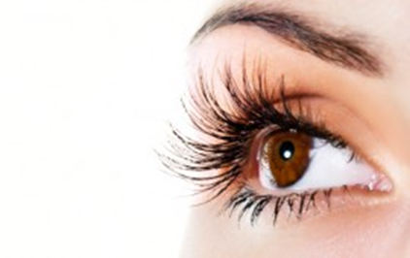
Naked Eye
vs
Spiritual Eye
1/19/2020
Rev. Joseph Chang
BOLGPC 爾灣 大公園靈糧堂

Slide 2
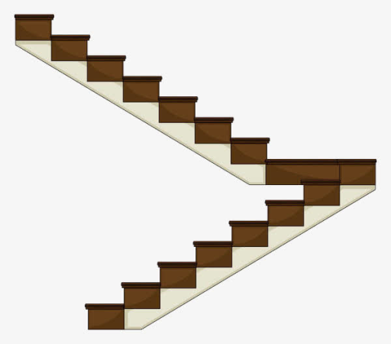
Illustration 1:
Q1:你們知道我們大門的樓梯有幾個階梯?
Do you know how many runs/treads/steps there are up
to the second floor from our front door?
Q2:這兩段樓梯, 他們的階梯數目是奇數還是偶數?
Is the number of steps odd or even?

Slide 3
⁴¹耶穌對他們說：你們若瞎了眼，就沒有罪了；但如今你們說我們能看見，所以你們的罪還在。
【約 9:41】
⁴¹Jesus said to them, ""If you were blind, you would have no guilt; but now that you say, 'We see,' your guilt remains. " 【John 9:41】

Slide 4
¹耶穌過去的時候，看見一個人生來是瞎眼的。²門徒問耶穌說：拉比，這人生來是瞎眼的，是誰犯了罪？是這人呢？是他父母呢？³耶穌回答說：也不是這人犯了罪，也不是他父母犯了罪，是要在他身上顯出神的作為來。⁴趁著白日，我們必須做那差我來者的工；黑夜將到，就沒有人能做工了.
¹As he passed by, he saw a man blind from birth. ²And his disciples asked him, "Rabbi, who sinned, this man or his parents, that he was born blind?" ³Jesus answered, ""It was not that this man sinned, or his parents, but that the works of God might be displayed in him." ⁴"We must work the works of him who sent me while it is day; night is coming, when no one can work."

Slide 5
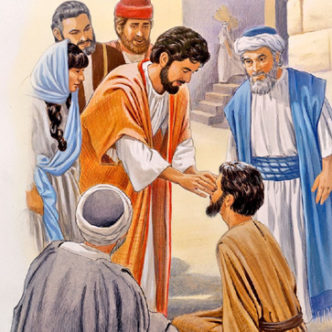
⁵我在世上的時候，是世上的光。⁶耶穌說了這話，就吐唾沫在地上，用唾沫和泥抹在瞎子的眼睛上，⁷對他說：你往西羅亞池子裡去洗（西羅亞繙出來就是奉差遣）。他去一洗，回頭就看見了。
⁵"As long as I am in the world, I am the light of the world.“
" ⁶Having said these things, he spat on the ground and made mud with the saliva. Then he anointed the man's eyes
with the mud ⁷and said to him, ""Go, wash in the
pool of Siloam" "(which means Sent). So he went
and washed and came back seeing and beg?"

Slide 6
⁸他的鄰舍和那素常見他是討飯的，就說：這不是那從前坐著討飯的人麼？⁹有人說：是他；又有人說；不是，卻是像他。他自己說：是我。¹⁰他們對他說：你的眼睛是怎麼開的呢？¹¹他回答說：有一個人，名叫耶穌，他和泥抹我的眼睛，對我說：你往西羅亞池子去洗。我去一洗，就看見了。
⁸The neighbors and those who had seen him before as a beggar were saying, "Is this not the man who used to sit and beg?" ⁹Some said, "It is he." Others said, "No, but he is like him." He kept saying, "I am the man." ¹⁰So they said to him, "Then how were your eyes opened?" ¹¹He answered, "The man called Jesus made mud and anointed my eyes and said to me, "'Go to Siloam and wash.'" So I went and washed and received my sight."

Slide 7
¹²他們說：那個人在那裡？他說：我不知道。¹³他們把從前瞎眼的人帶到法利賽人那裡。¹⁴耶穌和泥開他眼睛的日子是安息日。¹⁵法利賽人也問他是怎麼得看見的。瞎子對他們說：他把泥抹在我的眼睛上，我去一洗，就看見了。
¹²They said to him, "Where is he?" He said, "I do not know." ¹³They brought to the Pharisees the man who had formerly been blind. ¹⁴Now it was a Sabbath day when Jesus made the mud and opened his eyes. ¹⁵So the Pharisees again asked him how he had received his sight. And he said to them, "He put mud on my eyes, and I washed, and I see."

Slide 8
¹⁶法利賽人中有的說：這個人不是從神來的，因為他不守安息日。又有人說：一個罪人怎能行這樣的神蹟呢？他們就起了分爭。¹⁷他們又對瞎子說：他既然開了你的眼睛，你說他是怎樣的人呢？他說：是個先知。
¹⁶Some of the Pharisees said, "This man is not from God, for he does not keep the Sabbath." But others said, "How can a man who is a sinner do such signs?" And there was a division among them. ¹⁷So they said again to the blind man, "What do you say about him, since he has opened your eyes?" He said, "He is a prophet."

Slide 9
¹⁸猶太人不信他從前是瞎眼，後來能看見的，等到叫了他的父母來，¹⁹問他們說：這是你們的兒子麼？你們說他生來是瞎眼的，如今怎麼能看見了呢？²⁰他父母回答說：他是我們的兒子，生來就瞎眼，這是我們知道的。
¹⁸The Jews did not believe that he had been blind and had received his sight, until they called the parents of the man who had received his sight ¹⁹and asked them, "Is this your son, who you say was born blind? How then does he now see?" ²⁰His parents answered, "We know that this is our son and that he was born blind.

Slide 10
²¹至於他如今怎麼能看見，我們卻不知道；是誰開了他的眼睛，我們也不知道。他已經成了人，你們問他罷，他自己必能說。²²他父母說這話，是怕猶太人；因為猶太人已經商議定了，若有認耶穌是基督的，要把他趕出會堂。²³因此他父母說：他已經成了人，你們問他罷。
²¹But how he now sees we do not know, nor do we know who opened his eyes. Ask him; he is of age. He will speak for himself." ²²(His parents said these things because they feared the Jews, for the Jews had already agreed that if anyone should confess Jesus to be Christ, he was to be put out of the synagogue.) ²³Therefore his parents said, "He is of age; ask him."

Slide 11
²⁴所以法利賽人第二次叫了那從前瞎眼的人來，對他說：你該將榮耀歸給神，我們知道這人是個罪人。²⁵他說：他是個罪人不是，我不知道；有一件事我知道，從前我是眼瞎的，如今能看見了。²⁶他們就問他說：他向你做甚麼？是怎麼開了你的眼睛呢？
²⁴So for the second time they called the man who had been blind and said to him, "Give glory to God. We know that this man is a sinner." ²⁵He answered, "Whether he is a sinner I do not know. One thing I do know, that though I was blind, now I see." ²⁶They said to him, "What did he do to you? How did he open your eyes?"

Slide 12
²⁷他回答說：我方才告訴你們，你們不聽，為甚麼又要聽呢？莫非你們也要作他的門徒麼？²⁸他們就罵他說：你是他的門徒；我們是摩西的門徒。²⁹神對摩西說話是我們知道的；只是這個人，我們不知道他從那裡來！³⁰那人回答說：他開了我的眼睛，你們竟不知道他從那裡來，這真是奇怪！
²⁷He answered them, "I have told you already, and you would not listen. Why do you want to hear it again? Do you also want to become his disciples?" ²⁸And they reviled him, saying, "You are his disciple, but we are disciples of Moses. ²⁹We know that God has spoken to Moses, but as for this man, we do not know where he comes from." ³⁰The man answered, "Why, this is an amazing thing! You do not know where he comes from, and yet he opened my eyes.

Slide 13
³¹我們知道神不聽罪人，惟有敬奉神、遵行他旨意的，神才聽他。³²從創世以來，未曾聽見有人把生來是瞎子的眼睛開了。³³這人若不是從神來的，甚麼也不能做。³⁴他們回答說：你全然生在罪孽中，還要教訓我們麼？於是把他趕出去了。
³¹We know that God does not listen to sinners, but if anyone is a worshiper of God and does his will, God listens to him. ³²Never since the world began has it been heard that anyone opened the eyes of a man born blind. ³³If this man were not fromGod, he could do nothing. " ³⁴They answered him, "You were born in utter sin, and would you teach us?" And they cast him out.

Slide 14
³⁵耶穌聽說他們把他趕出去，後來遇見他，就說：你信神的兒子麼？³⁶他回答說：主阿，誰是神的兒子，叫我信他呢？³⁷耶穌說：你已經看見他，現在和你說話的就是他。³⁸他說：主阿，我信！就拜耶穌。
³⁵Jesus heard that they had cast him out, and having found him he said, ""Do you believe in the Son of Man?"" ³⁶He answered, "And who is he, sir, that I may believe in him?" ³⁷Jesus said to him, ""You have seen him, and it is he who is speaking to you." " ³⁸He said, "Lord, I believe," and he worshiped him.

Slide 15
³⁹耶穌說：我為審判到這世上來，叫不能看見的，可以看見；能看見的，反瞎了眼。
³⁹Jesus said, ""For judgment I came into this world, that those who do not see may see, and those who see may become blind."

Slide 16
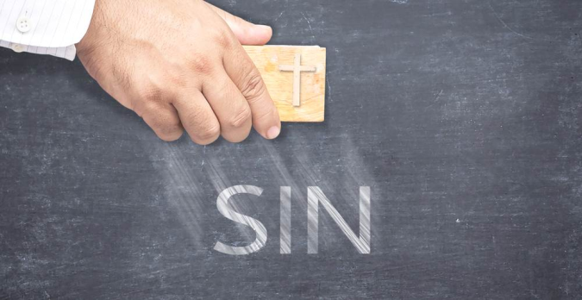
⁴⁰同他在那裡的法利賽人聽見這話，就說：難道我們也瞎了眼麼？⁴¹耶穌對他們說：你們若瞎了眼，就沒有罪了；但如今你們說我們能看見，所以你們的罪還在。
【約 9:1~41】
" ⁴⁰Some of the Pharisees near him heard these things, and said to him, "Are we also blind?" ⁴¹Jesus said to them, ""If you were blind, you would have no guilt; but now that you say, 'We see,' your guilt remains. " 【John 9:1~41】

Slide 17
Q:當這些事情發生的時候, 我要如何來迎接上帝
所給我的考試呢?
How should I face God’s tests when these things
happen to me?

Slide 18
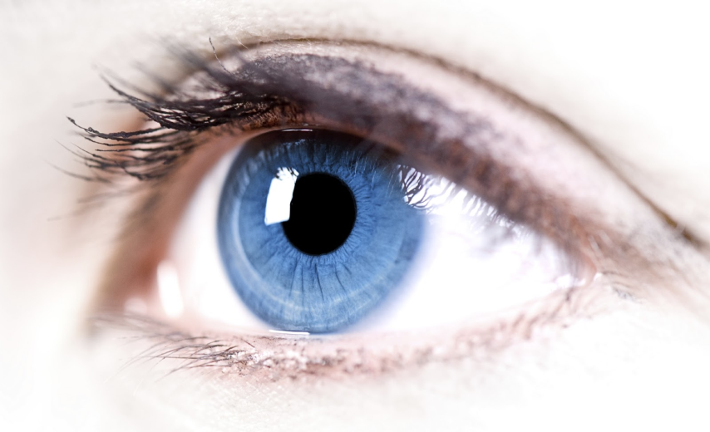
I. 你注意看的是甚麼?
What do you focus in your seeing? (John 9:1-16)

Slide 19
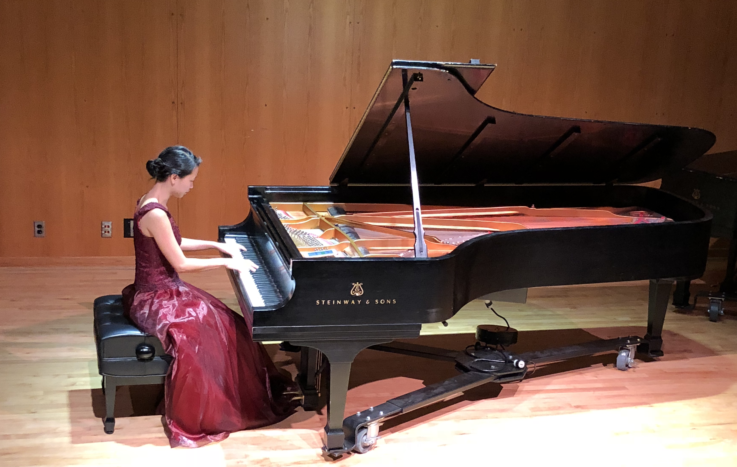
Illustration 2:
請牧師放您女兒演奏鋼琴的照片

Slide 20
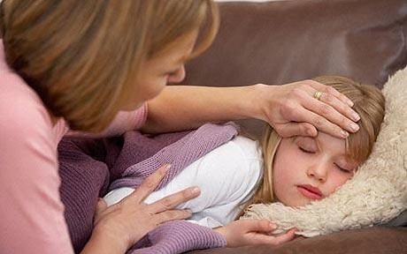
Illustration 3:

Slide 21
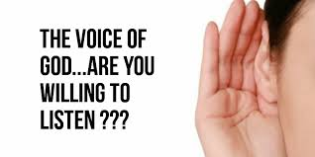
II. 你是否願意去聽?
Are you willing to listen? (John 9:17-34)

Slide 22
³¹我們知道神不聽罪人，惟有敬奉神、遵行他旨意的，神才聽他。
【約 9:31】
³¹We know that God does not listen to sinners, but if anyone is a worshiper of God and does his will, God listens to him. 【John 9:31】

Slide 23
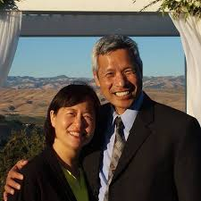
Illustration 4:
北加州慕主先鋒教會(Forerunner Christian Church)的牧師 - - 張瑋和黃國瑞

Slide 24
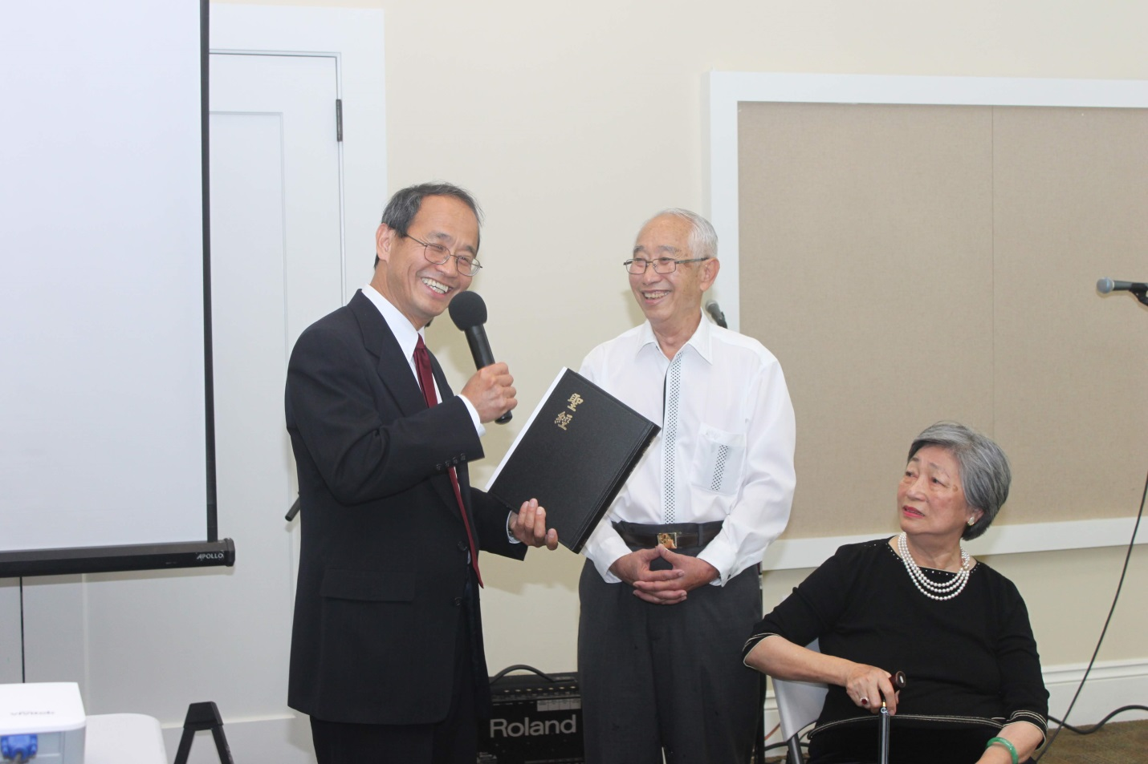
Illustration 5:
陳銀河(陳爸)

Slide 25
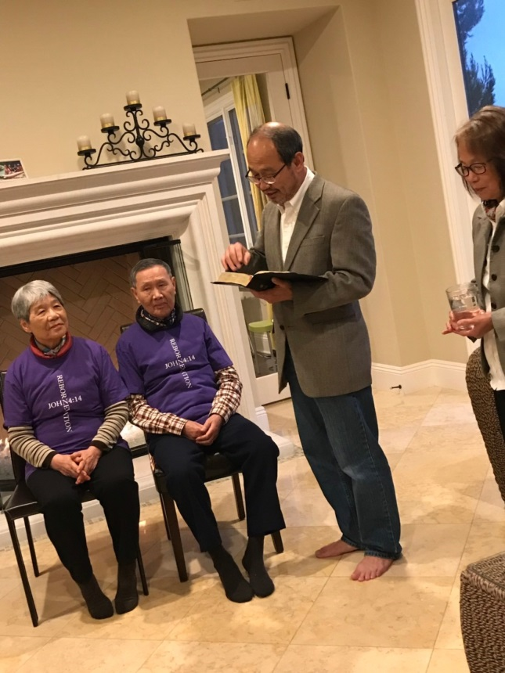
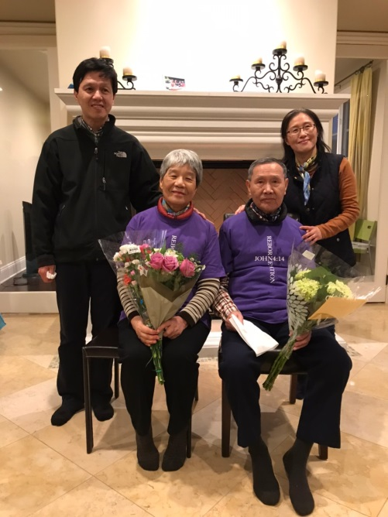
Illustration 6:
大勇的媽媽

Slide 26
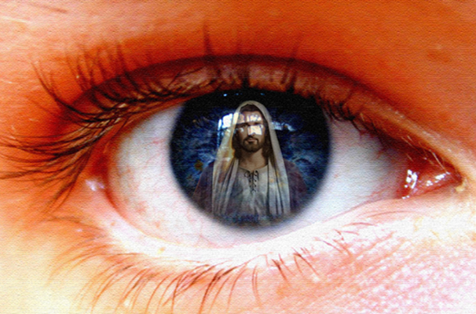
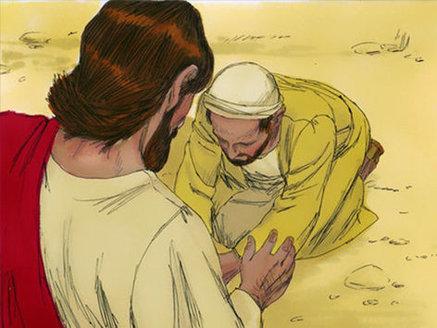
III. 你就會看見神.
You can see God. (John 9:35-41)

Slide 27
Conclusion:
若你可以注意那真正重要的事情, 若你願意聽那上帝一而再再而三向你說話的聲音, 那麼你必得見神!
If you can pay attention to what really matters and are willing to listen to the voice of God, then you must see God!

