Slide 1
Reply to
New Coronavirus
2/16/2020
Rev. Esther Chang
BOLGPC 爾灣大公園靈糧堂
1/26/2020
Rev. Joseph Chang
BOLGPC 爾灣大公園靈糧堂

Slide 2
不能出去丸

Slide 3
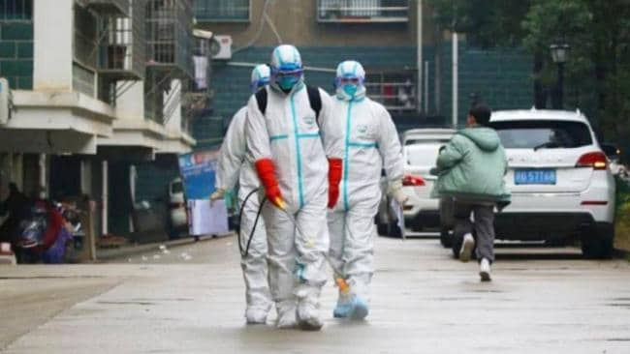
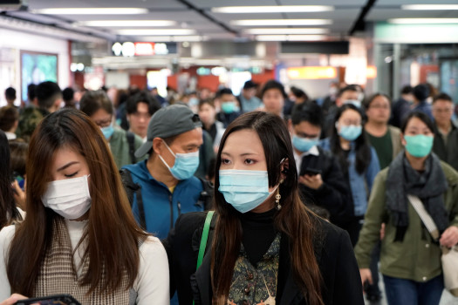
"新冠狀病毒-武漢肺炎"疫情蔓延
"new coronavirus-Wuhan pneumonia“

Slide 4
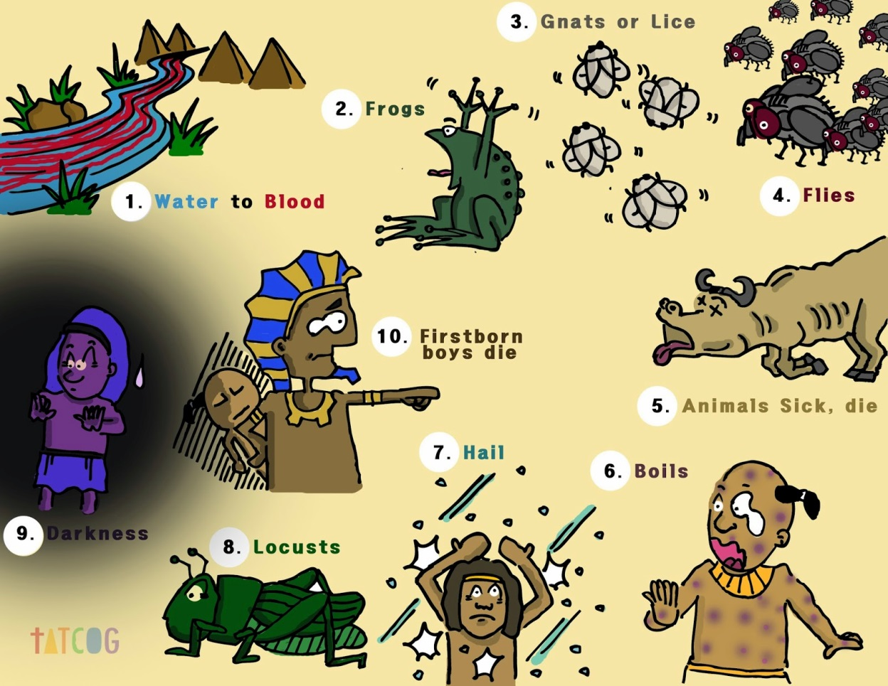
埃及地的十災/10 plagues of Egypt

Slide 5
一.相關的歷史背景:
二.埃及遭十災的始末
1.不認識約瑟的埃及新王開始惡代以色列人
A.不認識約瑟的新王面對日漸昌大的以色列人,心生不
安與猜忌(出1:9~10)
B.新王聳動埃及人虐待,苦待以色列人-----奴隸,免費的
勞力,(以色列人卻越發多起來)

Slide 6
¹¹於是埃及人派督工的轄制他們，加重擔苦害他們。他們為法老建造兩 座積貨城，就是比東和蘭塞。¹²只是越發苦害他們，他們越發多起來，越發蔓延；埃及人就因以色列人愁煩。¹³埃及人嚴嚴的使以色列人做工，¹⁴使他們因做苦工覺得命苦；無論是和泥，是作磚，是作田間各樣的工，在一切的工上都嚴嚴的待他們。
【出 1:11~14】
¹¹So they put slave masters over them to oppress them with forced labor, and they built Pithom and Rameses as store cities for Pharaoh. ¹²But the more they were oppressed, the more they multiplied and spread; so the Egyptians came to dread the Israelites ¹³and worked them ruthlessly. ¹⁴They made their lives bitter with hard labor in brick and mortar and with all kinds of work in the fields; in all their hard labor the Egyptians used them ruthlessly. 【Exod 1:11~14】

Slide 7
C.要求收生婆對臨盆以色列婦人,凡生男嬰,
格殺勿論,未果(出1:15~21)
D.命埃及人將以色列人所生男孩都丟到河裏(出1:22)

Slide 8
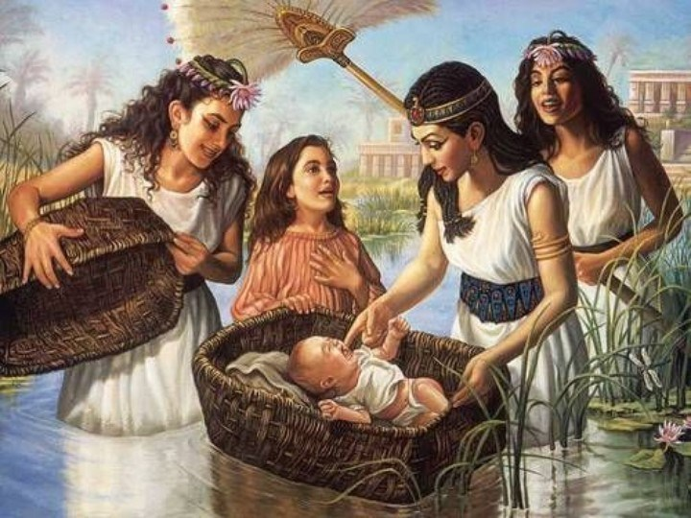
2.以色列男嬰被法老女兒所救,成為其子-----摩西
(出2:1~10)

Slide 9
3.以色列人受苦哀聲達於上帝(出2:23~25)
²³過了多年，埃及王死了。以色列人因做苦工，就嘆息哀求，他們的哀聲達於 神。²⁴ 神聽見他們的哀聲，就記念他與亞伯拉罕、以撒、雅各所立的約。²⁵ 神看顧以色列人，也知道他們的苦情。【出 2:23~25】 ²³During that long period, the king of Egypt died. The Israelites groaned in their slavery and cried out, and their cry for help because of their slavery went up to God. ²⁴God heard their groaning and he remembered his covenant with Abraham, with Isaac and with Jacob. ²⁵So God looked on the Israelites and was concerned about them.
【Exod 2:23~25】

Slide 10
4.上帝從曠野呼召摩西領以色列人出埃及(出3:7~10; 13~17)
⁷耶和華說：我的百姓在埃及所受的困苦，我實在看見了；他們因受督工的轄制所發的哀聲，我也聽見了。我原知道他們的痛苦，⁸我下來是要救他們脫離埃及人的手，領他們出了那地，到美好、寬闊、流奶與蜜之地,
⁷The LORD said, "I have indeed seen the misery of my people in Egypt. I have heard them crying out because of their slave drivers, and I am concerned about their suffering. ⁸So I have come down to rescue them from the hand of the Egyptians and to bring them up out of that land into a good and spacious land, a land flowing with milk and honey

Slide 11
就是到迦南人、赫人、亞摩利人、比利洗人、希未人、耶布斯人之地。⁹現在以色列人的哀聲達到我耳中，我也看見埃及人怎樣欺壓他們。¹⁰故此，我要打發你去見法老，使你可以將我的百姓以色列人從埃及領出來。
【出 3:7~10】
--the home of the Canaanites, Hittites, Amorites, Perizzites, Hivites and Jebusites. ⁹And now the cry of the Israelites has reached me, and I have seen the way the Egyptians are oppressing them. ¹⁰So now, go. I am sending you to Pharaoh to bring my people the Israelites out of Egypt." 【Exod 3:7~10】

Slide 12
¹⁴ 神對摩西說：我是自有永有的；又說：你要對以色列人這樣說：那自有的打發我到你們這裡來。¹⁵ 神又對摩西說：你要對以色列人這樣說：耶和華─你們祖宗的 神，就是亞伯拉罕的 神，以撒的 神，雅各的 神，打發我到你們這裡來。耶和華是我的名，直到永遠；這也是我的記念，直到萬代。
¹⁴God said to Moses, "I AM WHO I AM. This is what you are to say to the Israelites: 'I AM has sent me to you.'" ¹⁵God also said to Moses, "Say to the Israelites, 'The LORD, the God of your fathers--the God of Abraham, the God of Isaac and the God of Jacob--has sent me to you.' This is my name forever, the name by which I am to be remembered from generation to generation.

Slide 13
¹⁶你去招聚以色列的長老，對他們說：耶和華你們祖宗的 神，就是亞伯拉罕的 神，以撒的 神，雅各的 神，向我顯現，說：我實在眷顧了你們，我也看見埃及人怎樣待你們。¹⁷我也說：要將你們從埃及的困苦中領出來，往迦南人、赫人、亞摩利人、比利洗人、希未人、耶布斯人的地去，就是到流奶與蜜之地。【出 3:14~17】
¹⁶"Go, assemble the elders of Israel and say to them, 'The LORD, the God of your fathers--the God of Abraham, Isaac and Jacob-- appeared to me and said: I have watched over you and have seen what has been done to you in Egypt. ¹⁷And I have promised to bring you up out of your misery in Egypt into the land of the Canaanites, Hittites, Amorites, Perizzites, Hivites and Jebusites--a land flowing with milk and honey.' 【Exod 3:14~17】

Slide 14
5.法老心剛硬招災(5:1~9, 7:13; 6:1)
¹³法老心裡剛硬，不肯聽從摩西、亞倫，正如耶和華所說的。【出 7:13】 ¹³Yet Pharaoh's heart became hard and he would not listen to them, just as the LORD had said. 【Exod 7:13】

Slide 15
¹耶和華對摩西說：現在你必看見我向法老所行的事，使他因我大能的手容以色列人去，且把他們趕出他的地。【出 6:1】 ¹Then the LORD said to Moses, "Now you will see what I will do to Pharaoh: Because of my mighty hand he will let them go; because of my mighty hand he will drive them out of his country." 【Exod 6:1】

Slide 16
6. 神對法老 / 埃及的審判-----十災
A.九災(7:20~10:29):
水變血之災, 蛙災, 虱災, 蠅災, 畜疫之災, 瘡災, 雹災, 蝗災, 黑暗之災

Slide 17
B.末次之災:長子之災(12:29~30) /為以色列人定逾越節之禮
(12:1~28)
⁵要無殘疾、一歲的公羊羔，你們或從綿羊裡取，或從山羊裡取，都可以。⁶要留到本月十四日，在黃昏的時候，以色列全會眾把羊羔宰了。⁷各家要取點血，塗在吃羊羔的房屋左右的門框上和門楣上。【出 12:5~7】 ⁵The animals you choose must be year-old males without defect, and you may take them from the sheep or the goats. ⁶Take care of them until the fourteenth day of the month, when all the people of the community of Israel must slaughter them at twilight. ⁷Then they are to take some of the blood and put it on the sides and tops of the doorframes of the houses where they eat the lambs. 【Exod 12:5~7】

Slide 18
¹²因為那夜我要巡行埃及地，把埃及地一切頭生的，無論是人是牲畜，都擊殺了，又要敗壞埃及一切的 神。我是耶和華。¹³這血要在你們所住的房屋上作記號；我一見這血，就越過你們去。我擊殺埃及地頭生的時候，災殃必不臨到你們身上滅你們。¹⁴你們要記念這日，守為耶和華的節，作為你們世世代代永遠的定例。
【出 12:12~14】 ¹²"On that same night I will pass through Egypt and strike down every firstborn--both men and animals--and I will bring judgment on all the gods of Egypt. I am the LORD. ¹³The blood will be a sign for you on the houses where you are; and when I see the blood, I will pass over you. No destructive plague will touch you when I strike Egypt. ¹⁴"This is a day you are to commemorate; for the generations to come you shall celebrate it as a festival to the LORD--a lasting ordinance.
【Exod 12:12~14】

Slide 19
²⁹到了半夜，耶和華把埃及地所有的長子，就是從坐寶座的法老，直到被擄囚在監裡之人的長子，以及一切頭生的牲畜，盡都殺了。³⁰法老和一切臣僕，並埃及眾人，夜間都起來了。在埃及有大哀號，無一家不死一個人的。
【出 12:29~30】 ²⁹At midnight the LORD struck down all the firstborn in Egypt, from the firstborn of Pharaoh, who sat on the throne, to the firstborn of the prisoner, who was in the dungeon, and the firstborn of all the livestock as well. ³⁰Pharaoh and all his officials and all the Egyptians got up during the night, and there was loud wailing in Egypt, for there was not a house without someone dead. 【Exod 12:29~30】

Slide 20
⁴⁸若有外人寄居在你們中間，願向耶和華守踰越節，他所有的男子務要受割禮，然後才容他前來遵守，他也就像本地人一樣；但未受割禮的，都不可吃這羊羔。⁴⁹本地人和寄居在你們中間的外人同歸一例。
【出 12:48~49】 ⁴⁸"An alien living among you who wants to celebrate the Lord's Passover must have all the males in his household circumcised; then he may take part like one born in the land. No uncircumcised male may eat of it. ⁴⁹The same law applies to the native-born and to the alien living among you."
【Exod 12:48~49】

Slide 21
7.以色列人得神拯救出埃及(出12:37~42)
70人----->60萬
在埃及430年

Slide 22
三.從十災中神要我們看見甚麼?
(Reply to New Coronavirus)
1.我們看見 神是公義的 神!
(拿3:5~9)滿有憐憫慈愛,但也賞罰分明
2.每一個 神的拯救行動,同時必會有一個審判
3.神在一切之上,作主掌權,是掌管一切的 神
4.為首者的罪與不義,導致百姓一同陷罪,遭災受苦

Slide 23
5.在災難中, 神分別祂的子民,保護祂的子民
6.主來的腳步已近,當儆醒預備好自己,迎接主的再來
7.神兒女對世代有責任!
A.要加緊傳福音的腳步,無
論得時,不得時
B. 愛的行動:

Slide 24
B.愛的行動:
(1)保護自己就是保護別人!
(2)以禱告來守望!
【代下 7:14】¹⁴這稱為我名下的子民，若是自卑
、禱告，尋求我的面，轉離他們的 惡行，
我必從天上垂聽，赦免他們的罪，醫治他們的地。

Slide 25
¹⁴if my people, who are called by my name, will humble
themselves and pray and seek my face and turn from their
wicked ways, then will I hear from heaven and will forgive
their sin and will heal their land. 【2Chr 7:14】

Slide 26
主禱文的守望禱告:(太6:9~13)
⁹所以，你們禱告要這樣說：
我們在天上的父：求主憐憫,在疫情動盪不安之時,
我們的心仰望祢,除去一切的恐懼,
使我們依靠祢,剛強壯膽

Slide 27
願人都尊你的名為聖:
在災難中求主使人心甦醒,回轉歸向真神,
唯有祢是人們真正的依靠與盼望,
唯有祢能真正的醫治和拯救

Slide 28
願你的國降臨:
求主幫助我們定睛於祢,祢是坐寶座掌管一切的主,
祢是全能全知的 神,人會失控,
但你是永遠掌權的主,是平息風浪的主!
求主掌控一切的疫情,賜下你的平安在這地

Slide 29
願你的旨意行在地上，如同行在天上:
主,我們承認你的意念高過我的意念;
祢的道路也高過我們的道路,
祢知一切的真相,
主若許可,
求主使疫情停止不再蔓延,
但求主祢的旨意成 就如在天

Slide 30
我們日用的飲食，今日賜給我們:
求主賜下疫情與防疫一切需用的物資,並賜智慧,
能治癒的藥物盡快研發成功.
免我們的債，如同我們免了人的債:
求主赦免我們的罪與疏於禱告的虧欠;
求主的寶血塗抹遮蓋我們.求你幫助我們
能寬恕犯錯,無知與作惡的人

Slide 31
不叫我們遇見試探:
求主賜我們能分辨的心,不給惡者留地步,因種種疫情的資訊,造成人們之間的矛盾
救我們脫離兇惡（或作：脫離惡者）:
求主救我們脫離這冠狀病毒的兇惡,
身心靈有祢的保護與看顧也求主醫治這地!

Slide 32
因為國度、權柄、榮耀，
全是你的，直到永遠。阿們!

