Slide 1
當世界震動的時候...
When The Earth is Shaken...

Slide 2
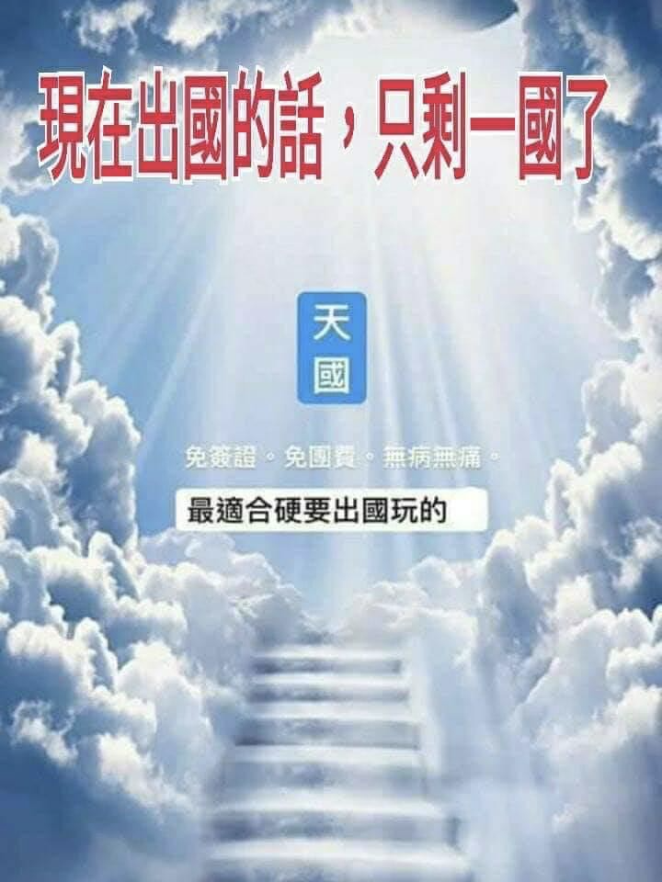

Slide 3
1 Whoever dwells in the shelter of the Most High
will rest in the shadow of the Almighty.
2 I will say of the Lord, “He is my refuge and my fortress,
my God, in whom I trust.”
3 Surely he will save you
from the fowler’s snare
and from the deadly pestilence.
4 He will cover you with his feathers,
and under his wings you will find refuge;
his faithfulness will be your shield and rampart.
5 You will not fear the terror of night,
nor the arrow that flies by day,
6 nor the pestilence that stalks in the darkness,
nor the plague that destroys at midday.
7 A thousand may fall at your side,
ten thousand at your right hand,
but it will not come near you.
8 You will only observe with your eyes
and see the punishment of the wicked. (Psalm 91:1–8)

Slide 4
1 住在至高者隱密處的，
必住在全能者的蔭下。
2 我要論到耶和華說：
他是我的避難所，是我的山寨，
是我的上帝，是我所倚靠的。
3 他必救你脫離捕鳥人的網羅
和毒害的瘟疫。
4 他必用自己的翎毛遮蔽你；
你要投靠在他的翅膀底下；
他的誠實是大小的盾牌。
5 你必不怕黑夜的驚駭，
或是白日飛的箭，
6 也不怕黑夜行的瘟疫，
或是午間滅人的毒病。
7 雖有千人仆倒在你旁邊，
萬人仆倒在你右邊，
這災卻不得臨近你。
8 你惟親眼觀看，
見惡人遭報。 (詩 91:1–8)

Slide 5
41 The next day the whole Israelite community grumbled against Moses and Aaron. “You have killed the LORD’s people,” they said.
42 But when the assembly gathered in opposition to Moses and Aaron and turned toward the tent of meeting, suddenly the cloud covered it and the glory of the LORD appeared. 43 Then Moses and Aaron went to the front of the tent of meeting, 44 and the LORD said to Moses, 45 “Get away from this assembly so I can put an end to them at once.” And they fell facedown.
46 Then Moses said to Aaron, “Take your censer and put incense in it, along with burning coals from the altar, and hurry to the assembly to make atonement for them. Wrath has come out from the LORD; the plague has started.” 47 So Aaron did as Moses said, and ran into the midst of the assembly. The plague had already started among the people, but Aaron offered the incense and made atonement for them. 48 He stood between the living and the dead, and the plague stopped. 49 But 14,700 people died from the plague, in addition to those who had died because of Korah. 50 Then Aaron returned to Moses at the entrance to the tent of meeting, for the plague had stopped.
(Nu 16:41–50)

Slide 6
41 第二天，以色列全會眾都向摩西、亞倫發怨言說：「你們殺了耶和華的百姓了。」42 會眾聚集攻擊摩西、亞倫的時候，向會幕觀看，不料，有雲彩遮蓋了，耶和華的榮光顯現。43 摩西、亞倫就來到會幕前。44 耶和華吩咐摩西說：45 「你們離開這會眾，我好在轉眼之間把他們滅絕。」他們二人就俯伏於地。
46 摩西對亞倫說：「拿你的香爐，把壇上的火盛在其中，又加上香，快快帶到會眾那裏，為他們贖罪；因為有忿怒從耶和華那裏出來，瘟疫已經發作了。」47 亞倫照著摩西所說的拿來，跑到會中，不料，瘟疫在百姓中已經發作了。他就加上香，為百姓贖罪。48 他站在活人死人中間，瘟疫就止住了。49 除了因可拉事情死的以外，遭瘟疫死的，共有一萬四千七百人。50 亞倫回到會幕門口，到摩西那裏，瘟疫已經止住了。
(民數記 16:41-50)

Slide 7
11 When Solomon had finished the temple of the LORD and the royal palace, and had succeeded in carrying out all he had in mind to do in the temple of the LORD and in his own palace, 12 the LORD appeared to him at night and said:
“I have heard your prayer and have chosen this place for myself as a temple for sacrifices.
13 “When I shut up the heavens so that there is no rain, or command locusts to devour the land or send a plague among my people, 14 if my people, who are called by my name, will humble themselves and pray and seek my face and turn from their wicked ways, then I will hear from heaven, and I will forgive their sin and will heal their land. 15 Now my eyes will be open and my ears attentive to the prayers offered in this place. (2 Ch 7:11–15)

Slide 8
11 所羅門造成了耶和華殿和王宮；在耶和華殿和王宮凡他心中所要做的，都順順利利地做成了。12 夜間耶和華向所羅門顯現，對他說：「我已聽了你的禱告，也選擇這地方作為祭祀我的殿宇。13 我若使天閉塞不下雨，或使蝗蟲吃這地的出產，或使瘟疫流行在我民中，14 這稱為我名下的子民，若是自卑、禱告，尋求我的面，轉離他們的惡行，我必從天上垂聽，赦免他們的罪，醫治他們的地。15 我必睜眼看、側耳聽在此處所獻的禱告。
(代下 7:11–15)

Slide 9
Therefore, since we are surrounded by such a great cloud of witnesses, let us throw off everything that hinders and the sin that so easily entangles. And let us run with perseverance the race marked out for us, 2 fixing our eyes on Jesus, the pioneer and perfecter of faith.
(Heb 12:1–2)

Slide 10
1 我們既有這許多的見證人，如同雲彩圍著我們，就當放下各樣的重擔，脫去容易纏累我們的罪，存心忍耐，奔那擺在我們前頭的路程，2 仰望為我們信心創始成終的耶穌。
(希伯來書 12:1–2)

Slide 11
A Prayer for Our World
God, You alone are worthy of honor, glory, and praise. With You, we can overcome every storm—including the global impact the coronavirus is having on our world.
Right now, we are asking You to:
Heal those who are sick and protect those who are not.
Give our leaders extra wisdom as they navigate this pandemic and economic uncertainty.
Strengthen Your global Church. Reveal to us how we can partner together to reach the needs of those around us.
Calm our fears. Fill us with Your hope, joy, and peace as we continue to trust in You.
Use this pandemic to pave the way for spiritual renewal. We want Your glory, power, and healing to be on display.
Come, Lord Jesus, come.
In Jesus’ Name, Amen.

Slide 12
為我們的世界祈禱
神啊！唯有你是配得尊貴，榮耀，和讚美。靠著你，我們能夠勝過一切的風暴，包括肆虐全球的冠狀病毒。
現在我們向你呼求：
伸手醫治生病的人，並且保護那些沒有感染的人。
多加智慧給我們的領導者，來應對冠狀病毒的大流行，和經濟不確定性。
加強屬於你全地的教會。 啓示我們如何一起合作來滿足周圍人們的需要。
除去我我們的恐懼。 用你的盼望，喜樂，和平安充滿我們，讓我們全然信靠你。
透過這次的疫情，震動這地，使人歸向你，帶來全地屬靈的復興。
願你的榮耀，大能，和醫治彰顯！
主耶穌，我們願你來，願你快快再來！
靠主耶穌的名，阿們。

