Slide 1
Royal Priesthood (2)—A Fair and Just Judg
君尊的祭司 (2)—公平公正的審判
4/26/2020 Rev. Joseph Chang BOLGPC 爾灣大公園靈糧堂

Slide 2
以色列人出埃及之後(1446 B.C. 以後)，
神給他們的心意是在萬民中要做首不做尾, 居上而不居下.
After the Israelis left Egypt(after 1446 B.C.),
the Lord will make you the head not the tail, you will always be at the top, never be at the bottom, Deut 28:13.

Slide 3
⁵如今你們若實在聽從我的話，遵守我的約，就要在萬民中作屬我的子民，因為全地都是我的。⁶你們要歸我作祭司的國度，為聖潔的國民。這些話你要告訴以色列人。
【出 19:5~6】 ⁵Now therefore, if you will indeed obey my voice and keep my covenant, you shall be my treasured possession among all peoples, for all the earth is mine; ⁶and you shall be to me a kingdom of priests and a holy nation. These are the words that you shall speak to the people of Israel.“
【Exod 19:5~6】

Slide 4
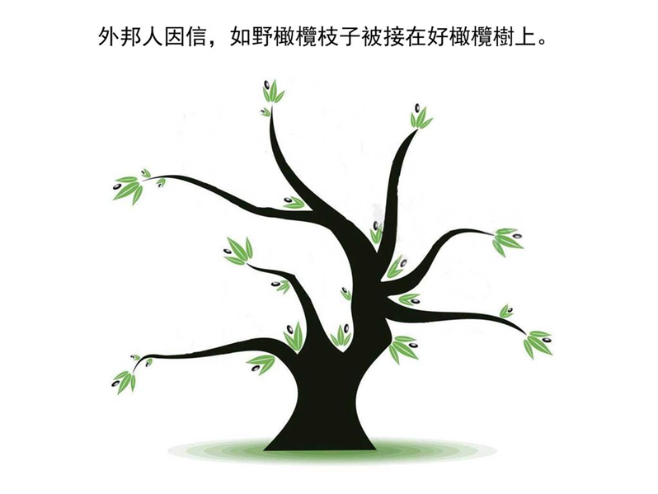
Gentiles are grafted to the olive tree because of their faith.

Slide 5
¹⁷若有幾根枝子被折下來，你這野橄欖得接在其中，一同得著橄欖根的肥汁，¹⁸你就不可向舊枝子誇口；若是誇口，當知道不是你托著根，乃是根托著你。¹⁹你若說，那枝子被折下來是特為叫我接上。²⁰不錯！他們因為不信，所以被折下來；你因為信，所以立得住；你不可自高，反要懼怕。【羅 11:17~20】 ¹⁷But if some of the branches were broken off, and you, although a wild olive shoot, were grafted in among the others and now share in the nourishing root of the olive tree, ¹⁸do not be arrogant toward the branches. If you are, remember it is not you who support the root, but the root that supports you. ¹⁹Then you will say, "Branches were broken off so that I might be grafted in." ²⁰That is true. They were broken off because of their unbelief, but you stand fast through faith. So do not become proud, but stand in awe. 【Rom 11:17~20】

Slide 6
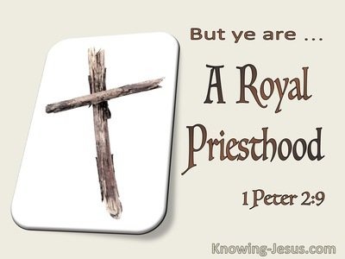
⁹惟有你們是被揀選的族類，是有君尊的祭司，是聖潔的國度，是屬神的子民，要叫你們宣揚那召你們出黑暗入奇妙光明者的美德。【彼前 2:9】 ⁹But you are a chosen race, a royal priesthood, a holy nation, a people for his own possession, that you may proclaim the excellencies of him who called you out of darkness into his marvelous light. 【1Pet 2:9】

Slide 7
⁶他叫我們能承當這新約的執事，不是憑著字句，乃是憑著精意；因為那字句是叫人死，精意是叫人活。（精意或作：聖靈）
【林後 3:6】 ⁶who has made us competent to be ministers of a new covenant, not of the letter but of the Spirit. For the letter kills, but the Spirit gives life.
【2Cor 3:6】

Slide 8
Q: 到底甚麼是君尊的祭司?
What is a royal priesthood?

Slide 9
I. The Five Offerings 5個祭
³⁷這就是燔祭、素祭、贖罪祭、贖愆祭，和平安祭的條例，並承接聖職的禮，【利 7:37】 ³⁷This is the law of the burnt offering, of the grain offering, of the sin offering, of the guilt offering, of the ordination offering, and of the peace offering, 【Lev 7:37】

Slide 10
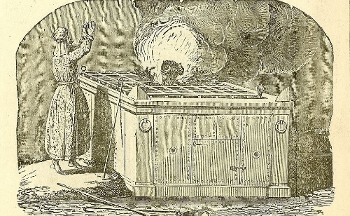
1. 燔祭 burnt offering
¹⁶「神愛世人，甚至將他的獨生子賜給他們，叫一切信他的，不至滅亡，反得永生。【約 3:16】 ¹⁶"For God so loved the world,that he gave his only Son, that whoever believes in him should not perish but have eternal life." 【John 3:16】

Slide 11
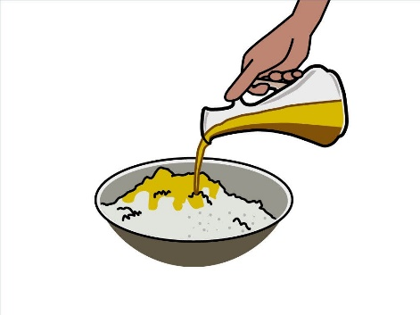
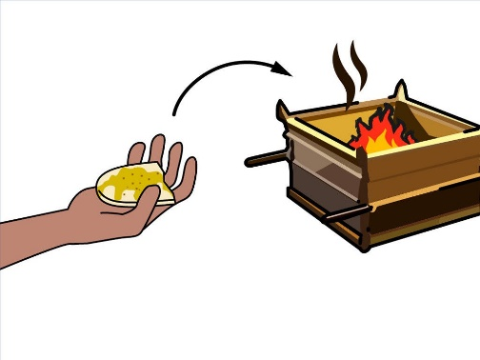
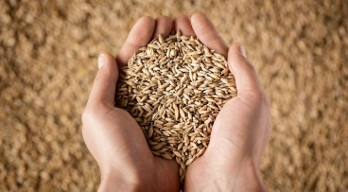
2. 素祭 grain offering
¹²這些物要獻給耶和華作為初熟的供物 . . . .【利 2:12a】 ¹²As an offering of firstfruits you may bring them to the Lord, . . . . 【Lev 2:12a】

Slide 12
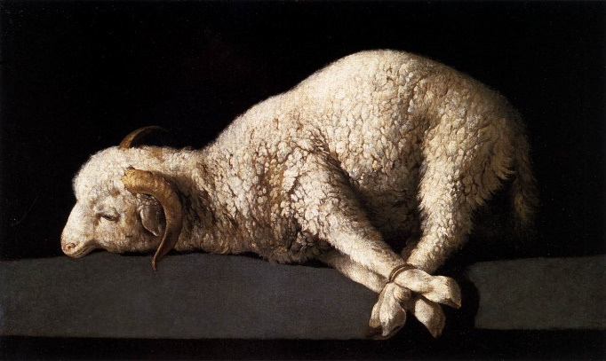
3. 平安祭 peace offering

Slide 13
⁸你們得救是本乎恩，也因著信；這並不是出於自己，乃是神所賜的；⁹也不是出於行為，免得有人自誇。¹⁰我們原是他的工作，在基督耶穌裡造成的，為要叫我們行善，就是神所預備叫我們行的。
【弗 2:8~10】 ⁸For by grace you have been saved through faith. And this is not your own doing; it is the gift of God, ⁹not a result of works, so that no one may boast. ¹⁰For we are his workmanship, created in Christ Jesus for good works, which God prepared beforehand, that we should walk in them. 【Eph 2:8~10】

Slide 14
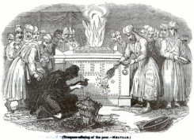
4. 贖罪祭 sin offering
⁹我們若認自己的罪，神是信實的，是公義的，必要赦免我們的罪，洗淨我們一切的不義。【約一 1:9】 ⁹If we confess our sins, he is faithful and just to forgive us our sins and to cleanse us from all unrighteousness. 【1John 1:9】

Slide 15
5. 贖愆祭 guilt offering

Slide 16
今天, 我們要來看贖愆祭:
Today, we are going to learn about the guilt offering.

Slide 17
⁸你城中若起了爭訟的事，或因流血，或因爭競，或因毆打，是你難斷的案件，你就當起來，往耶和華─你 神所選擇的地方⁹去見祭司利未人，並當時的審判官，求問他們，他們必將判語指示你。
⁸"If any case arises requiring decision between one kind of homicide and another, one kind of legal right and another, or one kind of assault and another, any case within your towns that is too difficult for you, then you shall arise and go up to the place that the Lord your God will choose. ⁹And you shall come to the Levitical priests and to the judge who is in office in those days, and you shall consult them, and they shall declare to you the decision.

Slide 18
¹⁰他們在耶和華所選擇的地方指示你的判語，你必照著他們所指教你的一切話謹守遵行。¹¹要按他們所指教你的律法，照他們所斷定的去行；他們所指示你的判語，你不可偏離左右。【申 17:8~11】
¹⁰Then you shall do according to what they declare to you from that place that the Lord will choose. And you shall be careful to do according to all that they direct you. ¹¹According to the instructions that they give you, and according to the decision which they pronounce to you, you shall do. You shall not turn aside from the verdict that they declare to you, either to the right hand or to the left. 【Deut 17:8~11】

Slide 19
⇨這個審判需要公平和公義做基礎:
This trial needs fairness and justice as the basis:
¹⁴公義和公平是你寶座的根基；慈愛和誠實行在你前面。【詩 89:14】 ¹⁴Righteousness and justice are the foundation of your throne; steadfast love (חֶסֶד) and faithfulness ( אֱמֶת 即真理) go before you. 【Ps 89:14】

Slide 20
II. Help Community to be stable upon the foundation of
Righteousness. 讓社區在公義的基礎上能夠安穩.

Slide 21
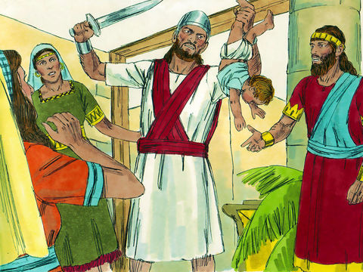
Illustration 1:
²⁸以色列眾人聽見王這樣判斷，就都敬畏他；因為見他心裡有 神的智慧，能以斷案。【王上 3:28】 ²⁸And all Israel heard of the judgment that the king had rendered, and they stood in awe of the king, because they perceived that the wisdom of God was in him to do justice. 【1King 3:28】

Slide 22
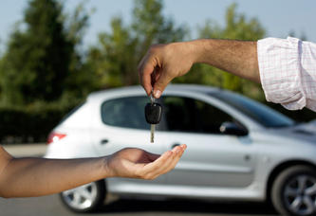
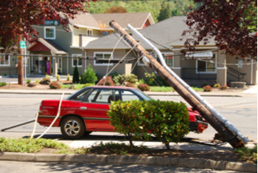
Illustration 2:

Slide 24
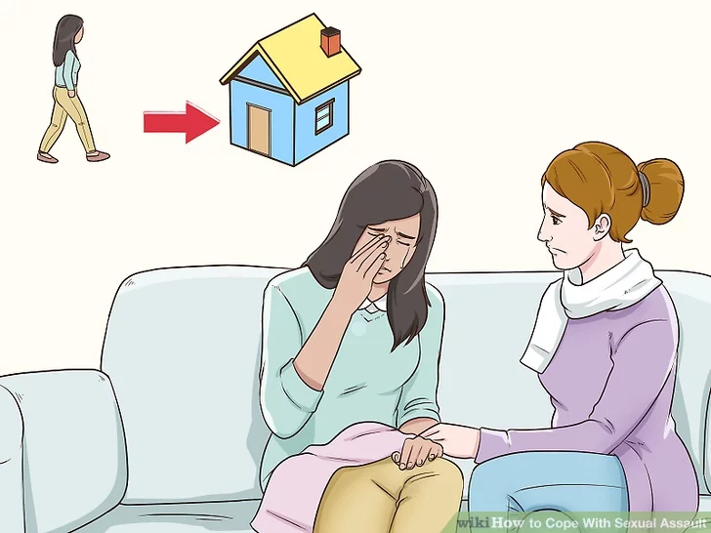
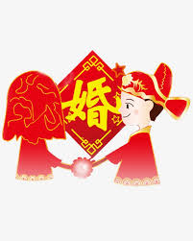
Illustration 3:
Dean of Students

Slide 25
²¹那時，彼得進前來，對耶穌說：主阿，我弟兄得罪我，我當饒恕他幾次呢？到七次可以麼？²²耶穌說：我對你說，不是到七次，乃是到七十個七次。
【太 18:21~22】 ²¹Then Peter came up and said to him, "Lord, how often will my brother sin against me, and I forgive him? As many as seven times?" ²²Jesus said to him, ""I do not say to you seven times, but seventy times seven. "
【Matt 18:21~22】

Slide 26
III. 訛詐弟兄的必須先作完全的賠償，顯出他悔改的證據，
然後獻上贖愆祭, 他的罪才能得到神的赦免.
If one wronged his brothers, he has to make restitution
with 20% surcharge to demonstrate his repentance, and
then the Lord will accept his Guilt Offering (利Lev 6:1-7).

Slide 27
¹耶和華曉諭摩西說：²若有人犯罪，干犯耶和華，在鄰舍交付他的物上，或是在交易上行了詭詐，或是搶奪人的財物，或是欺壓鄰舍，³或是在撿了遺失的物上行了詭詐，說謊起誓，在這一切的事上犯了甚麼罪；⁴他既犯了罪，有了過犯，就要歸還他所搶奪的，或是因欺壓所得的，或是人交付他的，或是人遺失他所撿的物，
¹The Lord spoke to Moses, saying, ²"If anyone sins and commits a breach of faith against the Lord by deceiving his neighbor in a matter of deposit or security, or through robbery, or if he has oppressed his neighbor ³or has found something lost and lied about it, swearing falsely-in any of all the things that people do and sin thereby- ⁴if he has sinned and has realized his guilt and will restore what he took by robbery or what he got by oppression or the deposit that was committed to him or the lost thing that he found

Slide 28
⁵或是他因甚麼物起了假誓，就要如數歸還，另外加上五分之一，在查出他有罪的日子要交還本主。⁶也要照你所估定的價，把贖愆祭牲─就是羊群中一隻沒有殘疾的公綿羊─牽到耶和華面前，給祭司為贖愆祭。⁷祭司要在耶和華面前為他贖罪；他無論行了甚麼事，使他有了罪，都必蒙赦免。【利 6:1~7】
⁵or anything about which he has sworn falsely, he shall restore it in full and shall add a fifth to it, and give it to him to whom it belongs on the day he realizes his guilt. ⁶And he shall bring to the priest as his compensation to the Lord a ram without blemish out of the flock, or its equivalent for a guilt offering. ⁷And the priest shall make atonement for him before the Lord, and he shall be forgiven for any of the things that one may do and thereby become guilty." 【Lev 6:1~7】

Slide 29
→一個人犯罪,要首先得到他所冒犯的人的赦免, 然後再尋求
上帝的赦免.
When a person commits a crime, he must first seek forgiveness from the victim, and then seek forgiveness from God.
(1). 尋求受害者的赦免—要賠上你欺騙他的數目, 加上20%.
表示你真的認錯了.
Forgiveness from the Victim —You have to make restitution
with 20% surcharge to demonstrate his repentance.
(2). 尋求上帝的赦免 —獻上贖愆祭. 就是獻上一隻公綿羊.
Forgiveness from God — Offer a guilt offering. It is to offer
a ram.

Slide 30
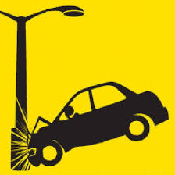
我們來回答前面的那兩個問題:
Let's answer the previous two questions:
A. 兩個神學生的問題.
The example of the sexual assault.
1)
2)
B. 撞壞借來的車的問題.
The example of crashing the borrowed car.

Slide 31
²³所以，你在祭壇上獻禮物的時候，若想起弟兄向你懷怨，²⁴就把禮物留在壇前，先去同弟兄和好，然後來獻禮物。【太 5:23~24】 ²³"So if you are offering your gift at the altar and there remember that your brother has something against you," ²⁴"leave your gift there before the altar and go. First be reconciled to your brother, and then come and offer your gift." 【Matt 5:23~24】

Slide 32
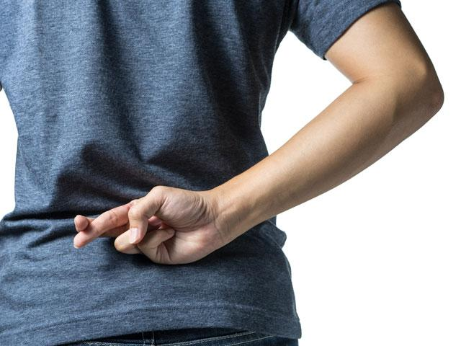
IV. 詐騙神的必須獻上贖愆祭, 然後作完全的賠償, 他的罪才
能得到神的赦免.
One who wronged God can offer the guilt offering first and
then make restitution of the goods. (利Lev 5:14-19)

Slide 33
¹⁴耶和華曉諭摩西說：¹⁵人若在耶和華的聖物上誤犯了罪，有了過犯，就要照你所估的，按聖所的舍客勒拿銀子，將贖愆祭牲─就是羊群中一隻沒有殘疾的公綿羊─牽到耶和華面前為贖愆祭；¹⁶並且他因在聖物上的差錯要償還，另外加五分之一，都給祭司。祭司要用贖愆祭的公綿羊為他贖罪，他必蒙赦免。
¹⁴The Lord spoke to Moses, saying, ¹⁵"If anyone commits a breach of faith and sins unintentionally in any of the holy things of the Lord, he shall bring to the Lord as his compensation, a ram without blemish out of the flock, valued in silver shekels, according to the shekel of the sanctuary, for a guilt offering. ¹⁶He shall also make restitution for what he has done amiss in the holy thing and shall add a fifth to it and give it to the priest. And the priest shall make atonement for him with the ram of the guilt offering, and he shall be forgiven.

Slide 34
¹⁷若有人犯罪，行了耶和華所吩咐不可行的甚麼事，他雖然不知道，還是有了罪，就要擔當他的罪孽；¹⁸也要照你所估定的價，從羊群中牽一隻沒有殘疾的公綿羊來，給祭司作贖愆祭。至於他誤行的那錯事，祭司要為他贖罪，他必蒙赦免。¹⁹這是贖愆祭，因他在耶和華面前實在有了罪。
【利 5:14~19】
¹⁷"If anyone sins, doing any of the things that by the Lord's commandments ought not to be done, though he did not know it, then realizes his guilt, he shall bear his iniquity. ¹⁸He shall bring to the priest a ram without blemish out of the flock, or its equivalent for a guilt offering, and the priest shall make atonement for him for the mistake that he made unintentionally, and he shall be forgiven. ¹⁹It is a guilt offering; he has indeed incurred guilt before the Lord." 【Lev 5:14~19】

Slide 35
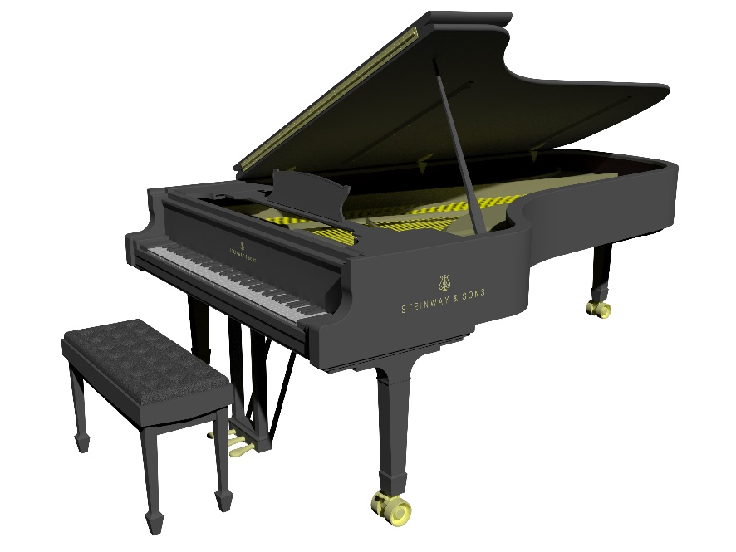
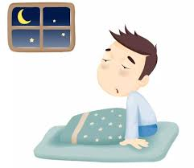
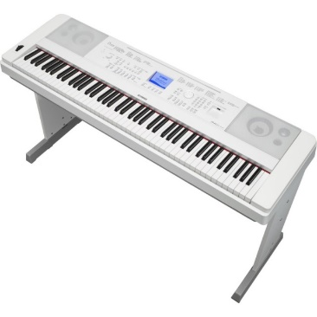
Illustration 4:

Slide 36
Conclusion:
¹⁰. . . 因為聖靈參透萬事，就是神深奧的事也參透了。
【林前 2:10b】 ¹⁰. . . For the Spirit searches everything, even the depths of God. 【1Cor 2:10b】
¹⁵屬靈的人能看透萬事，卻沒有一人能看透了他。¹⁶誰曾知道主的心去教導他呢？但我們是有基督的心了。
【林前 2:15~16】 ¹⁵The spiritual person judges all things, but is himself to be judged by no one. ¹⁶"For who has understood the mind of the Lord so as to instruct him?" But we have the mind of Christ. 【1Cor 2:15~16】

