Slide 1
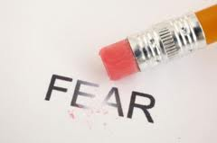
How Not to Fear?
如何不會害怕?
張玉明牧師
4/5/2020, 爾灣大公園靈糧堂

Slide 3
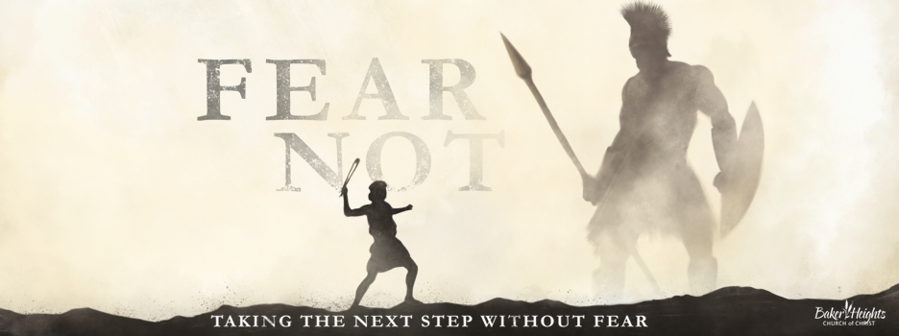
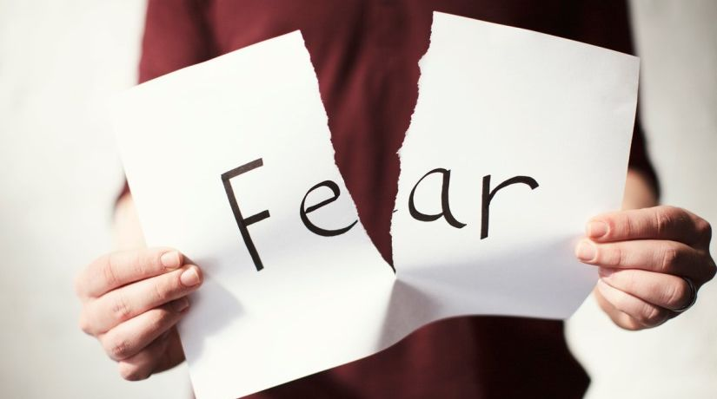
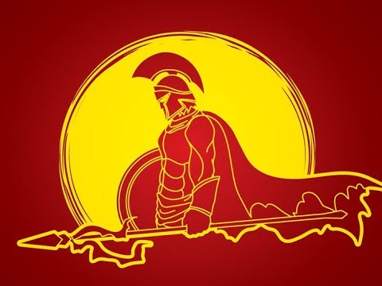
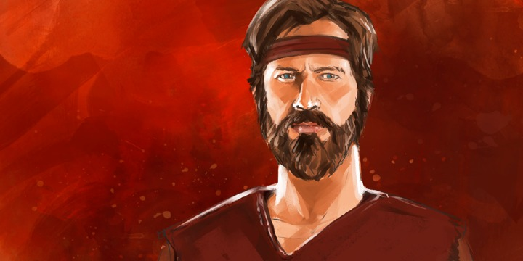

Slide 4
我們卻可以從另外一個人學到”如何不會害怕?”這個功課.
這個人就是大名鼎鼎的基甸/Gideon.
We can learn the lesson of "How not to fear? " from another
person. This person is Gideon.

Slide 5
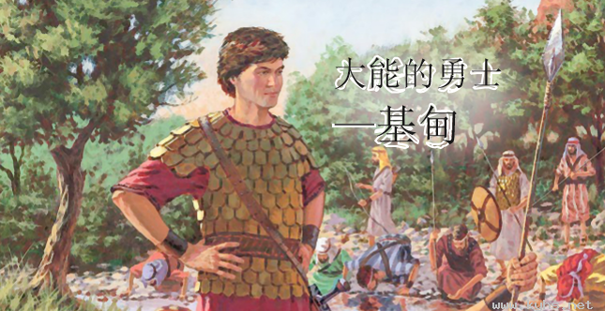

Slide 6
²米甸人壓制以色列人；以色列人因為米甸人，就在山中挖穴、挖洞、建造營寨。³以色列人每逢撒種之後，米甸人、亞瑪力人，和東方人都上來攻打他們， ⁴對著他們安營，毀壞土產，直到迦薩，
²And the hand of Midian overpowered Israel, and because of Midian the people of Israel made for themselves the dens that are in the mountains and the caves and the strongholds. ³For whenever the Israelites planted crops, the Midianites and the Amalekites and the people of the East would come up against them. ⁴They would encamp against them and devour the produce of the land, as far as Gaza,

Slide 7
沒有給以色列人留下食物，牛、羊、驢也沒有留下；⁵因為那些人帶著牲畜帳棚來，像蝗蟲那樣多，人和駱駝無數，都進入國內，毀壞全地。⁶以色列人因米甸人的緣故，極其窮乏，就呼求耶和華。
【士 6:2~6】 and leave no sustenance in Israel and no sheep or ox or donkey. ⁵For they would come up with their livestock and their tents; they would come like locusts in number—both they and their camels could not be counted—so that they laid waste the land as they came in. ⁶And Israel was brought very low because of Midian. And the people of Israel cried out for help to the Lord. 【Judg 6:2~6】

Slide 8
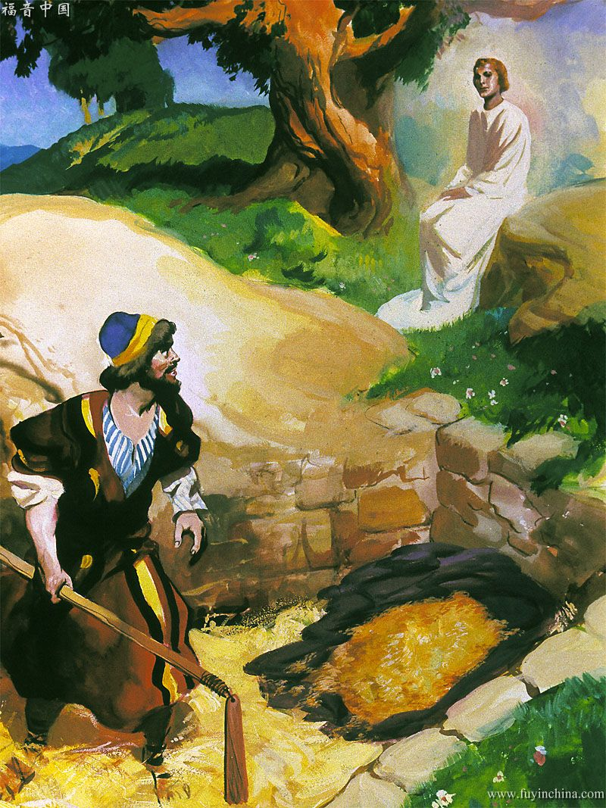

Slide 9
¹¹耶和華的使者到了俄弗拉，坐在亞比以謝族人約阿施的橡樹下。約阿施的兒子基甸正在酒醡那裡打麥子，為要防備米甸人。¹²耶和華的使者向基甸顯現，對他說：大能的勇士啊，耶和華與你同在！
【士 6:11~12】 ¹¹Now the angel of the Lord came and sat under the terebinth at Ophrah, which belonged to Joash the Abiezrite, while his son Gideon was beating out wheat in the winepress to hide it from the Midianites. ¹²And the angel of the Lord appeared to him and said to him, "The Lord is with you, O mighty man of valor." 【Judg 6:11~12】

Slide 10
神給基甸的異象有沒有實現?
Did God's vision for Gideon materialize?
²⁸這樣，米甸人被以色列人制伏了，不敢再抬頭。基甸還在的日子，國中太平四十年。
【士 8:28】 ²⁸So Midian was subdued before the people of Israel, and they raised their heads no more. And the land had rest forty years in the days of Gideon. 【Judg 8:28】

Slide 11
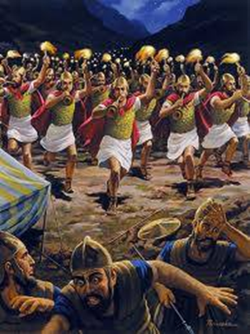
Q: 我們的神要我們成為 “大能的勇士”.
我們要怎麼樣達成呢?
Q: Our God wants us to be " mighty man of valor ". How can we achieve it?

Slide 12
A. Without God, you cannot change.
沒有神, 你不可能改變.
⁹我豈沒有吩咐你麼？你當剛強壯膽！不要懼怕，也不要驚惶；因為你無論往那裡去，耶和華─你的 神必與你同在。【書 1:9】 ⁹Have I not commanded you? Be strong and courageous. Do not be frightened, and do not be dismayed, for the Lord your God is with you wherever you go." 【Josh 1:9】

Slide 13
B. There will be extreme pain for you to change.
你要經過撕心裂肺的痛苦去改變.
“Trust God and let God.”
“Trust God and let God change you.”

Slide 14
我們從基甸的故事, 我們來看一看需要怎麼
樣的去改變?
From Gideon’s story, let's take a look at how
we need to change?
How can we Not Fear?
如何我們可以不要害怕?

Slide 15
I. Accept God’s Vision for You.
接受上帝給你的異象.
¹⁴耶和華觀看基甸，說：你靠著你這能力去從米甸人手裡拯救以色列人，不是我差遣你去的麼？
【士 6:14】 ¹⁴And the Lord turned to him and said, "Go in this might of yours and save Israel from the hand of Midian; do not I send you?" 【Judg 6:14】

Slide 16
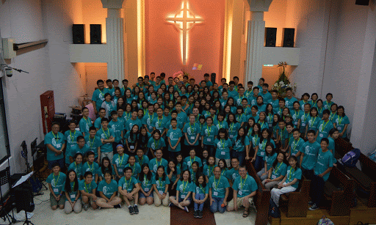
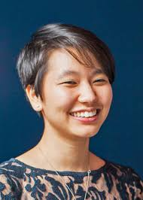
Illustration 1:

Slide 17
Illustration 2:
⁸你們得救是本乎恩，也因著信；這並不是出於自己，乃是神所賜的；⁹也不是出於行為，免得有人自誇。¹⁰我們原是他的工作，在基督耶穌裡造成的，為要叫我們行善，就是神所預備叫我們行的。
【弗 2:8~10】 ⁸For by grace you have been saved through faith. And this is not your own doing; it is the gift of God, ⁹not a result of works, so that no one may boast. ¹⁰For we are his workmanship, created in Christ Jesus for good works, which God prepared beforehand, that we should walk in them. 【Eph 2:8~10】

Slide 18
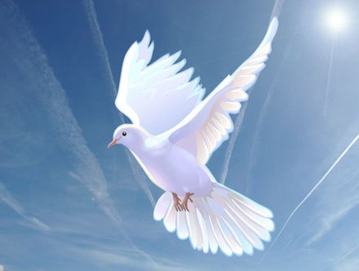
II. Leave Your Unholy Comfort Zone.
離開你那不聖潔的安樂窩.

Slide 19
Illustration 3:
²⁵當那夜，耶和華吩咐基甸說：你取你父親的牛來，就是（或作：和）那七歲的第二隻牛，並拆毀你父親為巴力所築的壇，砍下壇旁的木偶，²⁶在這磐石（原文作保障）上整整齊齊地為耶和華─你的 神築一座壇，將第二隻牛獻為燔祭，用你所砍下的木偶作柴。
²⁵That night the Lord said to him, "Take your father's bull, and the second bull seven years old, and pull down the altar of Baal that your father has, and cut down the Asherah that is beside it ²⁶and build an altar to the Lord your God on the top of the stronghold here, with stones laid in due order. Then take the second bull and offer it as a burnt offering with the wood of the Asherah that you shall cut down."

Slide 20
²⁷基甸就從他僕人中挑了十個人，照著耶和華吩咐他的行了。他因怕父家和本城的人，不敢在白晝行這事，就在夜間行了。" ²⁷So Gideon took ten men of his servants and did as the Lord had told him. But because he was too afraid of his family and the men of the town to do it by day, he did it by night

Slide 21
²⁸城裡的人清早起來，見巴力的壇拆毀，壇旁的木偶砍下，第二隻牛獻在新築的壇上，²⁹就彼此說：這事是誰做的呢？他們訪查之後，就說：這是約阿施的兒子基甸做的。³⁰城裡的人對約阿施說：將你兒子交出來，好治死他；因為他拆毀了巴力的壇，砍下壇旁的木偶。【士 6:25~30】.
²⁸When the men of the town rose early in the morning, behold, the altar of Baal was broken down, and the Asherah beside it was cut down, and the second bull was offered on the altar that had been built. ²⁹And they said to one another, "Who has done this thing?" And after they had searched and inquired, they said, "Gideon the son of Joash has done this thing." ³⁰Then the men of the town said to Joash, "Bring out your son, that he may die, for he has broken down the altar of Baal and cut down the Asherah beside it." 【Judg 6:25~30】

Slide 22
³²所以當日人稱基甸為耶路巴力，意思說：他拆毀巴力的壇，讓巴力與他爭論。【士 6:32】 ³²Therefore on that day Gideon was called Jerubbaal, that is to say, "Let Baal contend against him," because he broke down his altar. 【Judg 6:32】
Gideon fights against this weak spot all his life. 基甸一生都和這個軟肋奮鬥.

Slide 23
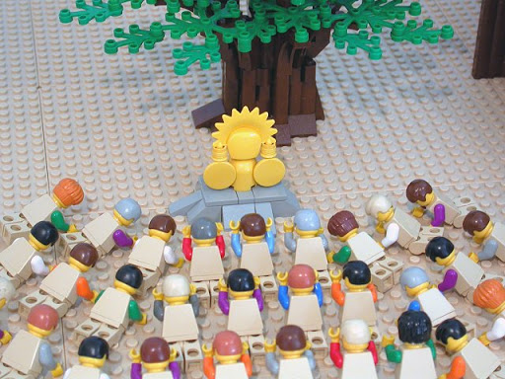
²⁷基甸以此製造了一個以弗得，
設立在本城俄弗拉。後來以色列人拜那以弗得行了邪淫；這就作了基甸和他全家的網羅。【士 8:27】 ²⁷And Gideon made an ephod of it and put it in his city, in Ophrah. And all Israel whored after it there, and it became a snare to Gideon and to his family. 【Judg 8:27】

Slide 24
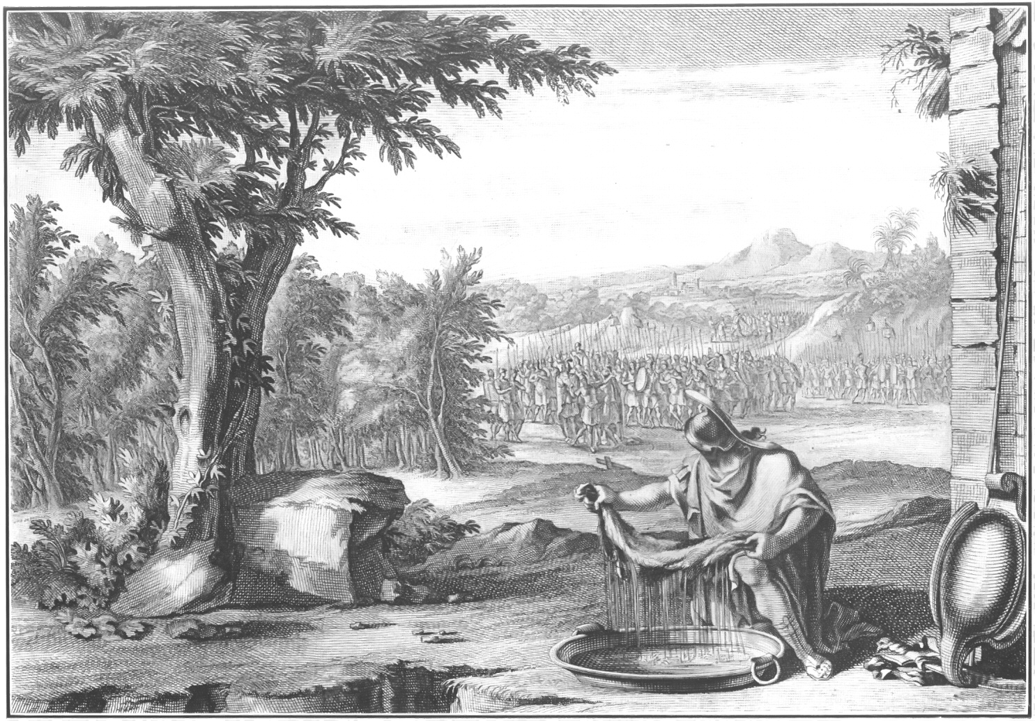
Illustration 4:

Slide 25
³⁶基甸對 神說：你若果照著所說的話，藉我手拯救以色列人，³⁷我就把一團羊毛放在禾場上：若單是羊毛上有露水，別的地方都是乾的，我就知道你必照著所說的話，藉我手拯救以色列人。³⁸次日早晨基甸起來，見果然是這樣；將羊毛擠一擠，從羊毛中擰出滿盆的露水來。³⁹基甸又對 神說：求你不要向我發怒，我再說這一次：讓我將羊毛再試一次。但願羊毛是乾的，別的地方都有露水。⁴⁰這夜 神也如此行：獨羊毛上是乾的，別的地方都有露水。【士 6:36~40】 ³⁶Then Gideon said to God, "If you will save Israel by my hand, as you have said, ³⁷behold, I am laying a fleece of wool on the threshing floor. If there is dew on the fleece alone, and it is dry on all the ground, then I shall know that you will save Israel by my hand, as you have said." ³⁸And it was so. When he rose early next morning and squeezed the fleece, he wrung enough dew from the fleece to fill a bowl with water. ³⁹Then Gideon said to God, "Let not your anger burn against me; let me speak just once more. Please let me test just once more with the fleece. Please let it be dry on the fleece only, and on all the ground let there be dew." ⁴⁰And God did so that night; and it was dry on the fleece only, and on all the ground there was dew. 【Judg 6:36~40】

Slide 26
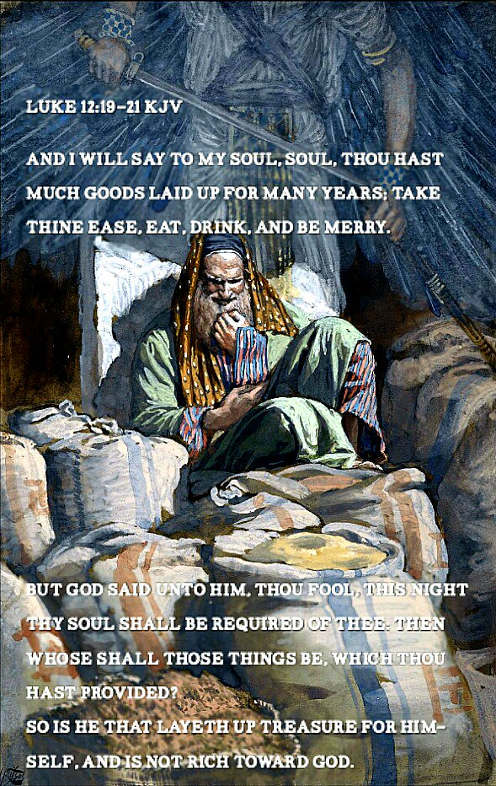
Illustration 5:
²⁰神卻對他說：無知的人哪，今夜必要你的靈魂；你所預備的要歸誰呢？【路 12:20】 ²⁰"But God said to him, 'Fool! This night your soul is required of you, and the things you have prepared, whose will they be?'" 【Luke 12:20】

Slide 27
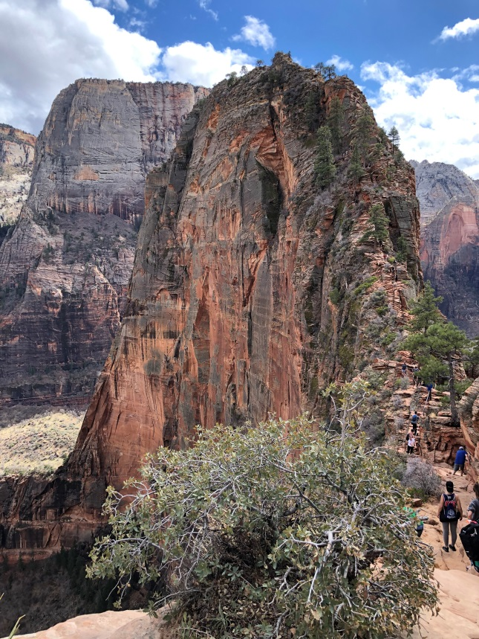
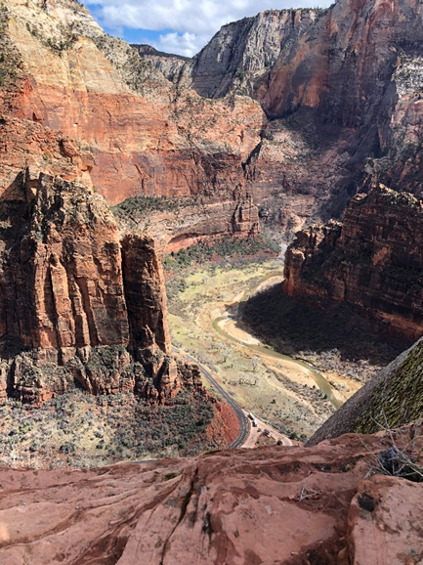
Illustration 6:
Zion National Park
Angel’s Landing

Slide 28
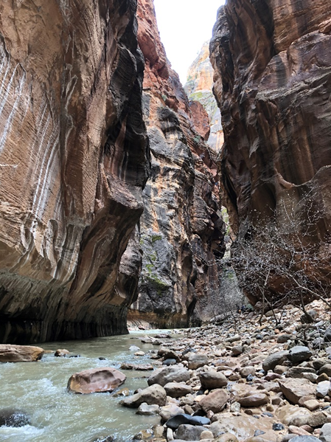
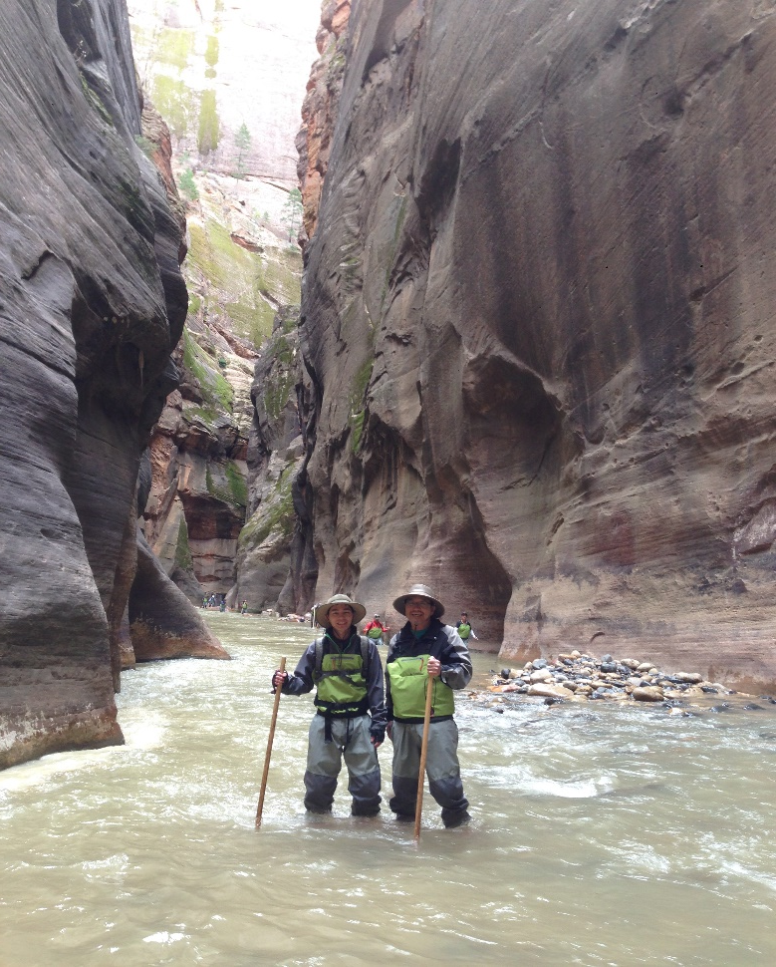
Narrow
Virgin River

Slide 29
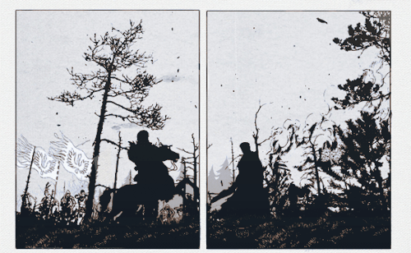
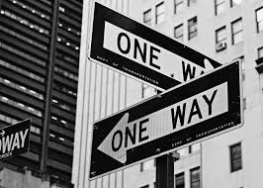
III. Step Out into the Road of No Return.
踏入那不歸路.

Slide 30
¹耶路巴力就是基甸，他和一切跟隨的人早晨起來，在哈律泉旁安營。米甸營在他們北邊的平原，靠近摩利岡。²耶和華對基甸說：跟隨你的人過多，我不能將米甸人交在他們手中，免得以色列人向我誇大，
¹Then Jerubbaal (that is, Gideon) and all the people who were with him rose early and encamped beside the spring of Harod. And the camp of Midian was north of them, by the hill of Moreh, in the valley. ²The Lord said to Gideon, "The people with you are too many for me to give the Midianites into their hand, lest Israel boast over me,

Slide 31
說：是我們自己的手救了我們。³現在你要向這些人宣告說：凡懼怕膽怯的，可以離開基列山回去。於是有二萬二千人回去，只剩下一萬。【士 7:1~3】 saying, 'My own hand has saved me.' ³Now therefore proclaim in the ears of the people, saying, 'Whoever is fearful and trembling, let him return home and hurry away from Mount Gilead.' " Then 22,000 of the people returned, and 10,000 remained. 【Judg 7:1~3】

Slide 33
→然後進一步又給他刪掉9,700人, 只剩下300人.
Then he further deleted 9,700 people, leaving only 300 people.
⁴耶和華對基甸說：人還是過多；你要帶他們下到水旁，我好在那裡為你試試他們。我指點誰說：這人可以同你去，他就可以同你去；我指點誰說：這人不可同你去，他就不可同你去。⁵基甸就帶他們下到水旁。
⁴And the Lord said to Gideon, "The people are still too many. Take them down to the water, and I will test them for you there, and anyone of whom I say to you, 'This one shall go with you,' shall go with you, and anyone of whom I say to you, 'This one shall not go with you,' shall not go." ⁵So he brought the people down to the water.

Slide 34
耶和華對基甸說：凡用舌頭舔水，像狗舔的，要使他單站在一處；凡跪下喝水的，也要使他單站在一處。⁶於是用手捧著舔水的有三百人，其餘的都跪下喝水。⁷耶和華對基甸說：我要用這舔水的三百人拯救你們，將米甸人交在你手中；其餘的人都可以各歸各處去。【士 7:4~7】
And the Lord said to Gideon, "Every one who laps the water with his tongue, as a dog laps, you shall set by himself. Likewise, every one who kneels down to drink." ⁶And the number of those who lapped, putting their hands to their mouths, was 300 men, but all the rest of the people knelt down to drink water. ⁷And the Lord said to Gideon, "With the 300 men who lapped I will save you and give the Midianites into your hand, and let all the others go every man to his home." 【Judg 7:4~7】

Slide 35
(31%)
(不到1%)
重點不在人數, 乃在警醒. Not on numbers, but vigilance.

Slide 36
Illustration 7:
In the wake of the September 11 attacks, Captain Mitch Nelson leads a US Special Forces team into Afghanistan for an extremely dangerous mission.

Slide 37
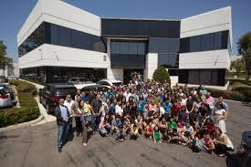
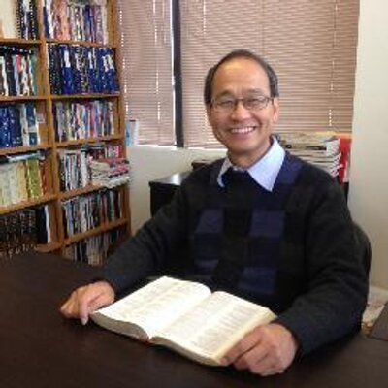
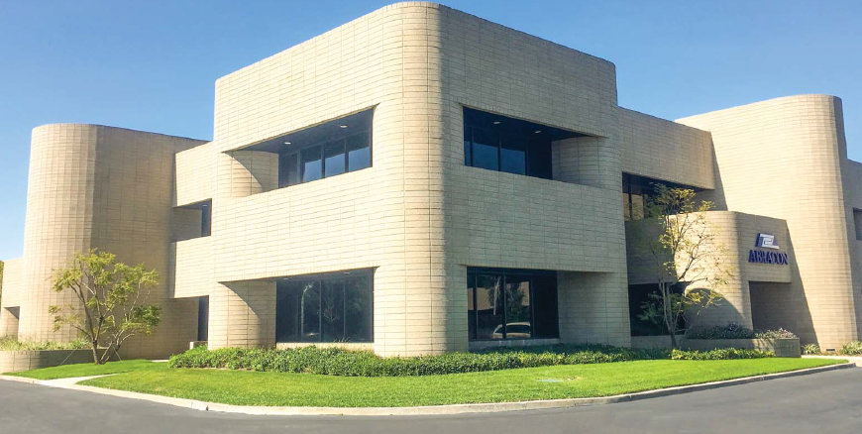
Illustration 8:

Slide 38
Illustration 9:
我們教會的CUP 申請了2年, 本來3月25日的聽證會, 碰到Corona Virus, 又要延到4/22.
Due to the Corona Virus outbreak, the hearing on March 25th will be postponed to 4/22.

Slide 39
IV. God will encourage us. 神會鼓勵我們.

Slide 40
⁹當那夜，耶和華吩咐基甸說：起來，下到米甸營裡去，因我已將他們交在你手中。¹⁰倘若你怕下去，就帶你的僕人普拉下到那營裡去。¹¹你必聽見他們所說的，然後你就有膽量下去攻營。於是基甸帶著僕人普拉下到營旁。 ¹²米甸人、亞瑪力人，和一切東方人都布散在平原，如同蝗蟲那樣多。
⁹That same night the Lord said to him, "Arise, go down against the camp, for I have given it into your hand. ¹⁰But if you are afraid to go down, go down to the camp with Purah your servant. ¹¹And you shall hear what they say, and afterward your hands shall be strengthened to go down against the camp." Then he went down with Purah his servant to the outposts of the armed men who were in the camp. ¹²And the Midianites and the Amalekites and all the people of the East lay along the valley like locusts in abundance,

Slide 41
他們的駱駝無數，多如海邊的沙。¹³基甸到了，就聽見一人將夢告訴同伴說：我做了一夢，夢見一個大麥餅滾入米甸營中，到了帳幕，將帳幕撞倒，帳幕就翻轉傾覆了。¹⁴那同伴說：這不是別的，乃是以色列人約阿施的兒子基甸的刀； 神已將米甸和全軍都交在他的手中。【士 7:9~14】
and their camels were without number, as the sand that is on the seashore in abundance. ¹³When Gideon came, behold, a man was telling a dream to his comrade. And he said, "Behold, I dreamed a dream, and behold, a cake of barley bread tumbled into the camp of Midian and came to the tent and struck it so that it fell and turned it upside down, so that the tent lay flat." ¹⁴And his comrade answered, "This is no other than the sword of Gideon the son of Joash, a man of Israel; God has given into his hand Midian and all the camp."
【Judg 7:9~14】

Slide 42
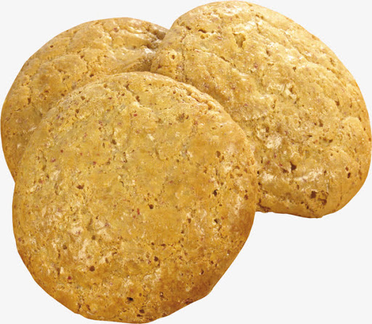

Slide 43
Conclusion
這個瘟疫終必過去, 最多一年或18個月, 到了疫苗出來的時候, 像米甸人一樣, 瘟疫就被制伏了.瘟疫過去之後, 神的國度是不是多了許多勇敢的人? 還是只是有許多躲在床底下的人, 走了出來? 當下一個困難臨到的時候, 我們是不是多了許多敢面對困難, 與困難爭戰的人? 還是繼續尋找床底下的空間?
The plague will eventually pass up to a year or 18 months. When the vaccine comes out, the plague will be subdued like the Midianites. After the plague, will there merge many more brave people in the kingdom of God? Or just a few people who come out from under the bed? When the next hardship comes, will there be many more people who dare to face and fight against the difficulties?

