Slide 1
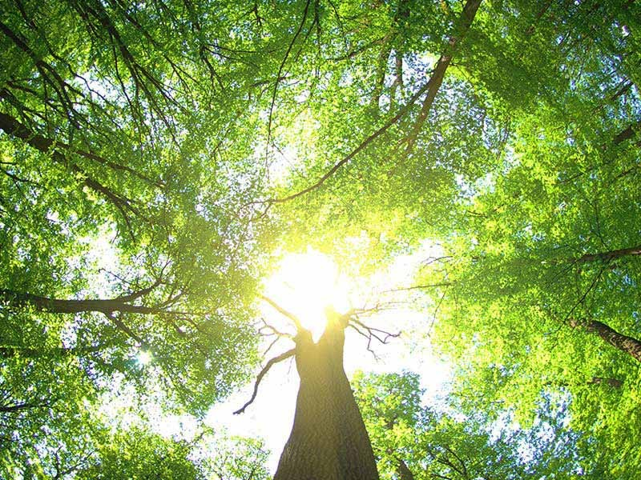
Natural Law
自然律
5/24/2020 Rev. Joseph Chang BOLGPC 爾灣大公園靈糧堂

Slide 2
When in the Course of human events, it becomes necessary for one people to dissolve the political bands which have connected them with another, and to assume among the powers of the earth, the separate and equal station to which the Laws of Nature and of Nature's God entitle them, a decent respect to the opinions of mankind requires that they should declare the causes which impel them to the separation.
在人類的歷史上, 有時候一群人必須從另外一群人的政治關聯上割捨開來, 彼此成為分開, 獨立, 對等的政治實體. 這政治實體是自然律和自然的神所給他們權柄可以設立的. 因為尊敬別人的意見, 今天我們必須清楚的向人類宣告是什麼原因使我們要分離.

Slide 3
We hold these truths to be self-evident, that all men are created equal, that they are endowed by their Creator with certain unalienable Rights, that among these are Life, Liberty and the pursuit of Happiness.--That to secure these rights, Governments are instituted among Men, deriving their just powers from the consent of the governed,
我們相信下列的真理是不問自明的, 每個人心裡可以曉得, 無可推諉的: 所有的人是受造而平等的, 每個人都擁有創造主付與他們不可分離, 不能被剝奪的權力, 譬如:生命, 自由, 和追求幸福的權力. 為了要保有這些權力, 政府就由人民當中產生, 政府的權柄是由接受統治的人民同意後產生的.

Slide 4
--That whenever any Form of Government becomes destructive of these ends, it is the Right of the People to alter or to abolish it, and to institute new Government, laying its foundation on such principles and organizing its powers in such form, as to them shall seem most likely to effect their Safety and Happiness.
如果任何時候政府變為要破壞這些權力, 那麼人民有權改變或甚至除掉這樣的政府, 另立新的政府, 設下新的政治原則, 政治制度, 使得人民可以享受安全和幸福.

Slide 5

I. What is Natural Law? 甚麼是自然律?

Slide 6

Illustration 1:

Slide 7
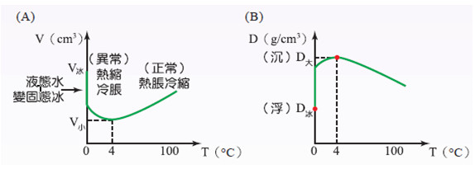
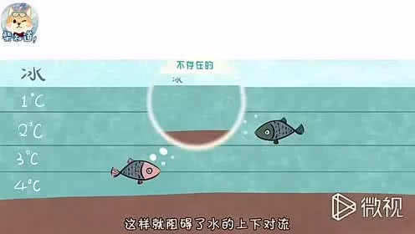
Illustration 2:

Slide 8

Illustration 3:

Slide 9

Illustration 4:

Slide 10
¹⁴沒有律法的外邦人若順著本性(自然)行律法上的事，他們雖然沒有律法，自己就是自己的律法。¹⁵這是顯出律法的功用刻在他們心裡，他們是非之心同作見證，並且他們的思念互相較量，或以為是，或以為非。）
【羅 2:14~15】
¹⁴For when Gentiles, who do not have the law, by nature do what the law requires, they are a law to themselves, even though they do not have the law. ¹⁵They show that the work of the law is written on their hearts, while their conscience also bears witness, and their conflicting thoughts accuse or even excuse them 【Rom 2:14~15】

Slide 11
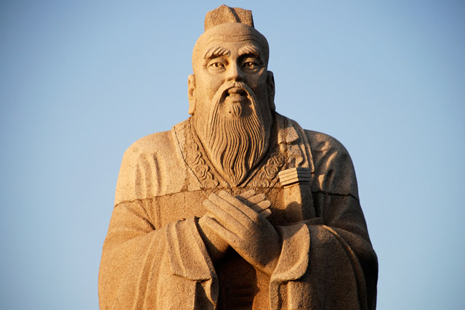
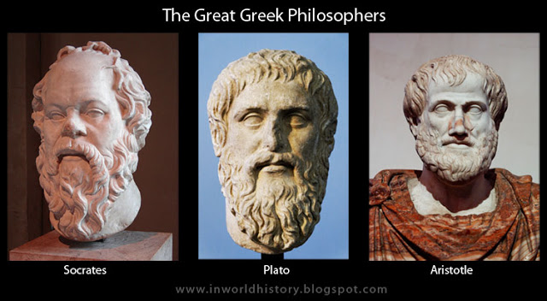
Illustration 5:

Slide 12
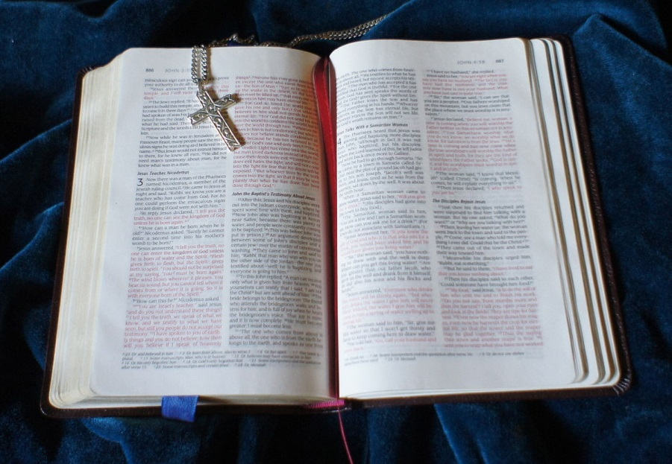
II. 那麼人類有自然律, 為什麼還要聖經?
If God placed Natural Law in the hearts of man,
why do we need the Bible?

Slide 13

⁹人心比萬物都詭詐，壞到極處，誰能識透呢？【耶 17:9】
⁹The heart is deceitful above all things, and desperately sick; who can understand it? 【Jer 17:9】

Slide 14
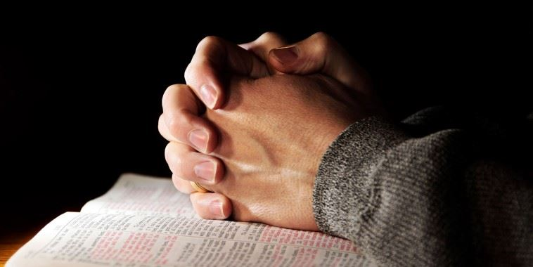
¹⁸他們不知道，也不思想；因為耶和華閉住他們的眼，不能看見，塞住他們的心，不能明白。【賽 44:18】
¹⁸They know not, nor do they discern, for he has shut their eyes, so that they cannot see, and their hearts, so that they cannot understand. 【Isa 44:18】

Slide 15
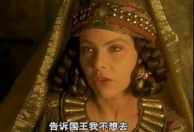
Illustration 6:
王后瓦實提 (Vashiti)

Slide 16
¹⁶米母干在王和眾首領面前回答說：王后瓦實提這事，不但得罪王，並且有害於王各省的臣民；¹⁷因為王后這事必傳到眾婦人的耳中，說：『亞哈隨魯王吩咐王后瓦實提到王面前，他卻不來』，他們就藐視自己的丈夫。
¹⁶Then Memucan said in the presence of the king and the officials, "Not only against the king has Queen Vashti done wrong, but also against all the officials and all the peoples who are in all the provinces of King Ahasuerus. ¹⁷For the queen's behavior will be made known to all women, causing them to look at their husbands with contempt, since they will say, 'King Ahasuerus commanded Queen Vashti to be brought before him, and she did not come.'

Slide 17
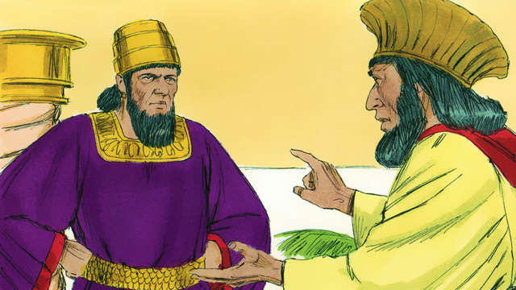
¹⁸今日波斯和瑪代的眾夫人聽見王后這事，必向王的大臣照樣行；從此必大開藐視和忿怒之端。【斯 1:16~18】
¹⁸This very day the noble women of Persia and Media who have heard of the queen's behavior will say the same to all the king's officials, and there will be contempt and wrath in plenty. 【Esth 1:16~18】

Slide 18
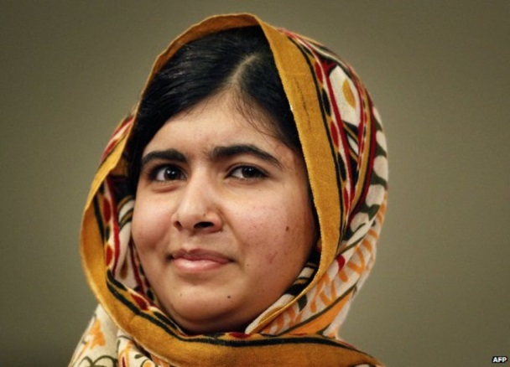
Illustration 7:
Malala Yousafzai

Slide 19
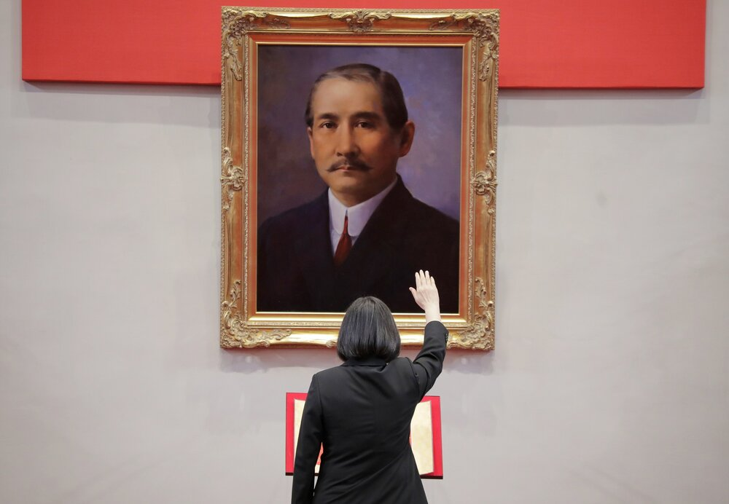
Illustration 8:

Slide 20
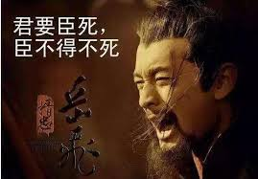
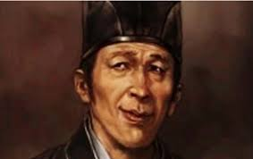
Illustration 9:

Slide 21
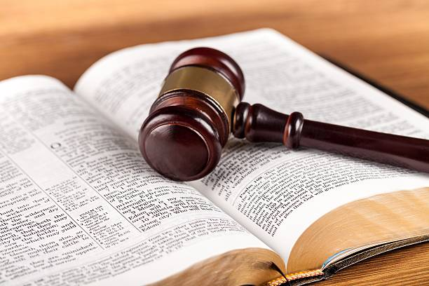
III. Biblical Laws are needed to build a good civil system.
聖經的律法是必須的, 才能夠建立好的社區.

Slide 22
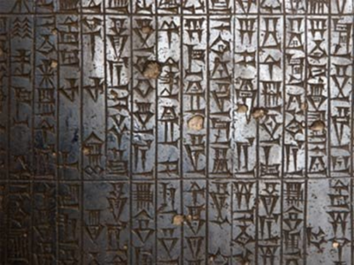
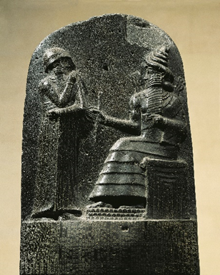
Illustration 10:
漢摩拉比法典/Hammurabi Law
Hammurabi (1792-1750 B.C.) had one of the oldest law code in history. Hammurabi receives the law from Shamash (Sun God)

Slide 23
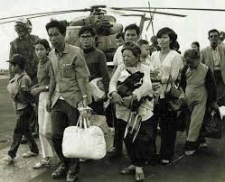

Illustration 11:

Slide 24
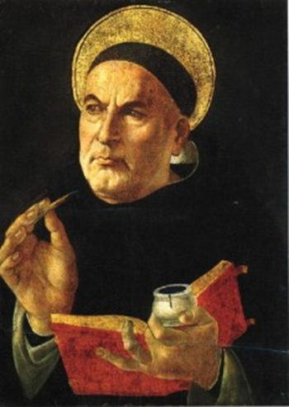
Thomas Aquinas

Slide 26

Eternal Law/永恆的律:
The principles by which God made and governs the universe.
神創造以及維持這個宇宙的法則.

Slide 27

Natural Law/自然律:
The reflection of eternal law in the very structure of the created rational mind, directing us to our natural good.
神永恆的律反映在我們的心中, 引導我們去做自然(順性)的好事.
³我屬我的良人，我的良人也屬我；【歌 6:3a】
³I am my beloved's and my beloved is mine; . . . 【Song 6:3a】

Slide 28
Divine Law/聖律:
The reflection of eternal law in God’s revealed Word.
神的永恆的律, 很大的部分藉著聖經向我們顯現. 包括舊約和新約.

Slide 29
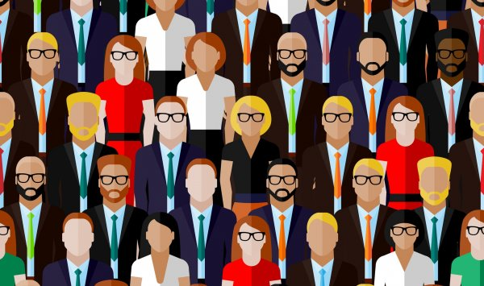
Human Law/人的律:
Detailed “determinations” or applications of natural law to the circumstances of particular human societies.
社會的法律——因著特定社會的需要, 把自然律應用在規範社會行為.

Slide 30


Illustration 12:

Slide 31

Law of Sin/罪律:
Not a law in the strict sense but a penalty or consequence resulting from Divine law for man’s turning his back on God.
就是對抗聖律, 背對神所引致的後果. 嚴格講, 沒有這種 “法律”.

Slide 32

Illustration 13:

Slide 33



Illustration 14:
Blue Law

Slide 34

Illustration 15:

Slide 35

Illustration 16:

Slide 36
¹論到你們信上所提的事，我說男不近女倒好。²但要免淫亂的事，男子當各有自己的妻子；女子也當各有自己的丈夫。³丈夫當用合宜之分待妻子；妻子待丈夫也要如此。⁴妻子沒有權柄主張自己的身子，乃在丈夫；丈夫也沒有權柄主張自己的身子，乃在妻子。【林前 7:1~4】
¹Now concerning the matters about which you wrote: "It is good for a man not to have sexual relations with a woman." ²But because of the temptation to sexual immorality, each man should have his own wife and each woman her own husband. ³The husband should give to his wife her conjugal rights, and likewise the wife to her husband. ⁴For the wife does not have authority over her own body, but the husband does. Likewise the husband does not have authority over his own body, but the wife does. 【1Cor 7:1~4】

Slide 37
Conclusion
⁶所以你們要謹守遵行；這就是你們在萬民眼前的智慧、聰明。他們聽見這一切律例，必說：這大國的人真是有智慧，有聰明！⁷那一大國的人有 神與他們相近，像耶和華─我們的 神、在我們求告他的時候與我們相近呢？⁸又那一大國有這樣公義的律例典章、像我今日在你們面前所陳明的這一切律法呢？【申 4:6~8】
⁶Keep them and do them, for that will be your wisdom and your understanding in the sight of the peoples, who, when they hear all these statutes, will say, 'Surely this great nation is a wise and understanding people.' ⁷For what great nation is there that has a god so near to it as the Lord our God is to us, whenever we call upon him? ⁸And what great nation is there, that has statutes and rules so righteous as all this law that I set before you today? 【Deut 4:6~8】

