Slide 1
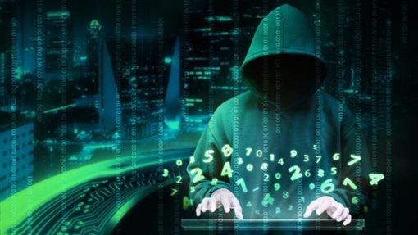
Unrestricted Warfare
超限戰
6/28/2020
Rev. Joseph Chang
BOLGPC 爾灣大公園靈糧堂

Slide 2
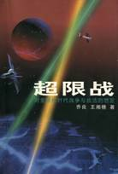
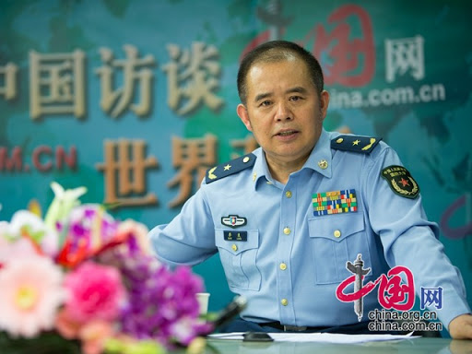
I. Unrestricted Warfare 超限戰—喬良的書

Slide 3
不是為道德而戰, 而是為利益而戰.
不再有前方後方
不再有軍人老百姓的差別
Not a war for morality, but a war for interests.
No front, no rear.
There is no longer a difference between soldiers and ordinary people.

Slide 4
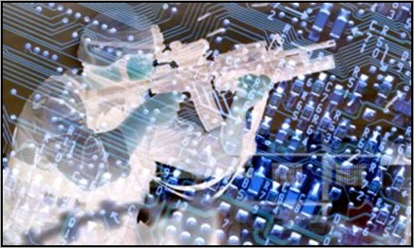
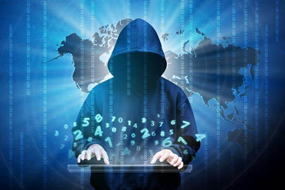
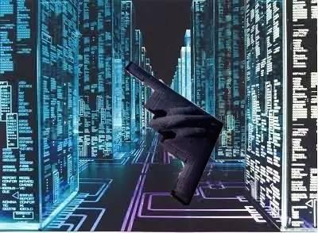

Slide 5
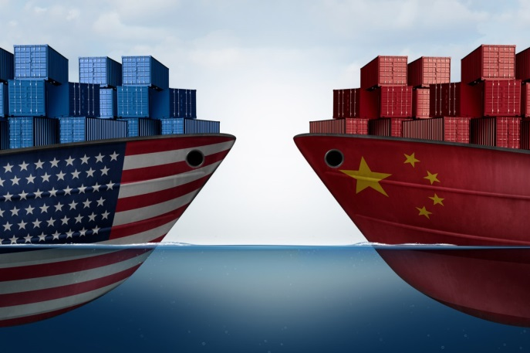
“非軍事的戰爭行動”是現今的戰爭型態:
"Non-military war action" is the current form of war:
1)貿易戰: 301 條款反傾銷法
Trade War :Article 301, Anti-dumping Law

Slide 6
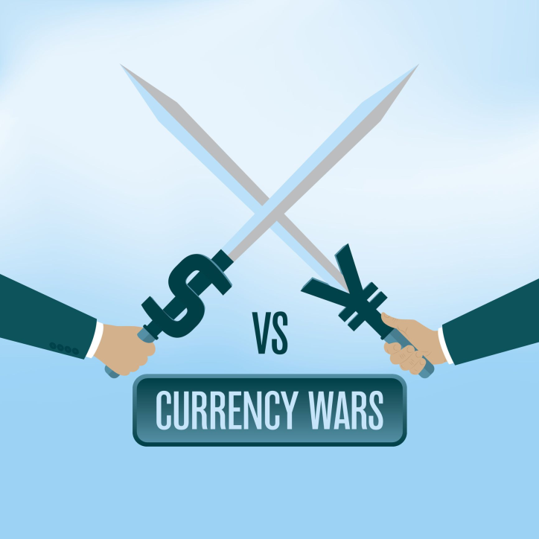
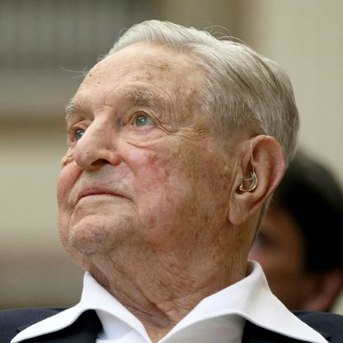
2)金融戰: George Soros 造成了亞洲許多國家的金融危機.
Currency War: George Soros caused the financial crisis in many
Asian countries.

Slide 7
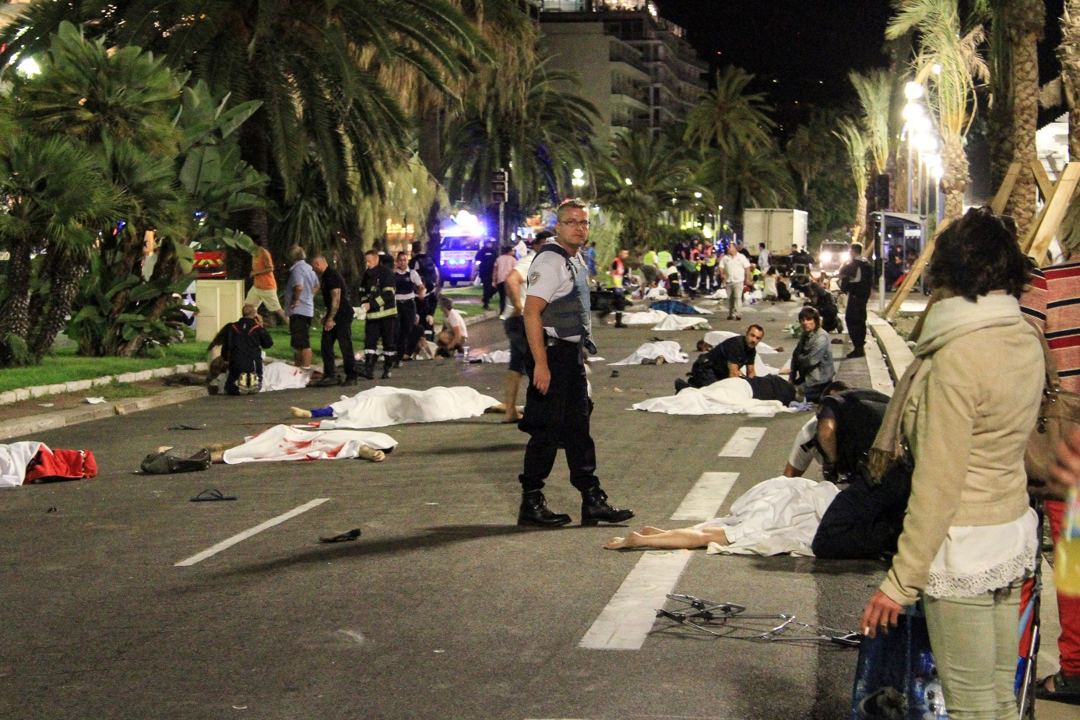
3)新恐怖戰爭: 傷亡人數少, 但是暴力的程度增大.
New terrorist wars: fewer casualties, but the level of violence
increases.

Slide 8
→現代的戰爭可以下列任何形式出現:
生態戰 Environmental Warfare—破壞地球的地理環境或局部生態.
氣象戰 Weather Warfare
心理戰 Psychological Warfare
走私戰 Smuggling Warfare, e.g. Fentanyl/芬太尼, heroin/海洛因
媒體戰 Media Warfare
毒品戰 Drug War
網絡戰 Internet Warfare
壟斷專利的技術戰 Patent Warfare
虛擬戰 Virtual Warfare
資源戰 Resources Warfare
經援戰 Economic Warfare
文化戰 Cultural Warfare –孔子學院.
國際法戰 International Law Warfare

Slide 9
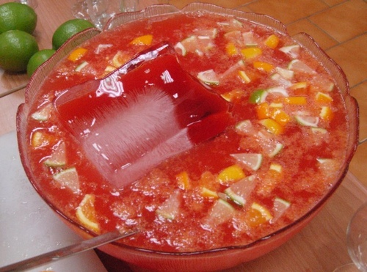
武力戰爭和非武力戰爭的混合雞尾酒.
A cocktail of armed and non-armed warfare.
1+1>1
“用一切手段, 包括武力和非武力, 軍事和非軍事, 殺傷和非殺傷的手段, 強迫對方滿足自己的利益 .”
“Use all means, including armed force or non-armed force, military and non-military, lethal and non-lethal means to compel the enemy to accept one’s interests ."

Slide 10
Illustration 1:
¹第三日，大衛和跟隨他的人到了洗革拉。亞瑪力人已經侵奪南地，攻破洗革拉，用火焚燒，²擄了城內的婦女和其中的大小人口，卻沒有殺一個，都帶著走了。³大衛和跟隨他的人到了那城，不料，城已燒燬，他們的妻子兒女都被擄去了。
¹Now when David and his men came to Ziklag on the third day, the Amalekites had made a raid against the Negeb and against Ziklag. They had overcome Ziklag and burned it with fire ²and taken captive the women and all who were in it, both small and great. They killed no one, but carried them off and went their way. ³And when David and his men came to the city, they found it burned with fire, and their wives and sons and daughters taken captive.

Slide 11
⁴大衛和跟隨他的人就放聲大哭，直哭得沒有氣力。⁵大衛的兩個妻─耶斯列人亞希暖和作過拿八妻的迦密人亞比該，也被擄去了。⁶大衛甚是焦急，因眾人為自己的兒女苦惱，說：要用石頭打死他。大衛卻倚靠耶和華─他的 神，心裡堅固。
【撒上 30:1~6】 ⁴Then David and the people who were with him raised their voices and wept until they had no more strength to weep. ⁵David's two wives also had been taken captive, Ahinoam of Jezreel and Abigail the widow of Nabal of Carmel. ⁶And David was greatly distressed, for the people spoke of stoning him, because all the people were bitter in soul, each for his sons and daughters. But David strengthened himself in the Lord his God.
【1Sam 30:1~6】

Slide 12
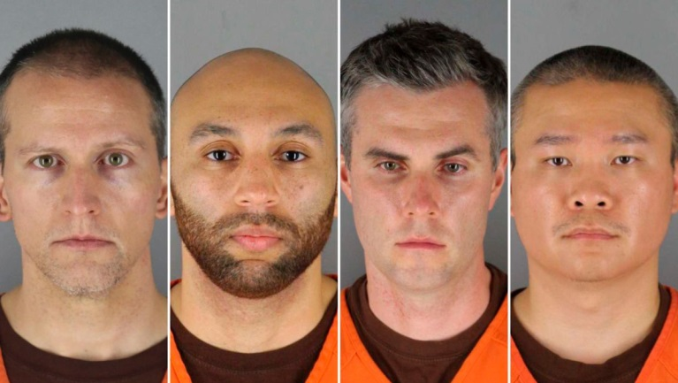
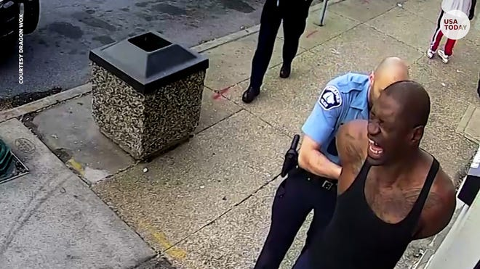
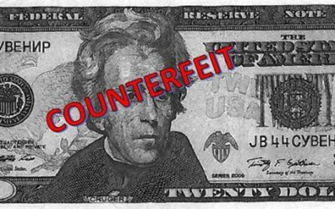
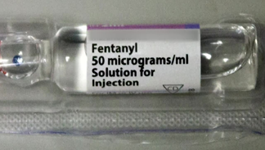
Illustration 2:

Slide 13
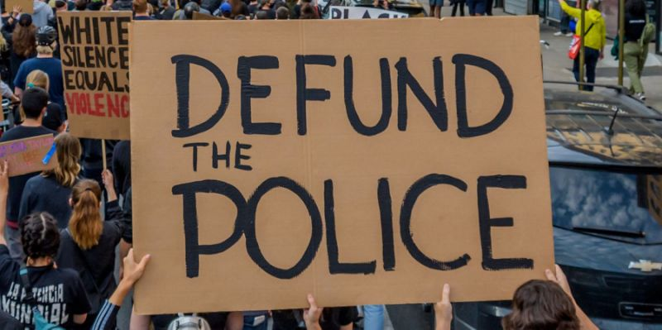
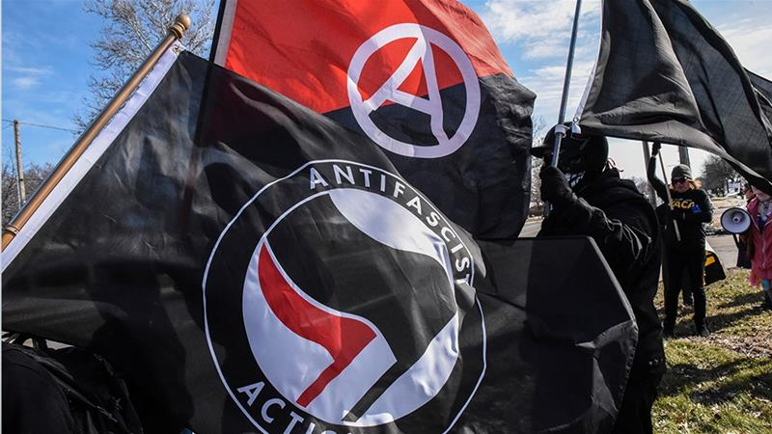
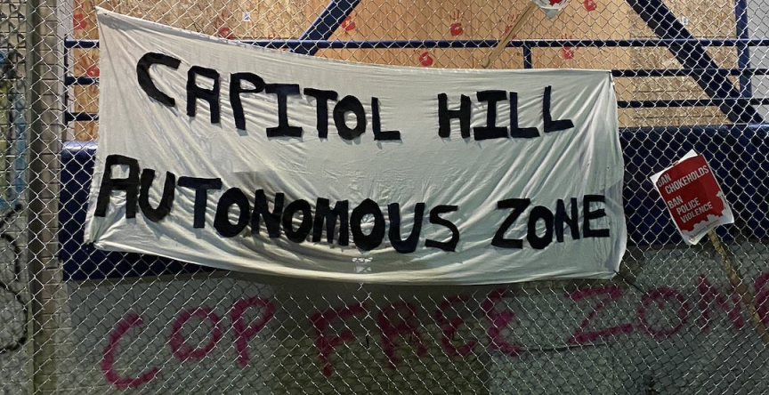

Slide 14
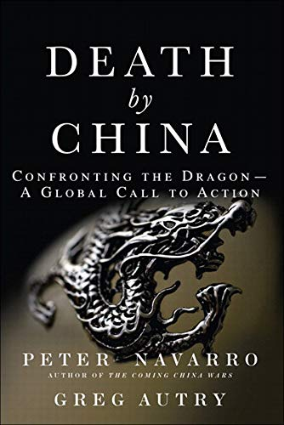
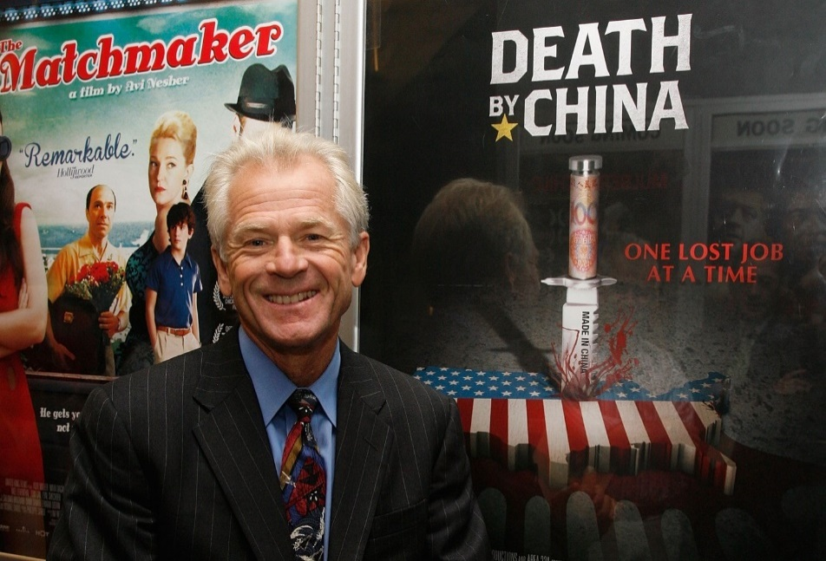
II. “Death by China”—Peter Navarro’s Book
”致命中國”—彼得, 納瓦羅的書

Slide 16
5.5 millions manufacturing job lost. 57,000 factories closed doors. Hard to find descent jobs. 5百50萬製造業的工作機會不見了. 57,000工廠離開美國到中國去了. 美國難找到好的薪水的工作.
US-Sino Unfair Trade Practices. 中美不公平的貿易關係.
Human Right Issue. 人權的迫害問題.

Slide 17
III. No Front, No Rear—New Normal
沒有前線, 沒有後方—新的戰爭.
戰爭已經沒有前線後方的界線了, 也沒有國界的界線了. 幾乎都是以個人個體為單位了.
There is no more front, no more rear in the warfare of ideology in this world.

Slide 18
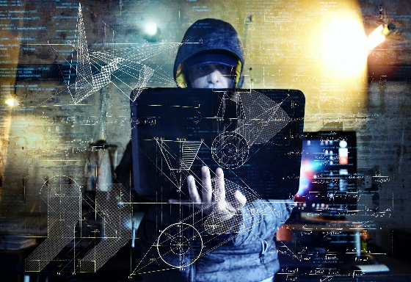
A. 數位戰爭/Digital Warfare:

Slide 19
¹⁶他又叫眾人，無論大小、貧富、自主的、為奴的，都在右手上或是在額上受一個印記。¹⁷除了那受印記、有了獸名或有獸名數目的，都不得做買賣。¹⁸在這裡有智慧：凡有聰明的，可以算計獸的數目；因為這是人的數目，他的數目是六百六十六。【啟 13:16~18】 ¹⁶Also it causes all, both small and great, both rich and poor, both free and slave, to be marked on the right hand or the forehead, ¹⁷so that no one can buy or sell unless he has the mark, that is, the name of the beast or the number of its name. ¹⁸This calls for wisdom: let the one who has understanding calculate the number of the beast, for it is the number of a man, and his number is 666. 【Rev 13:16~18】

Slide 20
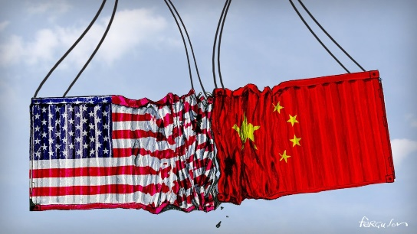
B. 貿易戰/Trade War

Slide 21
¹此後，我看見另有一位有大權柄的天使從天降下，地就因他的榮耀發光。²他大聲喊著說：巴比倫大城傾倒了！傾倒了！成了鬼魔的住處和各樣污穢之靈的巢穴（或作：牢獄；下同），並各樣污穢可憎之雀鳥的巢穴。³因為列國都被他邪淫大怒的酒傾倒了。地上的君王與他行淫；地上的客商因他奢華太過就發了財。【啟 18:1~3】 ¹After this I saw another angel coming down from heaven, having great authority, and the earth was made bright with his glory. ²And he called out with a mighty voice, " Fallen, fallen is Babylon the great! She has become a dwelling place for demons, a haunt for every unclean spirit, a haunt for every unclean bird, a haunt for every unclean and detestable beast. ³For all nations have drunk the wine of the passion of her sexual immorality, and the kings of the earth have committed immorality with her, and the merchants of the earth have grown rich from the power of her luxurious living." 【Rev 18:1~3】

Slide 22
C. 宗教戰/Religious Warfare:
³我被聖靈感動，天使帶我到曠野去，我就看見一個女人騎在朱紅色的獸上；那獸有七頭十角，遍體有褻瀆的名號。⁴那女人穿著紫色和朱紅色的衣服，用金子、寶石、珍珠為妝飾；手拿金杯，杯中盛滿了可憎之物，就是他淫亂的污穢。 ³And he carried me away in the Spirit into a wilderness, and I saw a woman sitting on a scarlet beast that was full of blasphemous names, and it had seven heads and ten horns. ⁴The woman was arrayed in purple and scarlet, and adorned with gold and jewels and pearls, holding in her hand a golden cup full of abominations and the impurities of her sexual immorality.

Slide 23
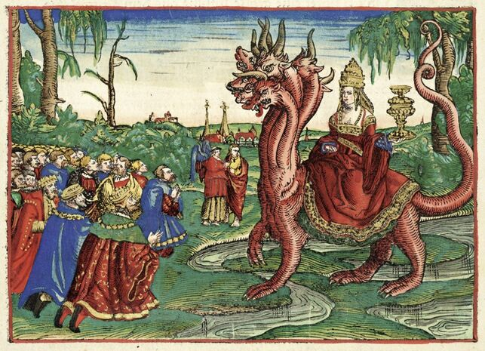
⁵在他額上有名寫著說：奧祕哉！大巴比倫，作世上的淫婦和一切可憎之物的母。⁶我又看見那女人喝醉了聖徒的血和為耶穌作見證之人的血。我看見他，就大大的希奇。【啟 17:3~6】 ⁵And on her forehead was written a name of mystery: "Babylon the great, mother of prostitutes and of earth's abominations." ⁶And I saw the woman, drunk with the blood of the saints, the blood of the martyrs of Jesus. When I saw her, I marveled greatly. 【Rev 17:3~6】

Slide 24
D. 氣象戰/Meteorological Warfare
第七碗的災:
²¹又有大雹子從天落在人身上，每一個約重一他連得（一他連得約有九十斤）。為這雹子的災極大，人就褻瀆神。【啟 16:21】 ²¹And great hailstones, about one hundred pounds each, fell from heaven on people; and they cursed God for the plague of the hail, because the plague was so severe. 【Rev 16:21】

Slide 25
第四碗的災:
⁸第四位天使把碗倒在日頭上，叫日頭能用火烤人。⁹人被大熱所烤，就褻瀆那有權掌管這些災的神之名，並不悔改將榮耀歸給神。【啟 16:8~9】 ⁸The fourth angel poured out his bowl on the sun, and it was allowed to scorch people with fire. ⁹They were scorched by the fierce heat, and they cursed the name of God who had power over these plagues. They did not repent and give him glory. 【Rev 16:8~9】

Slide 26
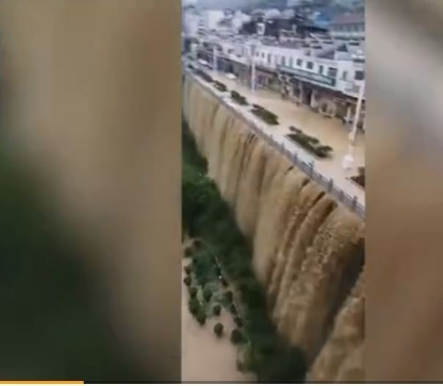
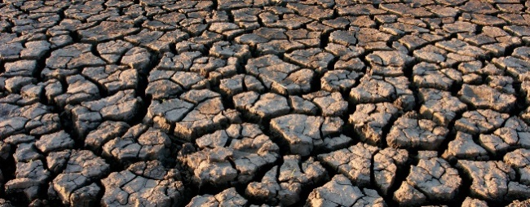

Slide 27
E. Pandemic/全世界的瘟疫戰
⁸我就觀看，見有一匹灰色馬；騎在馬上的，名字叫作死，陰府也隨著他；有權柄賜給他們，可以用刀劍、饑荒、瘟疫（瘟疫或作：死亡）、野獸，殺害地上四分之一的人。【啟 6:8】 ⁸And I looked, and behold, a pale horse! And its rider's name was Death, and Hades followed him. And they were given authority over a fourth of the earth, to kill with sword and with famine and with pestilence and by wild beasts of the earth. 【Rev 6:8】

Slide 28
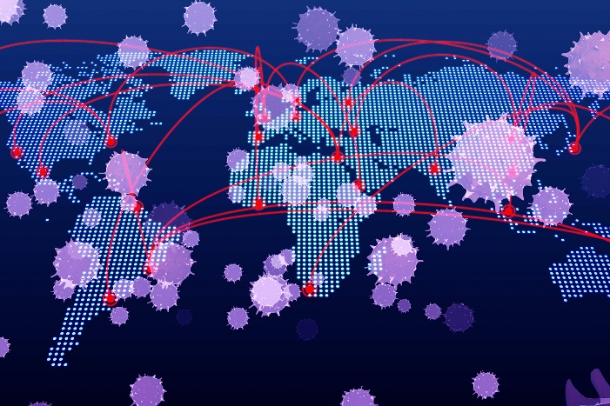

Slide 29
F. Cosmic War/星際戰爭
¹²揭開第六印的時候，我又看見地大震動，日頭變黑像毛布，滿月變紅像血，¹³天上的星辰墜落於地，如同無花果樹被大風搖動，落下未熟的果子一樣。¹⁴天就挪移，好像書卷被捲起來；山嶺海島都被挪移離開本位。【啟 6:12~14】 ¹²When he opened the sixth seal, I looked, and behold, there was a great earthquake, and the sun became black as sackcloth, the full moon became like blood, ¹³and the stars of the sky fell to the earth as the fig tree sheds its winter fruit when shaken by a gale. ¹⁴The sky vanished like a scroll that is being rolled up, and every mountain and island was removed from its place. 【Rev 6:12~14】

Slide 30
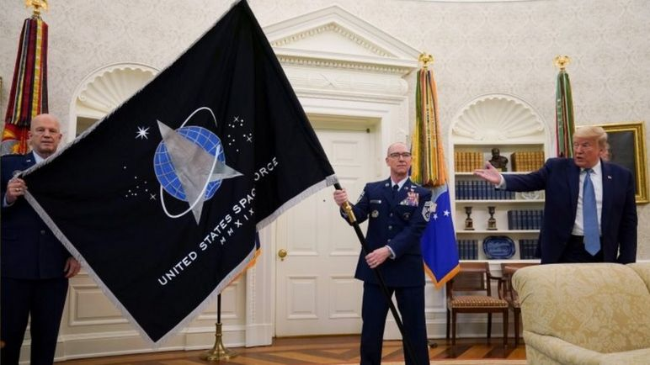
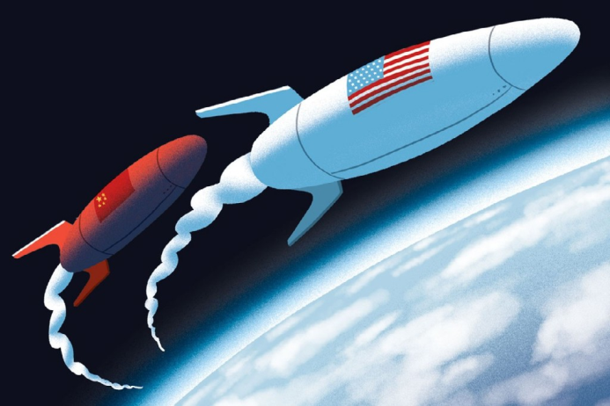
United States Space Force

Slide 31
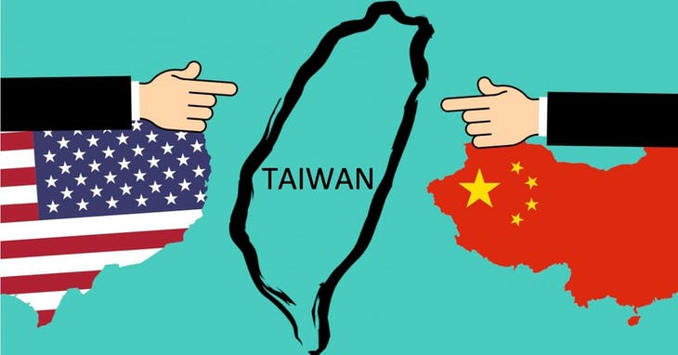
Illustration 3:

Slide 32
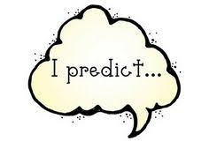
IV. My prediction/我的預測

Slide 33
¹³我又看見三個污穢的靈，好像青蛙，從龍口、獸口並假先知的口中出來。¹⁴他們本是鬼魔的靈，施行奇事，出去到普天下眾王那裡，叫他們在神全能者的大日聚集爭戰。
¹³And I saw, coming out of the mouth of the dragon and out of the mouth of the beast and out of the mouth of the false prophet, three unclean spirits like frogs. ¹⁴For they are demonic spirits, performing signs, who go abroad to the kings of the whole world, to assemble them for battle on the great day of God the Almighty.

Slide 34
¹⁵（看哪，我來像賊一樣。那儆醒、看守衣服、免得赤身而行、叫人見他羞恥的有福了！）¹⁶那三個鬼魔便叫眾王聚集在一處，希伯來話叫作哈米吉多頓。
【啟 16:13~16】 ¹⁵"("Behold, I am coming like a thief! Blessed is the one who stays awake, keeping his garments on, that he may not go about naked and be seen exposed!")" ¹⁶And they assembled them at the place that in Hebrew is called Armageddon. 【Rev 16:13~16】

Slide 35
¹我又看見一個獸從海中上來，有十角七頭，在十角上戴著十個冠冕，七頭上有褻瀆的名號。²我所看見的獸，形狀像豹，腳像熊的腳，口像獅子的口。那龍將自己的能力、座位、和大權柄都給了他。
¹And I saw a beast rising out of the sea, with ten horns and seven heads, with ten diadems on its horns and blasphemous names on its heads. ²And the beast that I saw was like a leopard; its feet were like a bear's, and its mouth was like a lion's mouth. And to it the dragon gave his power and his throne and great authority.

Slide 36
³我看見獸的七頭中，有一個似乎受了死傷，那死傷卻醫好了。全地的人都希奇跟從那獸，⁴又拜那龍─因為他將自己的權柄給了獸，也拜獸，說：誰能比這獸，誰能與他交戰呢？【啟 13:1~4】 ³One of its heads seemed to have a mortal wound, but its mortal wound was healed, and the whole earth marveled as they followed the beast. ⁴And they worshiped the dragon, for he had given his authority to the beast, and they worshiped the beast, saying, "Who is like the beast, and who can fight against it?" 【Rev 13:1~4】

Slide 37
¹¹我又看見另有一個獸從地中上來有兩角如同羊羔，說話好像龍。¹²他在頭一個獸面前，施行頭一個獸所有的權柄，並且叫地和住在地上的人拜那死傷醫好的頭一個獸。¹³又行大奇事，甚至在人面前，叫火從天降在地上。
¹¹Then I saw another beast rising out of the earth. It had two horns like a lamb and it spoke like a dragon. ¹²It exercises all the authority of the first beast in its presence, and makes the earth and its inhabitants worship the first beast, whose mortal wound was healed. ¹³It performs great signs, even making fire come down from heaven to earth in front of people,

Slide 38
¹⁴他因賜給他權柄在獸面前能行奇事，就迷惑住在地上的人，說：要給那受刀傷還活著的獸作個像。¹⁵又有權柄賜給他，叫獸像有生氣，並且能說話，又叫所有不拜獸像的人都被殺害。【啟 13:11~15】 ¹⁴and by the signs that it is allowed to work in the presence of the beast it deceives those who dwell on earth, telling them to make an image for the beast that was wounded by the sword and yet lived. ¹⁵And it was allowed to give breath to the image of the beast, so that the image of the beast might even speak and might cause those who would not worship the image of the beast to be slain. 【Rev 13:11~15】

Slide 39
Conclusion結論
*新的戰爭已經不是國家在做甚麼, 我不一定要參加.
The new war is no longer what is going on in national level, and I can avoid participation.
*新的戰爭已經愈來愈沒有國界, 愈來愈沒有前線後方的分別.
The new war has become increasingly borderless, and there is
no difference between the front and the rear.
*新的戰爭的範圍就是在我個人的四周圍發生, 不但是身體外面,
連我們的心裡都要進入戰爭了.
The scope of the new war is around every individual, not only
outside the body, but also in his/her heart.

Slide 40
*新的戰爭已經愈來愈不是哪一個國家在神的那一邊, 哪一個國
家站在神的敵對的一邊.
The new war has become less and less about which country is
on good side and bad side.
*新的戰爭乃是同時在各國各族各方各民同時發生.
The new war is happening at the same time in all tribes and people and languages and nations.

Slide 41
⁷又任憑他與聖徒爭戰，並且得勝；也把權柄賜給他，制伏各族、各民、各方、各國。
【啟 13:7】 ⁷Also it was allowed to make war on the saints and to conquer them. And authority was given it over every tribe and people and language and nation, 【Rev 13:7】

Slide 42
Onward Christian Soldiers! 基督精兵向前行!

