Slide 1
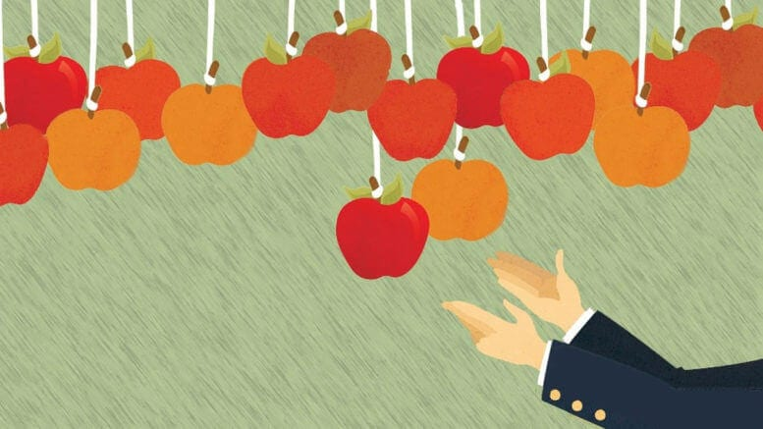
Low Hanging Fruit
低垂的果子
7/5/2020 Rev. Joseph Chang BOLGPC 爾灣 大公園靈糧堂

Slide 2
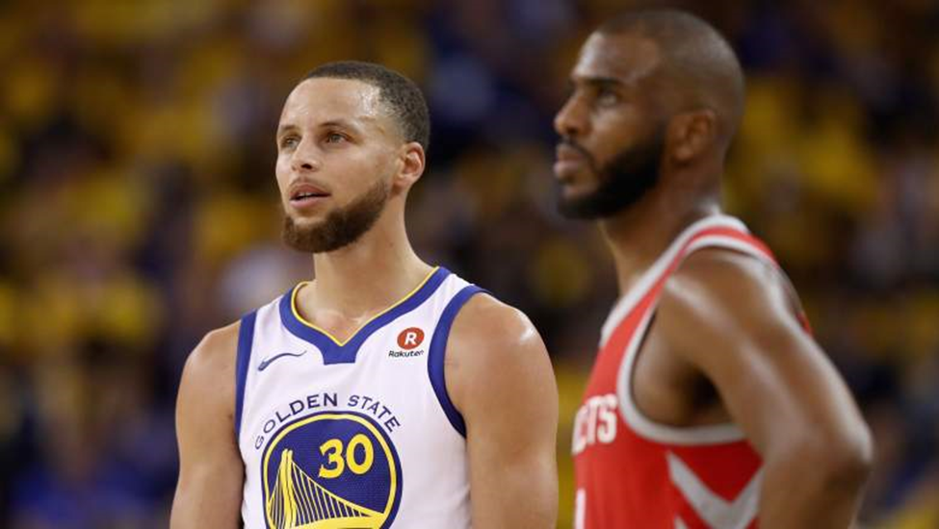
Illustration 1:
Stephen Curry and Chris Paul are the two highest paid players in the NBA.

Slide 3
In average, For the 2018-19 season, the average NBA salary is $6,388,007, per Basketball-Reference.
1 | Stephen Curry, PG | Golden State Warriors | $40,231,758
2 | Chris Paul, PG | Oklahoma City Thunder | $38,506,482
3 | Russell Westbrook, PG | Houston Rockets | $38,506,482
4 | John Wall, PG | Washington Wizards | $38,199,000
5 | Kevin Durant, SF | Brooklyn Nets | $38,199,000
6 | James Harden, SG | Houston Rockets | $38,199,000
7 | LeBron James, SF | Los Angeles Lakers | $37,436,858
8 | Kyle Lowry, PG | Toronto Raptors | $34,996,296
9 | Blake Griffin, PF | Detroit Pistons | $34,449,964
10 | Tobias Harris, SF | Philadelphia 76ers | $32,742,000

Slide 4
On average, for the 2018-19 season, the average NBA salary is $6,388,007,per Basketball-Reference.
(Rookie 一年開始的薪水就是$893,310)

Slide 5
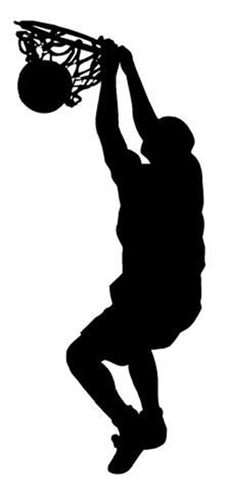

Slide 6
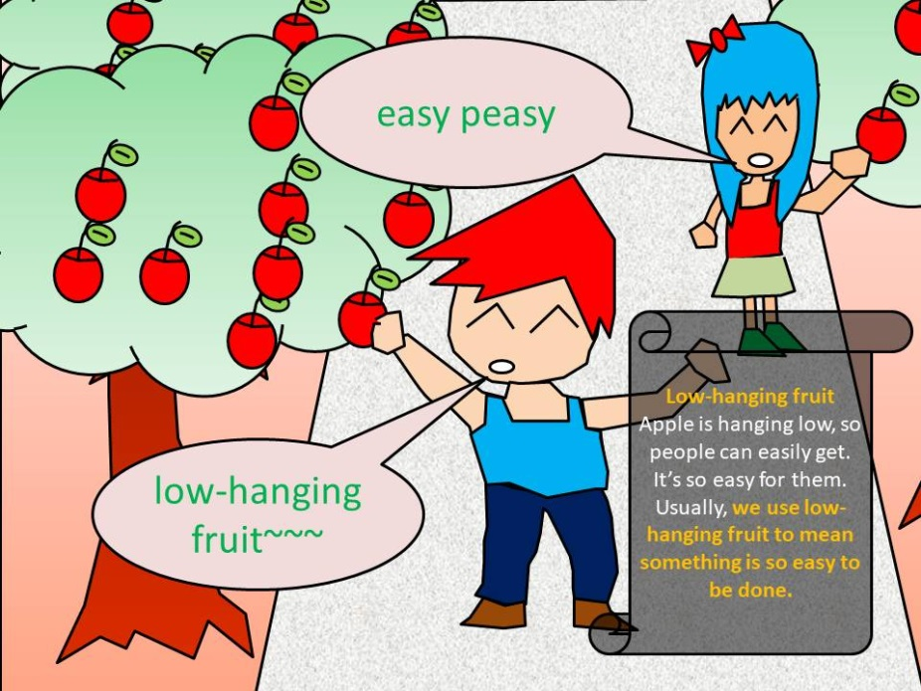
I. Low Hanging Fruit低垂的果子

Slide 7
¹⁹你在田間收割莊稼，若忘下一捆，不可回去再取，要留給寄居的與孤兒寡婦。這樣，耶和華─你 神必在你手裡所辦的一切事上賜福與你。²⁰你打橄欖樹，枝上剩下的，不可再打；要留給寄居的與孤兒寡婦。²¹你摘葡萄園的葡萄，所剩下的，不可再摘；要留給寄居的與孤兒寡婦。【申 24:19~21】 ¹⁹"When you reap your harvest in your field and forget a sheaf in the field, you shall not go back to get it. It shall be for the sojourner, the fatherless, and the widow, that the Lord your God may bless you in all the work of your hands. ²⁰When you beat your olive trees, you shall not go over them again. It shall be for the sojourner, the fatherless, and the widow. ²¹When you gather the grapes of your vineyard, you shall not strip it afterward. It shall be for the sojourner, the fatherless, and the widow. 【Deut 24:19~21】

Slide 8
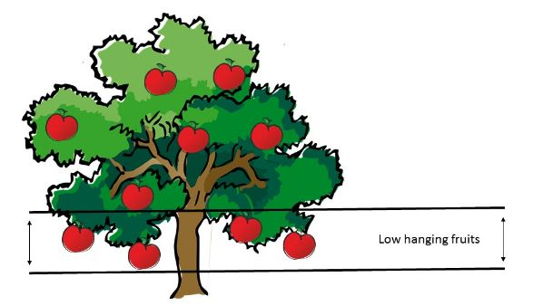

Slide 9
神不要窮苦的人盡是想到順手撿來低垂的果子.
God doesn't want poor people to think of picking low
hanging fruits.
→第一, 這種果子很少輪到你.
1st, the low-hanging fruit is rarely your turn.
→第二, 對你基本的問題沒有太大的訓練.
2nd, there is not much training to solve your basic problems.

Slide 10
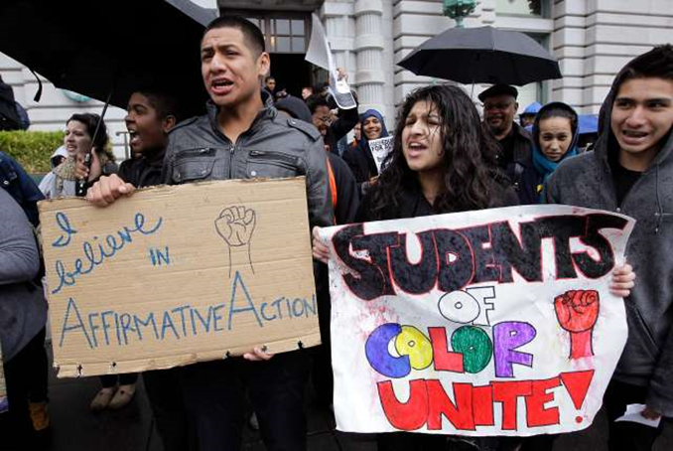
Illustration 2:
ACA5 Bill (California Assembly Constitutional Amendment 5)
Voters could repeal Prop. 209 by a simple majority.
只要簡單的多數，選民可以否決209號提案。

Slide 11
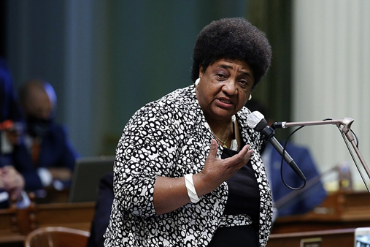
Assemblywoman Shirley Weber, a Democrat from San Diego who wrote the bill, also wants to pay compensation to the black due to damage of slavery.

Slide 12
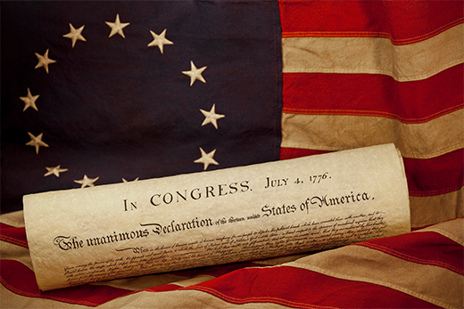
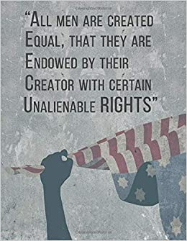
II. Pursuit of Happiness
Not Happiness as unalienable Rights
追求幸福的權力, 不是幸福的權力.

Slide 13
→美國的獨立宣言講得很好:
The American Declaration of Independence has the
good statement:
We hold these truths to be self-evident, that all men are created equal, that they are endowed by their Creator with certain unalienable Rights, that among these are Life, Liberty and the pursuit of Happiness.
我們相信下列的真理是不問自明的, 每個人心裡可以曉得, 無可推諉的: 所有的人是受造而平等的, 每個人都擁有創造主付與他們不可分離, 不能被剝奪的權力, 譬如:生命, 自由, 和追求幸福的權力.

Slide 14
這裡有兩點要特別申明的:
There are two points that need to be specifically stated.
(1) 就是人有追求幸福的權力.
People have the right to pursue happiness.
(2) 我們是受造平等, 在神面前我們都是寶貴的.
We are created equal and we are all precious before God.
這裡不是講生而平等.
This is not about being born equal.

Slide 15
¹⁰我們在你們那裡的時候，曾吩咐你們說，若有人不肯做工，就不可吃飯。¹¹因我們聽說，在你們中間有人不按規矩而行，甚麼工都不做，反倒專管閒事。¹²我們靠主耶穌基督吩咐、勸戒這樣的人，要安靜做工，吃自己的飯。【帖後 3:10~12】 ¹⁰For even when we were with you, we would give you this command: If anyone is not willing to work, let him not eat. ¹¹For we hear that some among you walk in idleness, not busy at work, but busybodies. ¹²Now such persons we command and encourage in the Lord Jesus Christ to do their work quietly and to earn their own living. 【2Thess 3:10~12】

Slide 16
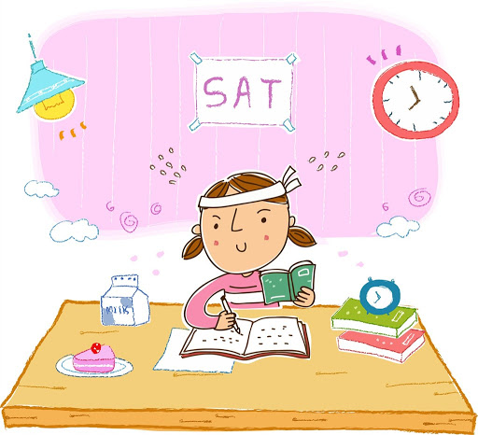
聖經鼓勵我們要hard working, 靠著實力, achieve excellence.
The Bible encourages us to work hard and achieve excellence with our own ability.

Slide 17
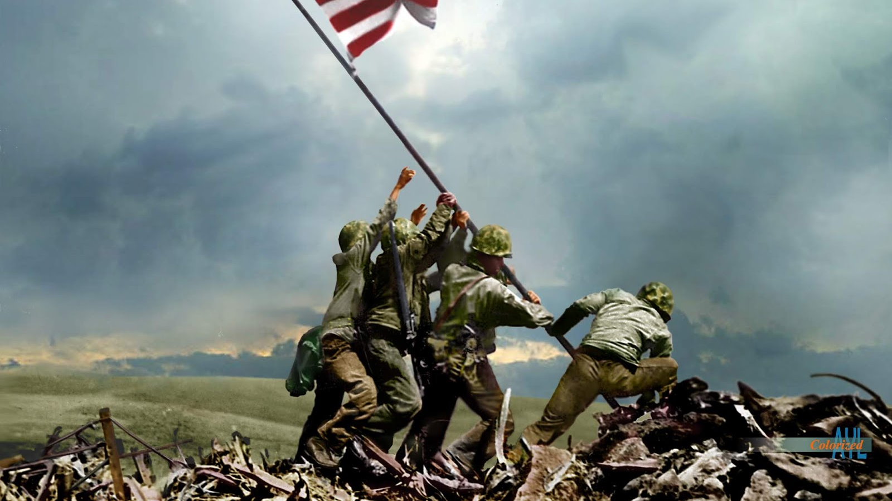
III. Freedom is not Free 自由不是廉價的

Slide 18
我最喜歡美國的國歌最後的兩句話:
I like best the last two phrases of the national anthem.
O say can you see, by the dawn's early light,
What so proudly we hailed at the twilight's last gleaming,
Whose broad stripes and bright stars through the perilous fight,
O'er the ramparts we watched, were so gallantly streaming?
And the rocket's red glare, the bombs bursting in air,
Gave proof through the night that our flag was still there;
O say does that star-spangled banner yet wave
O'er the land of the free and the home of the brave?
哦，你可看見，透過一線曙光，我們對著什麼，發出歡呼的聲浪？
谁的阔条明星，冒着一夜炮火，依然迎风招展，在我军碉堡上？
火箭闪闪发光，炸弹轰轰作响，它们彻夜见证，国旗安然无恙。
你看星条旗不是还高高飘扬 在这自由国土，勇士的家乡？

Slide 19
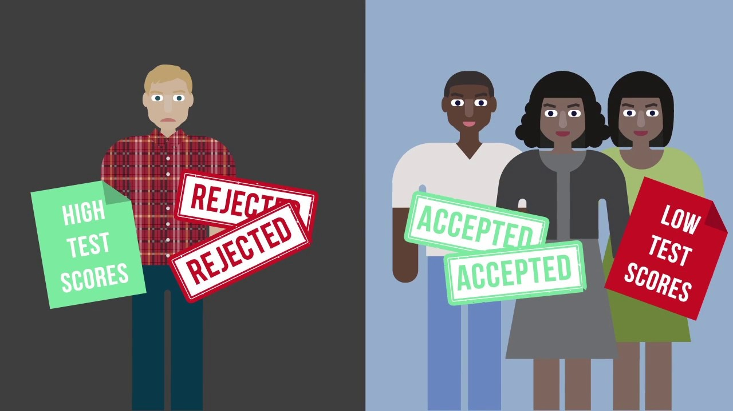
美國的自由和公平公義不是沒有代價得來的.
American freedom , fairness and justice are not free.
→Bakke 兩度被加州大學UC Davis denied admittance to Medical
School, 因為在100名學生裡面有16個位置是留給黑人學生的.
Regents of the University of California v. Bakke 1978
Allan Bakke

Slide 20
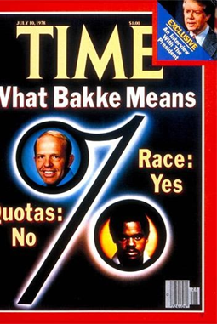
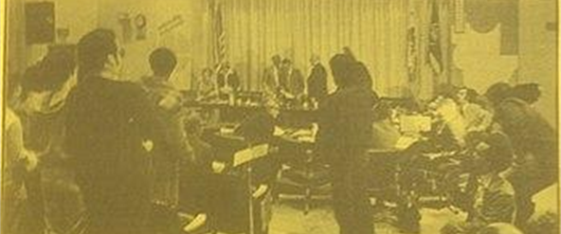
Regents of the University of California v. Bakke 1978

Slide 21
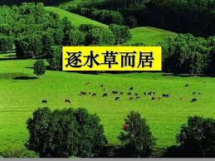
→華人在好的制度就可以活得很好, 在不好的制度, 就pack up and look for another. 這就是我們所說的 “逐水草而居” 的生活. Overseas Chinese settles down if it is a good system; they pack up and look for another place when they encounter a bad system.

Slide 22
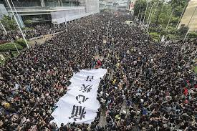
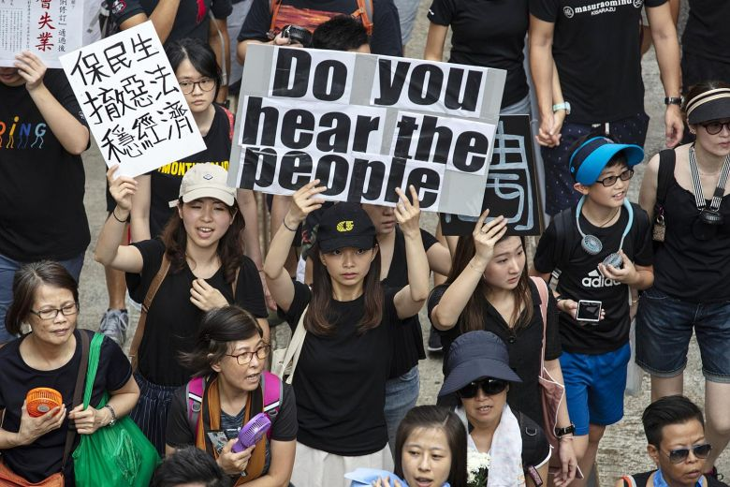
香港人不再能夠逐水草而居了. 四處流浪尋找好的制度. 而是
必須要為制度而戰.
People of Hong Kong can no longer wander around looking for
another good system. Instead, they must fight for it.

Slide 23
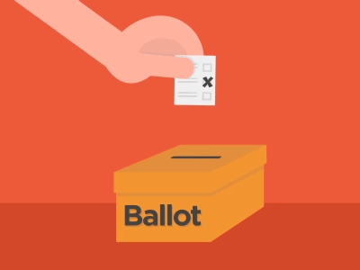
→November 3的Amendment 是華人建立制度, 或是讓別
人決定制度, 而自己在下面苟延殘喘的生活.
November 3 is for overseas Chinese to establish a system,
or let others decide the system for you.

Slide 24
Conclusion 結論

Slide 25
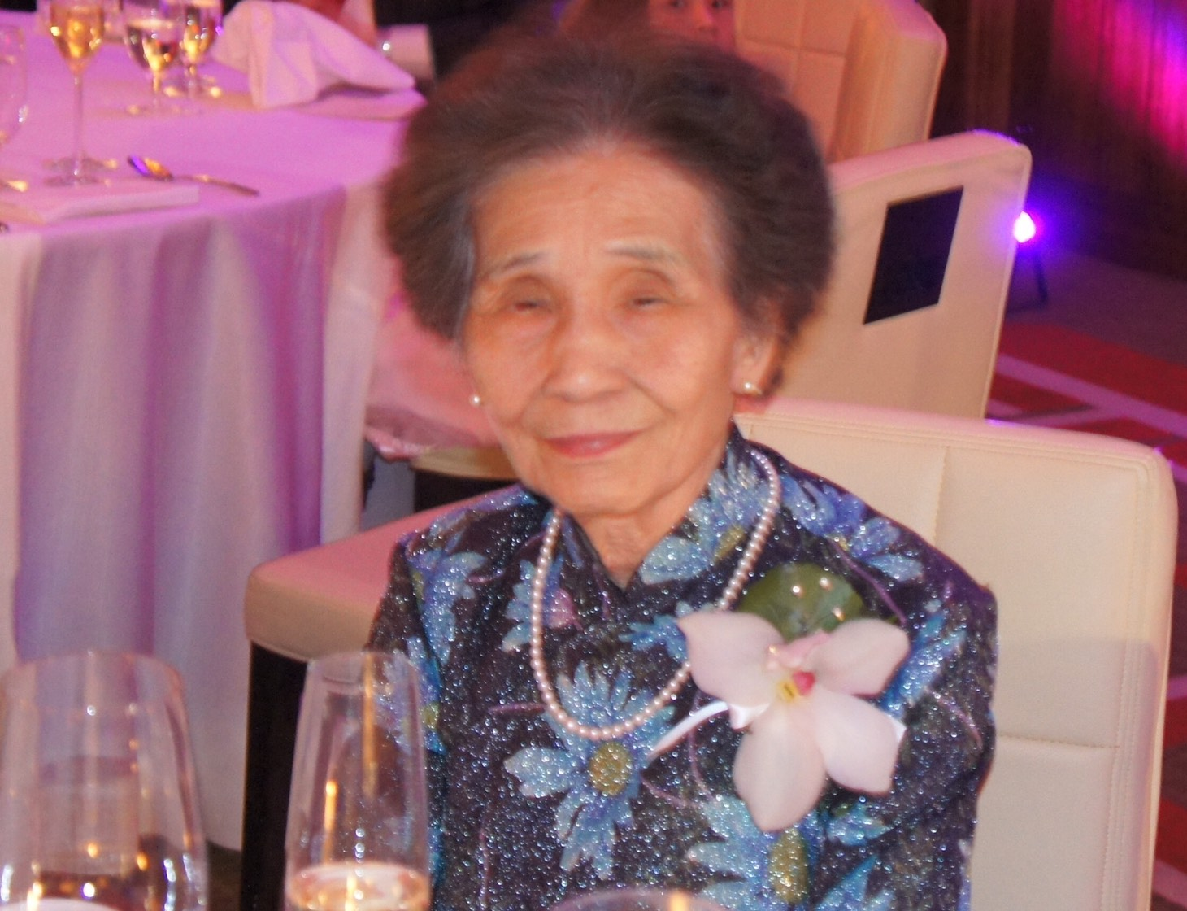
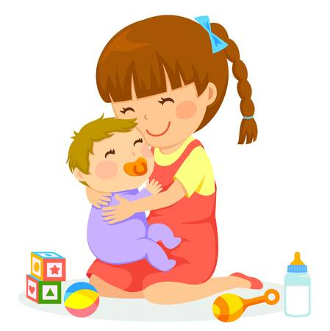

Slide 26
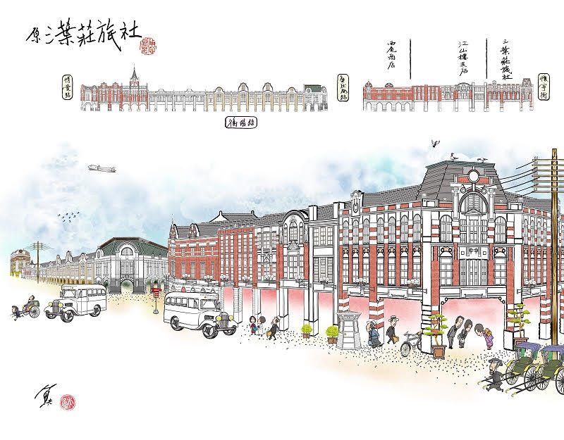
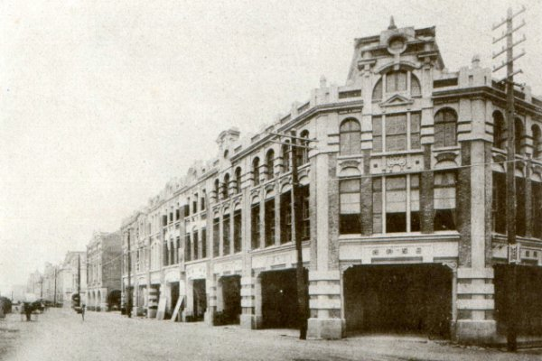

Slide 27
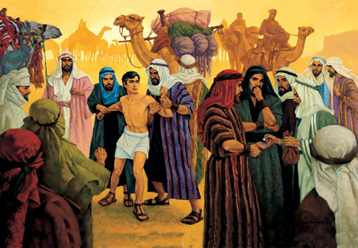
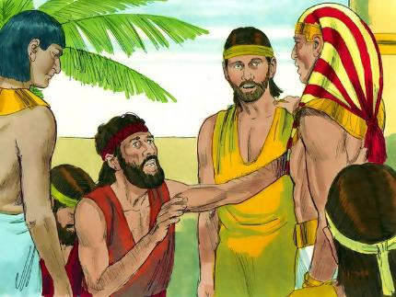
雅各死的時候, 曾經惡待他賣他到埃及的哥哥們來跪在他的
面前求饒, 約瑟怎麼說呢?
When Jacob died, Joseph’s brothers who sold him to Egypt
came to kneel before him to beg for mercy. What did Joseph say?

Slide 28
¹⁸他的哥哥們又來俯伏在他面前，說：我們是你的僕人。¹⁹約瑟對他們說：不要害怕，我豈能代替 神呢？²⁰從前你們的意思是要害我，但 神的意思原是好的，要保全許多人的性命，成就今日的光景。²¹現在你們不要害怕，我必養活你們和你們的婦人孩子。於是約瑟用親愛的話安慰他們。
【創 50:18~21】 ¹⁸His brothers also came and fell down before him and said, "Behold, we are your servants." ¹⁹But Joseph said to them, "Do not fear, for am I in the place of God? ²⁰As for you, you meant evil against me, but God meant it for good, to bring it about that many people should be kept alive, as they are today. ²¹So do not fear; I will provide for you and your little ones." Thus he comforted them and spoke kindly to them. 【Gen 50:18~21】

Slide 29
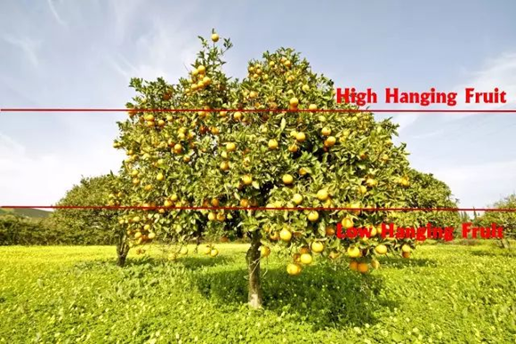
上帝要我們去採在樹梢上, 在最高處的Fruit.
God wants us to reach beyond the low-hanging fruit.

