Slide 1
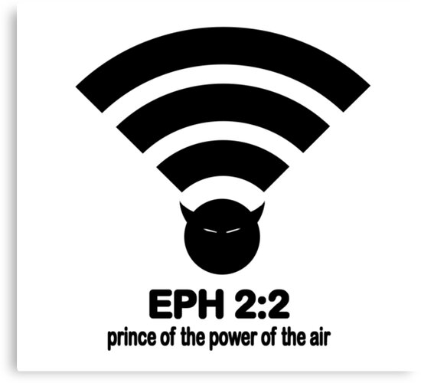
Prince of Air天空掌權者的首領
Prince of Air天空掌權者的首領
7/12/2020 Rev. Joseph Chang BOLGPC 爾灣大公園靈糧堂

Slide 2
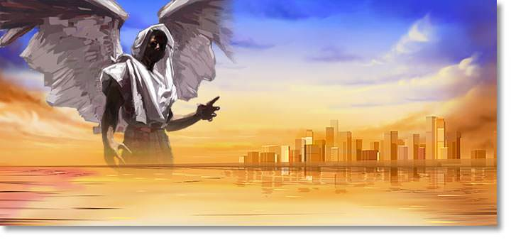
Prince of the Power of the Air, 簡稱為Prince of Air.

Slide 3
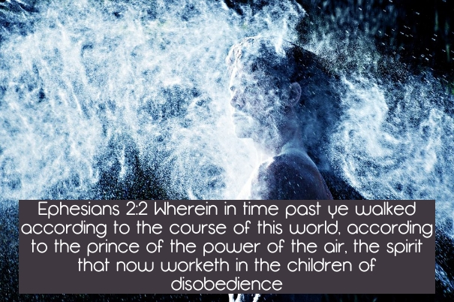
²那時，你們在其中行事為人，隨從今世的風俗，順服空中掌權者的首領，就是現今在悖逆之子心中運行的邪靈。【弗 2:2】 ²in which you once walked, following the course of this world, following the prince of the power of the air, the spirit that is now at work in the sons of disobedience- 【Eph 2:2】

Slide 4
I. Characterization of Prince of Air
天空掌權首領的特質

Slide 5
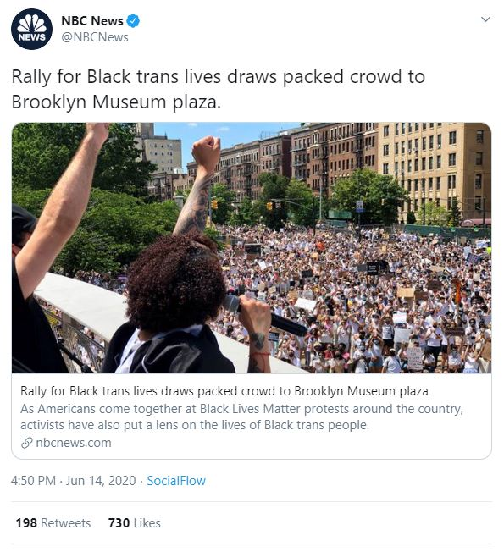
Example 1
Rep. Jim Jordan on Twitter
6/14 4:50pm NBC

Slide 6
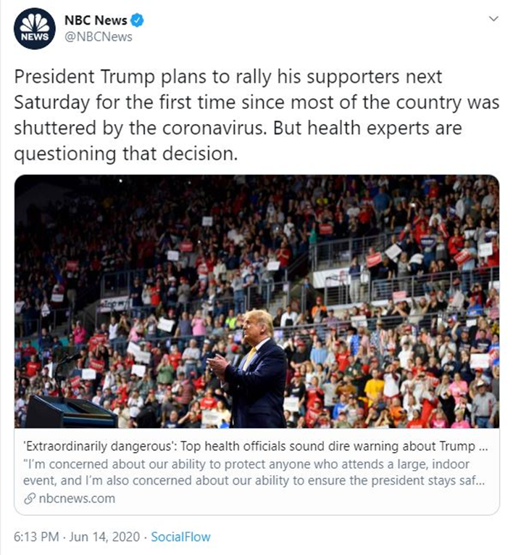
一個小時23分鐘以後
One hour and 23 minutes
later

Slide 7
比較這兩張圖片，不難發現NBC的這兩份新聞報導的目
的是不同的。
Compare these two pictures, and it is not hard to find out
the purposes of these two news reports from NBC are different.
1.第一個是宣傳支持黑人變性者權利。
The first one is to promote the Black Transgender Lives Matter.
2.第二個是阻止特朗普集會。
The second one is to stop Trump from having a rally.
→It is NOT about safety from Covid-19.這與Covid-19的安全無關。

Slide 8
新聞報導, 一般有三個主要的區塊:
1. 客觀的新聞報導—Fact Report.
應該是objective fact.
2. 主觀的意見—我們稱之為 “社論/editorial”.
Subjective Editorial.
3. 廣告/Advertisement.

Slide 9
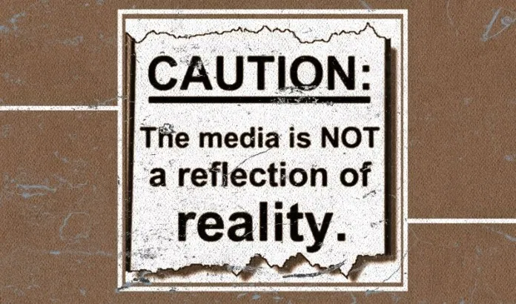
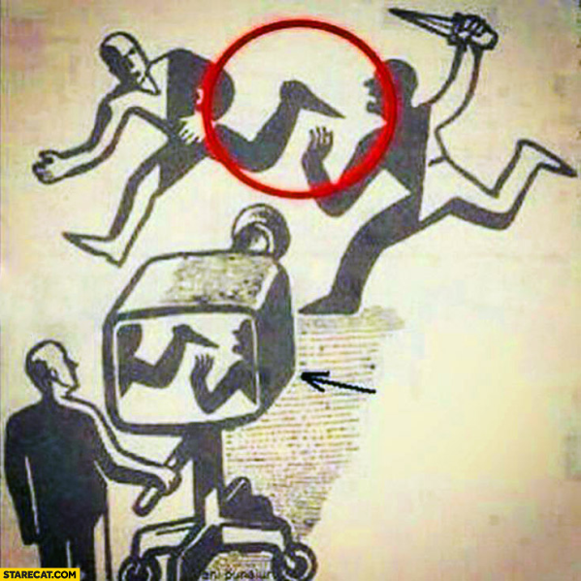
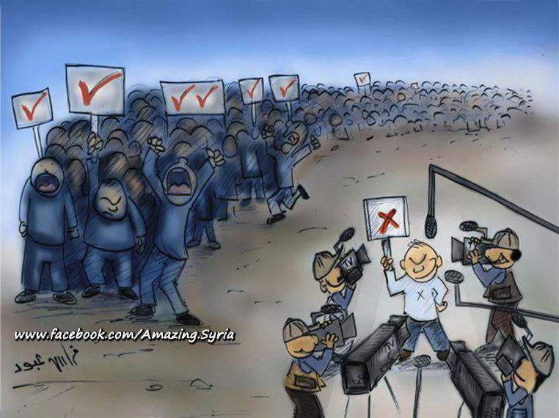
Example 2:

Slide 10
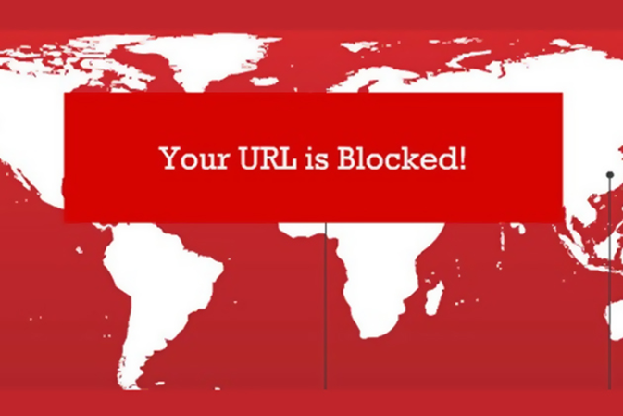
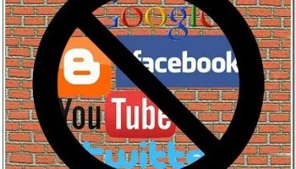
中國/China

Slide 11
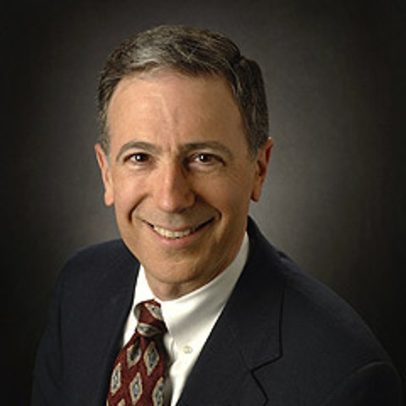
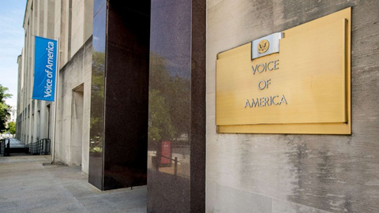
新任美國國際媒體署(U.S. Agency for Global Media)主管的帕克(Michael Pack)

Slide 12
但是受到了紐約時報中文網的反對，他們的理由是:
But it was opposed by the New York Times Chinese website. Their reasons are:
1. 無效
The current software is too old, so the apparent
effect is minimum
2. 破壞自由競爭
The government please do not intervene in the free
market of internet.

Slide 13
最讓人警惕的就是:
The most alarming thing is the following:
你以為你是在讀新聞的報告, 但實際上, 你是在讀新聞記者對這件事情的意見.
You thought you were reading the news report, but in fact, you were reading the news reporter's opinion on this matter.

Slide 14
⁶又有不守本位、離開自己住處的天使，主用鎖鍊把他們永遠拘留在黑暗裡，等候大日的審判。⁷又如所多瑪、蛾摩拉和周圍城邑的人，也照他們一味的行淫，隨從逆性的情慾，就受永火的刑罰，作為鑑戒。
⁶And the angels who did not stay within their own position of authority, but left their proper dwelling, he has kept in eternal chains under gloomy darkness until the judgment of the great day- ⁷just as Sodom and Gomorrah and the surrounding cities, which likewise indulged in sexual immorality and pursued unnatural desire, serve as an example by undergoing a punishment of eternal fire.

Slide 15
⁸這些作夢的人也像他們污穢身體，輕慢主治的，毀謗在尊位的。⁹天使長米迦勒為摩西的屍首與魔鬼爭辯的時候，尚且不敢用毀謗的話罪責他，只說：「主責備你罷！」
【猶 1:6~9】
⁸Yet in like manner these people also, relying on their dreams, defile the flesh, reject authority, and blaspheme the glorious ones. ⁹But when the archangel Michael, contending with the devil, was disputing about the body of Moses, he did not presume to pronounce a blasphemous judgment, but said, "The Lord rebuke you." 【Jude 1:6~9】

Slide 16
→上面的這些報導有兩個特點: The above reports have two characteristics.
1. 1st trait of Prince of Air:
Left their proper dwelling/不守本位:
2. 2nd trait of Prince of Air:
Usurp the authority/不服從權柄

Slide 17
新聞報導是要公平公正的. 一般的報導需要注重的是:
Professional journalism associations, individual news
organizations, and journalists themselves often have their
own "code of ethics;" however, most share these basic
principles:
truthfulness/真實性, accuracy/準確性,
objectivity/客觀性, impartiality/公正性,
fairness/公平性, and public accountability/對社會負責.

Slide 18
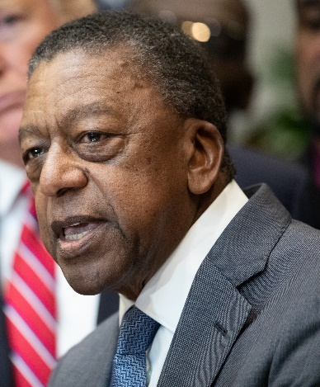
Example 3:
對黑人的賠償行動/Slavery reparations
Robert Johnson, billionaire. Co-founder of BET

Slide 19
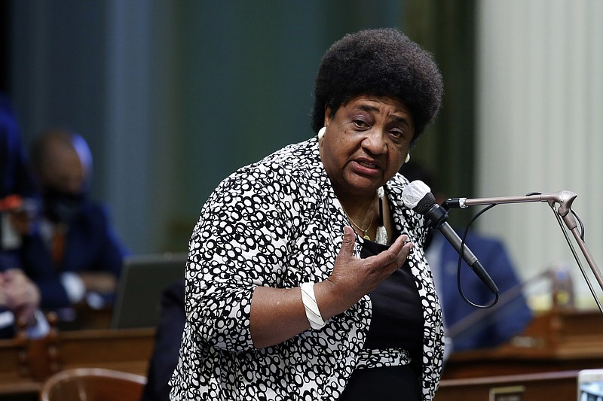
Example 4:
Assemblywoman Shirley Weber

Slide 20
Q: 如何來面對這個天空掌權者的首領?
How to face Prince of the Power of the Air?

Slide 21
¹你們死在過犯罪惡之中，他叫你們活過來。²那時，你們在其中行事為人，隨從今世的風俗，順服空中掌權者的首領，就是現今在悖逆之子心中運行的邪靈。³我們從前也都在他們中間，放縱肉體的私慾，隨著肉體和心中所喜好的去行，本為可怒之子，和別人一樣。
¹And you were dead in the trespasses and sins ²in which you once walked, following the course of this world, following the prince of the power of the air, the spirit that is now at work in the sons of disobedience- ³among whom we all once lived in the passions of our flesh, carrying out the desires of the body and the mind, and were by nature children of wrath, like the rest of mankind.

Slide 22
⁴然而，神既有豐富的憐憫，因他愛我們的大愛，⁵當我們死在過犯中的時候，便叫我們與基督一同活過來。你們得救是本乎恩。⁶他又叫我們與基督耶穌一同復活，一同坐在天上，⁷要將他極豐富的恩典，就是他在基督耶穌裡向我們所施的恩慈，顯明給後來的世代看。
⁴But God, being rich in mercy, because of the great love with which he loved us, ⁵even when we were dead in our trespasses, made us alive together with Christ-by grace you have been saved- ⁶and raised us up with him and seated us with him in the heavenly places in Christ Jesus, ⁷so that in the coming ages he might show the immeasurable riches of his grace in kindness toward us in Christ Jesus.

Slide 23
⁸你們得救是本乎恩，也因著信；這並不是出於自己，乃是神所賜的；⁹也不是出於行為，免得有人自誇。¹⁰我們原是他的工作，在基督耶穌裡造成的，為要叫我們行善，就是神所預備叫我們行的。【弗 2:1~10】 ⁸For by grace you have been saved through faith. And this is not your own doing; it is the gift of God, ⁹not a result of works, so that no one may boast. ¹⁰For we are his workmanship, created in Christ Jesus for good works, which God prepared beforehand, that we should walk in them. 【Eph 2:1~10】

Slide 24
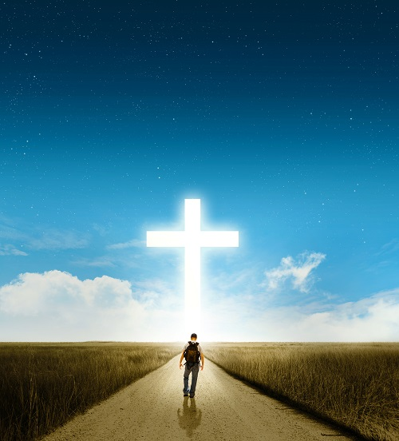
II. What Shall We Do? 我們要做甚麼?

Slide 25
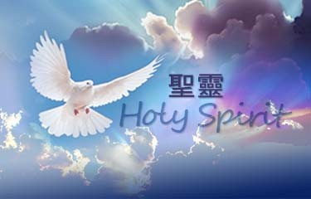
A. Seek the help of Holy Spirit 尋求聖靈的幫助.
¹⁰只有神藉著聖靈向我們顯明了，因為聖靈參透萬事，就是神深奧的事也參透了。【林前 2:10】 ¹⁰these things God has revealed to us through the Spirit. For the Spirit searches everything, even the depths of God. 【1Cor 2:10】

Slide 26
B. Heavenly Perspective 坐在天上的觀點.

Slide 27
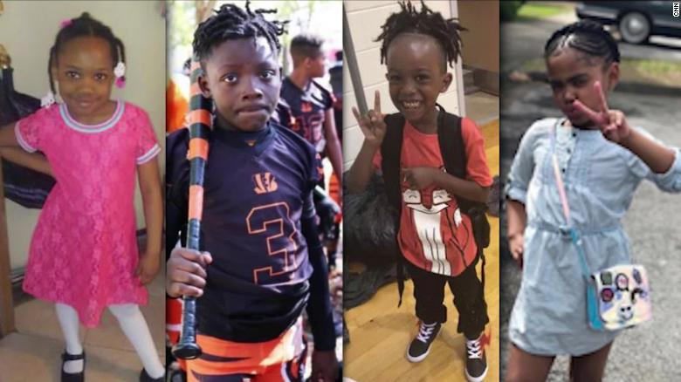
Example 5:
July 4th的這個周末
CNN的標題是 “At least 6 kids killed by gun violence over holiday weekend”

Slide 28
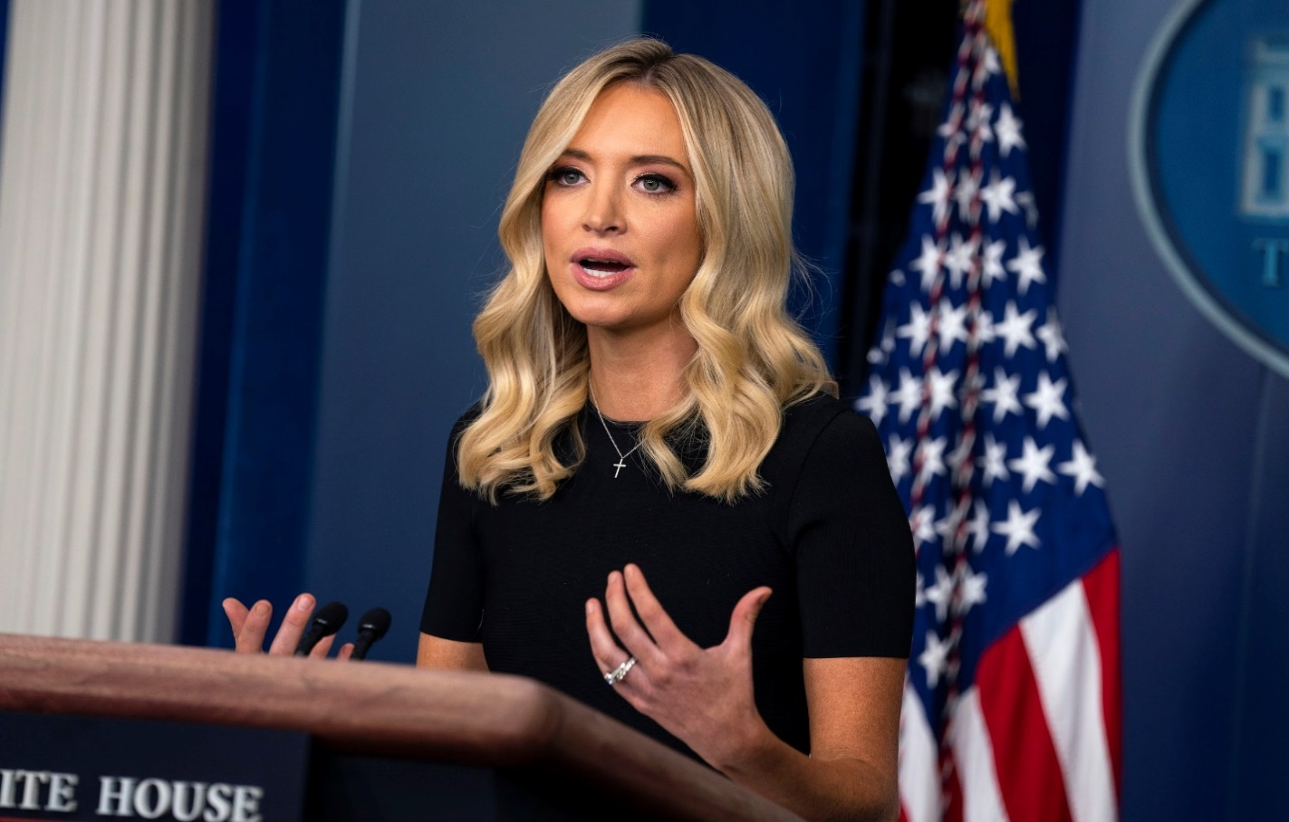
Kayleigh McEnany was appointed White House Press Secretary on 4/7/2020.

Slide 29
→在July 4th 結束後7/6/2020的Press Conference上, 她就很難過
的說:
At the Press Conference on 7/6/2020 , she said sadly.
I was asked probably 12 qs about the confederate flag…I didn’t receive one on the deaths that we got in this country this weekend. I didn’t receive one question about NYC shootings doubling for the 3rd straight week, and for the last 7 days shootings skyrocket by 142%.
我大概被問到了12個關於南軍旗幟的問題……但我沒有被問到任何一個關於這個週末在發生這個國家的死亡槍擊事件。 我沒有被問到任何一個有關紐約市槍擊事件連續三週翻倍，和最近7天的槍擊事件猛增了142％的問題。

Slide 30
C. Doing the Good Works that God prepared for you.
去行善, 就是神所預備要我們行的.

